Slide 1
Poetry
By Ramandeep

Slide 2
Literary Devices
Device | Example
Alliteration | Better butter always makes the batter better.
Onomatopoeia | The books fell on the table with a loud thump.
Rhyme scheme | Humpty Dumpty sat on a wall, Humpty Dumpty had a great fall.
Imagery | The fresh and juicy orange are very cold and sweet.
Symbol | A ladder may stand as a symbol for a connection between the heaven and the earth.

Slide 3
Figurative language
Figurative | Examples
Personification | The wind whispered through dry grass.
Hyperbole | I am trying to solve a million issues these days.
Simile | Her cheeks are red like a rose.
Oxymoron | Original copies / Open secret / Tragic comedy
Metaphor | The assignment was a breeze.

Slide 4
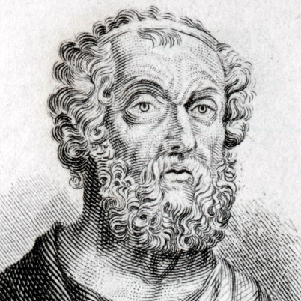
My Favorite Poet : Homer
A man named Homer lived at the end of Grecian dark ages. Over 2700 years ago, Homer collected and wrote down many of the ancient legends told by the traveling storytellers. Homer took all the stories about King Odysseus and put this collection of stories together in one book, which he named The Odyssey.

Slide 5
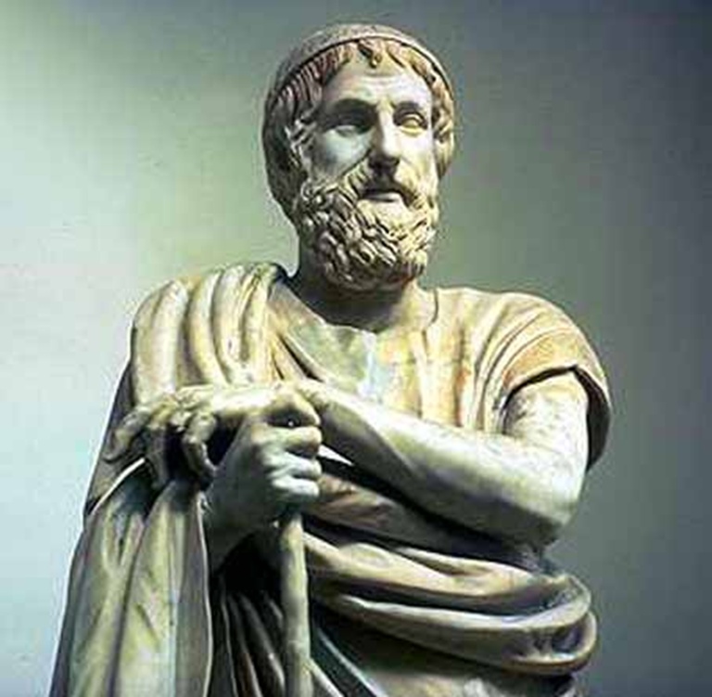
Biography
Homer is the greatest poet of ancient times I believe . He is the author of Iliad and the Odyssey which has been a privilege of being the greatest poems of world literature.it is not known for sure when Homer was born, the time of his birth is estimated somewhere between the 8th and 9th century B.C, some others say that Homer lived during the Trojan war in the early 12th century B.C. Homer belongs to Greece by birth but the exact location of his birth and living is also doubtful. Some believe that he was born on Chios Island while others say he lived in Ionia. The dialect and descriptions in his poems point towards the latter. Not much is known about Homer the and , his poems are his personality and life. For example, Homer is thought to be blind due to the description presented of the blind bard in The Odyssey. It is also supposed that the word Homer was used to address blind men roaming the streets reciting classical poetry. Some historians believe that Homer was also a story teller and a court singer.
Famous As: Ancient Epic Poet
Nationality: Greek
Born In: Greece
Place Of Death: Greece
Works & Achievements: Wrote the great epics, the Iliad and the Odyssey

Slide 6
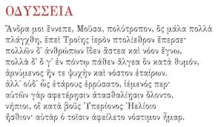
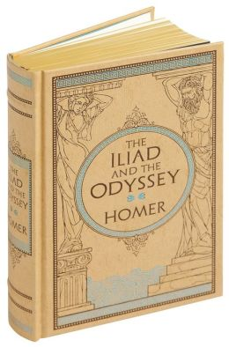
One of the poems by Homer also my favorite poem:The Iliad (bk I)
What really struck me is that even tough Homer was blind he still could take such amazing stories and turn them into great literature. His poems are so deep that you can see yourself in the state he was in.
Greek text of the Odyssey's opening passage

Slide 7
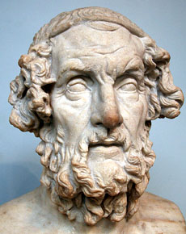
Marble terminal bust of Homer. Roman copy of a lost Hellenistic original of the 2nd c. BC. From Baiae, Italy. The so-called Hellenistic blind-type can be paralleled with figures of the Pergamon Altar, and the original of the type was perhaps created for the great library at Pergamon

Slide 8
5 Poems that I have written my self
Down Hill
You step in seats are freezing cold Boom louder and louder…
Your palms sweat even though it winter CRASH!!
Your hearts like a mice Opened your eyes
but face expressions as a lion Saw it was a dream
The wheels start to turn… Before you GO
Your thinking of the depth
… its deeper than you think
Waiting…Waiting
Feeling a cold icy breeze
Through your ears

Slide 9
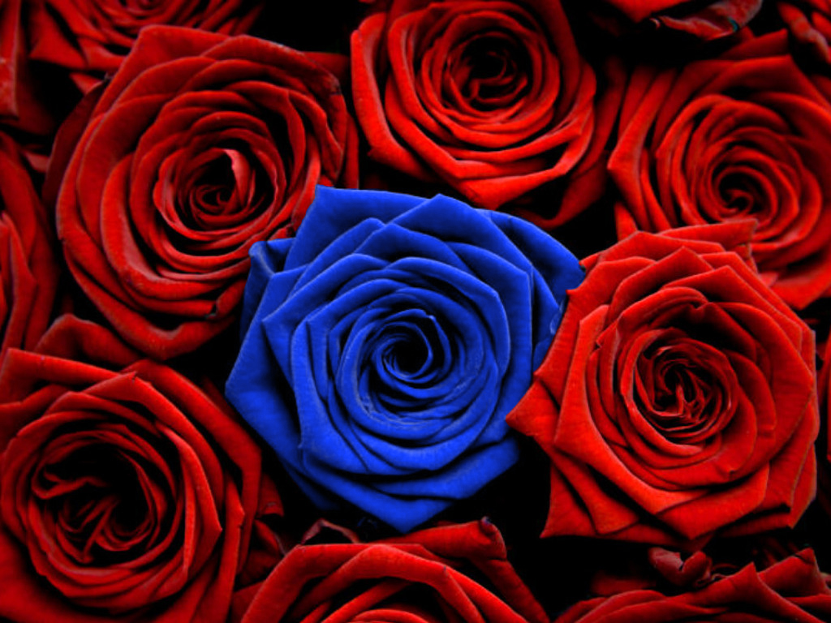
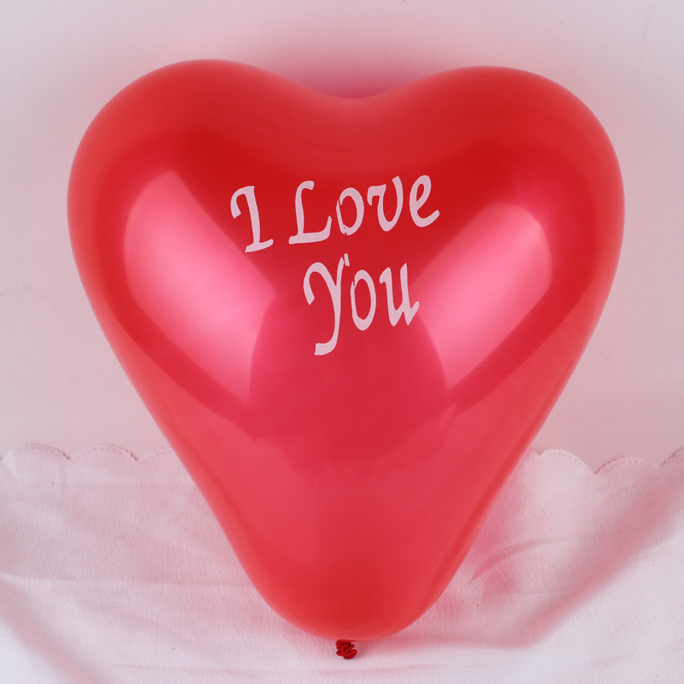
Vinegar Valentines
Roses are red violets are blue
Please take me back because
I love you
I pump lots of tires and lots of balloons
My heart only does pump but only for
you

Slide 10
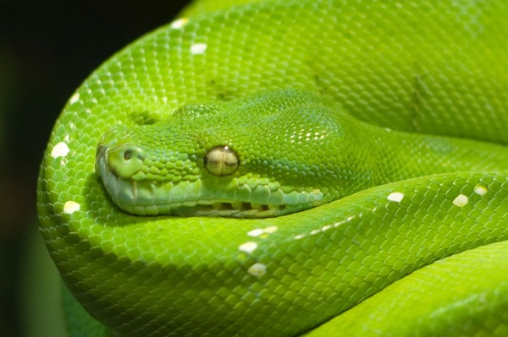
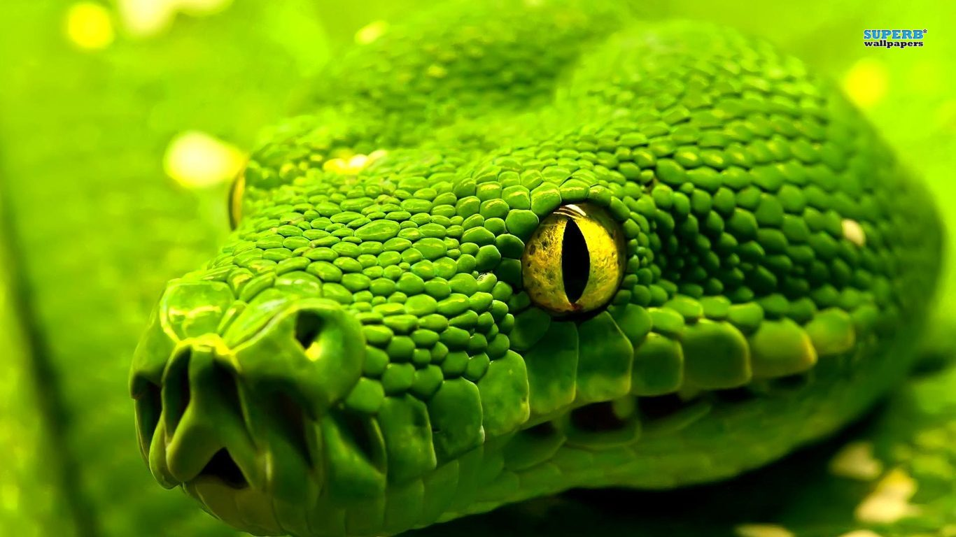
My favorite reptile(wish I had as a pet)
In the green forest
a Python hunting for rats
waiting to attack

Slide 11
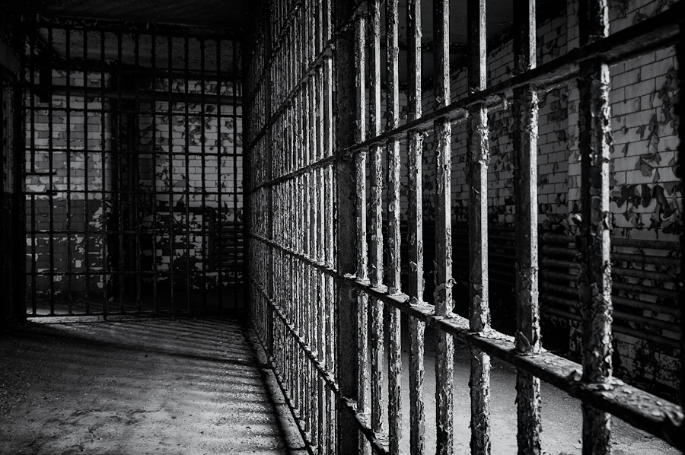
Ballad
I'm shy and quite but loud when I want
Places like parks and fields are calm
Hearing the trees whistles
While they sway side to side
Branches of trees growing is like time
That’s passing by
Trapped in a cage where it dark
And filled up with gloom
Stepping outside is the feeling more free
I feel just like a bird that just needed some room
To fly in

Slide 12
Thank you for reading my poetry project

Slide 13
Evaluation
Writing 5/5
Graphics 5/5
Spelling 3/5
Part 1 5/5
Part 2 5/5
Part 3 4/5
Total mark 27/30
Ramandeep,
  Really impressed you wrote a ballad, and one that was actually brilliant. However, there was an issue with your other poems there seems to only be 4, and the Vinegar valentines need some more work.

