Slide 1
Samurai
By Eugene

Slide 2
Introduction
Samurais were Japanese warriors that lived in the east, away from the Europeans. They were skilled sword users. They use the katana to slash into the enemy’s armor. They also follow a certain code of conduct similar to the knight’s code, chivalry

Slide 3
Hierarchy of a Samurai
Emperor
Shogun
Daimyos
Peasants
Samurai
Ronin
Artisans
Merchants

Slide 4
Shogun
Military Commander
Minamoto no Yoritomo was the first shogun
Held more power than the Emperor
Had the power to control troops around the country

Slide 5
Daimyo
Powerful warlord
Within their own territory, they have military and economic power
Most powerful warlord will be upgraded to a shogun.
A Daimyo’s army was made of a group of samurais

Slide 6
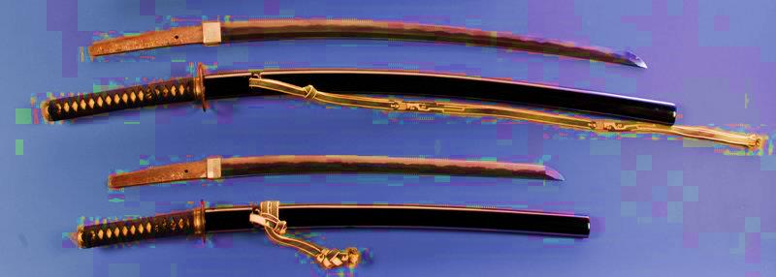
Ronin
A samurai without a master
Refused to commit seppuku upon the loss of his master
Suffered great shame
Wield 2 swords

Slide 7
Samurai Weapons

Slide 8
Weapon Details: Katana
The length of a katana is between 23 inches to 35 inches.
It is really hard to make a katana
Curved and slender is the most important identity of the katana

Slide 9
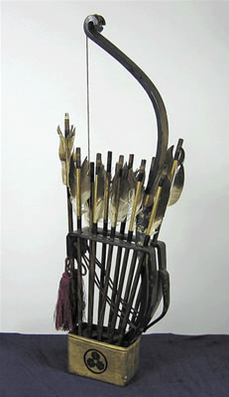
Weapon Details (Yumi)
A Japanese term for Japanese Bows.
Daikyū (A long bow)
Hankyū(A short bow)

Slide 10
Weapon Details (Bō)
Bō (Long Staff)
It is 1.8 meters long
Hanbō (Half Staff)
It is 90 cm long
Jō (Wooden Staff)
It is 1.2 meters long

Slide 11
Armor Difference
Samurai
Knight
Wield 4 types of weapon : Katana, Short Sword, Bow and Spear
Armor made with iron and leather.
Armor was lighter so the samurais could be more flexible
Total armor weight is 12kg
Wield different types of weapons such as a mace, a lance, a long sword etc. with a shield.
Armor was made fully with metal
Total armor weight 27kg

Slide 12
Armor Similarities
Armors were strapped together
The armor included iron for both
Full body coverage
Both use swords as weapons

Slide 13
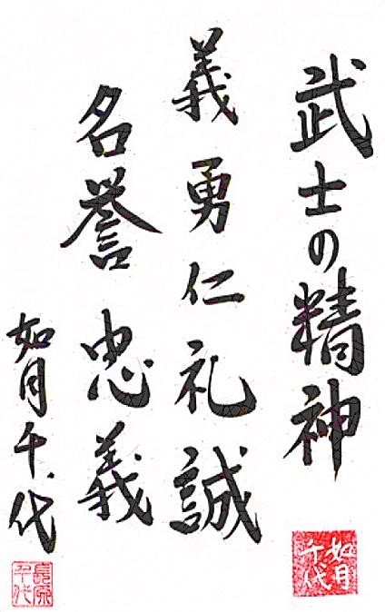
Bushido
The word Bushido means ‘The way of a samurai’
Separated into seven attributes
(Gi, Yuuki, Jin, Rei, Makoto, Meiyo ,and Chuugi)
When a samurai fail to protect his lord, he will feel humiliated and commit seppuku which is stabbing himself in the belly with the samurai’s short sword.
Defend the Shrine

Slide 14
Chivalry
Includes the following seven values:
Duty, Honor, Honesty, Commitment, Loyalty, Courage, and Kindness.
Nobility
Protect the weak
Defend the church and believe the church’s teaching

Slide 15
Similarities and Differences
Same
Different
Six of the code values were the same.
Both are honorable code of conduct.
Samurais protect the shrine and knights protect the church.
Samurais kill themselves if they fail to protect their lord.

Slide 16
Becoming a Knight
Started as a child
Becomes a ‘Squire’ at an age of 14
Becomes a ‘Knight’ at an age of 21
Becomes a ‘Page’ at an age of 7

Slide 17
Training as a “Page”
At the age of 7, a training child will be sent to a lord’s castle to serve as a page
He will learn and practice horsemanship, archery and swordsmanship
He will also preform various types of tasks in the castle

Slide 18
Training as a “Squire”
At the age of 14, a page will be attached to a knight, upgrading to a squire
Training was concentrated on strength, fitness and skill with different variety of weapons
They would learn the code of conduct, ‘Chivalry’
They would also clean the stables, care for the knight’s horse, polish the knight’s armor and maintain the knight’s weapon

Slide 19
Samurai Training
Samurais started training at an age of three years old.
At the age of 15, he exchanged the wooden sword into a metal sword.
They also practiced combat skills such as wrestling and ju-jitsu (modern judo)
Practiced archery with a 2.5 meter bow
Some samurais were killed during the training.

Slide 20
Ju-Jitsu
Modern Judo
Utilizes techniques of throwing, grappling, kicking, disengaging, attacking and many more.
No weapons were used
Each school have their own specialties

Slide 21
Major Difference
Samurai
Knight
Katana (Two-handed)
Japanese
Educated
Lived in the East
Trained in wrestling and modern judo
Practices Buddhism and Shintoism
One-handed weapon with a shield
European
Not educated
Lived the West
No martial arts experiences
Practices Christianity

Slide 22
Bibliography
Works Cited
Armento, Beverly Jeanne. Across the centuries. Boston: Houghton Mifflin, 1991. Print.
"Knight vs Samurai - Medieval Japan." Medieval Japan. N.p., n.d. Web. 7 Apr. 2014. <http://medievaljapanbyluke.weebly.com/knight-vs-samurai.html>.
"Samurai." Wikipedia. Wikimedia Foundation, 4 Aug. 2014. Web. 7 Apr. 2014. <http://en.wikipedia.org/wiki/Samurai>.
"Samurai Indonesia, Battodo Indonesia, Nakamura Ryu, Samurai Character Building." Samurai Indonesia Battodo Indonesia Nakamura Ryu Samurai Character Building Samurai Code of Conduct Comments. N.p., n.d. Web. 7 Apr. 2014. <http://bansai-dojo.com/bushido/kode-etik-samurai/?lang=en>.
What life was like among samurai and shoguns: Japan, AD 1000-1700. Alexandria, Va.: Time-Life Books, 1999. Print.

Slide 23
Thank you for watching
Presentation by:
Eugene Ip
Theresa Huynh
Christopher Begaso
Stephen Herrera
The End

