Slide 1
The Art of Word
A Poetry Project by Ryan

Slide 2
Literary Devices and Figurative Language
Alliteration: ex. Nonchalant Nuns Nicked Nicks Nikes
Onomatopoeia: ex. Roar!!!
Rhyme Scheme: The Poem was great
With classical weight, It Ensued thought
And surely will be taught.
Symbolism: The Pentagram is a symbol of both
The devil (In Christianity) and The god of the
Hunt (In Paganism)

Slide 3
Literary Devices and Figurative Language P.2
Similes: Good, Well
Metaphor: Tis better to rule in hell, then it is to serve in
Heaven.
Oxymoron: Simile, Antonym.
Personification: He was the personification of evil.
Hyperbole: He is the best painter alive!
Imagery: His skin had a deathly cold to it.

Slide 4
Wilfred Owen
Wilfred Owen was a British and Welsh poet who served for the British during World War 1. His poems detailed the many pains and atrocities of the war and are considered by many to be some of the best poems of the war. Wilfred was born in Shropshire on the 18th of March 1893. He is the oldest of four children, all of which were raised as Anglican of the evangelical school. He discovered his knack for poetry in 1903 while on vacation in Cheshire. When the war started he wasn’t quick to enlist but eventually he did on the 21st of October 1915. He trained for seven months then on June 4th 1916 he was assigned to the Manchester Regiment. During his service he fell into a shell hole,
While in hospital he was diagnosed with Shell shock and sent to hospital. During this time he met fellow war poet Siegfried Sassoon. An experience which would change his life. He began studying under Siegfried and composed some of his greatest poems during this time. Then at the very end of August 1918 Owen returned to the front line. However when leading a charge on enemy encampments he was shot and killed. Much of his work was published post mortem.

Slide 5
Dulce et Decorum est.
How sweet and honorable it is to die for one’s country:
Death pursues the man who flees,
spares not the hamstring or cowardly backs
of battle-shy youths.
I really enjoy this poem because while it is short,
It really conveys a message about the war and how
People involved in it felt. I believe he is criticizing the
War but also there's a bitter undertone to revel
His resentment of his fellow troops.

Slide 6
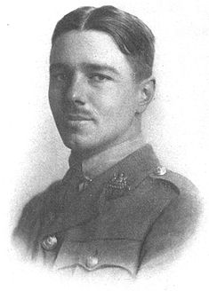
Wilford Owen

Slide 7
Demolition (Haiku)
Amidst the end war
There is nothing left to see
What was but now not.

Slide 8
Tale (Cinquain)
Story
Never Ending
A Continuation
Of a endless saga of life
Story

Slide 9
Glass (Tanka)
In the darkest hour
Nobody would look at me
As if I'm see threw
The transparency of man
Is not for a man to see.

Slide 10
Spiral (Limerick)
While searching for something to find
You'll find what you left behind
An impossible truth
With surprise to boot
As your mind slowly unwinds.

Slide 11
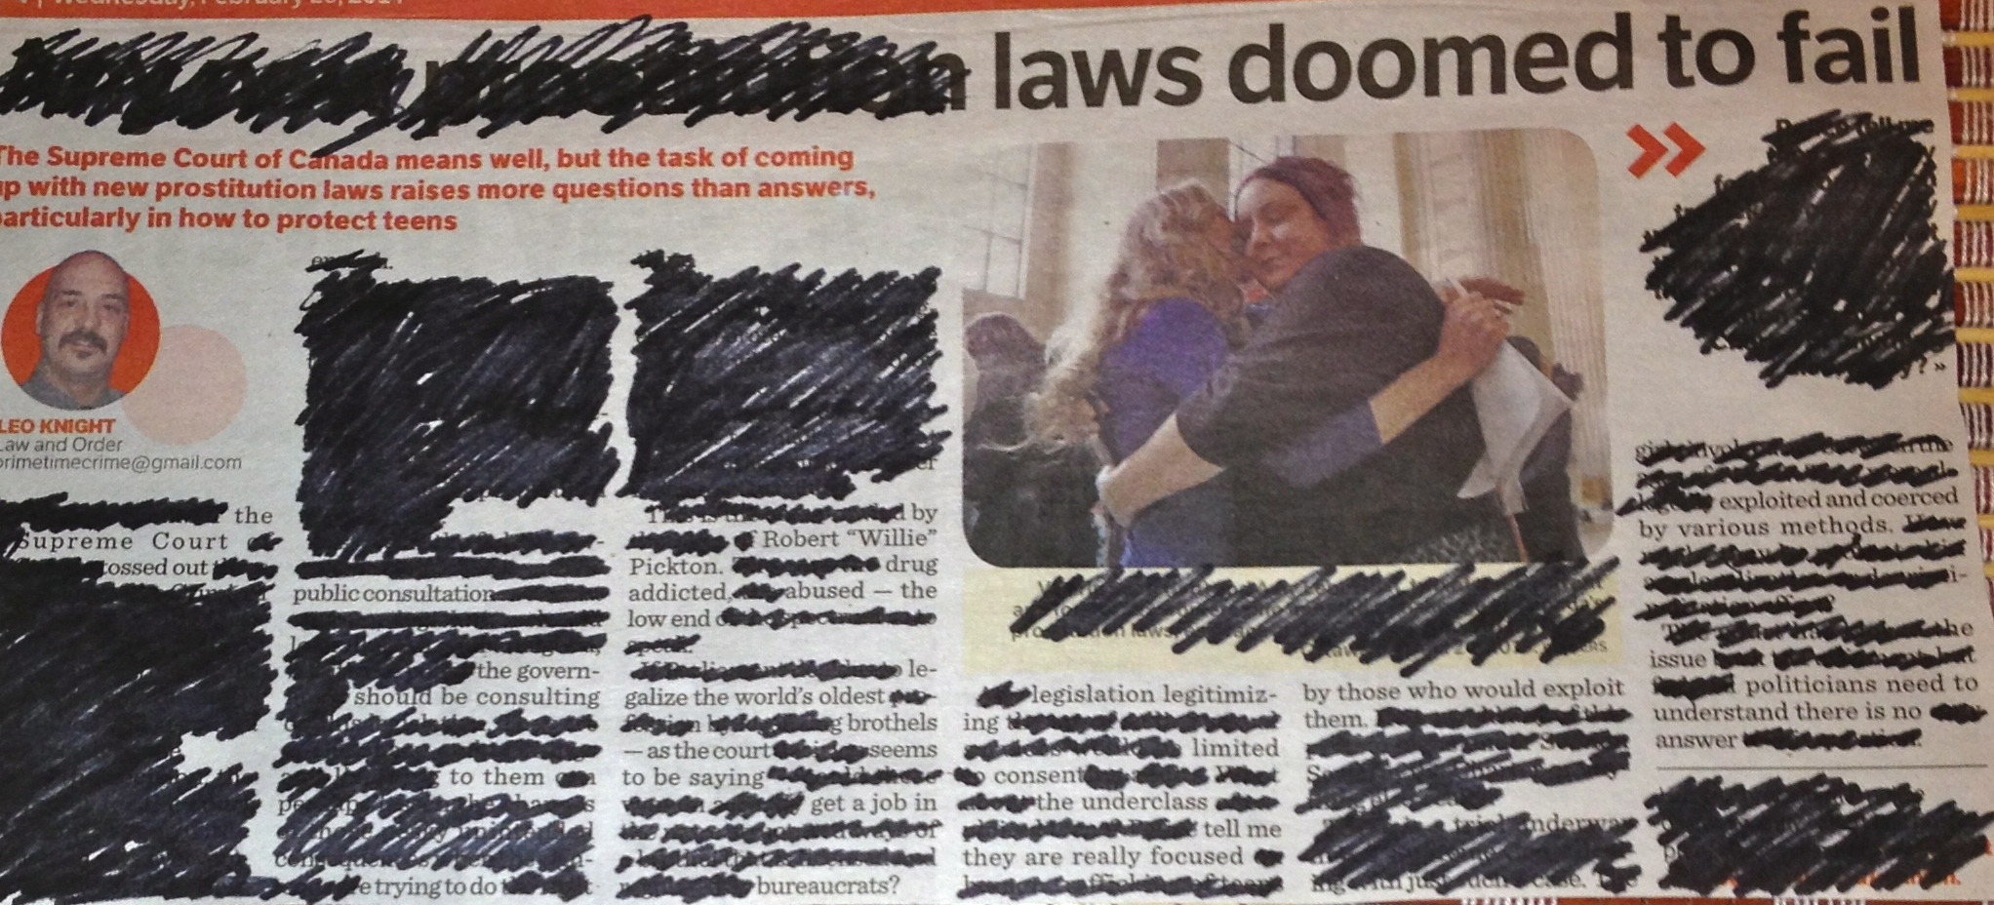
Legislation (Blackout)
This Article was originally about prostitution laws being changed in the Vancouver/Langly area.

Slide 12
Evaluation
Writing 5/5
Graphics 3/5
Spellings 5/5
Part 1 5/5
Part 2 5/5
Part 3 5/5
Total mark 28/30
Ryan
  Great poems that are really creative and full of meaning. However, you really needed I think some more images to help your project look more appealing (ps. This wallpaper really makes it hard to read your project)

