Slide 1
A Warrior People
Isaac, Ryan, Sean, Neerav, Harish

Slide 2
Origins and Homelands
The Vikings lived in Scandinavia, however they were of north German decent
The Vikings traveled far and wide via there longboats. To such places as England, parts of Russia, a lot of Europe, and even places like China and North Africa!
Many of the Vikings weren't actually warriors and spent most of their time farming.

Slide 3
Culture and Religion
-Vikings were pagans
- worshipped multiple gods and goddesses, with each one of them representing some aspect of the world as it was experienced by them.
types of gods and goddesses:
-Odin: god in the Norse mythology
-Thor: god of thunder, sky, fertility, and the law
-Loki: was a god in asgard
-Frey: god of the venir race
-Freya: goddess of sex, war, and death
-Idun: goddess of spring and immortal youth
Sif: goddess who married Thor
-Hel: goddess who was daughter of Loki.

Slide 4
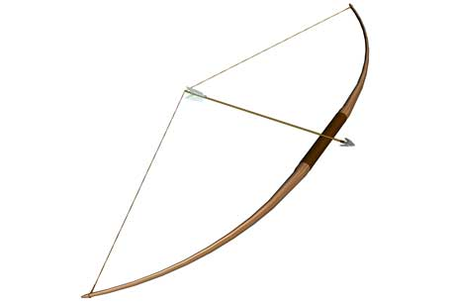
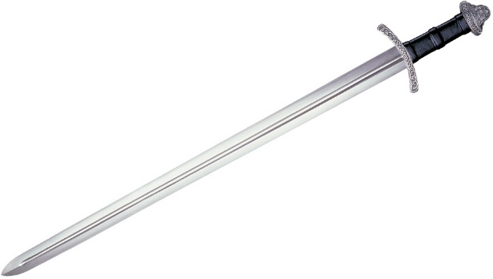
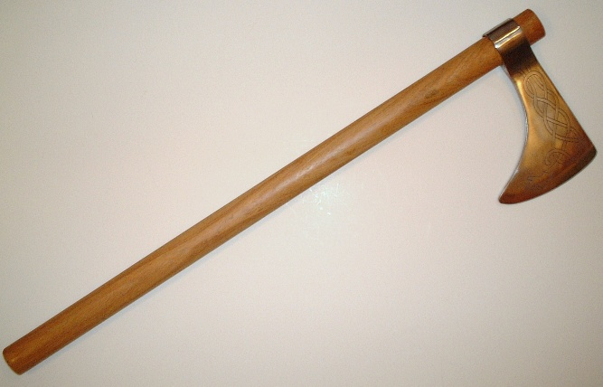
Armour and Weapons
All free men were expected to own their own weapons
They Used spears, swords, battle-axes and sometimes bows and arrows.
The bows were decorated with inlays of sliver, copper and bronze.
Many swords were given names. (Leg-Biter and Gold-hilt.)

Slide 5
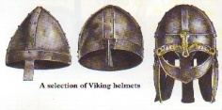
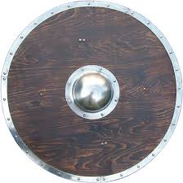
Armour and Weapons con’t
Strong iron helmets with a little piece of iron to protect the nose were worn
Shields were usually round and made out of wood
Shields were usually 1 meter in diameter
Vikings wore chainmail armour

Slide 6
Viking Foods
The Vikings both grew crops and kept animals.
The Vikings used a range of farming tools constructed from wood and iron. These included: shovels, picks, hoes, sickles and scythes.
Vikings farmers raised sheep, pigs, poultry, goats and cattle. Wool from sheep was the main material used to make Viking clothes
Viking fishermen used both nets and barbed hooks to catch fish
Fish formed a major part of a Viking’s diet.
Goat meat, horse meat and beef were all commonly eaten – often in stews.
Honey was used as a sweetener. Honey was also used to make mead, a strong alcoholic drink.
The most common vegetables in a Vikings diet were cabbages and peas.
The Vikings also picked cherries, apples and plums in the summer months.
Onions, garlic and dill were added to stews to give them more flavor.
Huge iron cauldrons were used to cook meat and make stews.

Slide 7
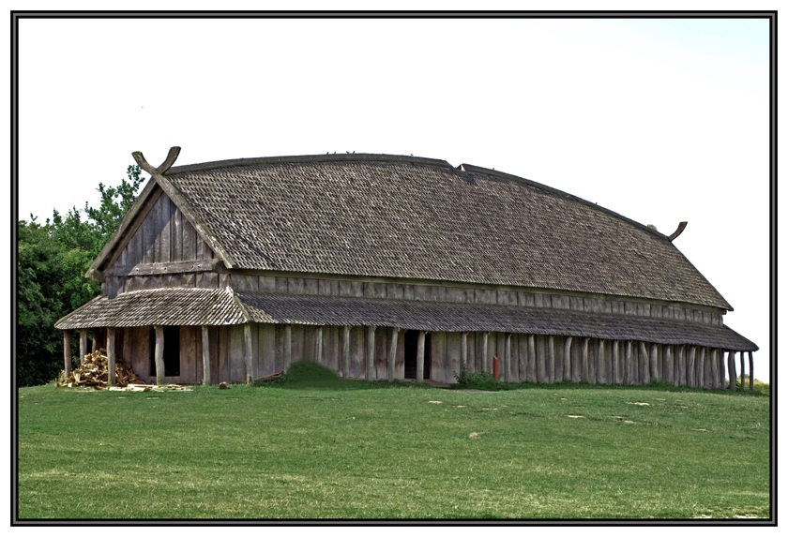
Viking Holmes
They spent a vast quantity of their time out on ships.
They also built themselves wood shelters and small forts when they were on land.
Vikings lived in long rectangular homes
The homes were generally one roomed with a cooking fire in the middle
The larger houses in a Viking village were known as great halls.

Slide 8
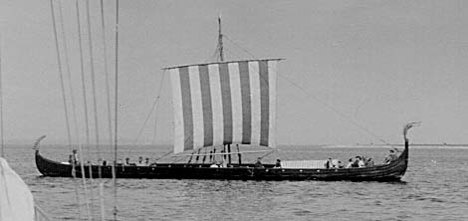
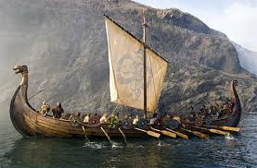
Transportation
They used the waters as their “highways” because traveling on foot was hard on the body and made certain areas inaccessible. There were also many obstacles when traveling on foot, such as.
Vast forests that covered the Viking lands.
Huge mountains to climb over.
They mostly built towns near water to make it easy to get out to sea.

Slide 9
Celebrations
One of the great Viking celebrations took place during February and was called “Jolablot” the festival signaled the arrival of spring and the end of the harsh winter.
The largest modern day Viking festival is known as JORVIK and it is a city-wide celebration of York’s Viking heritage
JORVIK attracts over 40,000 visitors to the city each year.
The JORVIK festival’s highlights include lectures, guided walks, and battle re-enactments.
In Viking culture death was a honor because it meant the chance to meet the gods, so when a important figure was killed in battle or died. They were put on a boat with important jewelry, weapons and even sacrifices and sent out to sea after the boat had been lit on fire.

Slide 10
Entertainment
The Vikings enjoyed violent and bloody games, these included, ball, lifting stones, and wrestling.
Often at the end of a wrestling match both competitors would be bloody injured, and sometimes even dead!
Board games were also popular in the Viking tribes.
The Vikings loved to party and often had drinking competitions with beer, mead, and sometimes wine.
Many of the Viking woman would participate in these drinking contests as well. But were less active in other activities.

Slide 11
Enemies and Raiding Targets
the Vikings enemies were the Anglo-Saxons, Norwegians, Icelanders, and Danish. or anyone who tried to invade them
A common misconception about the Vikings is that they were one unified force.
In reality they were many small tribes with separate chieftains fighting amongst each other.

Slide 12
Famous Vikings, Egil Skallagrimsson
Egil Skallagrimsson - The warrior-poet Egil started his legacy at an early age. He wrote his first poem at the age of 3 and killed a boy with a axe at the age of 7. Egil continued writing poetry and killing as he grew and was eventually forced to run from Norway when the king decided he’d had enough. Being an outlaw gave Egil the chance to go pillaging and plundering, which he did, along with taking on eleven men by himself, using his teeth to tear out throats, and gouging out eyes. After a lifetime of killing and writing poems, he died a peaceful death in his 80s.

Slide 13
Conclusion
The Vikings are often depicted as brutish or savage
They have many of there own customs that make them the opposite of that
By todays standards they could be called “over killers” because they take joy in killing, however this is often very situational.
Oh and no they didn't’t wear horn helmets, lies! All Lies!

Slide 14
Thanks for Listening!
P.S Mr. Howl did enjoy this presentation, not matter what he tells you…

Slide 15
Bibliography
"Weapons and Armor." BBC News. BBC, 7 Apr. 2014. Web. 7 Apr. 2014. <http://www.bbc.co.uk/history/ancient/vikings/weapons_01.shtml>.
"Hurstwic: Viking Mail." Hurstwic: Viking Mail. N.p., n.d. Web. 7 Apr. 2014. <http://www.hurstwic.org/history/articles/manufacturing/text/viking_mail.htm>.
"Viking History." - Viking Denmark. N.p., n.d. Web. 7 Apr. 2014. <http://www.vikingdenmark.com/viking-history.html>.
http://en.wikipedia.org/wiki/Vikings

