Slide 1
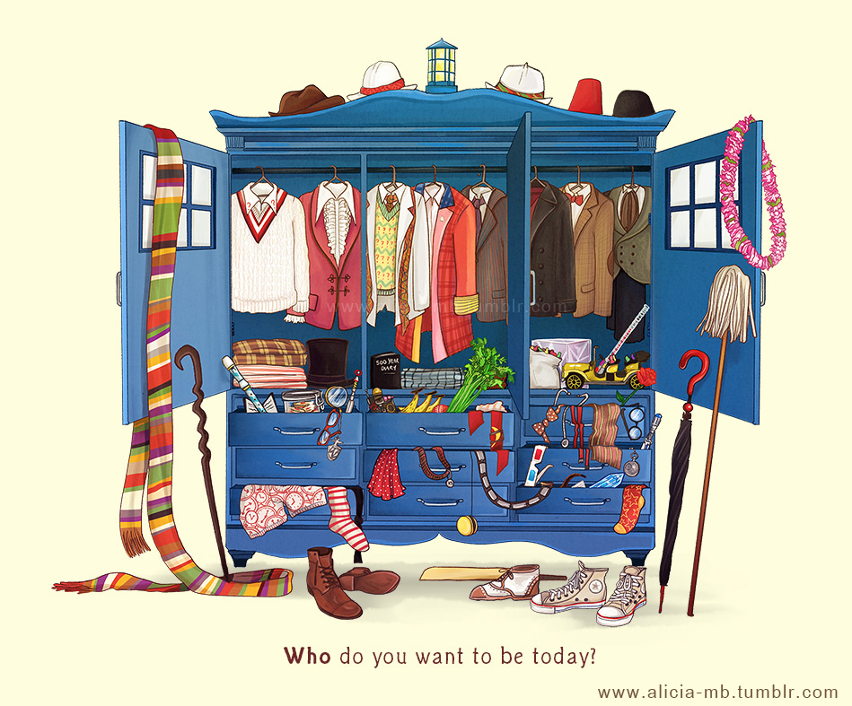
Doctor Who
Alycia
April 25, 2014

Slide 2
Conception
The British Broadcasting Corparation was set up to promote a sense of British culture, much like the CBC
In 1962 Eric Maschwitz, head of Light Entertainment commissioned Donald Wilsonto to research the prospects of producing science fiction programmes
The Head of Serial Dramas, Alice Frick and Donald Bull of the BBC Survey Group set up the basis of Doctor Who
John Braybon wrote a follow up report of stories that represented the genre and created much of the groundwork of Doctor Who as well as serving as inspiration BBC produced Sci-fi show
When a gap in programming occurred between Grandstand and Juke Box Jury it was decided that the empty space would do nicely as a juvenile science fiction programme because it would attract both the children and sports fans
C.E. Webber thought about having a time machine in the show that would travel through time, space, and maybe even other realities
The show was originally intended to be educational. For example both Barbara and Ian, two main characters are school teachers who were supposed to help provide explanations for things. Another example is that when the time machine traveled into the past we would learn about the events that took place.
Notes:
http://mercurie.blogspot.ca/2013/11/the-50th-anniversary-of-doctor-who.html

Slide 3
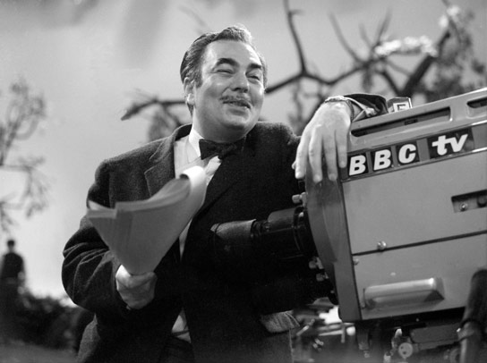
Head of Drama: Sydney Newman
The BBC wanted to create a stronger sense of British programming
This served to solidify British Imperialism
During the events of the cold war there was a rise in the popularity of science-fiction
Sydney Newman was well-known for his work in science fiction as part of the CBC so the BBC hired Sydney as head of Drama to expand that genre
Sydney conceived the ideas of a time machine bigger on the inside than out, the character of the doctor, and the title name
When the first episode was filmed Sydney Newman told Verity to take the time to re-film it because he was unsatisfied
Sydney wanted Hartnell to be less gruff and give off a more grandfatherly feel. He also felt that the display of the Doctor’s granddaughter, Susan’s strangeness was done horribly and was confusing

Slide 4
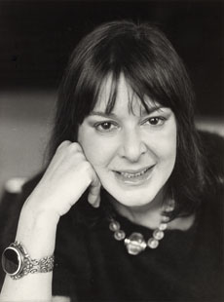
Producer: Verity Lambert
Sydney Newman offered Verity the job after she worked with him as a production assistant on ABC
Verity Lambert was the first female producer in the BBC as well as the youngest at 27
Verity’s role in the BBC showed people that women were capable of doing jobs men traditionally did, breaking the mold of women staying in the home
Verity played a vital role in gathering cast members
In regards to the role of Barbara, she asked her friend Jacqueline Hill to take the part
Verity was very opinionated and her views often clashed with Newman’s
An example of this would be supporting Terry Nation’s first script for the show despite Newman specifically saying that he did not want any bug eyed monsters or robots on the show

Slide 5
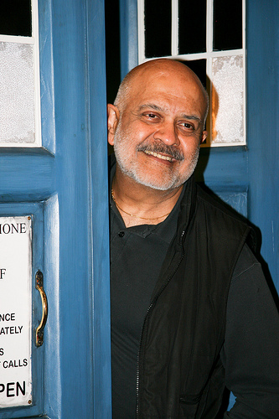
Director: Waris Hussein
He was the first Asian BBC director as a English Indian
Waris was only 24 when he took the job
According to Waris he had to put up with quite a bit of innuendo
He also felt that he was being stared at but it made him even more determined to do well
Waris was crucial to the casting of William Hartnell as the First Doctor as he accompanied Verity to convince him
Waris’s first impression of William was that he was "a very opinionated man — that is, prejudiced“ and that William look down on him because he wasn’t white
Despite the first impressions these two in fact worked well together on set
Notes:
http://tardis.wikia.com/wiki/Waris_Hussein

Slide 6
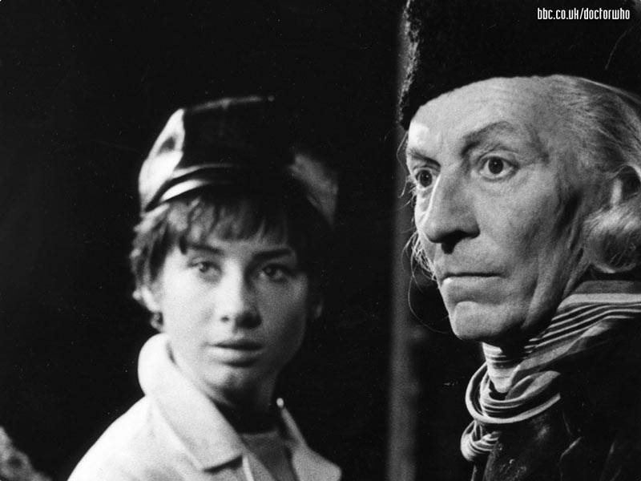
The First Doctor: William Hartnell
William Hartnell was actually the third choice to play the part of the doctor
William “Bill” at the time was being typecast as a rough, gruff, and commanding old man which worked for him because he used to be in the military
Bill was wary of accepting the role but was convinced after a second lunch with Verity and Waris
In the Pilot episode Bill was instructed to play the character in a similar manner as the roles he had been typecast for but after Sydney saw the pilot he ordered Verity to re-film the episode with a more grandfatherly character
In later seasons Bill became ill and was unable to continue the series so they replaced him with another actor introducing the idea of renewal or now commonly known as regeneration

Slide 7
Icon: Police Box
In “An Unearthly Child” we are introduced to the Doctor’s space and time machine now commonly referred to as the TARDIS (Time and Relative Dimensions in Space)
Originally C.E. Webber wanted a ship that was invisible or like a wisp or air but Sydney vetoed the idea saying that the snow needed an icon
The concept created was a ship with a Chameleon Circuit, a program which would allow the ship to change shape with each area they travelled too that would fit in inconspicuously. For example it they landed in Ancient Rome then the ship would take the shape of a roman column
This proved to be too costly so they came up with the idea that the Chameleon Circuit was broken and when it landed in 1963 Toter’s Lane it took the shape of a police box a common sight at the time and had remained that way ever since despite the Doctor’s attempts to fix it
This common sight in the 1960s created a great juxtaposition when the crew landed in foreign alien lands and past historical events

Slide 8
Icon: Daleks
Some people say that the popularity of the Daleks is what led to the success of Doctor Who
The Daleks were created by Terry Nation for the second serial of Doctor Who in his script commonly referred to as the Daleks or the mutants
Terry, knowing that the monsters were going to be played by humans didn’t want them to be humanoid so that it would feel more authentic and scary
The Daleks are said to have been based on the Nazi, seeing as their obsession with pure daleks and believing that they are the master race to the point where they are willing to wipe out all other races show quite a resemblance to the Nazis themselves.
Terry grew up during the second world war and that experience has bled through the personality of his aliens, which can be witnessed through their catchphrase: Eterminate!
The Daleks are aliens that were once human but have been mutated horribly due to radiation. They retreated into their metal shells to survive.
In Terry’s script the Daleks are attempting to rid their world of radiation but have found that after many generations of being exposed to it they have become dependant on the radiation. To make themselves stronger they planned to shoot a nuclear bomb back at the planet allowing only them to survive and not the Thals, whom they unwillingly share the planet with.
Notes:
http://www.dailymail.co.uk/tvshowbiz/article-1382252/Daleks-Doctor-Whos-notorious-enemies-return-screens.html
http://whatculture.com/tv/doctor-who-the-history-of-the-daleks.php

Slide 9
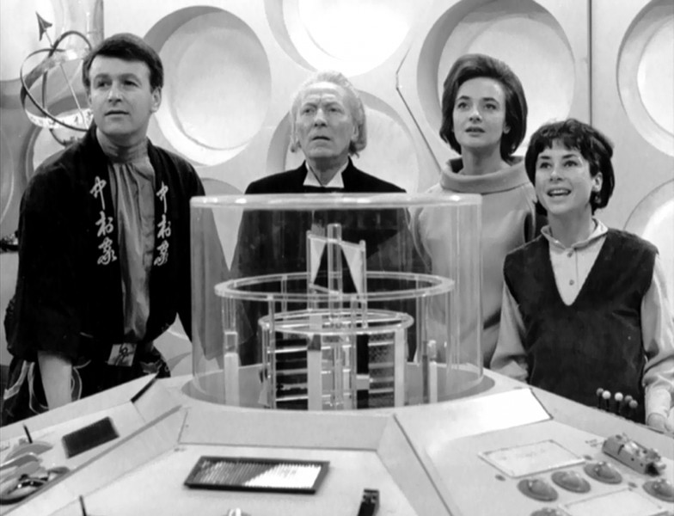
Character Archetypes: Then and Now
When the characters for the show was first conceived it was planned to have a dashing man in his 30s-40s, a stylish woman in her 20s-30s, and older man character 45-50, and a young girl to ask questions and get in trouble
These character types were desired by Sydney Newton
Ever since the 2005 reboot we usually only see one companion with the doctor and it is always a girl.
Although hinting at the doctor having a love interest has gone on ever since The Aztecs I with William Hartnell t was not until the reboot that people have started to believe the Doctor should have a romantic interest
This belief stems from the 1996 film produced by Americans. With Americans at the time their movies always had to have a kiss, so when they acquired the rights to Doctor Who he of course had to kiss his companion, Grace Halloway
Russell T. Davies and Steven Moffat have built and played with this idea of having a romantic relationship throughout new who, especially with David Tennant’s early days as he goes through three different companions in three different seasons and Matt Smith as Moffat does enjoy throwing girls at him.
In an attempt to make modern doctor who more relatable the main character is usually a modern day girl from the British Isles

Slide 10
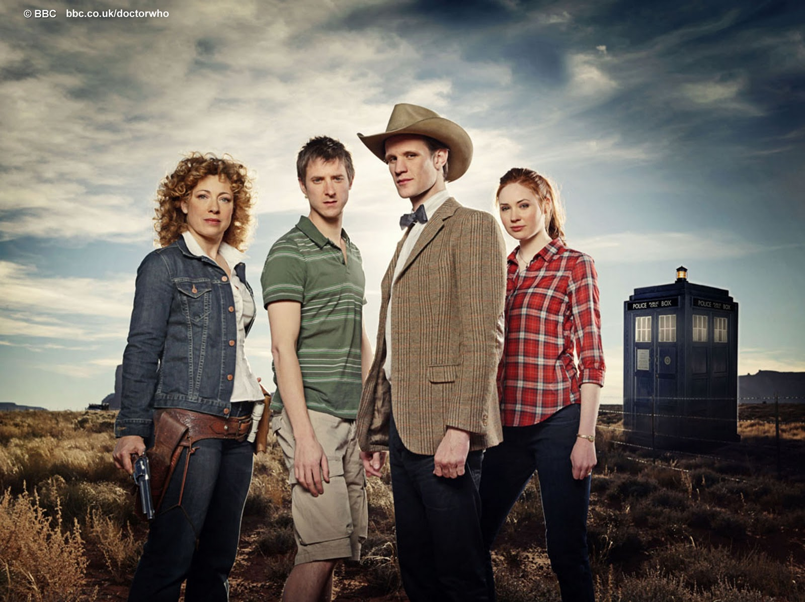
Popularity in America/American Influences
The season 7 opener contained the first ever episode to be filmed in America. The location was Utah.
Ever since then more locations in the US have been used in the series to the extent that some fans have complained that the show has become Americanized
Coincidentally the American locations have piqued the interests of American viewers
The rebooted series is also more friendly to casual viewers because the most a story is dragged out is in two-parters unlike Classic Who so more Americans can watch the story without having to follow a series with 7 parts.
Another factor is the changing view of heroes in America. The US commonly is known in film for their action heroes when It comes to adventure stories. As “Nerd Culture” had risen and become more socially acceptable the idea of a hero that uses his brain to solve problems is more appealing against the backdrop of an action packed show

Slide 11
Bibliography
The 50th Anniversary of Doctor Who by A Shroud of Thoughts
http://mercurie.blogspot.ca/2013/11/the-50th-anniversary-of-doctor-who.html
This website provides information on the origin of doctor who. It also goes into detail the roles Newman and Lambert played in the show.
Doctor Who's first director: 'I was a kid who'd been thrown into the lion's den by the telegraph
http://www.telegraph.co.uk/culture/tvandradio/doctor-who/10457945/Doctor-Whos-first-director-I-was-a-kid-whod-been-thrown-into-the-lions-den.html
This highlight’s the situations Waris faced when coming to Doctor Who due to age and race. It also details his determination to do a good job no matter what was thrown at him.
Waris Hussein by Tardis Data Core
http://tardis.wikia.com/wiki/Waris_Hussein
This website goes through the a basic history of Hussein. It also reveals some of the underlying prejudice and racial issues at the time and how Hussein dealt with it.
Why the BBC tried to... Exterminate Nazi Daleks! As Doctor Who's most notorious enemies return to our screens, we reveal what inspired their creator
By Tom Daniels
http://www.dailymail.co.uk/tvshowbiz/article-1382252/Daleks-Doctor-Whos-notorious-enemies-return-screens.html
This website shows how the Daleks were created and Terry Nation’s view on them. It also comments on how the characters were a iffy thing and only were put on screen due to time constraints.
http://whatculture.com/tv/doctor-who-the-history-of-the-daleks.php
This website tells us about the background of the Daleks, how they were created, their inspiration, and their popularity. It also talks about the extent of the Dalek’s popularity to the point where they have become an icon.
Why Doctor Who Became Popular Again
Because in 2013, cleverness is cool
By Barry Thompson
http://www.esquire.com/blogs/culture/doctor-who-popular

