Slide 1
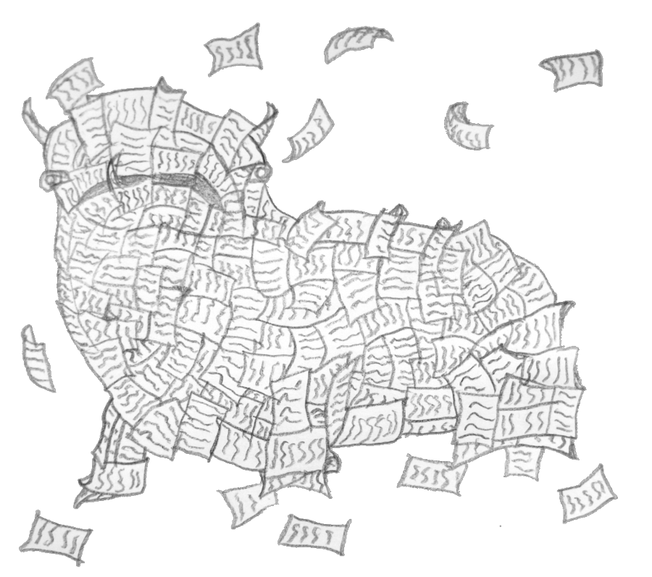
Technology resources to support research
(Or: How to Tame Alot of Paper)
Ashley Shaw
ashleygshaw@gmail.com

Slide 2
Some of the processes…
Searching for literature
Google Scholar; ‘non-academic’ sources: Twitter, Feedly (or another RSS feed connected to sites that are popular in your field)
Talk to librarians – they’re experts on this and love interacting with students instead of just books
Managing PDFs & references
Annotating and note taking
Writing

Slide 3
PDFs & Referencing
PDF managers allow you to store and sort papers. Most also have features for sorting, classifying, tagging, annotating, searching, filtering, and creating bibliographies.
Reference managers focus on storing reference data and outputting bibliographies.
Most of them actually do both, with varying degrees of success…
Reference managers:
Endnote – great at citations, ubiquitous, costly ($120/$250, EndNote basic web free through UBC) – UBC libraries won’t offer help with Endnote as they will for RefWorks, Mendeley, or Zotero
RefWorks – web based, free through UBC
Zotero – open source, powerful tools, clunky interface – also works well as a PDF manager
Mendeley – free, desktop and web pieces – their social network side is great to share readings/data and is used frequently for this in the sciences but not so much in social sciences/humanities
You can back up any of them to an .ris or bibtex file to move your list of references between computers or programmes.
Wikipedia comparison: http://en.wikipedia.org/wiki/Comparison_of_reference_management_software

Slide 4
PDFs & Referencing, con’t
PDF Managers:
Papers (now Papers3) – links across devices through Dropbox, great support - $45 for Mac/Windows, $10 iOS
Bookends – fully featured, intuitive to use - $50 Mac, $10 iOS
Sente – high powered, syncs between devices – free for basic (100 references), $30 for upgrade, then yearly payments for extra storage
Things to think about when choosing a pdf or reference manager: does its filing system make sense for you, is the interface intuitive, do you want to highlight/annotate in the programme or use a separate annotation programme, does it output nicely in the reference format you use most, is ‘write n’ cite’ important to you, does it work across the platforms/devices you want, will you have to pay (often) for upgrades
There are LOTS of comparisons/reviews on line if you Google something like ‘Papers vs Bookends’

Slide 5
Taking notes
Highlighting and annotating can be done in all PDF managers and most PDF readers, with varying degrees of ease.
Features to look for include ease of use and ability to sync across devices, compatibility with PDF managers, format for saving annotations, assortment of tools available, ability to export your notes into a separate document, ability to freeform highlight for things that aren’t text.
Popular apps include:
iAnnotate
GoodReader (GoodNotes)
PDF Expert
Foxit

Slide 6
Taking notes, con’t
For taking notes, organising info, clipping web articles:

Slide 7
Taking notes, con’t
Everyone who’s used Evernote thinks it’s been life changing. I use it to take notes in classes and lectures with slides, links, and even voice recordings all attached; write notes from books/articles; keep info (for school and life) that I can easily access on any device from anywhere; clip things I find on the web that I want to read later; share notes or notebooks with others for collaborative projects (or to send my husband the shopping list)
Other useful tools: Group Notes – for collaborative note taking/writing/annotating
Evernote –
also has Skitch for images and text

Slide 8
Writing
Word isn’t the only option!
Mac iWork suite now free for iOS
OpenOffice, LibreOffice
LaTex editors
Scrivener – allows you to break documents into pieces (i.e. chapters, sections, etc) and easily move between pieces, so you don’t have to scroll back and forth in Word or try to merge many different documents. Highly recommended by many writers and PhD students. (http://www.literatureandlatte.com/index.php)

Slide 9
Other tips
There is no one ‘best’ program or system, but there might be one that is best for you.
Spend time thinking about how you work and what devices you use before choosing tools. Most come with a free trial - test drive a few before investing.
Once you get used to a system, don’t change to a new one unless there’s a really good reason.
Create a system of tags/keywords that you use consistently across all ‘tools’.
Back up everything! Remember that if you back up to a USB that you carry with you, or to another computer/drive in your home, it’s possible that if your laptop were to get stolen/lost in a fire then your backup would be lost as well.
You can easily set programs to save a copy automatically to Dropbox or iCloud.
Professional archive services have a monthly charge equivalent to a latte. Skip one trip to Starbucks in exchange for the peace of mind of having your data automatically backed up continuously.

Slide 10
Other tips
There are lots of blogs that talk about managing the workflow: PhD Talk, Thesis Whisperer, Macademise, 3monththesis

