Slide 1
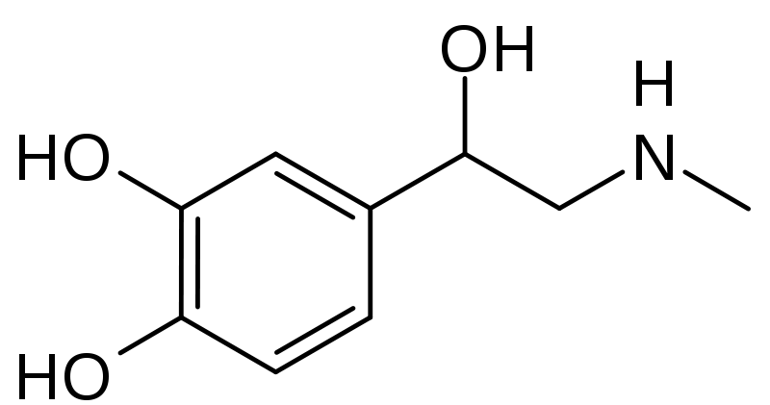
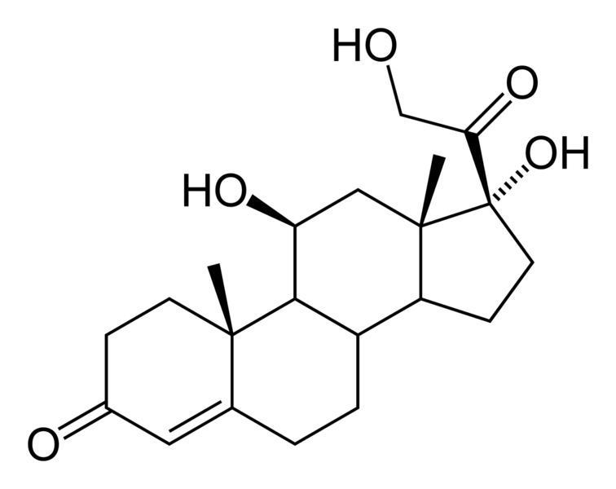
Fight or Flight, or Frenzy? Navigating Health & Happiness in a Demanding World
David King, PhD
Post-Doctoral Fellow (SFU) & Instructor of Psychology (UBC)
www.davidbking.net

Slide 2
My background…
Dreams, Spiritual Intelligence
Health…
Stress & Coping
Social Systems & Stress → Health
Meaning Making

Slide 3
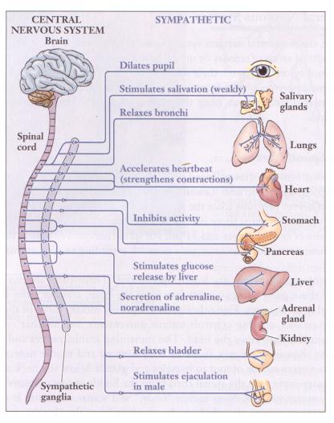
Fight or Flight
Sympathetic nervous system responds to threat…
Breathing increases.
Heart rate increases.
Blood pressure rises.
Muscles tense.
Hands & feet get cold.
Mouth gets dry.
Decreased digestion.
Blood glucose rises.
Pupils dilate, etc.
Notes:
ALSO: bladder relaxes, inhibition of erection, auditory exclusion (loss of hearing), tunnel vision (loss of peripheral vision).
PRIMARY GOALS: quick mobilization, increased blood flow to muscles, increased oxygen to brain and heart, increased blood pressure/heart rate/blood glucose for energy, sped up blood clotting to improve healing, increased clarity with pupils dilating. Resources are routed away from nonessential systems (digestive & reproductive, for example) to essential.

Slide 4
Fight or Flight
Cortisol (“The Stress Hormone”)
Adrenaline (Epinephrine)
Notes:
Epinephrine/norepinephrine are hormones/neurotransmitters that regulate heart rate, metabolism, respiration, oxygen to the brain, etc
Cortisol regulates blood pressure & cardiovascular function, suppresses nonessential systems (e.g., digestive, reproductive), reduces inflammation and improves tissue repair, increases blood glucose and enhances brain’s use of glucose.
Oxytocin is also released to mobilize you to seek out social support, receive care and support.

Slide 5
Returning to Baseline
Fight or Flight
Homeostasis
Homeostasis
Perceived Threat
Notes:
When stressor is removed…Return to homeostasis; parasympathetic nervous system takes over again: regeneration, reconstructive processes; heart rate & blood pressure slowed; muscle tension decreased; respiration rate returns to normal.

Slide 6
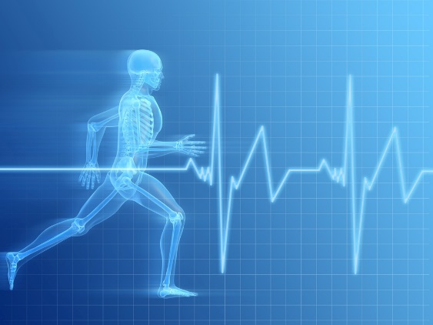
Fight or Flight

Slide 7
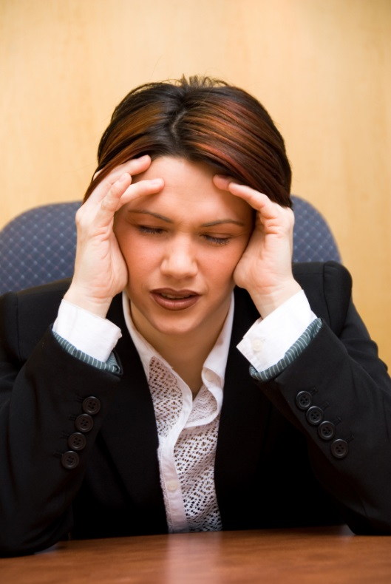
Fight or Flight
Notes:
TODAY – Responses persist, but fight and flight responses have assumed a wider range of behaviors. For example, the fight response may be manifested in angry, argumentative behavior, and the flight response may be manifested through social withdrawal, substance abuse, and even television viewing.

Slide 8
Returning to Baseline
Chronic Stress
Fight or Flight
Homeostasis
Homeostasis
Perceived Threat
Notes:
IF CHRONIC STRESS ENSUES: Glucocorticoids (like cortisol) stop working over time, as HPA axis becomes dysregulated; Persistent inflammation ensues; Inflammation plays a role in many diseases across lifespan; Immune function becomes impaired; Increased risk of heart disease, sleep problems, obesity, memory impairment, etc.

Slide 9
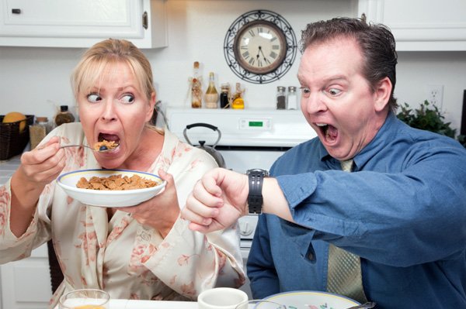
…or Frenzy?
Notes:
Whether we’re dealing with daily hassles and stressors, or more serious and traumatic events.

Slide 10
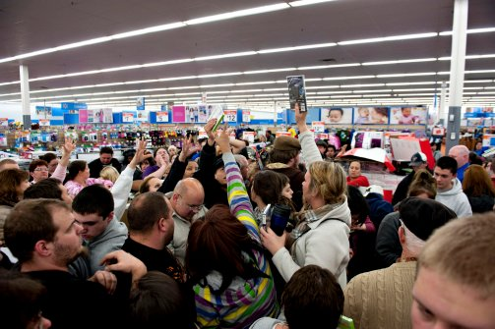
…or Frenzy?

Slide 11
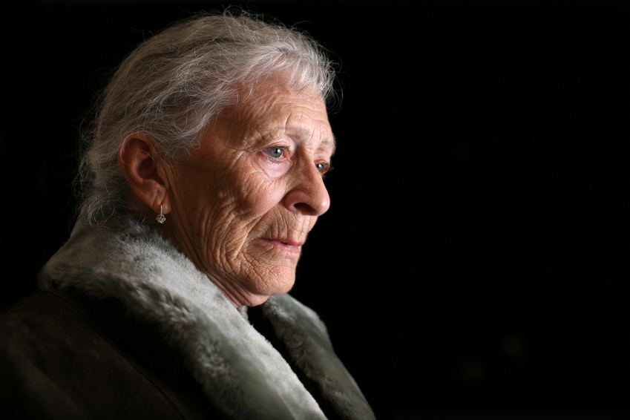
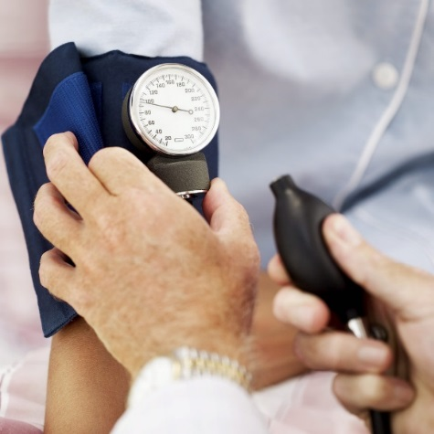
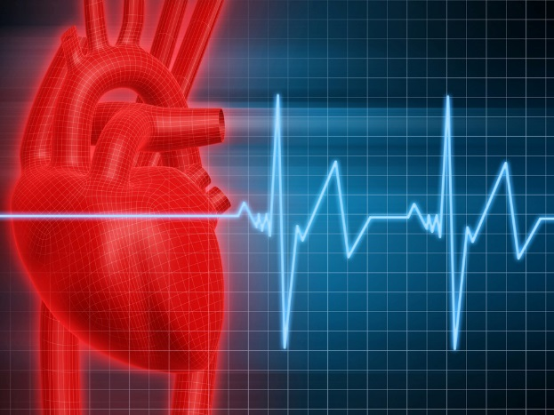
The impact of stress is far-reaching…
Notes:
The potential outcomes of stress range from physical to mental, emotional, and social. From the common cold and increased risk of cardiovascular disease, to depression and anxiety.
Physiological stress can occur in and of itself – airport study.

Slide 12
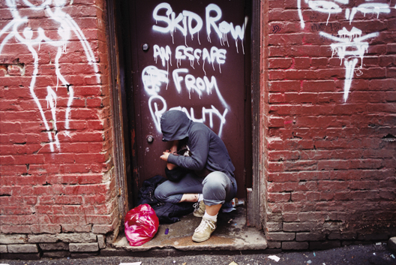
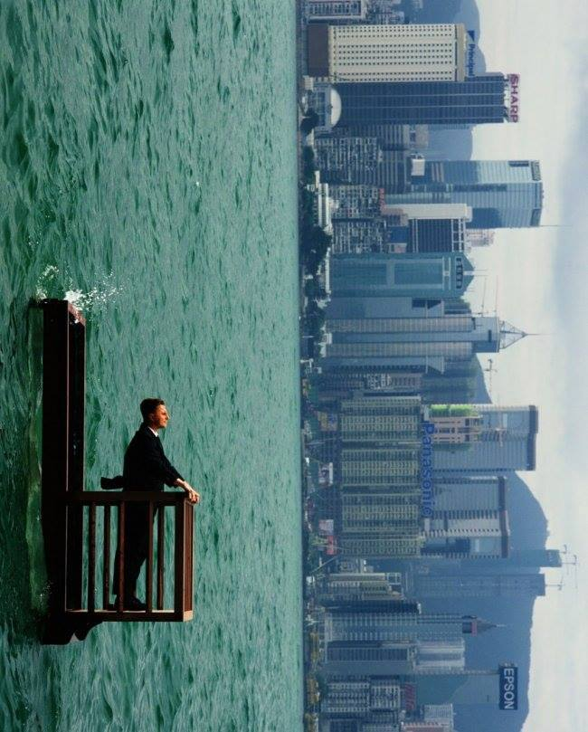
CONTEXT MATTERS!
Your
perspective
matters.
Notes:
…in everything.
Social Context, Socio-Economic Status, Work vs. Home, etc.
Either way, your perspective matters. Where you come from matters…in particular, socio-economic status.

Slide 13
What is Stress?
Transactional Model of Stress (Lazarus)
Stress occurs when the environment taxes or exceeds the resources of the organism.
Event is Threatening/ Demanding
Stress
Event
Evaluation of Event
Event is NOT Threatening/ Demanding
No Stress

Slide 14
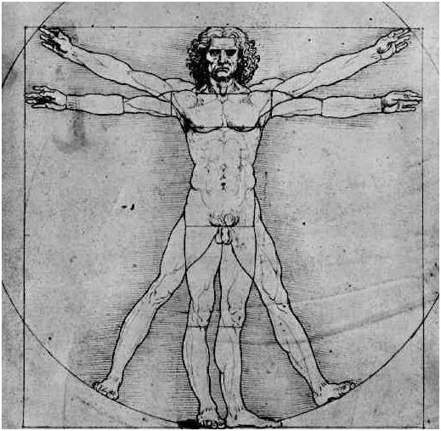
What is Health?
WHO’s Definition of Health (1948)
Health is a complete state of well-being, encompassing:
Physical well-being
Mental/Emotional well-being
Social well-being
Cultural well-being?
Spiritual well-being?
Ecological well-being?

Slide 15
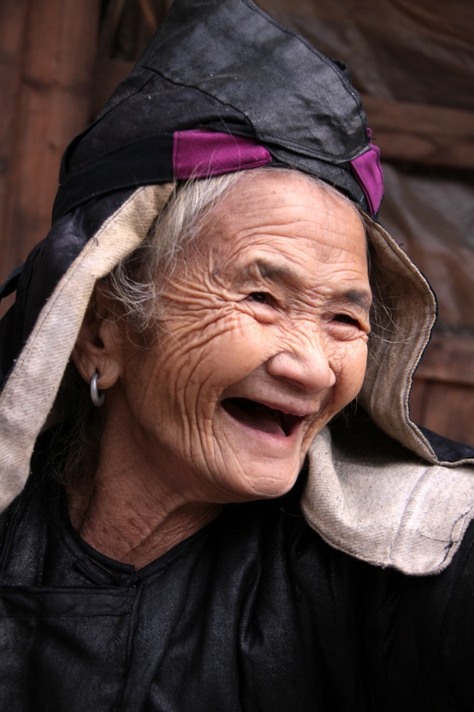
What is Health?
“Health is a large word. It embraces not the body only, but the mind and spirit as well; and not today's pain or pleasure alone, but the whole being and outlook of a [person].”
~ James H. West

Slide 16
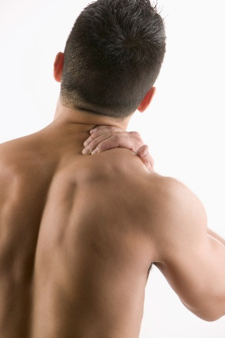
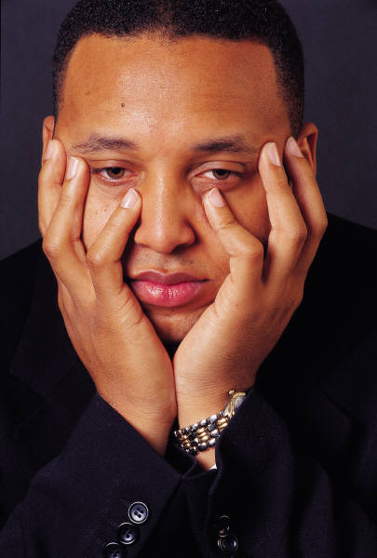
Stress & Health
Physical
Social
Existential
Mental & Emotional

Slide 17
Beat Stress & Improve Health
Physical
Social
Existential
Mental & Emotional
?
?
?
?

Slide 18
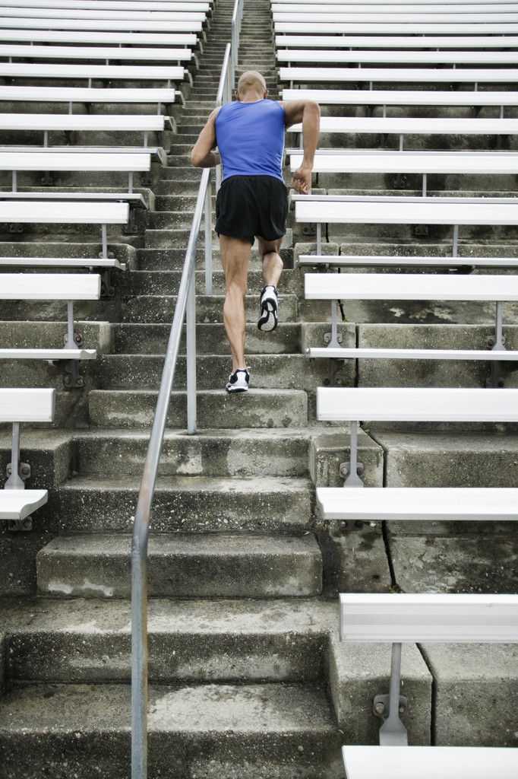
Health Behaviours
What we do on a daily basis matters!
Physical

Slide 19
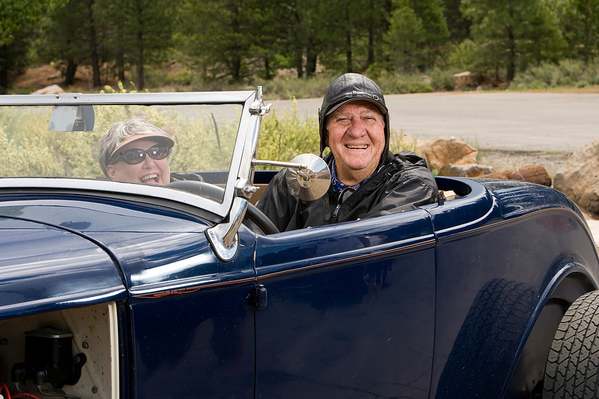
Health Behaviours
Now and throughout our lives…
Physical

Slide 20
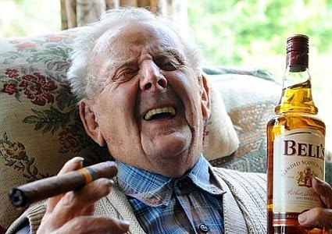
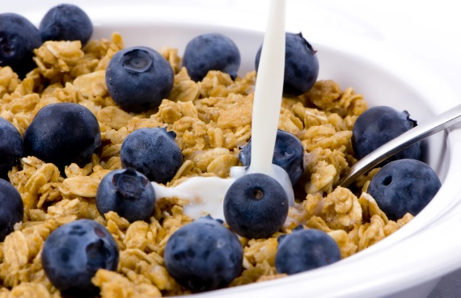
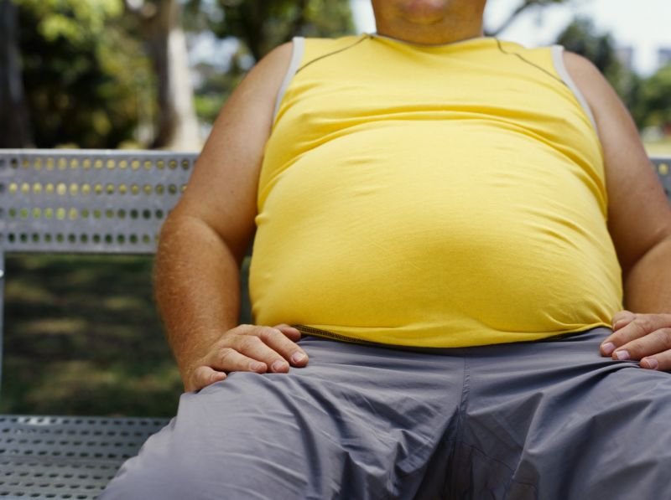
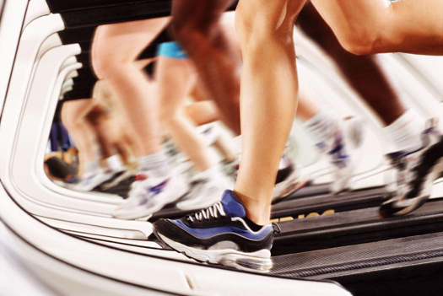
7 Key Health Practices Alameda County Study (1965 - )
Physical
Notes:
Followed over 7000 adults from 1965 onward…
The Alameda County study found seven risk factors—or health practices—associated with poor physical health and excess mortality: drinking excessive amounts of alcohol, smoking cigarettes, being obese, sleeping fewer or more than seven to eight hours per night, being physically inactive, eating between meals, and not eating breakfast.

Slide 21
Get some sleep…
Physical

Slide 22
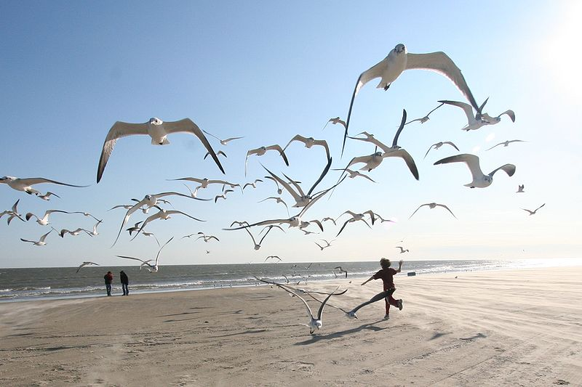
Coping with Stress
How you respond matters…
Mental & Emotional
By Ed Schipul from Houston, TX, US (running with the seagulls) [CC-BY-SA-2.0 (http://creativecommons.org/licenses/by-sa/2.0)]

Slide 23
Coping with Stress
Problem-Solving – make a plan, do something.
Positive Reappraisal – find the positive / silver lining.
Support Seeking – surround yourself by supportive others.
vs.
Denial & Avoidance – work through stuff.
Rumination – but don’t dwell on it either.
Mental & Emotional

Slide 24
What do you believe about stress?
Do you believe that stress is harmful to your health?
New research is showing that stress only has some of its negative effects for those who believe it is harmful.
Rethink stress response as helpful, and physiological response is less intense – more similar to excitement and joy.
Stress mobilizes you and prepares you for action.
“This is my body helping me rise to the challenge.”
Mental & Emotional
See TED Talk by Kelly McGonigal: How to make stress your friend
Notes:
There’s also research suggesting that if you say you’re “excited” about public speaking rather than “nervous,” you’ll actually be less stressed.

Slide 25
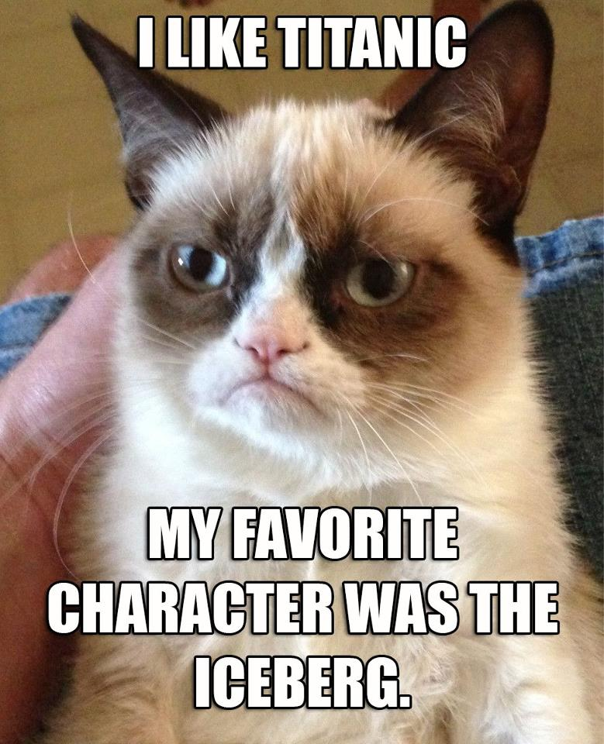
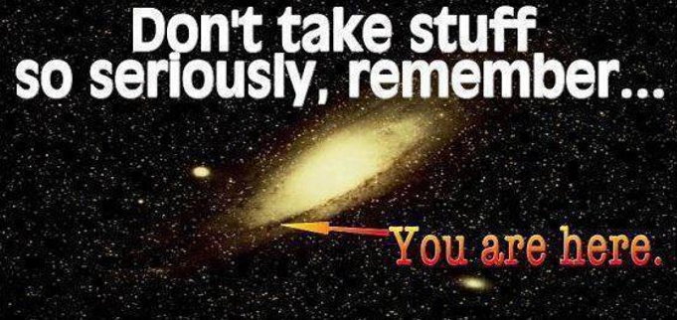
At the very least, try not to sweat the small stuff.
Notes:
We want to avoid falling into more negative and pessimistic patterns

Slide 26
Burnout
Mental & Emotional

Slide 27
How to Avoid Burnout
Striking a balance…
Work-Family Balance
Internal and External Recovery
Mental & Emotional

Slide 28
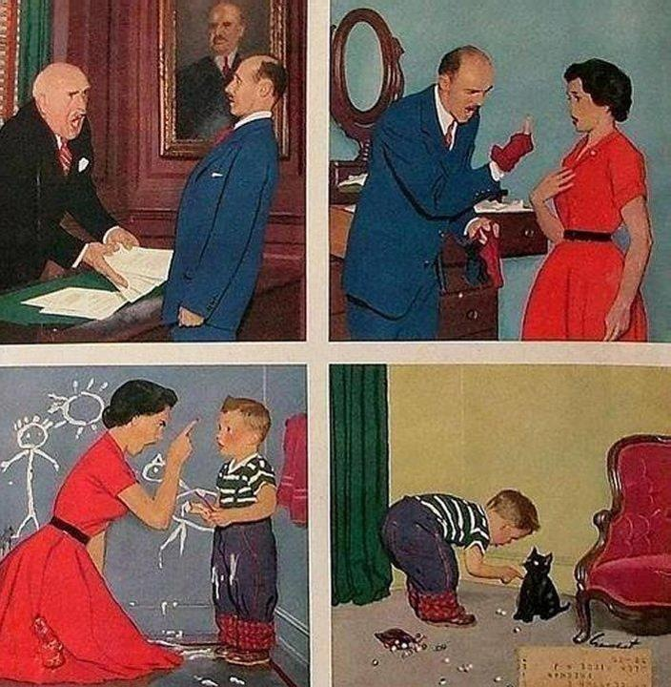
Stress is contagious!
Social

Slide 29
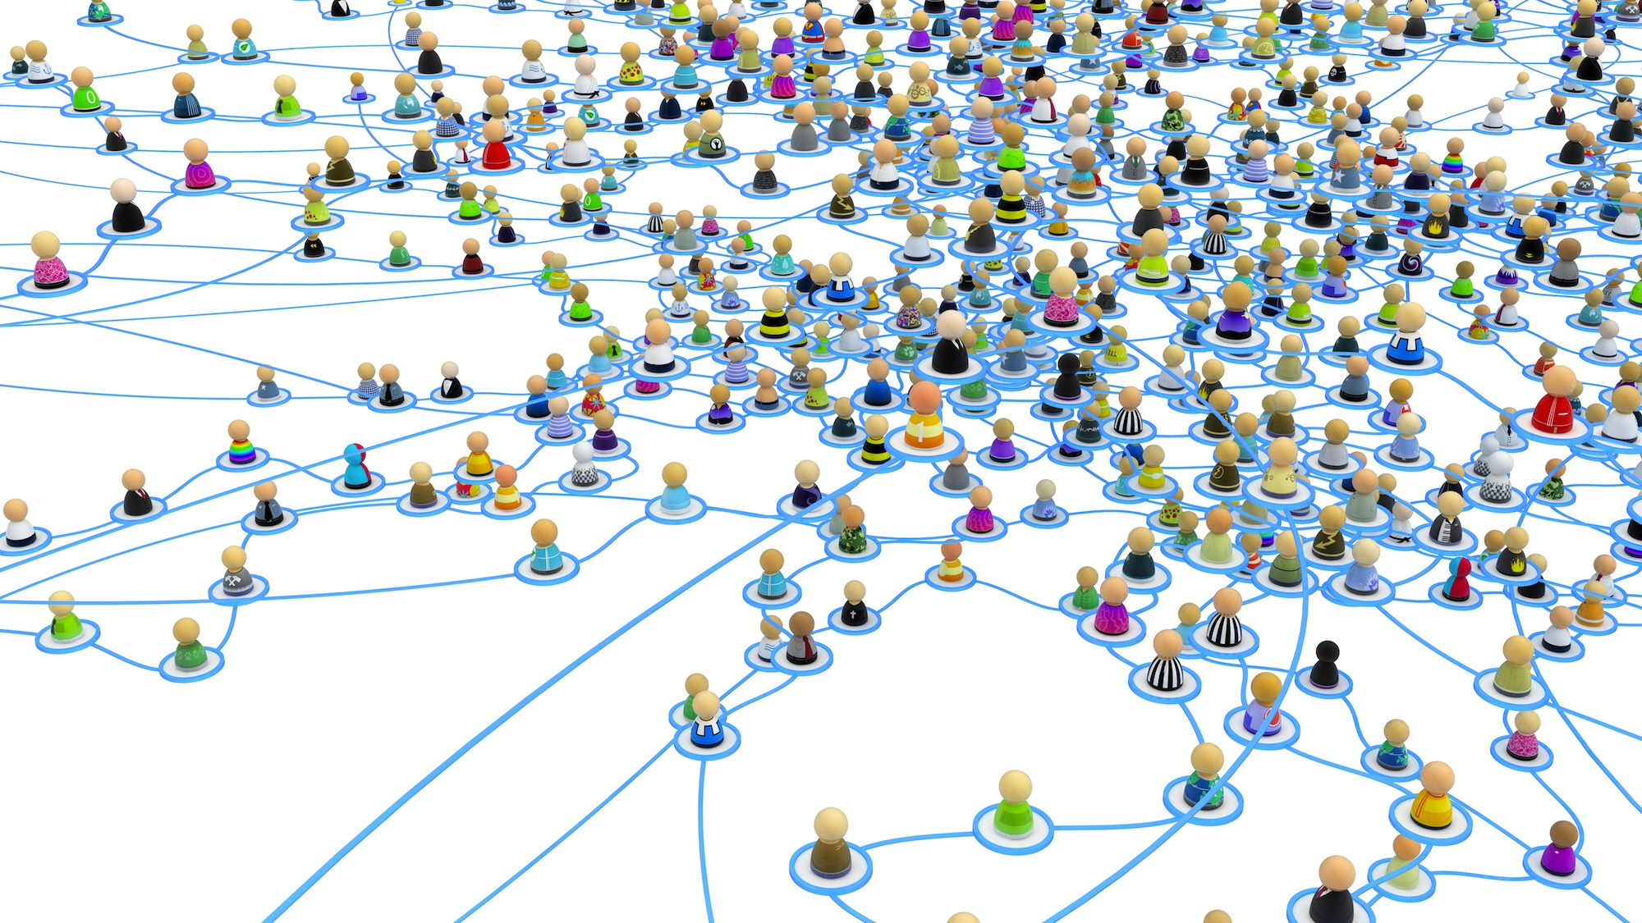
Social
See TED Talk by Nicholas Christakis: The hidden influence of social networks
Notes:
Your colleague’s husband’s sister can impact your health.

Slide 30
We’re all connected, for better or for worse.
Social
What about social media?
Notes:
The conclusion that can be drawn is that we’re all connected, for better or for worse. It is worth considering how we can make our impact on others more positive.

Slide 31
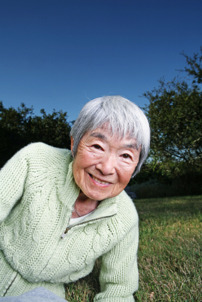
Slow down. Be present.
Social

Slide 32
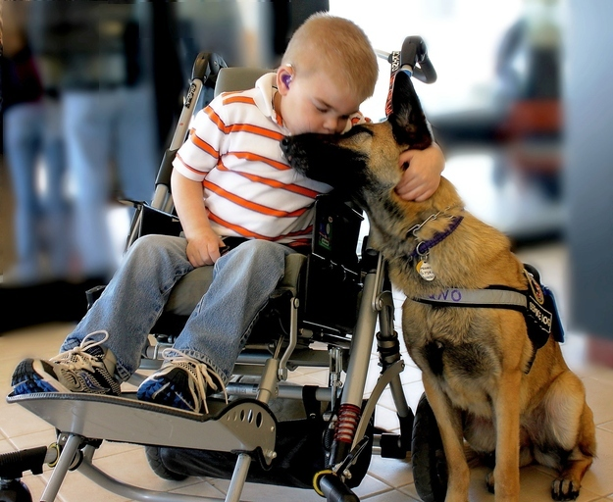
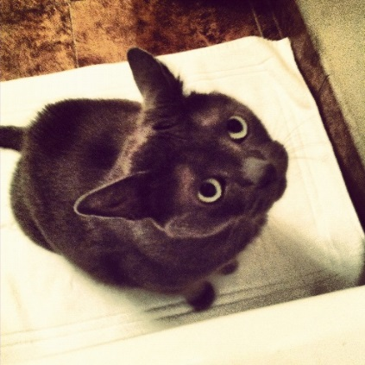
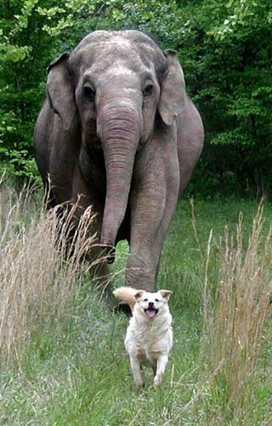
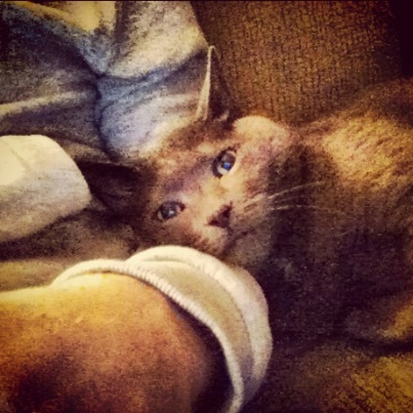
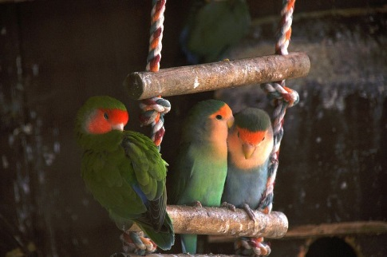
Support comes in many forms…
Social

Slide 33
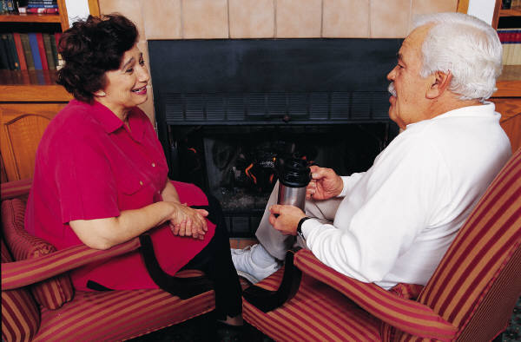
Find Some Meaning
Sense of Purpose
Sense of Direction
Sense of Order
Values & Goals
Reflection on the Past
Reason for Existence
Existential

Slide 34
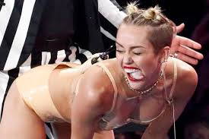
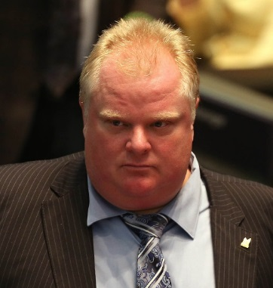
In order to make sense of it all…
Notes:
…and more importantly, to make sense of it all.
It’s really not surprising given the world we live in.

Slide 35
Be Mindful
Existential
Mindfulness-based meditation linked to improved quality of life, reduced stress, and better sleep.
Notes:
The intentionally focused awareness of one’s immediate inner & outer experiences.
Moment-by-moment attention to thoughts, emotions, sensations, and surroundings.
Losing oneself in the present moment, lack of judgment, simple observation.

Slide 36
Connect to Something Bigger
Existential

Slide 37
UBC STUDY: The visual presence of wood in a room lowers sympathetic nervous system (SNS) activation in occupants (Fell, 2010).

Slide 38
Be Positive!
Forgiveness
Learned Optimism
Kindness and Gratitude
Personal Meaning
Creativity & Flow
Existential

Slide 39
YOU CAN Beat Stress & Improve Health!
Physical
Social
Existential
Mental & Emotional
?
?
?
?
?
?
?
?
?
?
?
?
?
?
?
?
?
?
?
?

Slide 40
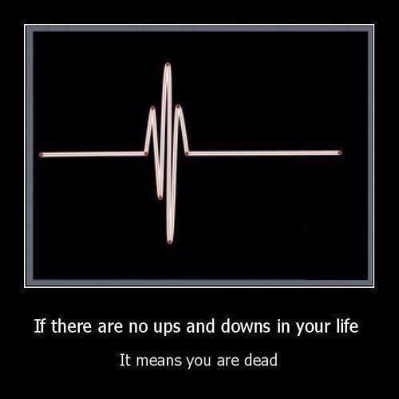
But remember…
Notes:
All that being said, stress is a normal part of our lives, and it’s not completely avoidable.

Slide 41
Thank you!
www.davidbking.net

Slide 42
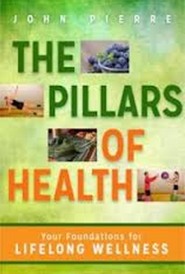
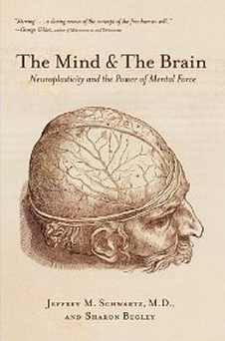
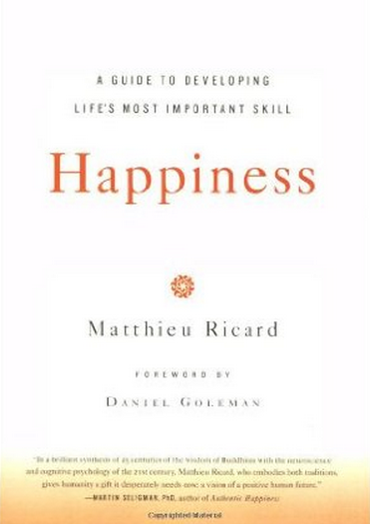
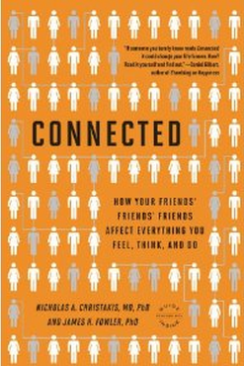
Recommended Reads
Physical
Social
Existential
Mental & Emotional

