Slide 1
Preparing an Outstanding Literature Review: From a Reviewer’s Perspective
Department of Educational Studies
February 28, 2019
Tom Sork

Slide 2
Outline
Definitions
Purposes
Stages/“steps” in doing reviews
What different readers expect to see
Common weaknesses
Resources
A short personal story…

Slide 3
What is a literature review #1
“A literature review is an evaluative report of information found in the literature related to your selected area of study. The review should describe, summarize, evaluate and clarify this literature. It should give a theoretical base for the research and help you (the author) determine the nature of your research.”
Source: Jesson, J., Matheson, L., & Lacey, F. M. (2011). Doing your literature review: Traditional and systematic techniques. Los Angeles: Sage.

Slide 4
What is a literature review #2
“A literature review is a critical and in depth evaluation of previous research. It is a summary and synopsis of a particular area of research, allowing anybody reading the paper to establish why you are pursuing this particular research. A good literature review expands on the reasons behind selecting a particular research question.” [emphases added]
Source: https://explorable.com/what-is-a-literature-review

Slide 5
What is a literature review #3
“A literature review can be just a simple summary of the sources [NOT AT UBC!], but it usually has an organizational pattern and combines both summary and synthesis. A summary is a recap of the important information of the source, but a synthesis is a re-organization, or a reshuffling, of that information. It might give a new interpretation of old material or combine new with old interpretations. Or it might trace the intellectual progression of the field, including major debates. And depending on the situation, the literature review may evaluate the sources and advise the reader on the most pertinent or relevant.” [emphases added]
Source: https://writingcenter.unc.edu/tips-and-tools/literature-reviews/

Slide 6
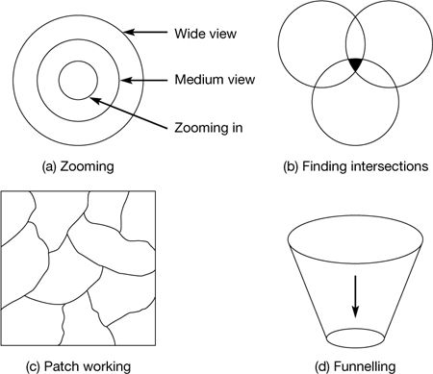
Possible ways of picturing the literature review…
Source: Wellington, J. et. al. (2005). Succeeding with your doctorate. Sage Publications, Figure 5.1. doi: 10.4135/9781849209977.n2

Slide 7
Purpose(s) of a literature review…
to answer the question: What do we know – or not know – about this particular topic/issue/subject?
to survey, summarize, assess & distill information about a topic.
to position you as a well-informed, authoritative participant in a scholarly conversation.
to establish an intellectual foundation for a research project.
to convince others that you are sufficiently engaged with a body of relevant literature to propose an original research project.

Slide 8
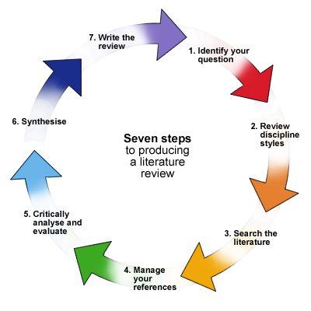
Producing a literature review…
An attractive graphic….BUT, there is nothing linear about producing a good literature review!
Source: University of Sheffield, retrieved from: https://dkit.ie.libguides.com/literaturereview

Slide 9
Producing a literature review…
An attractive graphic….BUT, there is nothing linear about producing a good literature review!
HOWEVER, the review itself may look like it was the product of a linear process!
Source: University of Sheffield, retrieved from: https://dkit.ie.libguides.com/literaturereview

Slide 10
Assessing each step, through multiple lenses…
Source: University of Sheffield, retrieved from: https://dkit.ie.libguides.com/literaturereview

Slide 11
Some things readers may look for…
How clear is the question, issue, topic or purpose?
How well does the review contextualize (historically, intellectually) your study?
How detailed is the description of how the literature was selected?
How relevant (and current) is the literature selected?
How well have you surfaced the assumptions, paradigms, worldviews behind the literature?
How well have you shown the historical trajectory of conceptual, theoretical and empirical developments?

Slide 12
Some things readers may look for (cont.)…
How carefully have you assessed the quality of the material selected for review?
What contrasting perspectives have you included and how have you treated them?
How strong/clear is your voice/presence in the review?
How effectively have you analyzed the included material?
How well have you synthesized the literature?

Slide 13
Some common weaknesses…
No information on how search was conducted.
No information on criteria for including/excluding literature.
Lack of clarity/definitions of key concepts used.
“Flybys” of each piece of literature; little or no analysis.
Too many “dated” references; current work missing.
Missing pieces of key/closely-related literature.
Incomplete or missing synthesis; leaving the work to readers.
Weakly-argued or missing conclusions.
Weak or missing “authorial” voice.

Slide 14
Resources

Slide 15
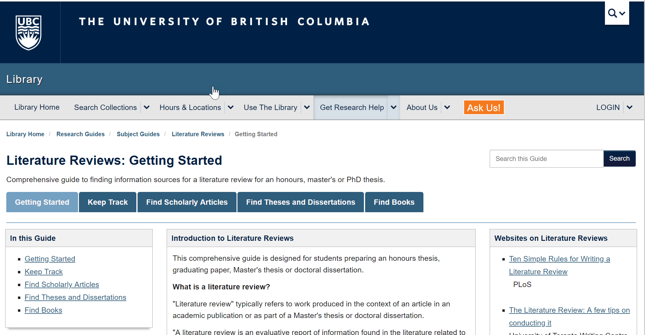

Slide 16
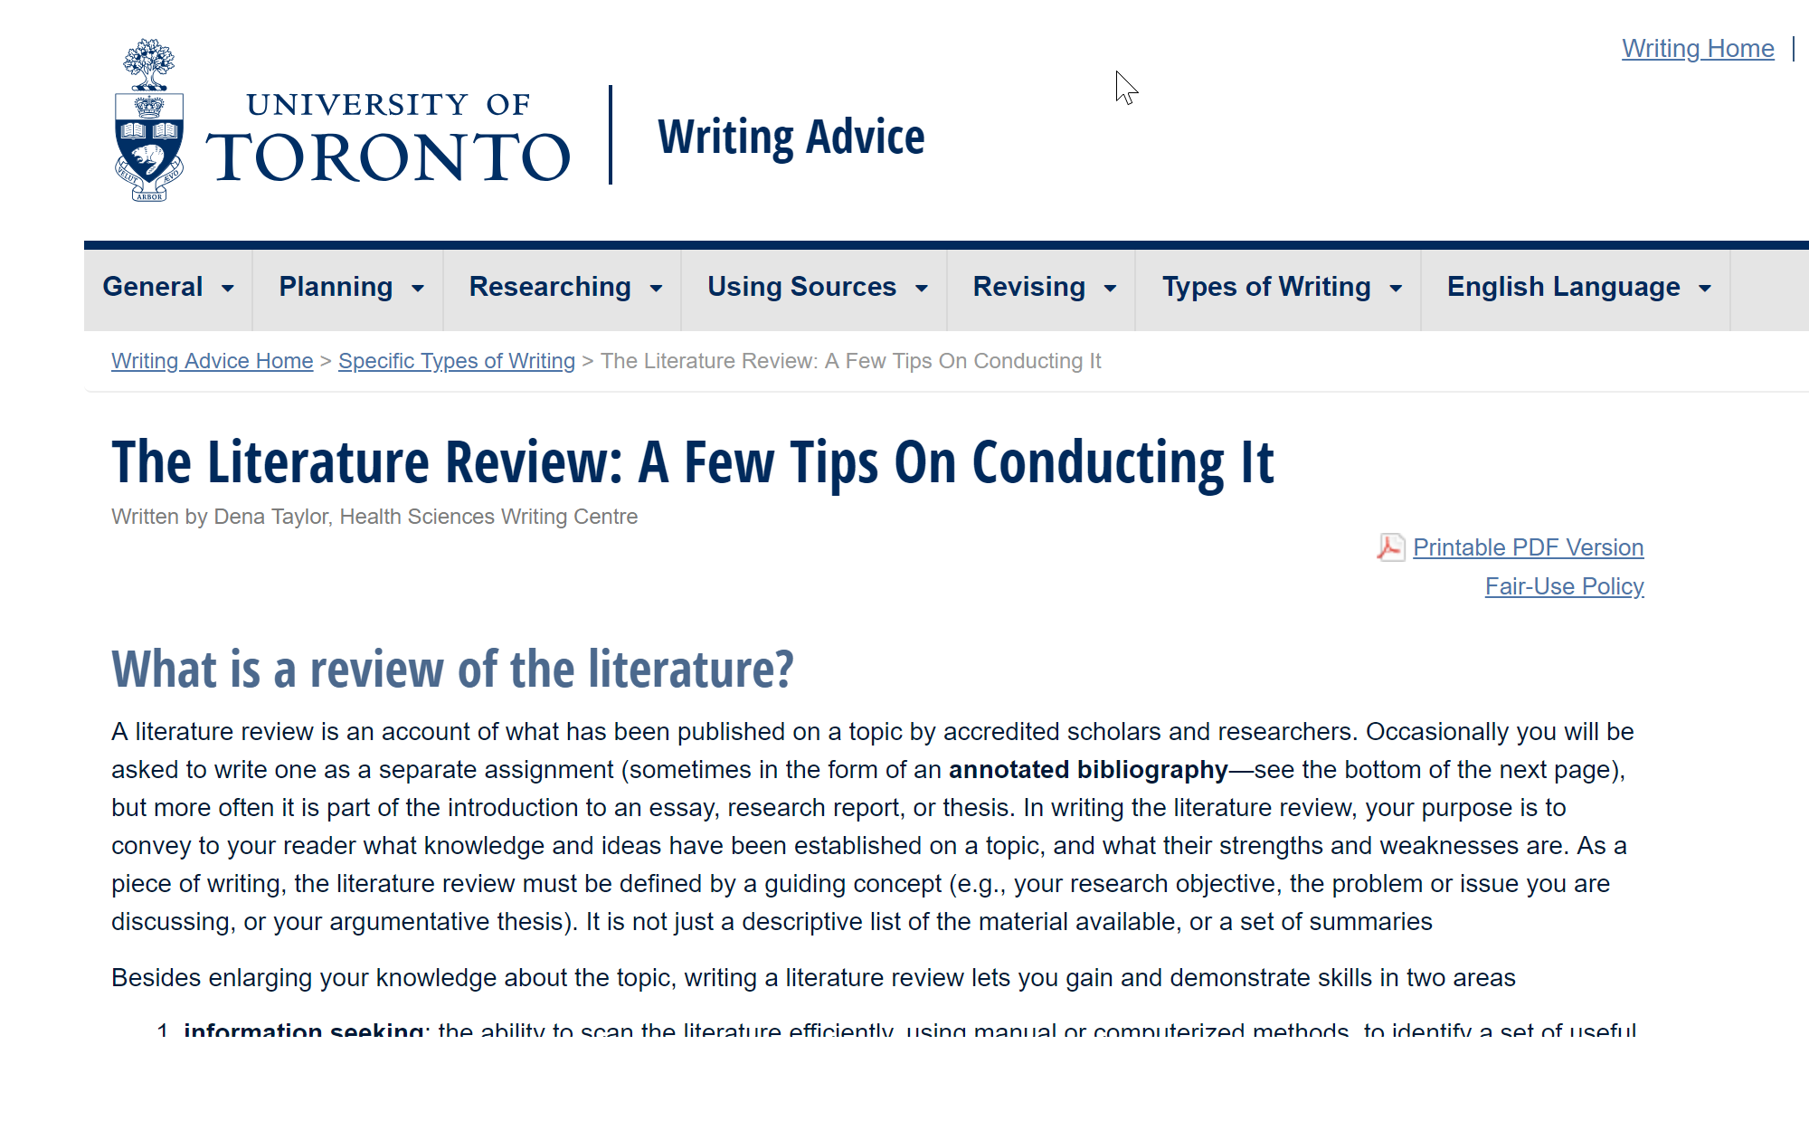

Slide 17
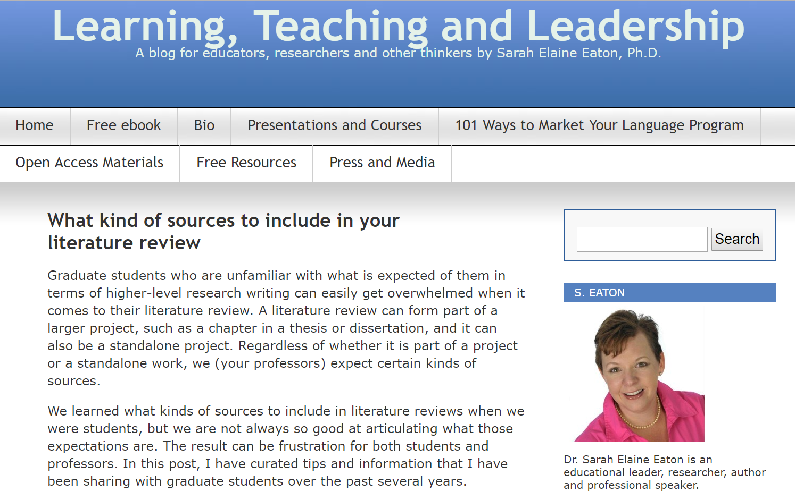
https://drsaraheaton.wordpress.com/2018/02/27/what-kind-of-sources-to-include-in-your-literature-review/

Slide 18
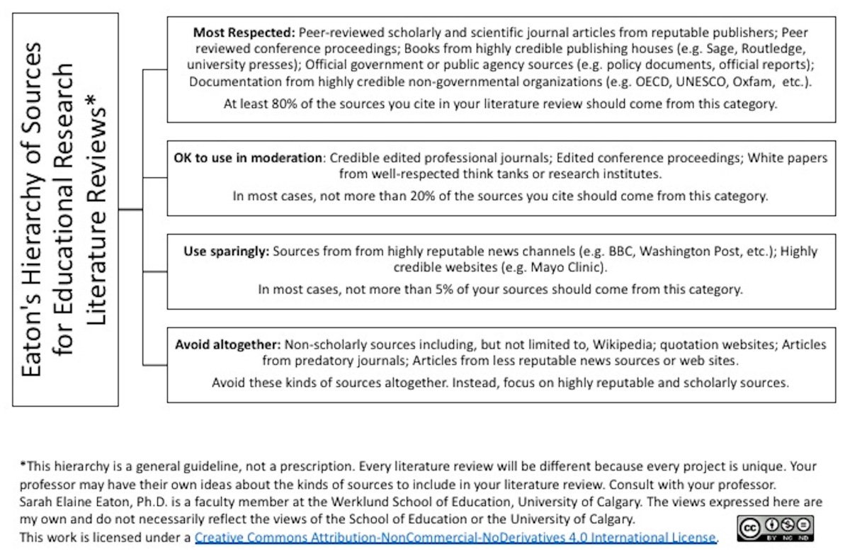
https://drsaraheaton.wordpress.com/2018/02/27/what-kind-of-sources-to-include-in-your-literature-review/

Slide 19
Eaton’s hierarchy of sources (2018)…
Most respected | Peer-reviewed scholarly and scientific journal articles from reputable publishers; peer-reviewed conference proceedings; books from highly credible publishing houses; official government or public agency sources; documentation from highly-credible non-governmental organizations.
OK to use in moderation | Credible edited professional journals; edited conference proceedings; White Papers from well-respected think tanks or research institutes.
Use sparingly | Sources from highly reputable news channels; highly credible websites.
Avoid altogether | Non-scholarly sources including, but not limited to, Wikipedia, quotation websites; articles from predatory journals; articles from less reputable news sources or websites.
https://drsaraheaton.wordpress.com/2018/02/27/what-kind-of-sources-to-include-in-your-literature-review/

Slide 20
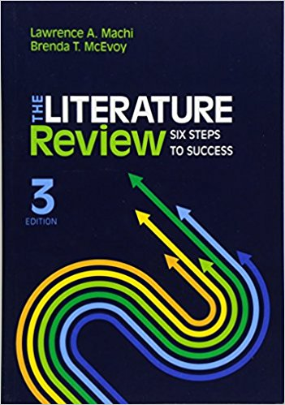
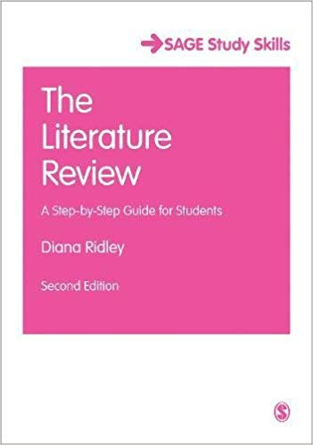

Slide 21
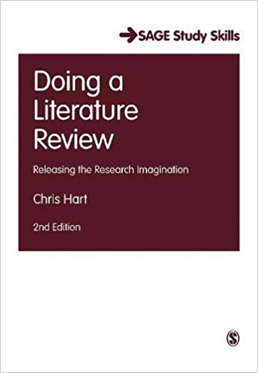
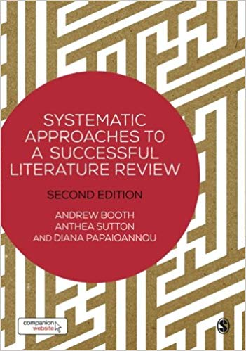

Slide 22
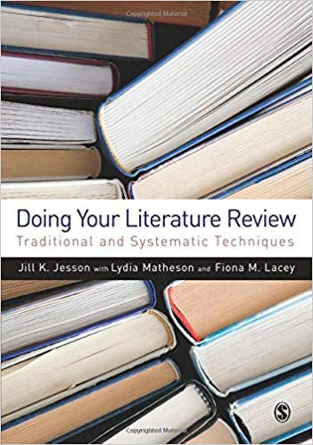
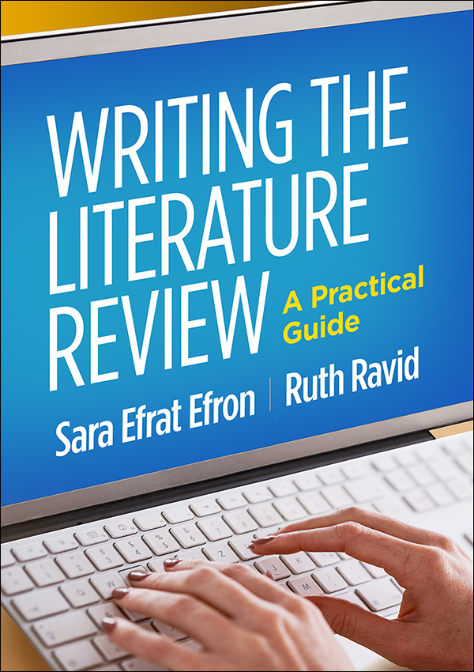

Slide 26
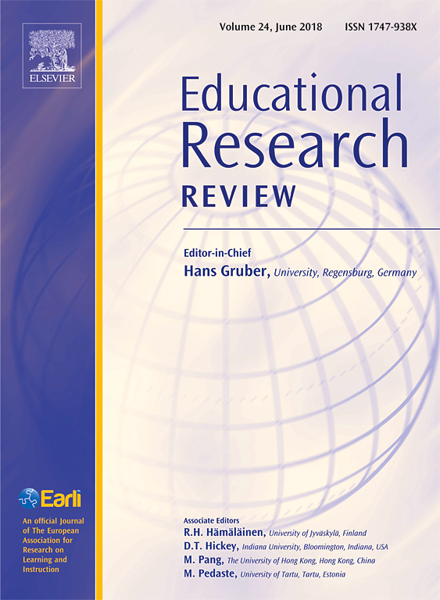

Slide 27
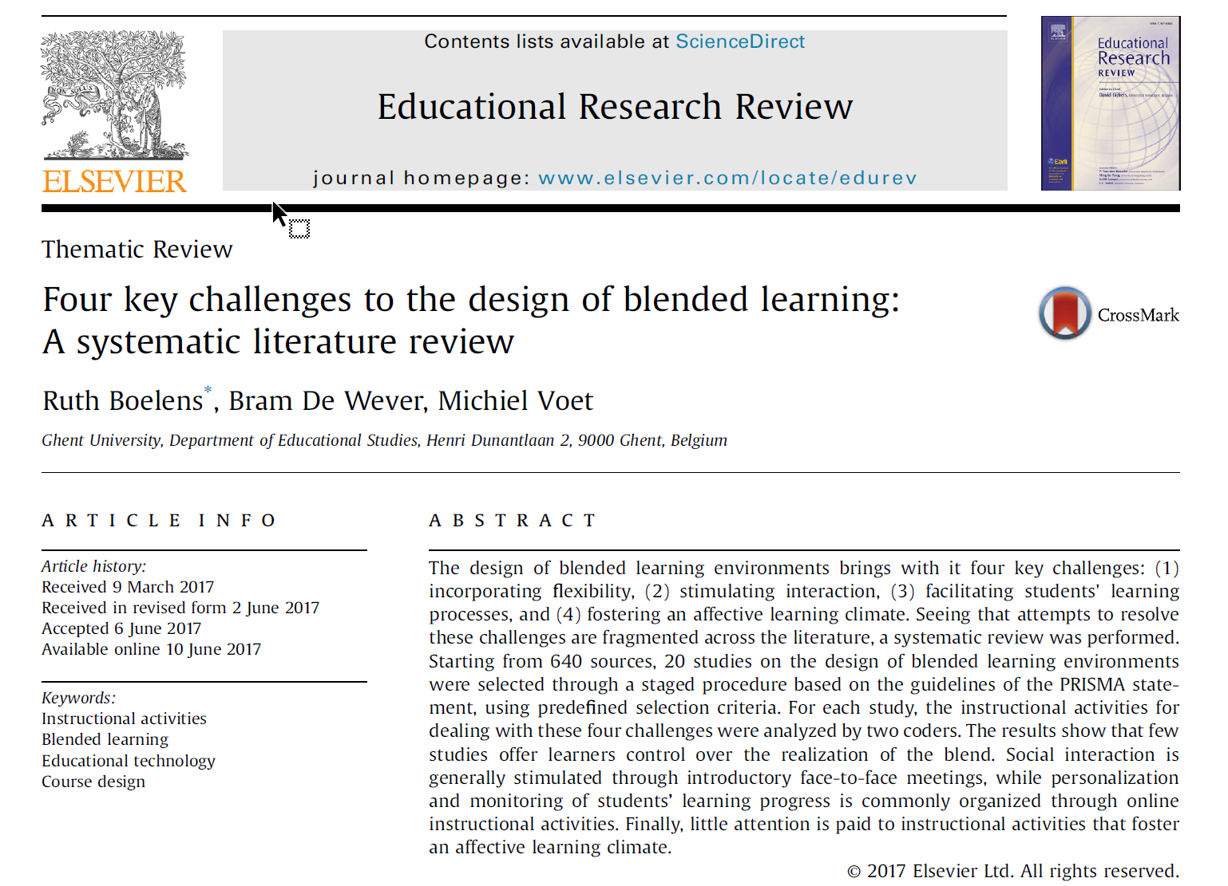

Slide 29
Source: http://www.prisma-statement.org/

Slide 30
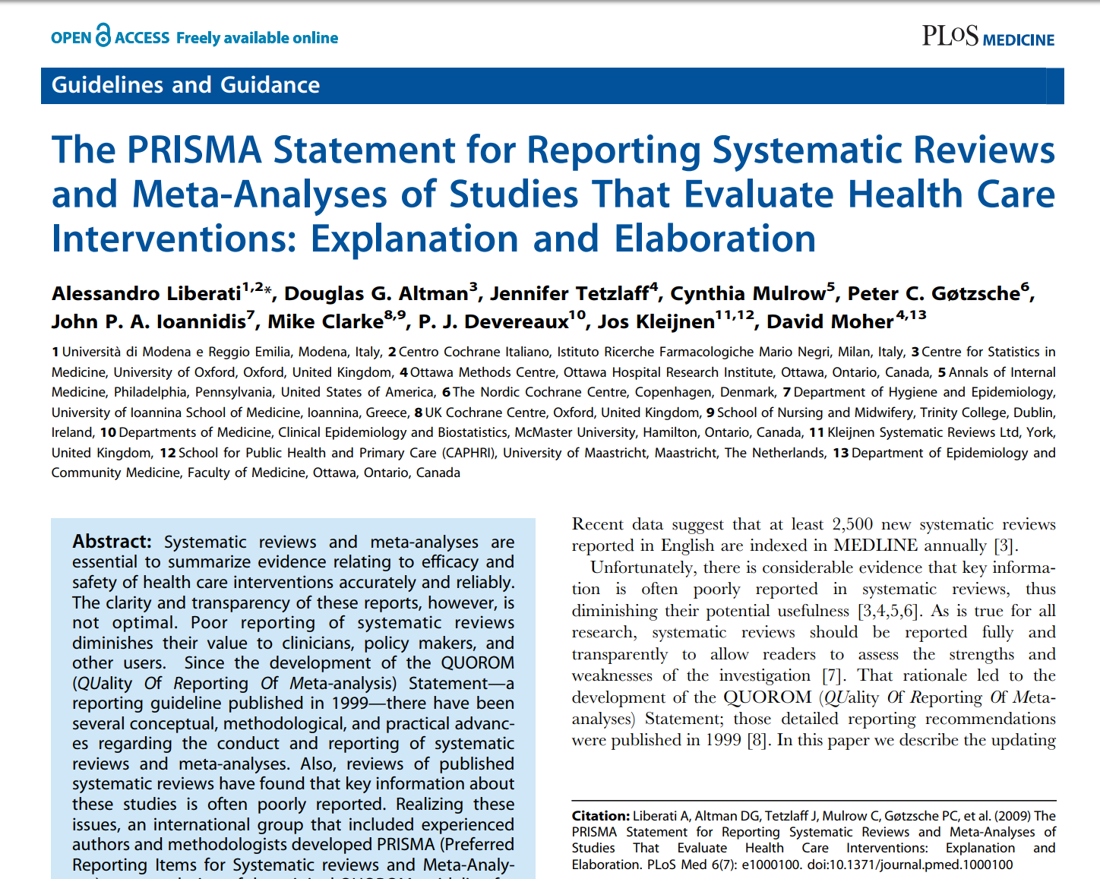

Slide 31
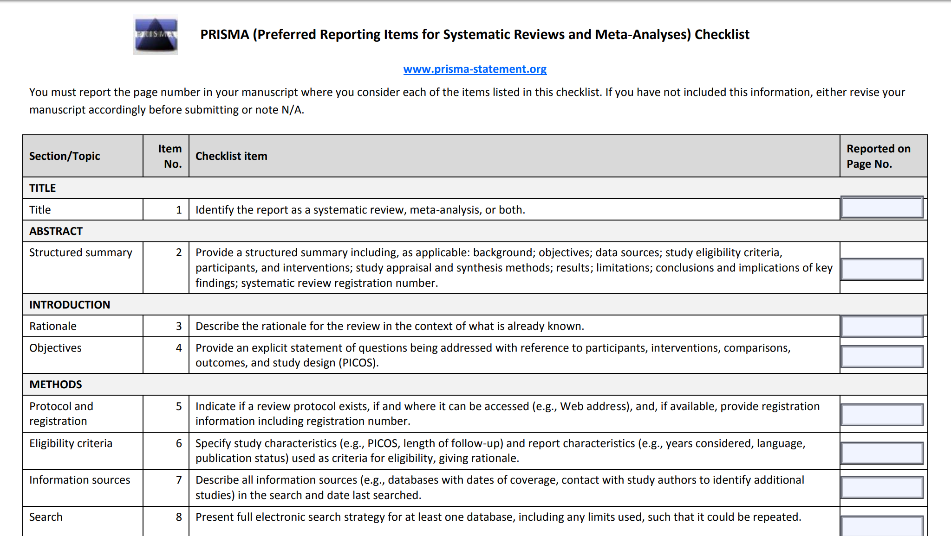

Slide 33
A personal “lit review” story…

Slide 34
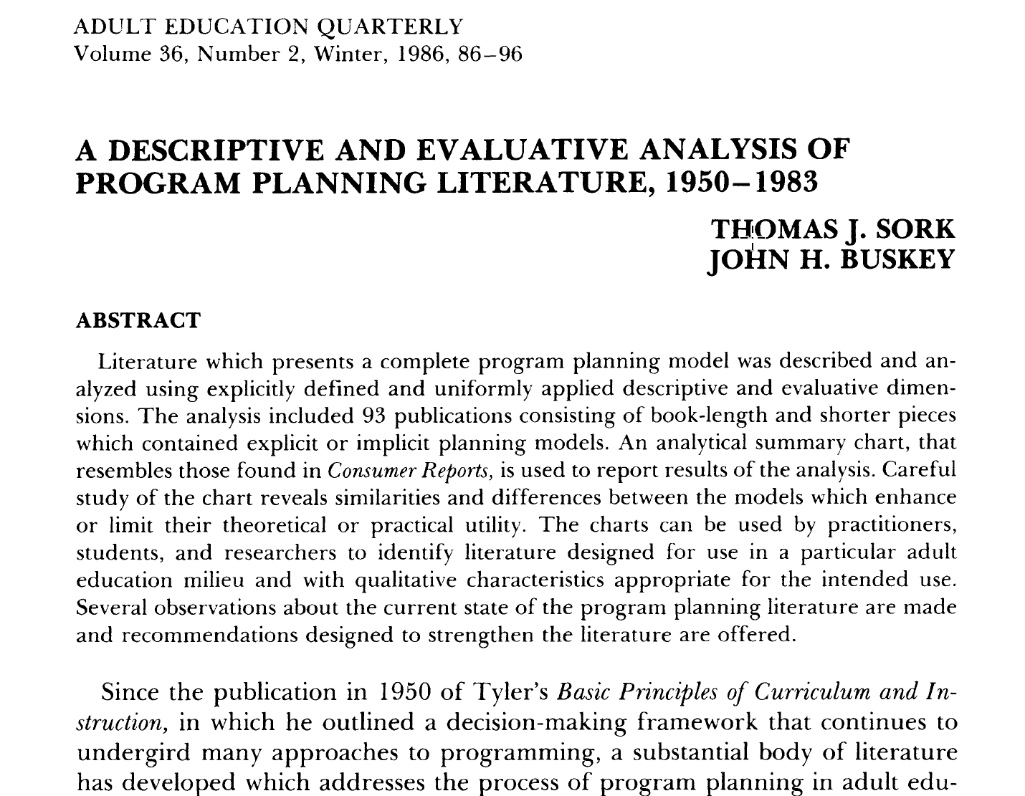

Slide 37
What Sork & Buskey were able to say….
Lack of cross-referencing and absence of cumulative development.
As a whole, literature has low degree of theoretical explanation.
Few books treat planning in a comprehensive fashion.
Models vary more due to contextual differences than substantive differences in process.
Heavy bias toward planning involving face-to-face/group instruction.
Roles played and proficiencies required by those who plan are not addressed in most models.

Slide 38
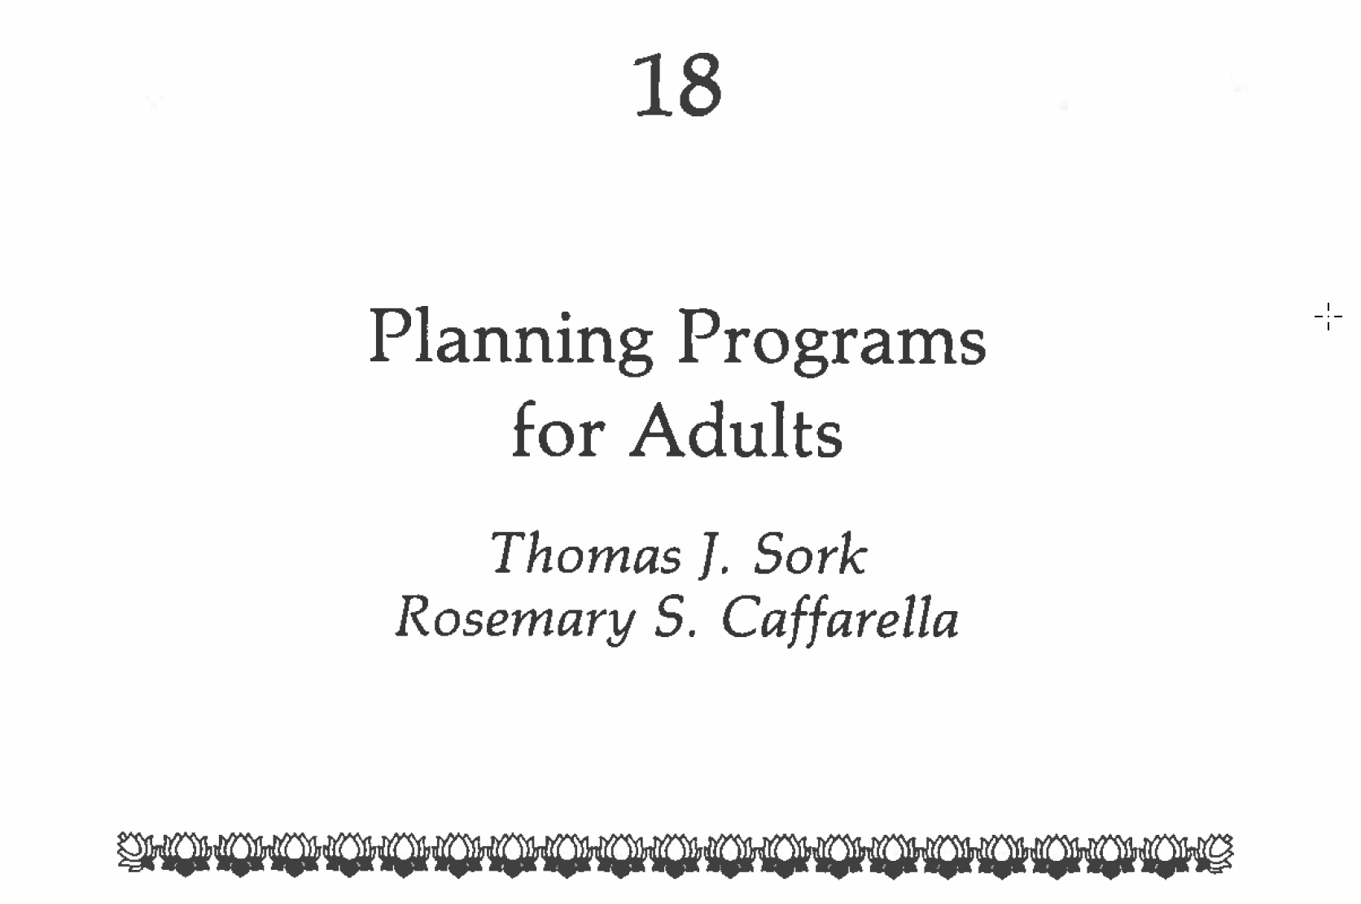
In S. B. Merriam & P. M. Cunningham (Eds). (1989). Handbook of adult and continuing education. San Francisco: Jossey-Bass.

Slide 39
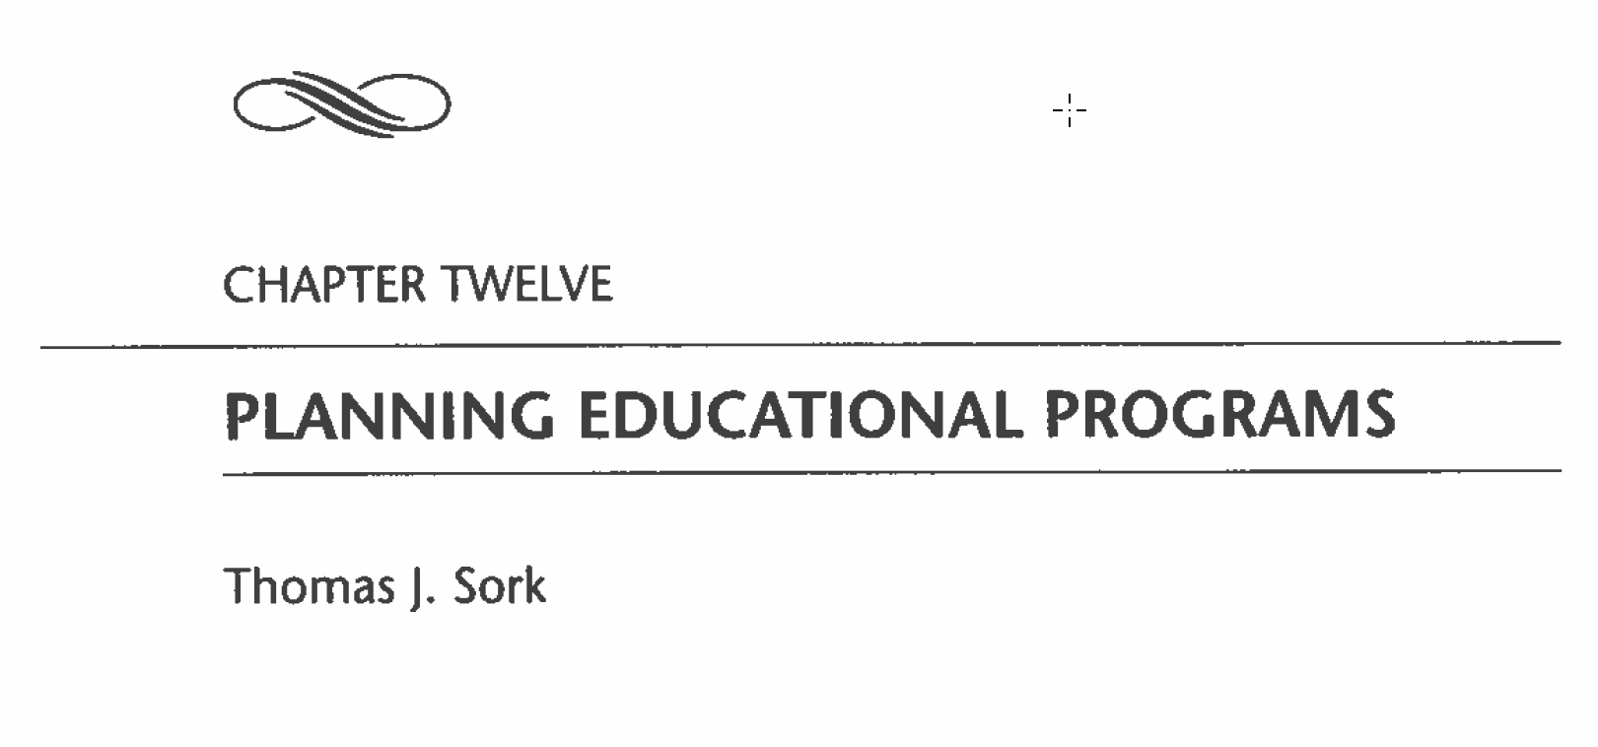
In A. L. Wilson & E. R. Hayes (Eds.). (2000). Handbook of adult and continuing education. San Francisco: Jossey-Bass.

Slide 40
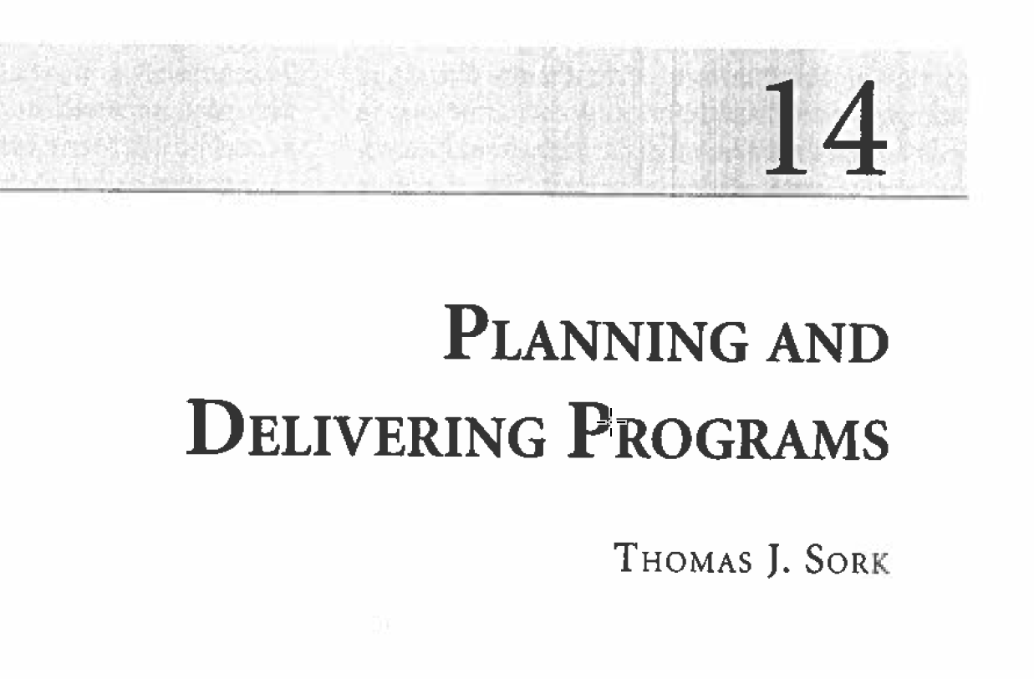
In C. E. Kasworm, A. D. Rose & J. M. Ross-Gordon (Eds.). (2010). Handbook of adult and continuing education. Los Angeles: Sage.

Slide 41
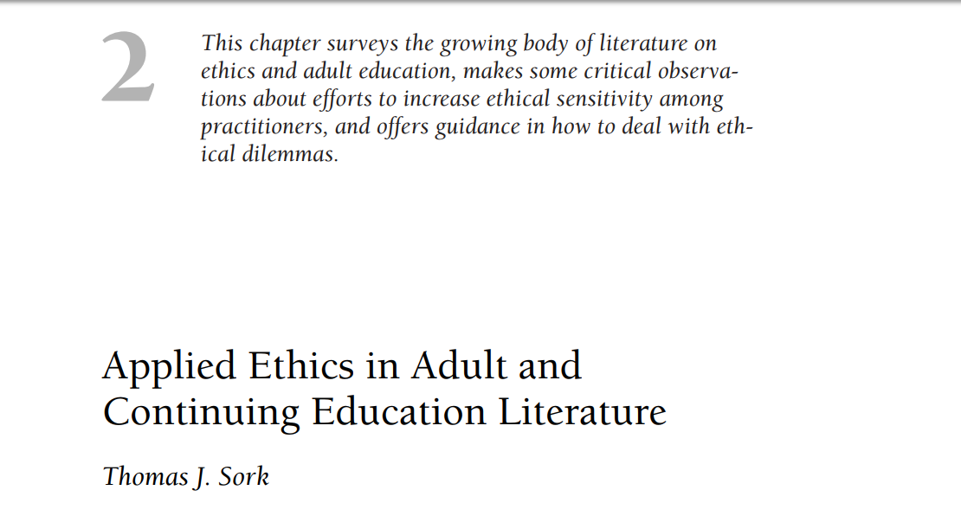
In E. J. Burge (Ed.). (2009). Negotiating ethical practice in adult education (New Directions for Adult and Continuing Education, no. 123). San Francisco: Jossey-Bass.

Slide 42
Questions…

