Slide 1
Conversations
The Kinesthetic Way

Slide 2
Lesson Overview
Review Entrance Slips (Think-Pair-Share)
Trust Circle
Summary of the Article, Important Concepts
Community Building Activity
Questions?/ Exit Slips

Slide 3
Learning Objectives
Students will understand the key points from the assigned reading.
Students will understand the importance of trust and community for meaningful discussions.
Students will be able to relate the themes of this reading to inquiry as a whole.

Slide 4
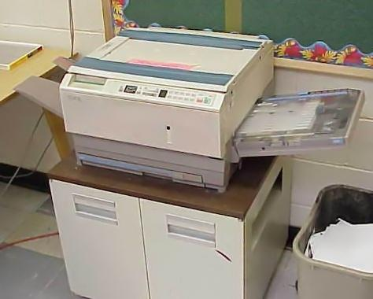
Conversation Concerns
Rushed and not serious
Occur in photocopy rooms and hallways
University professors talk about research
Notes:
http://this-time-and-this-place.blogspot.ca/2011/04/its-342am.html

Slide 5
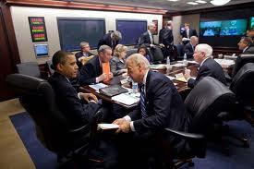
Teachers Scholar Project
developed to “encourage thoughtful conversations”
videotape classes
reflect on teaching with a group of peers
community conversations over different disciplines

Slide 6
The Project
peer nominated teachers from different disciplines
1 year study
regular teaching discussions
class observations

Slide 7
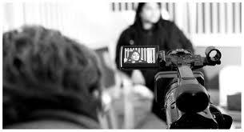
Results Videotape Sharing
familiar with colleagues teaching approaches
context to engage in conversation
teachers test concerns against other’s concerns
Notes:
know that you have read the readings so know that they videotaped teaching sessions and five minute clips were shown to the group

Slide 8
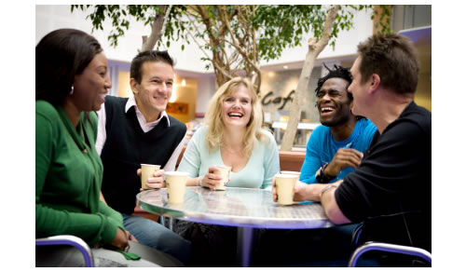
Teaching Narrative
Lack of forums
Discussed the videos.
Discussion led to seeing each others innermost hopes and concerns with teaching.
Same problems described from very different perspectives
Notes:
Brandy

Slide 9
Narrative Cont
Relate to each other’s frustrations from the stories and discussion.
Learn from each other as well as their self.
“deep questioning of our tendency to forget the anxieties and apprehensions harbored behind our students’ sometimes silent and unresponsive faces.”
Notes:
brandy

Slide 10
Looking Back on Experience
Look back on their teaching.
Conversations were more positive focused than factual or student bashing … but why?
Community distinction:
Gemeinschaft = a “we” identity built on trust and shared goals
Gesellschaft = an “I” community

Slide 11
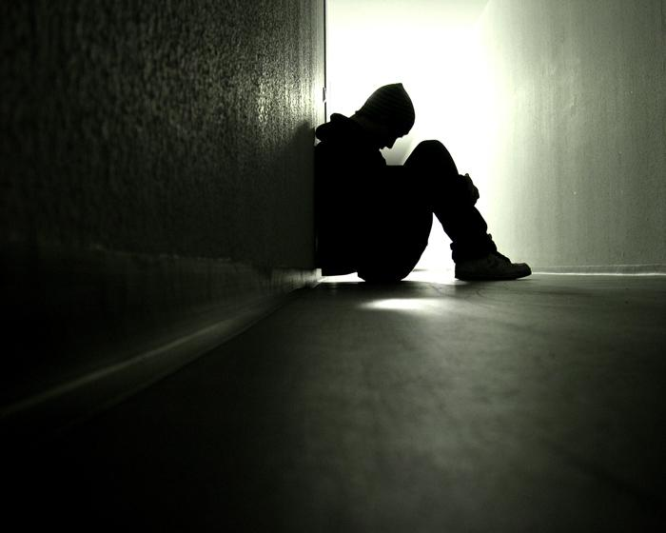
We NOT Me
Gesellschaft:
Job competitiveness & strategy
“Pain of disconnection”
Mutuality broken down
Gemeinshaft:
“Shared connection of being”
Give-and-take conversations
Reflection
Understanding

Slide 12
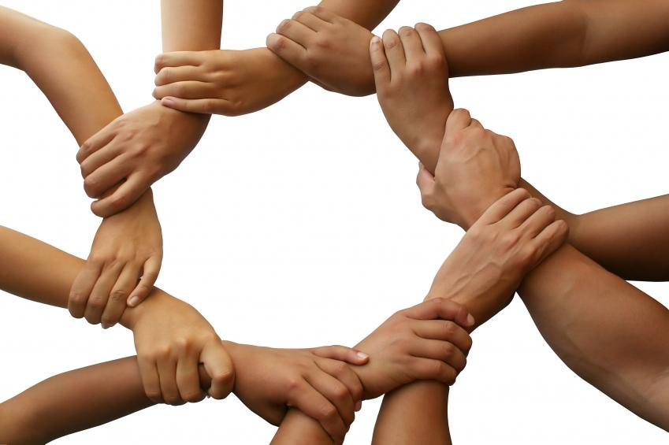
Benefits of Mutuality for Educators
Interdisciplinary as well as intradisciplinary
Transformative
Understanding & Friendship
Shared history … COMMUNITY

Slide 13
“Only by knowing the truth of our own condition can we hope to know the true condition of our students”
Notes:
GAME AFTER THIS!- Lindsay Move your booty

Slide 14
Questions
How do you think creating trust with in conversations and developing communities connects to the notion of inquiry?
Notes:
-feel comfortable talking to others
-a way to share ideas and perspectives
-during inquiry you need to ask questions and get honest responses

Slide 15
Exit Slip
As teacher candidates on your practicum, what are some ways you might try to build trust and a sense of community in your school placement/ with your colleagues?

