Slide 1
4 MAT Cycle of Instruction
Learning Process
Deep Kaur

Slide 2
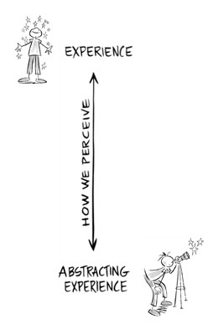
Perceiving the Information
Each student has his/her own perception based on their past experiences
Experience: Providing them personal engagement- sensations, emotions, physical memories; involving them in the learning process as an active member of the learning community.
Conceptualization: The translation of experience in words, pictures or any other form.
Making a connection between experience and conceptualization is crucial to the learning process.

Slide 3
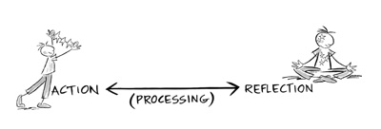
Processing the information
The information gained during perception is processed in variety of ways. Basic process involves:
Reflection: transformation of knowledge by “structuring, ordering, and intellectualizing.”
Action: Application of the information by doing.
Processing encourages the learner to test the ideas in real world and adapt to the situations.

Slide 4
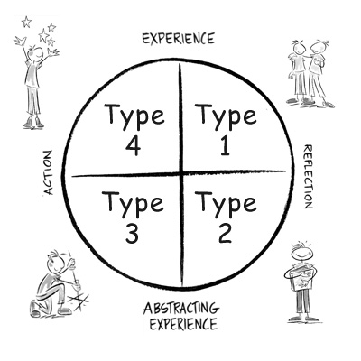
Learning Styles
If?
Doing and feeling to understand the meaning, exploring hidden ideas
Why?
Learning by feeling, emotions, watching, Making associations to personal experiences.
How? Learning by doing, kinesthetic learning, or DIY learning.
What?
Learning by listening and reading: They seek facts and formulate their ideas.

Slide 5
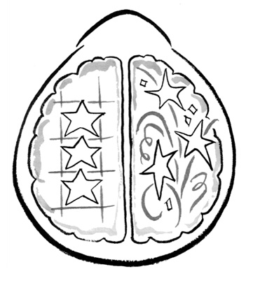
Right and Left Brain
Left
It breaks down the information in structure, sequence, or language
Right
it works to synthesize, provides depth of understanding, helps in artistic expression, solves problems, and recognizes the patterns.

Slide 6
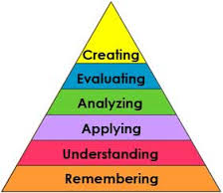
Why we need 4MAT cycle
To reach the higher levels of bloom’s taxonomy, teachers need to train students to use both sides of brain by providing them various opportunities….

Slide 7
Why we need 4MAT cycle
4 Mat cycle of instruction helps teachers to attend all learning styles and to train students to use both sides of brain in order to augment their learning experiences. Based on 4 MAT cycle we can break down our instruction into four different parts

Slide 8
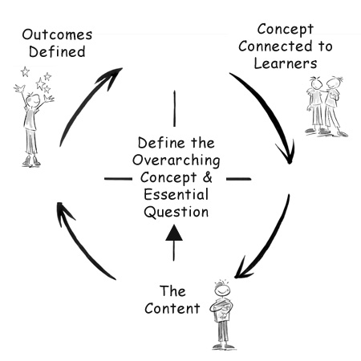
Instruction Breakdown

Slide 9
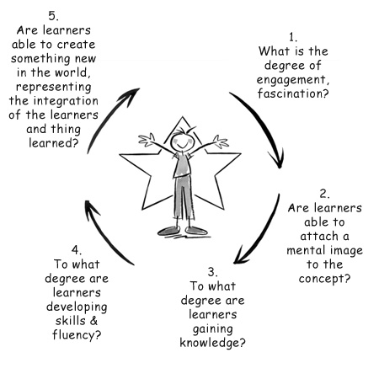
4MAT assessment

Slide 10
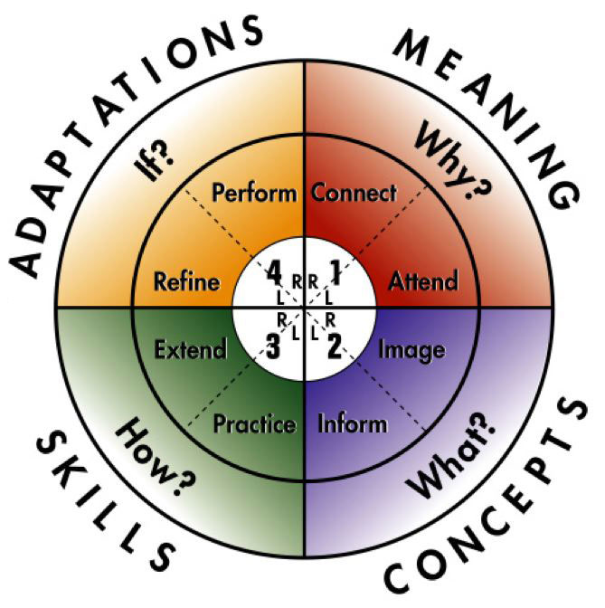
4 MAT Cycle

Slide 11
Thanks for Watching !

