Slide 1
The Learning Platform of Tomorrow

Slide 2
One of the world’s most popular learning management systems (LMS)
We provide an online learning platform for institutions

Slide 3
Our Mission
To empower educators to improve our world
Our Vision
To give the world the most effective platform for learning
Notes:
https://docs.moodle.org/dev/Mission

Slide 4
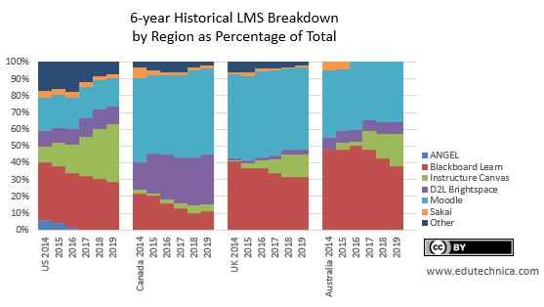
The Competition
Notes:
https://edutechnica.com/tag/market-share/

Slide 5
Notes:
https://philonedtech.com/state-of-higher-ed-lms-market-for-us-and-canada-mid-year-2020-edition/

Slide 6
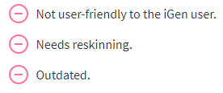
The Problem(s)
Notes:
https://www.learndash.com/why-moodle-is-becoming-irrelevant/
https://www.capterra.com/p/80691/Moodle/reviews/
https://www.trustradius.com/products/moodle/reviews?sr=1&sr=2

Slide 7
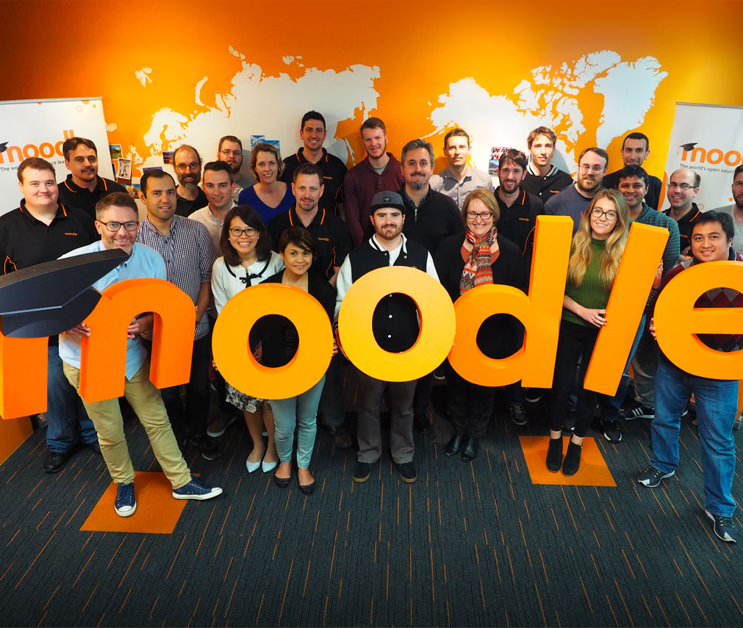
The Team
CEO
Former teacher, instructional designer, and LMS administrator
Deep experience with different LMS platforms
Staff
A group of experienced passionate professionals
International team
Yannick Wong
CEO of Moodle

Slide 8
The Solution
Redesigned UI
Modularity
Integrated SIS

Slide 9
The Solution
Redesigned UI
Modularity
Integrated SIS

Slide 10
The Solution
Redesigned UI
Modularity
Integrated SIS

Slide 11
The Solution
Redesigned UI
Modularity
Integrated SIS

Slide 12
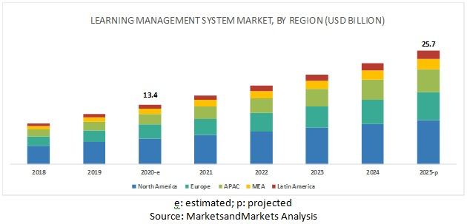
Market Opportunity
Pandemic led to huge boom in the use of e-learning and thus the LMS market
US$13.4 billion industry in 2020
US$25.7 billion industry in 2025

Slide 13
Marketing
Brand Name Recognition
Industry Contacts
Open-Source Platform
Integrated SIS

Slide 14
What We Need
Initial investment of US$20 million
2-year period
Goals:
Ramp up hiring
Procure additional hardware and software technology and tools
Commence marketing

Slide 15
Our Mission
To empower educators to improve our world
Our Vision
To give the world the most effective platform for learning

