Slide 1
Analyst Report: Inpixon
By: Greg Patton
ETEC 522

Slide 2
Introduction
Inpixon is a tech company based out of Palo Alto, California. Their Indoor Positioning Analytics platform is designed to detect and position all active cellular, WIFI, and Bluetooth devices within a building while securing privacy and anonymity. https://inpixon.com/inpixon-jibestream
“Inpixon Indoor Positioning Analytics (IPA) is the first indoor positioning solution and data analytics suite to deliver simultaneous locationing, tracking and analysis for virtually any and every mobile device and asset—all from a single platform.”
https://inpixon.com/wp-content/uploads/InpixonIPA-brochure.pdf

Slide 3
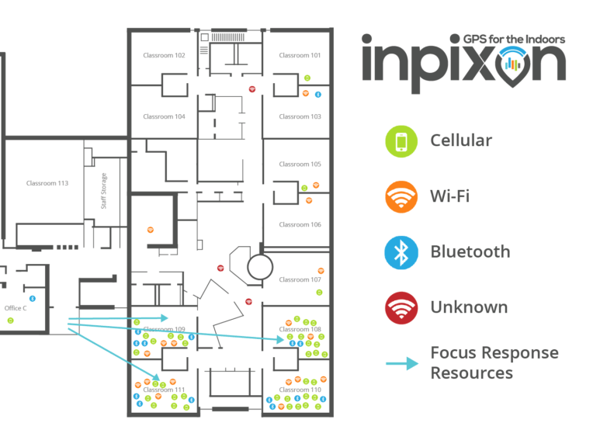
Introduction
Though primarily focused on the business world, Inpixon has delved into education with their "Smart School Safety Network"; technology that will "...be able to identify the location of students, teachers, administrators and visitors within a facility and will send alerts to officials when it detects unknown wireless devices which may, for instance, indicate a trespasser." https://www.inpixon.com/company/news/inpixon-chosen-for-planned-smart-schools-safety-network
What I believe would be interesting to investors is the potential of Inpixon's technology beyond just the safety aspect in an educational setting.

Slide 4
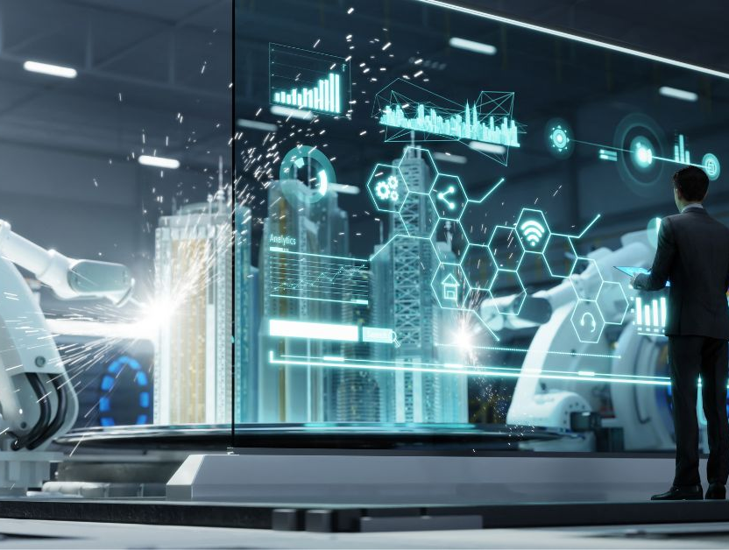
Rationale
As we move farther away from traditional “stand and deliver” classrooms and towards inquiry-based, facilitated learning, it is inevitable that the technology used in the classroom will also transform. Handheld devices, almost ubiquitous now in most high schools, could be on the leading edge of this transformation. This technology, bolstered by faster networks like 5G, will allow students to access more information and at a faster rate than ever before. Schools need to find a way to take advantage of this and use it for both their and the students’ benefit.

Slide 5
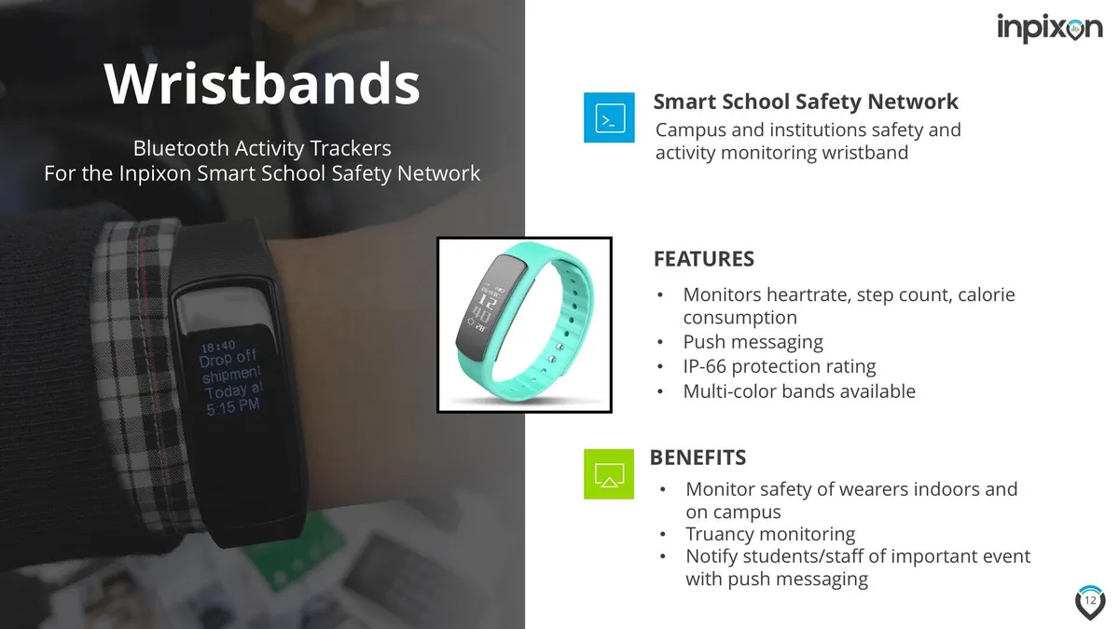
Rationale
With their School Safety Network Wristbands, Inpixon has started to scratch the surface of the potential their technology has in a school setting, yet it will be when their technology is incorporated into handheld devices that Inpixon has the opportunity aid in changing the educational landscape.

Slide 6
Rationale
The three main aspects to this technology that show potential in respects to Education transformation are:
Geofencing
Proximity Messaging
Indoor Navigation

Slide 7
Geofencing
“Use geofences to create a virtual perimeter on a map and target users that cross this virtual boundary. Geofences can be any shape or size and can be set up to trigger alerts or targeted messages when a user enters, exits or dwells within the predefined area.” https://www.jibestream.com/use-cases/geofencing

Slide 8
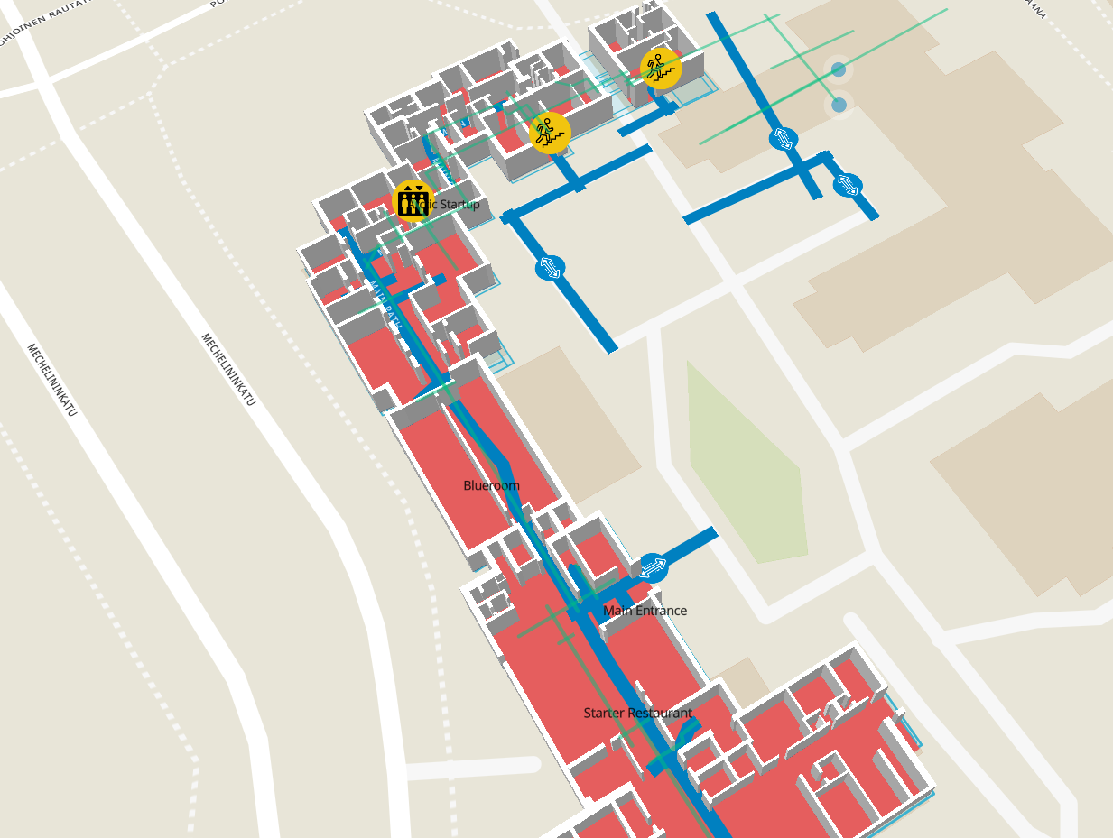
Geofencing
A geofence could be generated around an area as broad as an entire school site, or as narrow as a particular classroom. A geofence around the school would allow administration to know who has entered, or exited, the building and at what time this occurred. Geofenced classrooms would automatically take attendance as students entered the room. A geofence could also be established around an area where access to the network would be blocked.

Slide 9
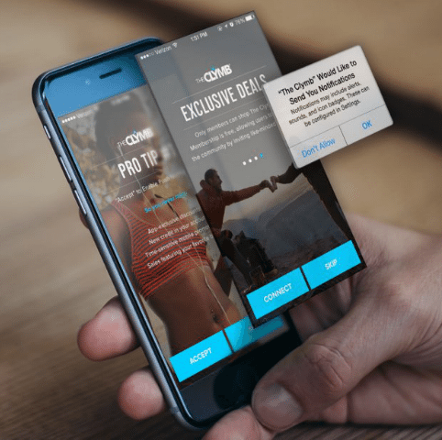
Proximity Messaging
“Trigger messages and build a library of data around the proximity of assets, users and locations. …(U)se this data to deliver hyperlocal content in real-time based on destinations and points of interest around them, such as nearby stores, coffee shops or other relevant spaces.” https://www.jibestream.com/use-cases/proximity-messaging

Slide 10
Proximity Messaging
Once a geofence is triggered, proximity messages like announcements, updated daily schedules with changes, overdue library book notifications, after school/lunch club meetings, athletics schedules, cafeteria menu, and appointments with counsellors, administration or youth care workers could be sent to staff and students. Teachers could also push out assignments and information for class, like videos or articles that could be reviewed at any time.

Slide 11
Indoor Navigation
“Our indoor mapping platform empowers users to navigate between two waypoints on a map or to a particular destination. Our wayfinding algorithm uses speed, weight, and accessibility parameters, along with distance, to generate an optimal travel path.” https://www.jibestream.com/use-cases/indoor-navigation

Slide 12
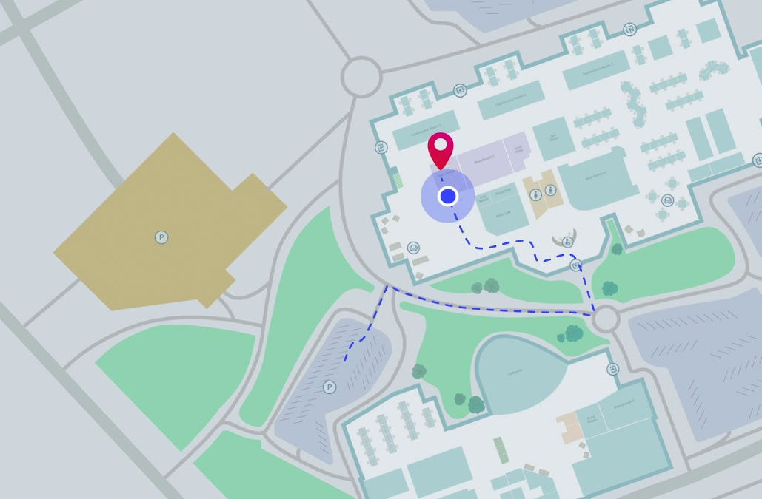
Indoor Navigation
Indoor Navigation would allow students and staff members access to a virtual map of the school, their position, and directions to their destination. This function could also be paired with proximity messaging, so that if there is a sudden classroom change a notification could be pushed to individuals with this information and a navigation route.

Slide 13
Final Thoughts
By allowing the free flow of text materials, be it written assignments, podcasts, videos, and potentially AR/VR/MR lessons, teachers can start to transform their classroom. They become facilitators of learning, helping students with what they have processed and how it relates to the subject matter, rather than lecturers.
The idea of the traditional school becomes redundant; no more bells, roll calls, and announcements. All information is pushed through the student’s preferred personal device, allowing them to choose how they receive their content. The school starts to transform from a facility with conformities into a more open-form community.

Slide 14
Final Thoughts
Inpixon has the history with Indoor Positioning Analytics and knowledge working with the Corporations, Governments, Healthcare, Manufacturing, Retail, Hospitality, and Mining that a move into Education is a viable next step for a company that has positioned itself on the leading edge of this technology. Their Smart School Safety Network and incorporation of a smart wristband shows that they are positioning themselves within the Educational setting. It will be that next step to broadening their technology to encompass more educational aspects that will be an exciting adventure for this company.

Slide 15
References
https://finpedia.co/bin/Inpixon/
https://www.gim-international.com/content/news/inpixon-to-acquire-gps-technology-for-indoor-and-outdoor-positioning-system-2
https://www.inpixon.com/
https://www.inpixon.com/blog/benefits-of-indoor-maps-for-workplaces
https://www.inpixon.com/company/news/inpixon-chosen-for-planned-smart-schools-safety-network
https://inpixon.com/inpixon-jibestream
https://inpixon.com/wp-content/uploads/InpixonIPA-brochure.pdf
https://www.jibestream.com/use-cases/geofencing
https://www.jibestream.com/use-cases/indoor-navigation
https://www.jibestream.com/use-cases/proximity-messaging

