Slide 1

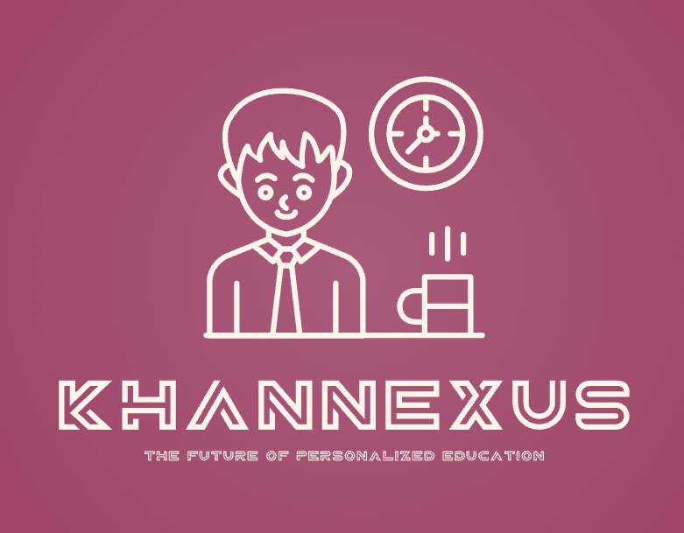
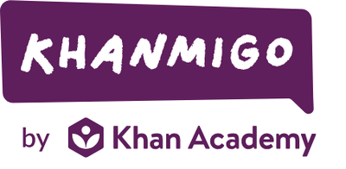
Khanmigo Reimagined: Empowering Student-Centred Learning
A Smart LMS for Educators, Tutors & Therapists
Tim Lee
Director, Khanmigo Initiative

Slide 2

The Problem
Traditional LMS platforms are rigid and impersonal
Lack of support for individualized learning
Provide limited insight into student progress
Educators lack tools needed for course customization and many do not integrate well with third-party tools

Slide 3
The Solution
Designed to be used in both traditional classrooms and online learning
Can also be used by therapists to support children in social-emotional learning
Integrates Khanmigo to provide a personalized AI tutor for each student
Provides in-depth data on student performance and emotional well-being

Slide 4
What Sets KhanNexus Apart?
🎯 Adaptive AI assistant
📊 Real-time learner insights
🔗 Seamless tool integration
🔒 Privacy-first design

Slide 5
Market Opportunity
Global EdTech market: $146B (2022) → $348B (2030)
AI in education:
$4B → $25B by 2030
SEL & mental health tools: $3.3B by 2027

Slide 6

Pilot programs with educators and therapists
Strategic partnerships with industry experts in development
Roadmap to scale across institutions

Slide 7

Join Us in Transforming Learning!
For more information and to partner with us, please visit:
https://www.khanmigo.ai/

