Slide 1
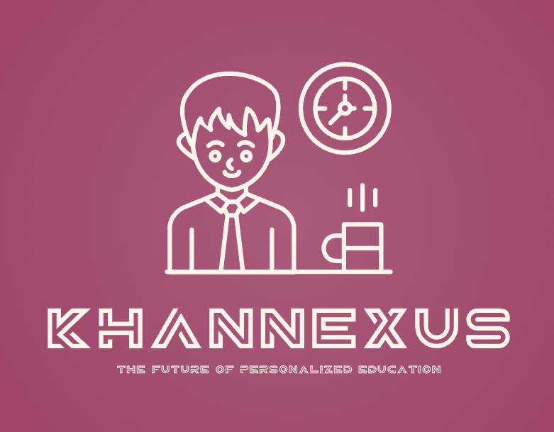
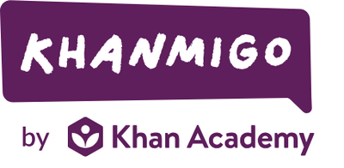
KhanNexus: The Student-Centred LMS
Tim Lee
Director- Khanmigo Initiative

Slide 2
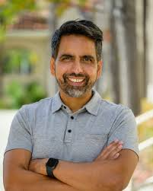
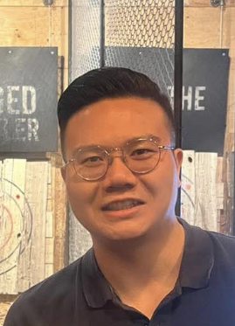
Our Mission
”To empower learners and educators through intelligent, personalized tools that support academic growth, emotional well-being, and social development, and allow every learner to thrive in their own unique way."
Team members
Sal Khan
Founder and CEO
He founded KhanAcademy in 2008 to provide engaging and accessible tutoring to students around the world. Sal’s vision has revolutionized digital education, making high-quality learning resources available to millions of students and educators worldwide.
Tim Lee
Director of the Khanmigo Initiative
Prior to joining KhanAcademy, he was a teacher and program director for online and hybrid learning in Richmond for several years. With his detailed knowledge on remote learning and traditional learning management systems, he joined the Khanmigo Initiative to ensure KhanNexus has an accessible and student-centred design.

Slide 3

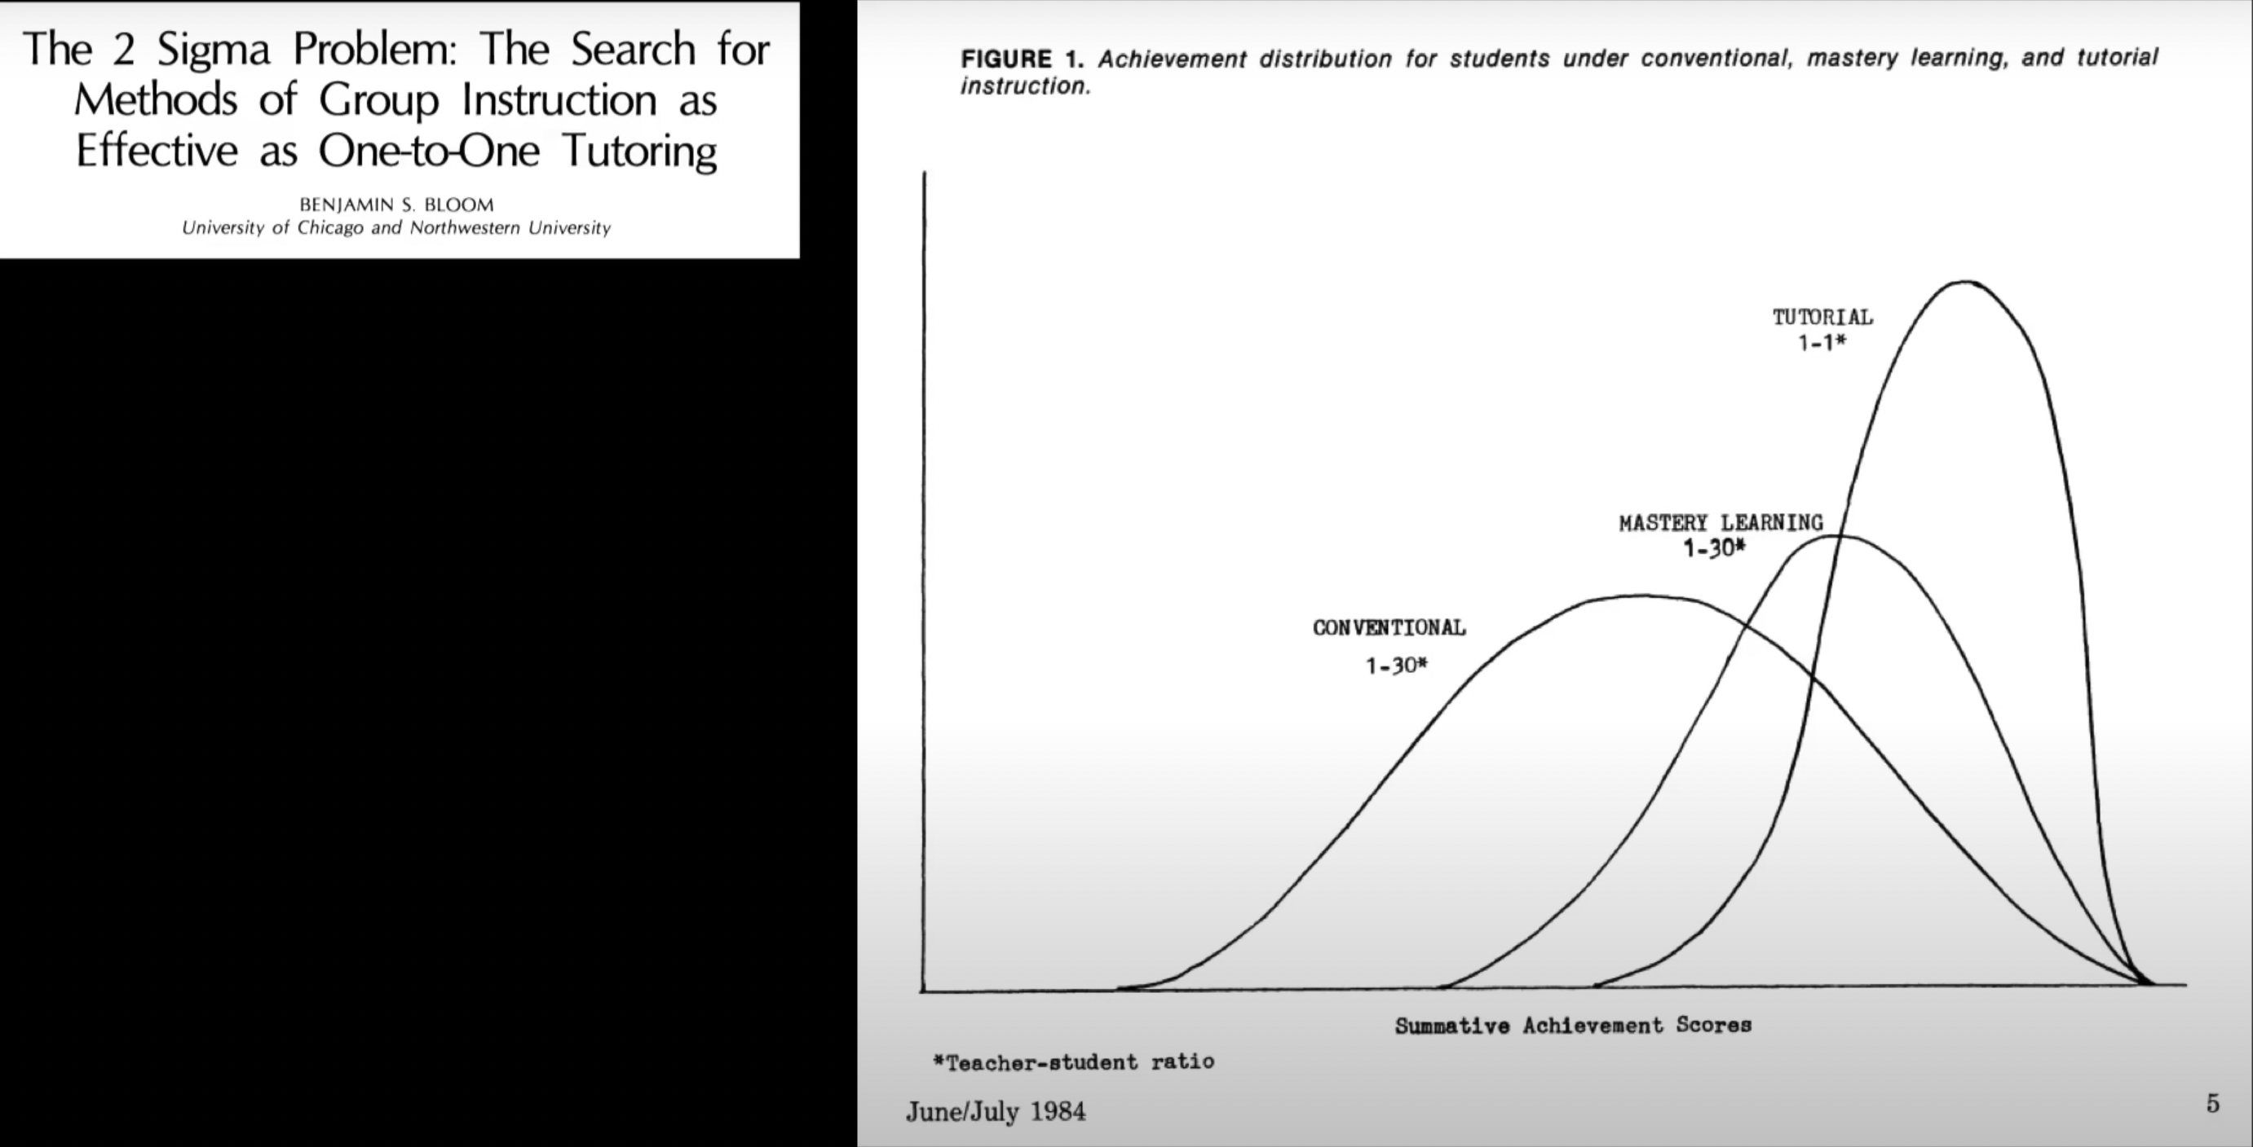
The Problem
- Traditional LMS platforms are rigid and impersonal
- Do not provide analysis on student performance
or offer insights on patterns and trends
- Lack tools to customize courses and many do not
integrate with third-party tools

Slide 4
The solution

Slide 5
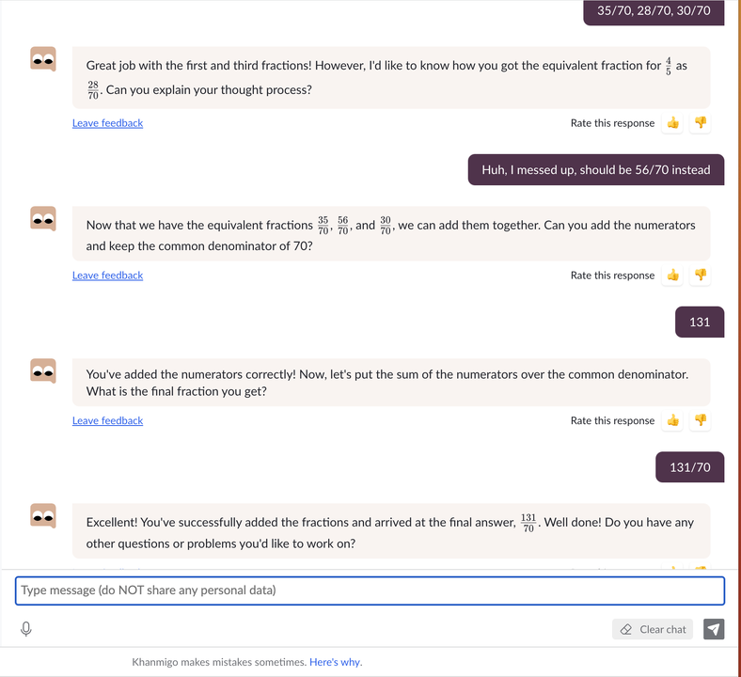
Socratic Method of teaching

Slide 6
Target users
Educators and students in K-12 and higher education
Tutors in private and institutional settings
School districts and government institutions
Therapists or counsellors working in schools or supporting neurodiverse learners

Slide 7
Key features: Students
- Khanmigo AI provides both academic and emotional support to students
- Offers step-by-step guidance and asks probing questions rather than simply giving answers
- Provides personalized learning and feedback based on past performance
- Privacy-first design ensures a safe and supportive learning environment
- Integrates interactive and engaging content
- Supports neurodivergent students

Slide 8
Key features: Educators
- Uses AI to analyze student data and provide detailed insights into student progress and emotional well-being
- Offers AI tools to help create lesson plans, worksheets, or rubrics
- Easily customizable courses and seamless integrations with existing tools
- Khanmigo provides both emotional and technical support for educators
- Allows for collaboration with therapists and school counselors

Slide 9
Key features: therapists & School counselors
- Can be used as a collaborative planning tool with educators and students
- Real-time emotional monitoring
- Analyzes behavioural patterns and creates customizable support plans for each student
- Supports executive functioning skills
- Provides a resource library for SEL and mental health

Slide 10
Market landscape and analysis
KhanNexus sits at the intersection of several markets and subsectors.
EdTech
- Projected to rise from $146B (2022) → $348B (2030)
- Growth rate of 13.6%
AI in Education
- Projected to rise from $4B → $25B by 2030
- One of the fastest growing subsectors in Edtech
SEL
- Estimated to to grow to $3.3B by 2027
- Schools and institutions are increasingly investing in tools that support social-emotional learning
Digital Therapeutics in Education
- Emerging subsector that includes tools that support neurodiverse learners
- Few platforms offer both academic and emotional support

Slide 11
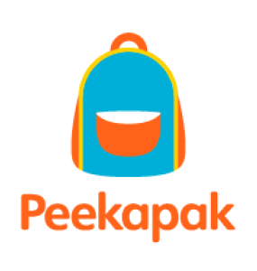
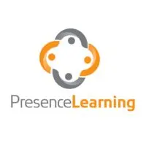
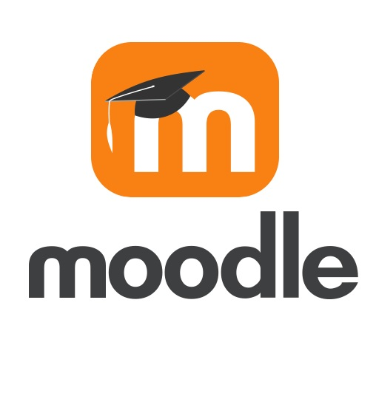

competitors
Type of Educational Tools | Competitors | What Sets KhanNexus Apart
General LMS | Canvas, Google Classroom | AI personalized learning, SEL integration, data analytics
AI Tutors | Squirrel AI, Century Tech | Designed to be used both inside and outside the classroom
SEL Platforms | Peekapak, 7 Mindsets | Provides both academic + emotional support
Therapy Tools | PresenceLearning, Mightier | Provides both academic + emotional support

Slide 12
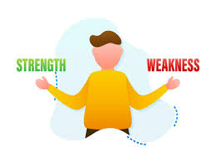
SWOT ANALYSIS
Strengths:
- Mission driven and proven brand
- Student-centred design
- AI-powered personalization
- Cross-disciplinary use
- Highly scalable
Weaknesses:
- Early-stage development
- Resource intensive
- Dependance on partnerships
- Concerns over AI

Slide 13


SWOT ANALYSIS
Opportunities:
- EdTech market is projected to grow to $348B by 2030
- Increasing emphasis on SEL and adoption of SEL tools
- First tool to provide both academic and emotional support
- Potential for global reach
Threats:
- Competition from established LMS platforms
- Funding challenges
- Privacy and compliance risks
- Concerns over AI

Slide 14
Subscription-based service
KhanNexus Subscription Plans
Plan | Price | Target Audience | Key Features
KhanNexus Core | FREE | Individual learners, parents, educators | Basic AI tutor, progress tracking, forums, SEL check-ins
KhanNexus Pro | $15/month or $150/year | Educators, tutors, therapists | Unlimited tutoring, learning paths, SEL tools, analytics
KhanNexus Collaborate | $99/month or $999/year | Tutoring centers, therapy practices | Team accounts, shared profiles, case management, scheduling
KhanNexus Enterprise | Custom Pricing | Schools, districts, therapy networks | Unlimited users, API access, compliance support, training

Slide 15

Growth plan
Year 1: Pilot and Funding
Year 2: Product Expansion and Early Adoption
Year 3: Market Penetration and Brand Building
Year 4: Institutional Scaling and Impact Measurement
Year 5: Global Expansion and Sustainability

Slide 16

The ask
We are seeking:
$1M in seed funding to develop and pilot KhanNexus.
Strategic partnerships with school districts and EdTech investors.
ROI:
Scalable subscription model for schools and tutoring centers.
Licensing opportunities for therapists and SEL organizations.
Long-term data insights for educational research.

Slide 17
Join us in transforming learning

Slide 18
References and sources
Bloom, B. S. (1984). The 2 sigma problem: The search for methods of group instruction as effective as one-to-one tutoring. Educational Researcher, 13(6), 4-16. https://doi.org/10.3102/0013189X013006004
EdSurge. (2023). The rise of AI in education: Opportunities and challenges. Retrieved from https://www.edsurge.com
EdTech Digest. (2024). Top trends in EdTech: AI, SEL, and hybrid learning. Retrieved from https://www.edtechdigest.com
Grand View Research. (2023). Artificial intelligence in education market size, share & trends analysis report. Retrieved from https://www.grandviewresearch.com
HolonIQ. (2023). Global education technology market size and forecast. Retrieved from https://www.holoniq.com
Khan Academy. (n.d.). Our mission. Retrieved August 3, 2025, from https://www.khanacademy.org/about
Latterly. (2025). Khan Academy marketing mix 2025: A case study. https://www.latterly.org/khan-academy-marketing-mix/
MarketsandMarkets. (2023). Social and emotional learning (SEL) market by component, type, end user, and region – Global forecast to 2027. Retrieved from https://www.marketsandmarkets.com
***All images were sourced from Microsoft Powerpoint or Google Image Search and the KhanNexus logo was created using Logo.app***

Slide 19
reflection
AI Usage:
I used AI to help with market research and to make my presentation slides more visually appealing. I found that using AI was an efficient way to gather data and trends in the current market and to provide additional sources that I could reference for my assignment. In addition, using AI design ideas from Powerpoint allowed me to reformat my presentation and make the slides more clear and aesthetic. I also used AI to help create the various tiers in the subscription plan and to help check my reference list for any mistakes in formatting.

Slide 20
reflection
Strengths
- My venture provides a service that is not yet available (a learning management system that provides personalized tutoring as well as social-emotional support)
- Mission aligned and passionate team
- Venture fits within several fast-growing markets
- Included a detailed analysis of market landscape, competitors, and a SWOT analysis
- Provided a detailed growth plan for the foreseeable future
- Established credibility as an experienced teacher and used personal experience to explain the development of KhanNexus
Weaknesses
- Since KhanNexus is a reimagined venture, there currently no deliverable product
- Lacks user reviews and has not been optimized through user feedback
- Does not include a detailed financial ROI plan for investors
- Not enough detail on the technical feasibility of KhanNexus
- Could be more transparent about how user data is stored and protected

