Slide 1


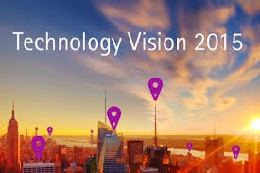
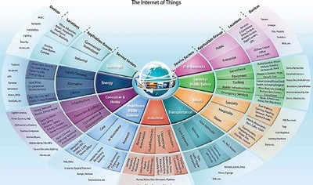
How I became a zombie while trying to keep up
Play Loud
https://www.youtube.com/watch?v=r8JzYC-HCHk

Slide 2

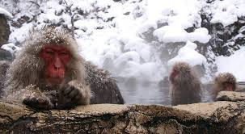
“At present, however, it seems to me that the computer is not leading to a new kind of orality, but rather to an increased emphasis on visual communication.” (Bolter, Preface, Writing Space, 2nd Edition, 2001)
I went to Japan, taught English and skied a lot at Sugadaira Mountain. It was 1992. I didn’t have Internet. I wrote letters home. I waited patiently for letters from home. I voraciously
read the English language Japanese newspapers.
empty spaces
https://www.youtube.com/watch?v=_FUmfX4GKAY
This Quotation makes me think of the blind, and of their experience of digital technology.

Slide 3
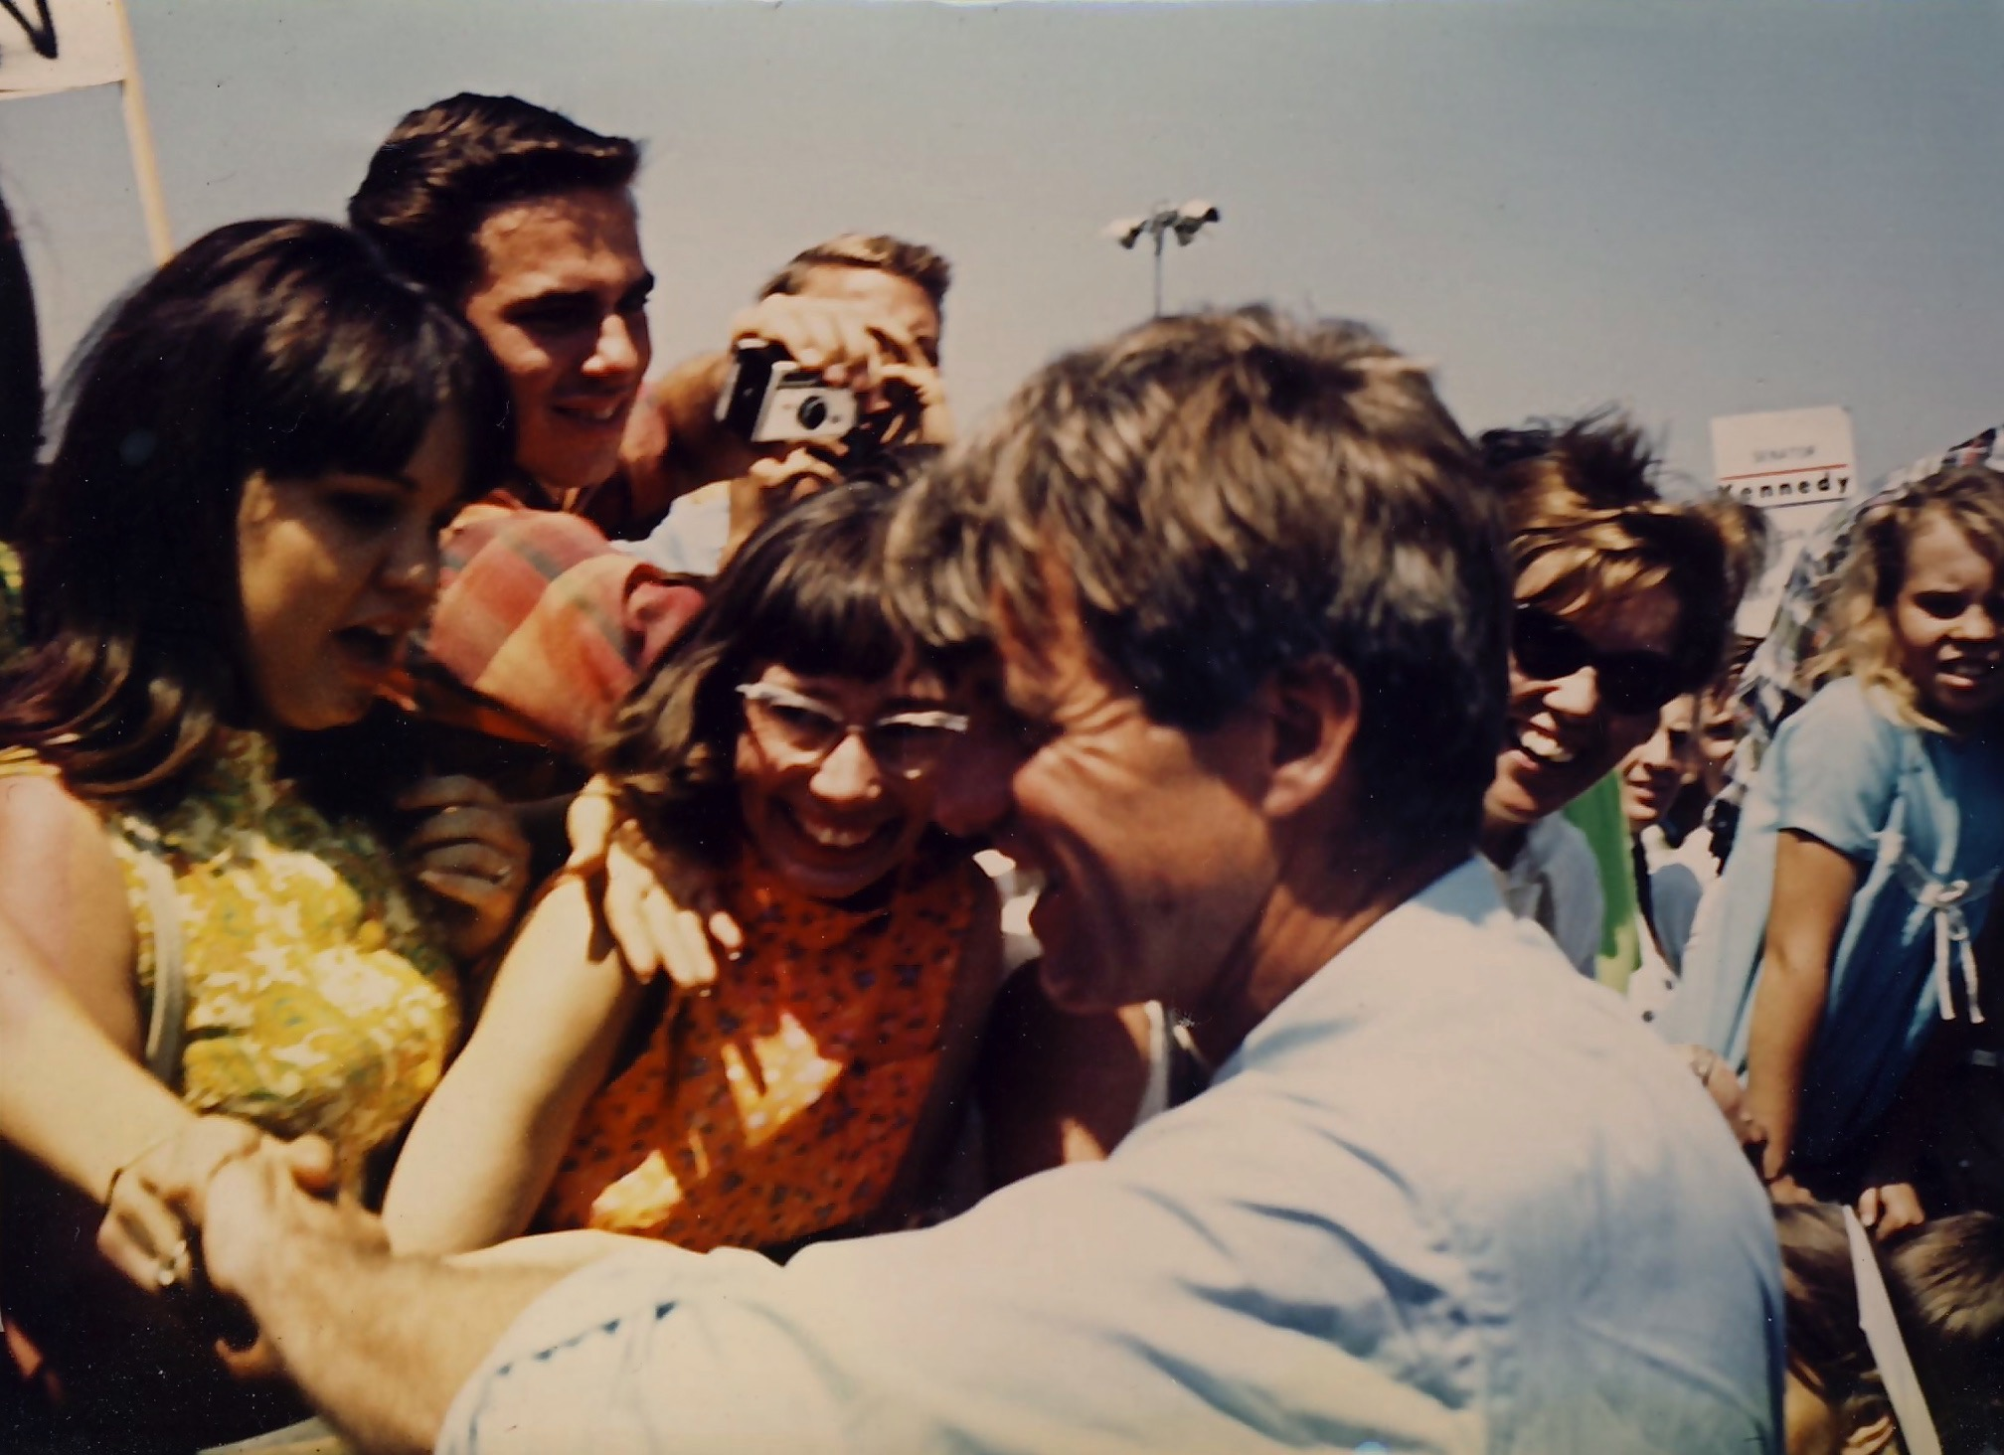
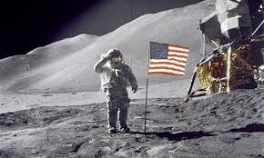
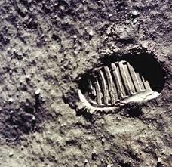
In 1968, Robert Kennedy was assassinated. Just before that my family went to see him at the Airport.
My dad took this photograph
This woman with the sunglasses is my mom
The next summer, in July of 1969, men landed on the moon. We were dreaming of becoming astronauts. As is true today, much was happening with
politics, and with technology (and astronauts).

Slide 4
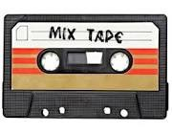
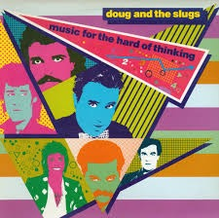
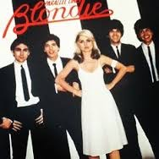
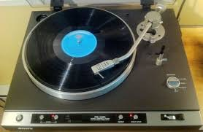
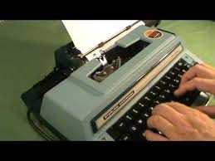
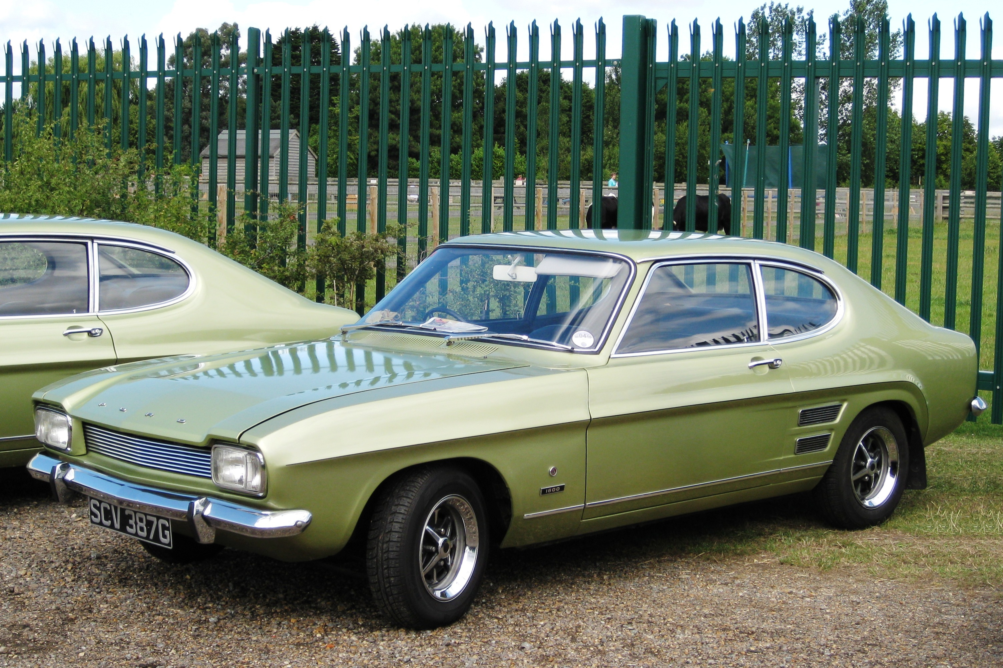
“Your generation will experience the greatest changes in Technology the world has ever seen.”
https://www.youtube.com/watch?v=StKVS0eI85I
someone said this to me sometime in the 1980s. it was probably that forward thinking, grey-haired professor of political science.
This was my car in 1984
this is the tape I played in my car

Slide 5
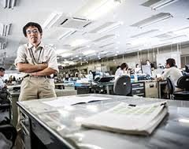

I had a 1988 Apple Classic
No hard drive
No internet
From 1992 to 1995
I lived in Japan
It was a low-tech teaching life

Slide 6
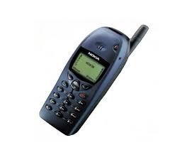
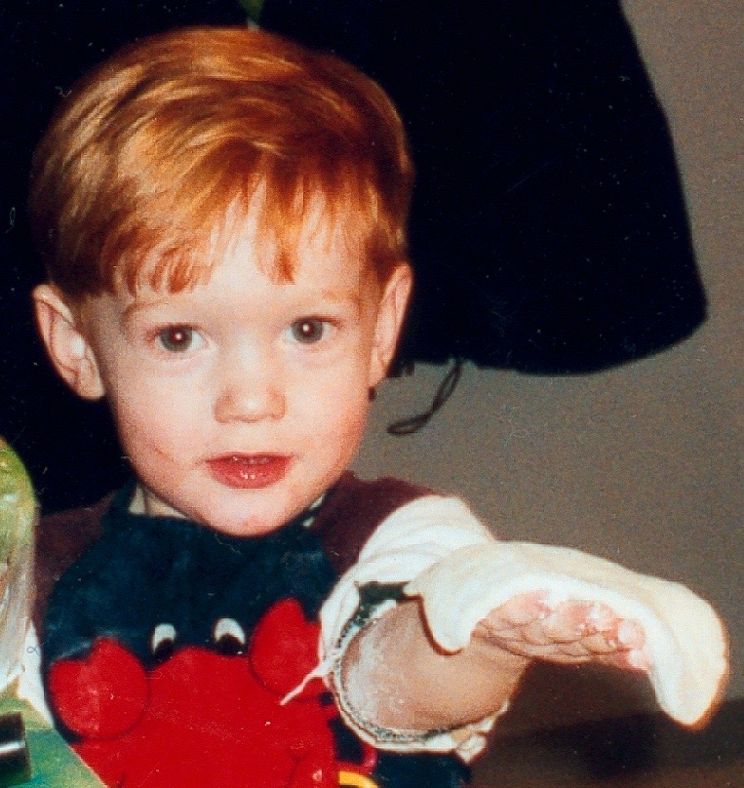
and in 1998, I bought my first new computer. . .
After Japan . . .
I bought my first cell phone.
. . . my first son was born in 1997
things are easier now (2015) when you get a new mac
but Nanosaur was fun

Slide 7
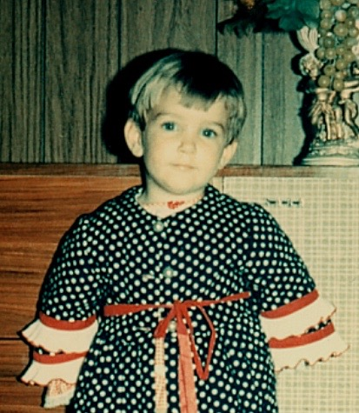
“
“The marker (= >p. 23) following a sentence indicates that the reader can finds a relaled discussion on page 23. This is meant to be a printed version of a hyperlink, which seems to me appropriate for a book on hypertext.
Richard Grusin and I first used the technique in Remediation. There is nothing radical about this technique of course, and it seems odd to me that a system of internal references is not used more often in contemporary books.”
(Bolter, Preface)
me
(= > Slide 3)
at
3

Slide 8
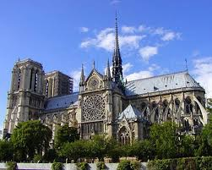
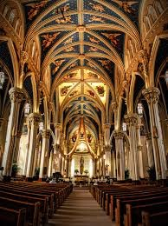
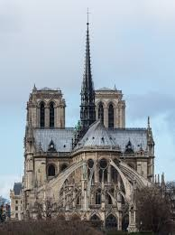
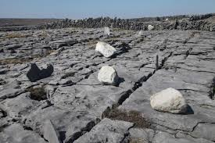
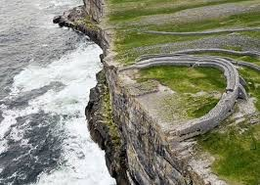

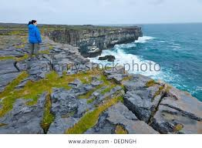

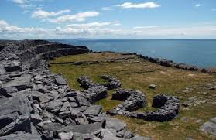
I think we feel superior to our ancestors, but I also think this is fallacious consciousness.
My Response to Jay Bolter’s exploration of Victor Hugo’s novel, Notre Dame in chapter one of Writing Space
I would rather live now than before because I think I will experience less physical pain than my ancestors, but in many ways I think their lives were richer .

Slide 9
“Writing initiated what print and computers only
continue, the reduction of dynamic sound to
quiescent space. the separation of the word from
the living present. Where alone spoken words can
exist.” (p. 81, Ong)
The computer has evolved, and it is no longer a dormant space.
Digital technologies are always seeking to satisfy the
speed and imagination that pour forth from human
minds. They increasingly represent “the living present”.

Slide 10
works Cited:
Bolter, David Jay, Writing Space, 2nd Edition, Routledge, New York, 2001, print
Ong, Walter, J., Orality and Literacy, Routledge, New York, 1982, print.

