Slide 1
Git Hayetsk Wednesday, February 24th Talking Stick Festival Git Hoan Saturday, March 5th Coastal First Nations Dance Festival
Avery Palmer

Slide 2
Talking Stick Festival
This year marks the 15th anniversary of the Talking Stick Festival
This festival displays Indigenous performance and art from a variety of artists.

Slide 3
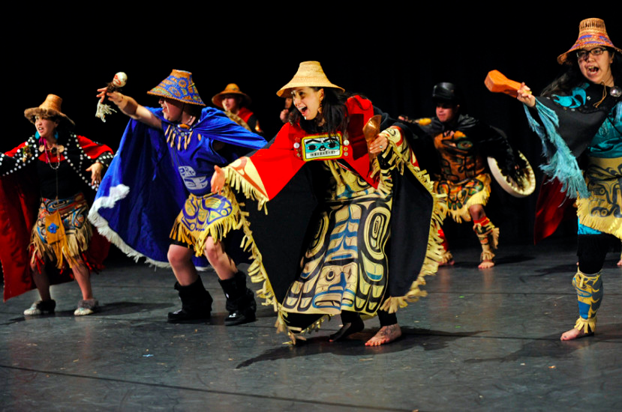
Git Hayetsk
Mike and Miquel Dangeli co-lead this dance group comprised of Northern and Northwest coast nations of the Sm’algyax speaking people.
The name of the group is in the Sm’algyax language and translates to the people of the copper shield
Songs and dances are a mixture of contemporary and ancient

Slide 4
Witnessing – Git Hayetsk
The space at the Roundhouse Community Center
Each piece was introduced individually. The meaning of the piece, where it came from and other background information was provided prior to the performance.
The Photography
The Trickster
Victory Song
Notes:
Background information is very important. Acknowledging where the piece originated from
Talk about the girl from off the street who loved the talks about each piece prior to the performance. “Allowed her to visualize and make connections to the introduction throughout the performance.”
Photographer =
Started with fake camera to take pictures of the canvases covered with black cloth held by the dancers
Took picture of the canvases to reveal pictures taken by Benjamin Alfred Haldane. Pictures taken one by one to reveal three pictures in total that were held by dancers. The photographer then came out with a real camera. This dancer then proceeded to take pictures of and with the audience.
The piece was introduced as bridging the traditional and the contemporary. Which is an important concept in this day and age. I won’t talk more about this as it is what I wrote my paper about.
Trickster:
We were warned before this piece had even began that the trickster may be playing his games with the audience. One dancer came out with a beautiful head dress that had a blue bird with a beak that was able to open and close at the performers wishes.

Slide 5
Coastal First Nations Dance Festival
The Coastal First Nations Dance Festival is put on each year by the Dancers of Damelahamid in partnership with the UBC Museum of Anthropology in Vancouver
This festival celebrates the work of Indigenous peoples of the northwest coast of North America including British Columbia, the Yukon, Alaska and Washington State.
International groups have been invited from New Zealand and Australia

Slide 6
Git Hoan
Git Hoan means people of the Salmon. This group was re-formed in 2002 after originally forming in 1996 and is based out of Washington State.
The members of Git Hoan are from three main tribes in Southeast Alaska, the Tsimshian, Haida and Tlingit.
The group is lead by David Boxley who is a carver and culture bearer.

Slide 7
Witnessing - Git Hoan
Photo is of the Git Hoan finale at the Coastal First Nations Dance Festival at the Museum of Anthropology at UBC Vancouver 2016.
Honour Song
Beaver song
For Ravens

Slide 8
Stereotyping and Protocol
“In the experiences shared with me by other dancers, as well as those that I have faced in my own practice, it is strikingly common to be confronted by preconceived notions suggesting that our style of dance is a “tradition” in the most over-simplified sense of the term. In other words, all the songs and dances are thought to be old, unchanged, and unconsciously performed in set routines without relevance to the present. These stereotypes discredit the work of Northwest Coast First Nations dance artists—dance group leaders, composers, and choreographers—who are actively producing dance group performances that critically engage with pressing political issues within their communities both nationally and globally.” – Dr. Mique’l Dangeli
“Protocol governing rights to songs and dances is entrenched in local politics—family, clan, community, and Nation—and informs how their performance engages with wider provincial, national, and international politics.” - Dr. Mique’l Dangeli
Notes:
Think about these two passages throughout my witnessing of both performances
I feel that stereotyping performances is a topic that needs discussing. Especially to credit the composers of contemporary dance group pieces.
I chose the second quote because acknowledging where each piece came from and the story behind it was a common theme of both performances.

Slide 9
Reviews
“Other performances involved masks that opened their eyes to symbolize ancestral spirits and animal masks that could clap their beaks together to make sounds and stick out their tongues. Such innovative masks indicate how cultural heritage of the Indigenous are not being merely passed on to younger generations, but how they are being actively transformed and integrated into their new perspectives on their cultural traditions.” - Ubyssey
Notes:
I thought talking about how the traditions are staying true and passed down, but how sometimes they are transformed
I liked that she talked about contemporary indigenous practice but I’m not sure if it was the best wording and example. I could be wrong and don’t know enough about traditional Indigenous dance to say more on the comparison between contemporary and ancient.

