Slide 1
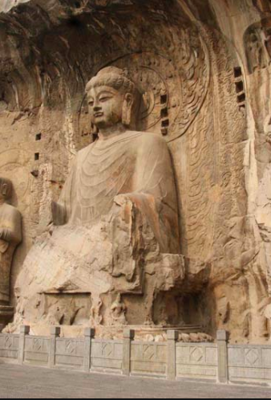
Decolonializing the Digital Humanities
for FNIS 401
(February 26, 2018)
Allan Cho
Digital Humanities Librarian

Slide 2
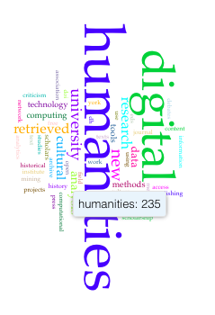
Outline for Today
1. Defining DH
2. Exercise
3. Challenges
4. De-colonialize DH?
Notes:
2

Slide 3
Part I
Defining Digital Humanities
Notes:
3

Slide 4
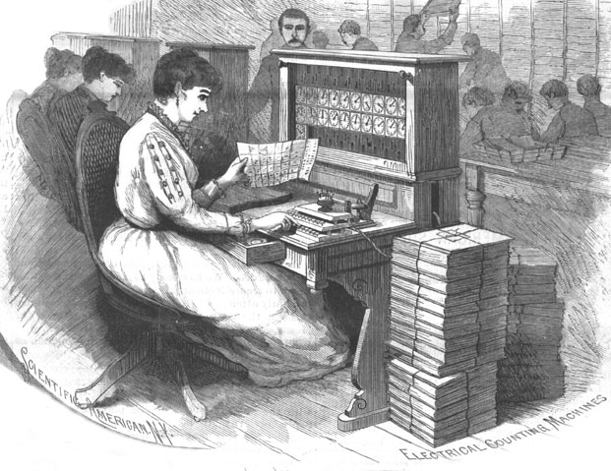
Crisis in the Humanities? Not with DH
A crisis in the humanities?
The central virtue of a liberal education is that it teaches you how to write, and writing makes you think
DH integrates use of technologies, new ways of learning, and thoughtful analysis of tools that can be used outside of the classroom
Notes:
4

Slide 5
What is (are) Traditional Digital Humanities?
A community of practice combining technology with humanistic inquiry.
- Wikipedia
The development, exploration, and evaluation of computer-based technologies and resources for enabling the pursuit of research questions in the humanities.
- Susan Brown

Slide 6
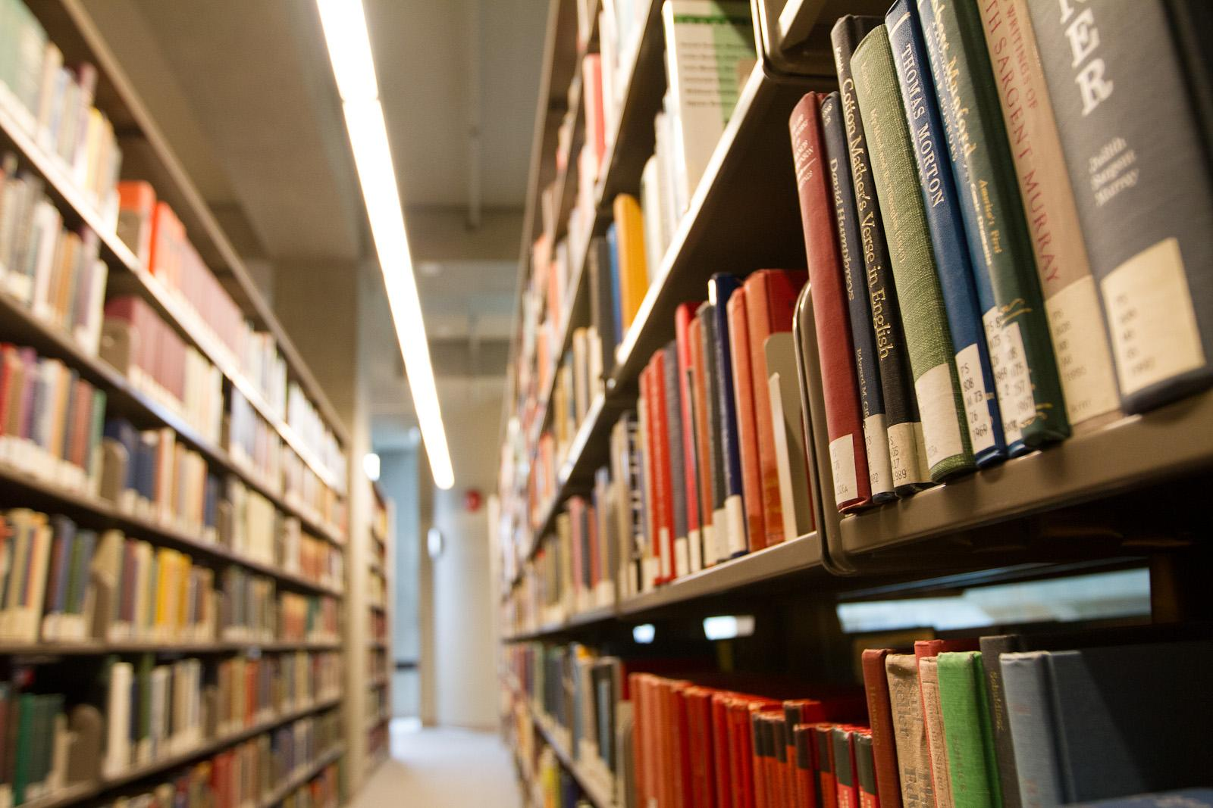
How did we access information in the past?

Slide 7
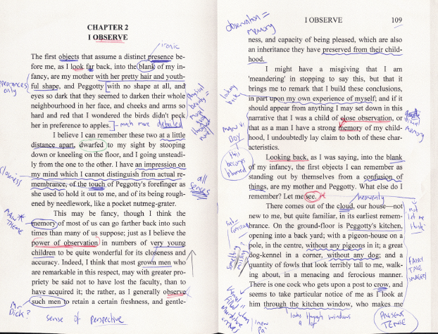
How Do (we) Humanists Read?
In the past . . .
Traditional close reading is the careful, sustained interpretation of a brief passage of a text.
The close reading of a text became a fundamental method in literary criticism in the 20th century

Slide 8
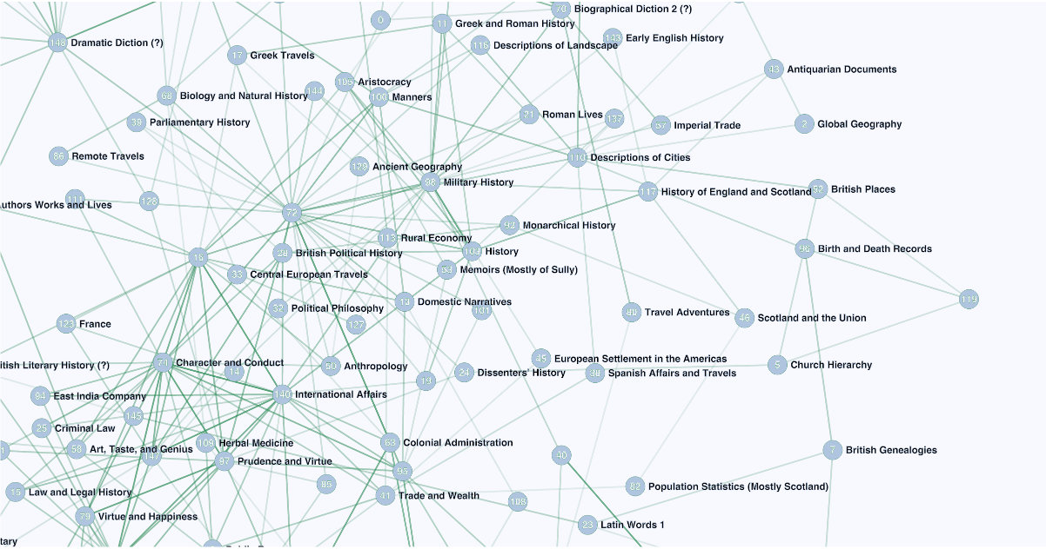
Text Analysis With DH
“Distant reading” refers to a professional reading method that relies heavily on computer programs
Uses big data analytics for the purposes of literary scholarship
Franco Moretti
Notes:
With the help of other academics and data specialists, Moretti has developed a system of using computers to analyze novels as raw data. While computers can't 'read' and understand a novel in the way people can, they are very good at searching for specific information you give them and finding patterns. They can measure sentence length, structure, and lexicon, and they can give a scholar patterns of data to analyze. In this way, distant reading is more of a practice than a literary theory.
For example, Moretti put the titles of 7,000 British novels published between 1740 and 1850 into his computer. He then had the computer count the words of each title, and compare the averages. The computer found that as time went on, the titles grew shorter. In 1740, the average novel had a title of twenty-five words. By 1850, that had shrunk to a much more manageable eight words.
It's natural to wonder 'so what?' when you hear that. On its own, that information is little more than a piece of trivia. However, Moretti took this information and looked into what else changed at the same rate as titles, and he found an answer: the market for books.

Slide 9
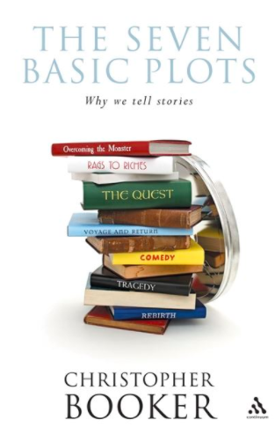
Man versus Machine
Machine learning algorithms?
Or human subject expertise?
Self-driving car or . . . ?
Notes:
With the help of other academics and data specialists, Moretti has developed a system of using computers to analyze novels as raw data. While computers can't 'read' and understand a novel in the way people can, they are very good at searching for specific information you give them and finding patterns. They can measure sentence length, structure, and lexicon, and they can give a scholar patterns of data to analyze. In this way, distant reading is more of a practice than a literary theory.
For example, Moretti put the titles of 7,000 British novels published between 1740 and 1850 into his computer. He then had the computer count the words of each title, and compare the averages. The computer found that as time went on, the titles grew shorter. In 1740, the average novel had a title of twenty-five words. By 1850, that had shrunk to a much more manageable eight words.
It's natural to wonder 'so what?' when you hear that. On its own, that information is little more than a piece of trivia. However, Moretti took this information and looked into what else changed at the same rate as titles, and he found an answer: the market for books.

Slide 10
“Methods” of DH
Enhanced Critical Curation
Augmented Editions and Fluid Texts
Big data
Distant/Close, Macro/Micro reading
Cultural Analytics, Aggregation, and Data-Mining
Visualization and Data Design
The Animated Archive
Humanities Gaming
Code, Software, and Platform Studies
Database Documentaries
Repurposable Content and Remix Culture
Notes:
With the help of other academics and data specialists, Moretti has developed a system of using computers to analyze novels as raw data. While computers can't 'read' and understand a novel in the way people can, they are very good at searching for specific information you give them and finding patterns. They can measure sentence length, structure, and lexicon, and they can give a scholar patterns of data to analyze. In this way, distant reading is more of a practice than a literary theory.
For example, Moretti put the titles of 7,000 British novels published between 1740 and 1850 into his computer. He then had the computer count the words of each title, and compare the averages. The computer found that as time went on, the titles grew shorter. In 1740, the average novel had a title of twenty-five words. By 1850, that had shrunk to a much more manageable eight words.
It's natural to wonder 'so what?' when you hear that. On its own, that information is little more than a piece of trivia. However, Moretti took this information and looked into what else changed at the same rate as titles, and he found an answer: the market for books.

Slide 11
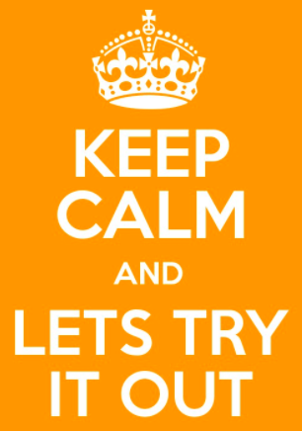
Exercise: Which One Is Better?
JSTOR’s Text Analyzer - http://www.jstor.org/analyze/
Voyant - https://voyant-tools.org/
Notes:
With the help of other academics and data specialists, Moretti has developed a system of using computers to analyze novels as raw data. While computers can't 'read' and understand a novel in the way people can, they are very good at searching for specific information you give them and finding patterns. They can measure sentence length, structure, and lexicon, and they can give a scholar patterns of data to analyze. In this way, distant reading is more of a practice than a literary theory.
For example, Moretti put the titles of 7,000 British novels published between 1740 and 1850 into his computer. He then had the computer count the words of each title, and compare the averages. The computer found that as time went on, the titles grew shorter. In 1740, the average novel had a title of twenty-five words. By 1850, that had shrunk to a much more manageable eight words.
It's natural to wonder 'so what?' when you hear that. On its own, that information is little more than a piece of trivia. However, Moretti took this information and looked into what else changed at the same rate as titles, and he found an answer: the market for books.

Slide 12
Part II
Challenges of Digital Humanities
Notes:
12

Slide 13
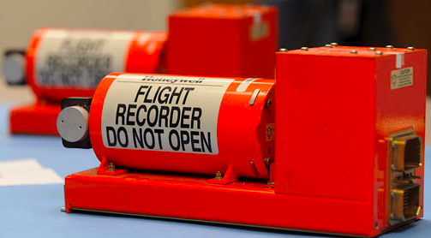
Problem of the “Black Box”
Do we fully understand what happens to the data that we input?
Do we place too much trust in the "black box" of software that cannot be sufficiently examined for errors?

Slide 14
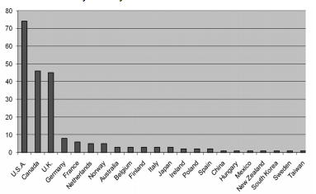
DH Scholarship Globally or Not?
The Alliance of Digital Humanities Organizations (ADHO), the umbrella professional organization for digital humanities
DH mainly in United States, Canada, and Western Europe (Risam, 2016)
Notes:
I briefly define the “webcast” as it can be a broad term - and not necessarily the most clearly agreed on.
14

Slide 15
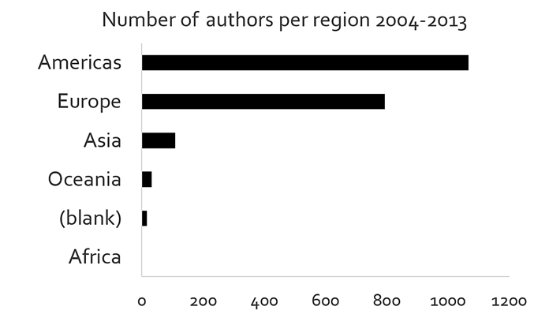
Geographical Representation Disparity
(Risam, 2016)
Notes:
I briefly define the “webcast” as it can be a broad term - and not necessarily the most clearly agreed on.
15

Slide 16
Diversity in DH?
What is the role that race and/or identity politics plays in DH?
Lack of racial diversity in digital humanities to the modality of UNIX and computers themselves (MacPherson, 2012)

Slide 17
Inclusion & Exclusion in DH
Do we need to examine the canon that skews toward traditional texts and excludes crucial work by women, people of color, and the GLBTQ community? (Earhart, 2012)
Does DH fail to meet the needs of users with disabilities?

Slide 18
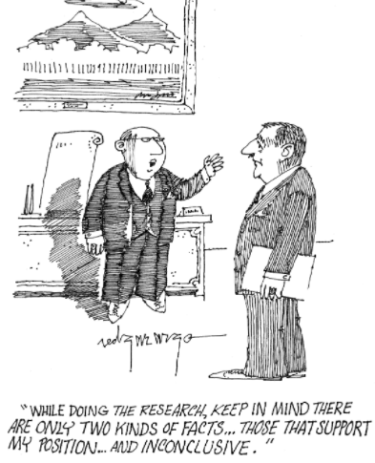
Research Bias?
Is teaching and pedagogy the neglected in DH?
Grants and tenure in the humanities are geared more toward research with quantifiable results rather than teaching innovations, which are harder to measure
What about Indigenous Studies or Ethnic Studies or Asian Canadian Studies?

Slide 19
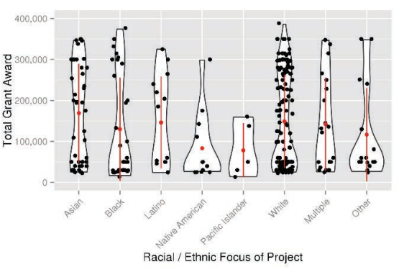
Racial Hegemony in DH?
Is there diversity in the digital humanities or does it embed historical, self-reinforcing patterns of marginalization
National Endowment for the Humanities, (NEH) funds digital humanities projects
What about indigenous peoples? What about colonialized peoples?
Grant Funding Levels by Race/Ethnicity

Slide 20
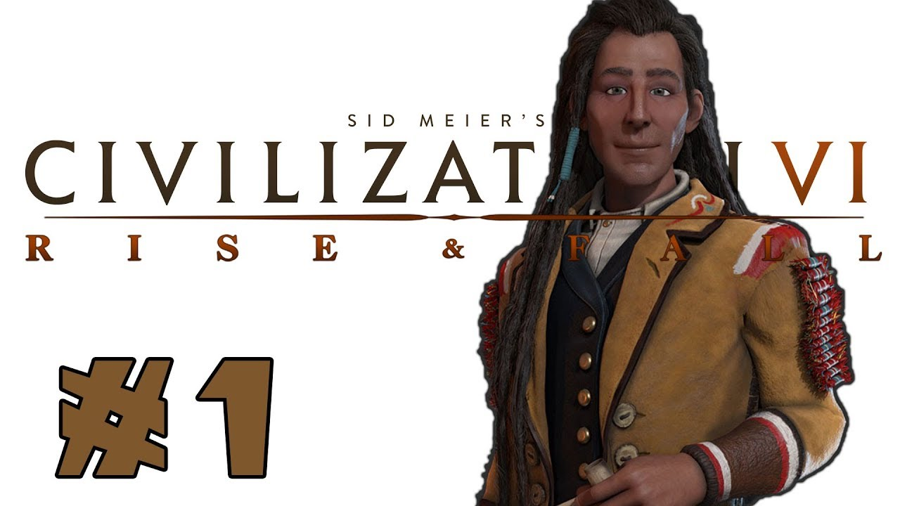
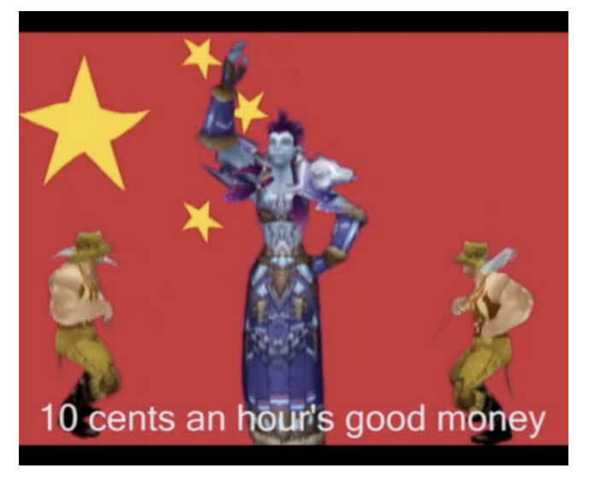
Civilization and Its Many Discontents
Makers of Civilization VI did not ask permission to use the likeness of Chief Poundmaker
World of Warcraft “mirrors the dispossession of information workers in the Fourth Worlds engendered by ongoing processes of globalization” (Nakamura, 2009)

Slide 21
Part III
Decolonizing of the Digital Humanities?
Notes:
21

Slide 22
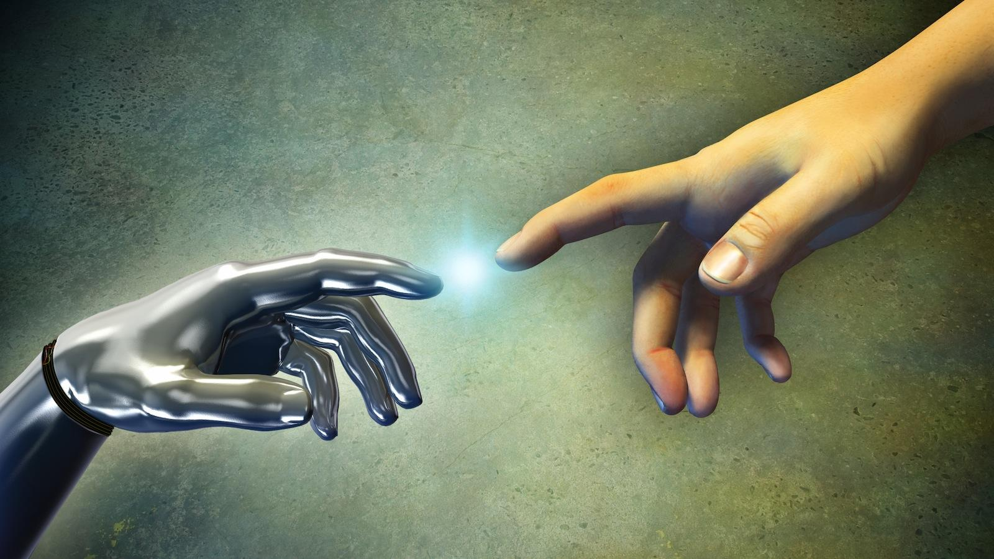
Is DH a refuge from race/class/gender/sexuality?
#transformDH
Poco DH
Black Digital Humanities
Digital Feminism
Criticial DH

Slide 23
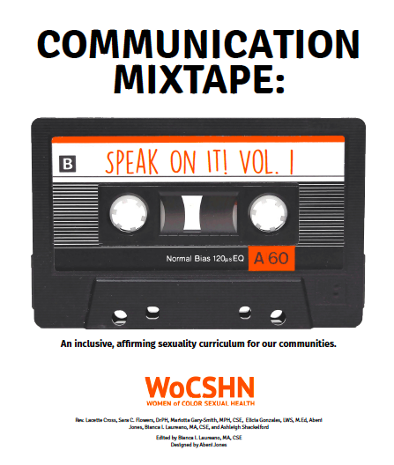
What is #transformDH?
#transformDH is an academic guerrilla movement seeking to (re)define capital-letter Digital Humanities as a force for transformative scholarship by collecting, sharing, and highlighting projects that push at its boundaries and work for social justice, accessibility, and inclusion.” (#transformDH Tumblr)
Notes:
I briefly define the “webcast” as it can be a broad term - and not necessarily the most clearly agreed on.
23

Slide 24
What is #transformDH?
1. Questions of race, class, gender, sexuality, and disability should be central to digital humanities and digital media studies.
2. Feminist, queer, and antiracist activists, artists, and media-makers outside of academia are doing work that contributes to digital studies in all its forms. This work productively destabilizes the norms and standards of institutionally recognized academic work.
3. We should shift the focus of digital humanities from technical processes to political ones, and always seek to understand the social, intellectual, economic, political, and personal impact of our digital practices as we develop them.
- Moya Bailey, Alexis Lothian, and Amanda Phillips
Notes:
I briefly define the “webcast” as it can be a broad term - and not necessarily the most clearly agreed on.
24

Slide 25
Part IV
Case Study - The Chinese Canadian Stories project
Notes:
25

Slide 26
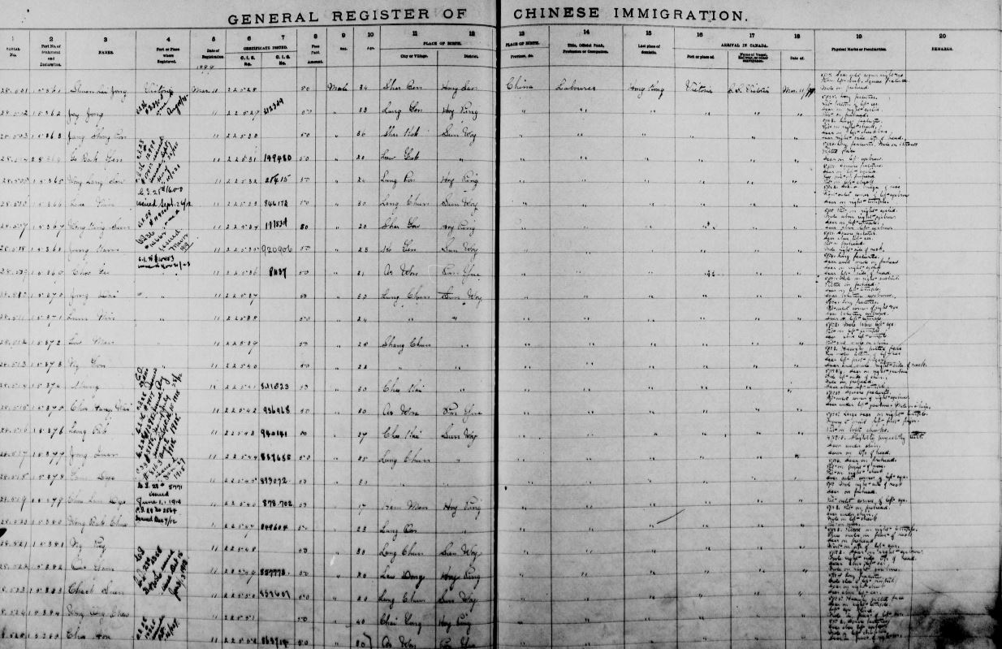

Slide 27
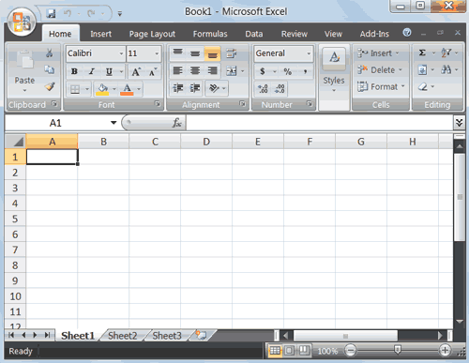
The Chinese Canadian Stories project
Historians are good at capturing data and census records
Demographic statistics
Determine patterns and trends during certain time periods
Synthesizes this information into books & articles
So what?
Notes:
UBC’s Daxue project models existing projects that use crowdsourcing and online videos networks (such as YouTube)
Projects such as Amara - http://about.amara.org/2013/02/05/announcing-crowdsourced-subtitles-for-your-youtube-channel/
Amara is an award winning subtitle editor - the UBC Daxue project builds on this concept of crowdsourcing, using students as the “crowd”
Amara.org feature– free crowd subtitling for every personal YouTube user
videos accessible to people around the world who speak a different language? Want deaf and hard of hearing users to be able to watch
YouTube accounts can connect to Amara and invite its viewers to help. Whenever subtitles get created, they will be synced directly to one’s YouTube channel. It takes about 10 seconds to connect your YouTube account.
One example of how academic libraries can harness the technology and work with faculty on teaching and learning = “embedded librarianship”
(Although UBC Library was fortunate and timing was right for the TLEF grant to come along (in addition to open-minded faculty)
27

Slide 28
Headtax Database Digitized

Slide 30
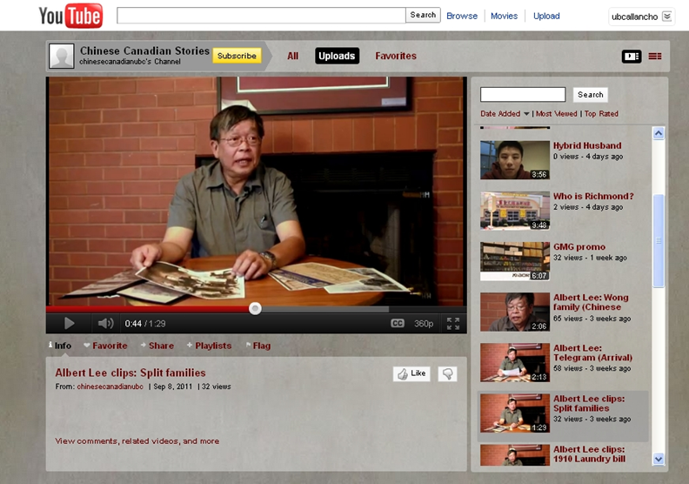
Digital Storytelling and Oral History

Slide 31
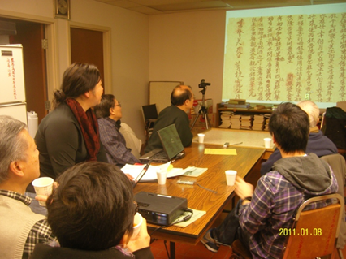
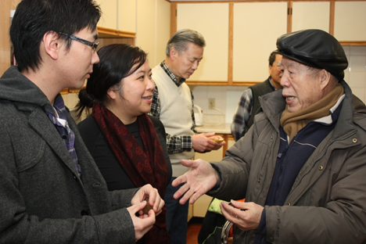
Community Outreach and Engagement

Slide 33
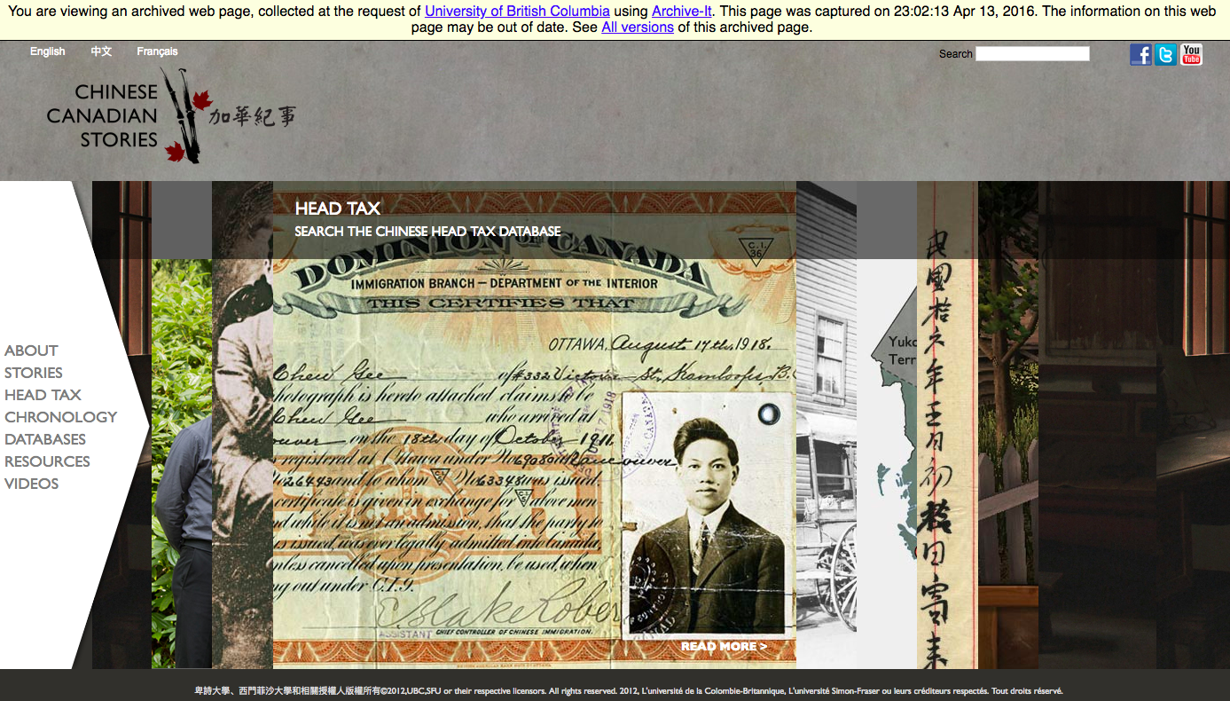

Slide 34
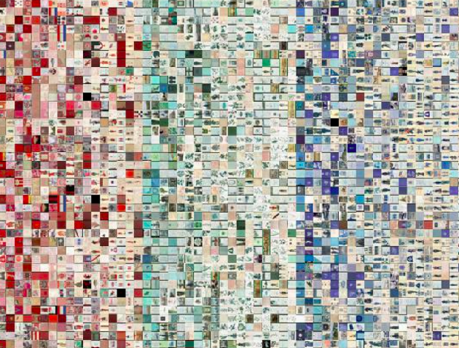
A Learning Opportunity
Understanding institutional hierarchies, cultures, & practices
Critiquing the not forgetting the original mission of the project
Why did we do it? What can we learn from this project?
Notes:
34

Slide 35
Ramsay’s “Type 2” Digital Humanities
Type 1
English
History
Type 2
Media studies practitioners
Internet culture
Archaeologists
Digital artists
Gaming studies
Notes:
35

Slide 36
References
Weingart, Scott B., and Nickoal Eichmann-Kalwara. "What’s Under the Big Tent?: A Study of ADHO Conference Abstracts." Digital Studies/Le champ numérique 7.1 (2017).
Risam, Roopika. "Beyond the margins: Intersectionality and the digital humanities." DHQ: Digital Humanities Quarterly, Volume 9, Number 2 (2015).
McPherson, Tara. "Why are the digital humanities so white? Or thinking the histories of race and computation." Debates in the digital humanities (2012): 139-160.
Notes:
36

Slide 37
References
Risam, “Diasporizing the Digital Humanities: Displacing the Center and Periphery.” International Journal of E-Politics 7.3 (2016): 65-78.
Nakamura, Lisa. "Don't hate the player, hate the game: The racialization of labor in World of Warcraft." Critical Studies in Media Communication 26.2 (2009): 128-144.
Notes:
37

Slide 38
Any Questions?
Allan Cho @allancho
www.library.ubc.ca

