Slide 1
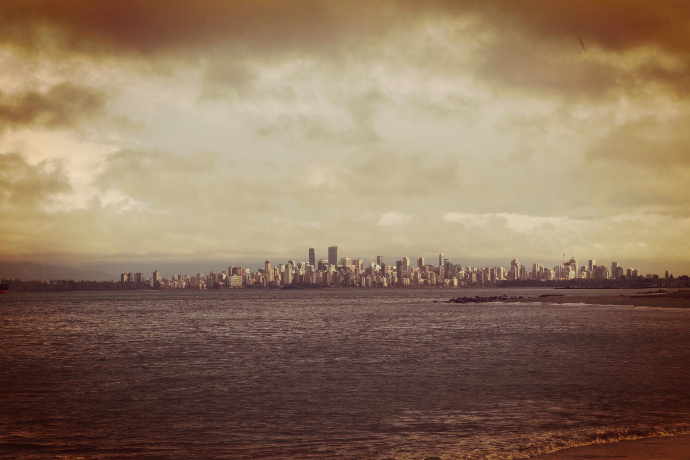
PODCASTS
A personal story
@viewmagazine
By DR DAVID DUNKLEY GYIMAH

Slide 2
An explanation of the slides follows for Dr David Dunkley Gyimah’s presentation on Monday :
By DR DAVID DUNKLEY GYIMAH

Slide 3
An explanation of the slides follows: Next photo was used to frame the idea that radio which preceded podcasts was designed as inherently personal and constituted social media in its prototypical form.
By DR DAVID DUNKLEY GYIMAH

Slide 4
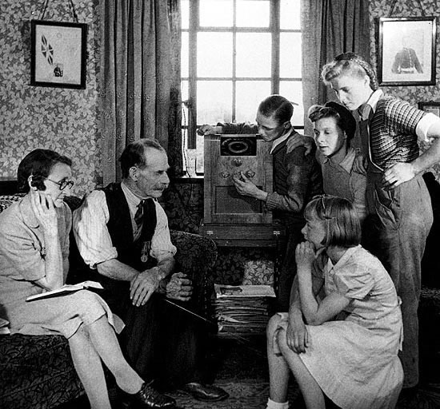
PODCASTS
A personal story
@viewmagazine
By DR DAVID DUNKLEY GYIMAH

Slide 5
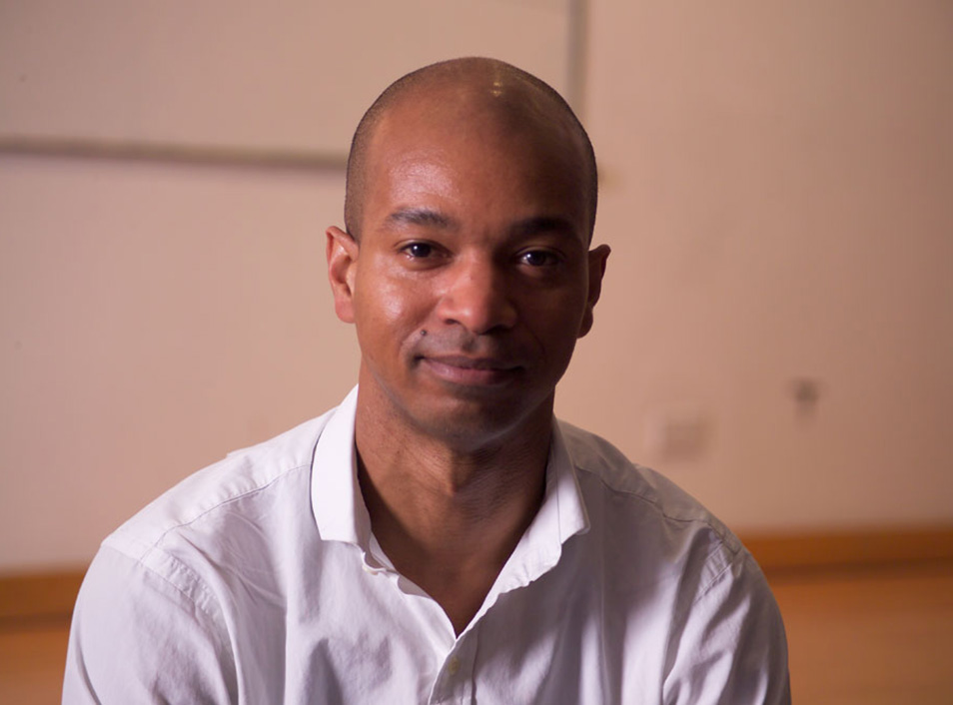
WHAT IS A PODCAST ?
HOW DO GET GOOD?
INFLUENCES?
HOW TO MAKE THEM?
EQUIP / KNOWLEDGE

Slide 6
Podcasts are media bits e.g. Radio or video distributed via the net. Hence a lot of its techniques and styles can be found in traditional media.
By DR DAVID DUNKLEY GYIMAH

Slide 7
Next slides were used to frame how I got involved in radio at an early age and some of the highlights for me.
By DR DAVID DUNKLEY GYIMAH

Slide 8
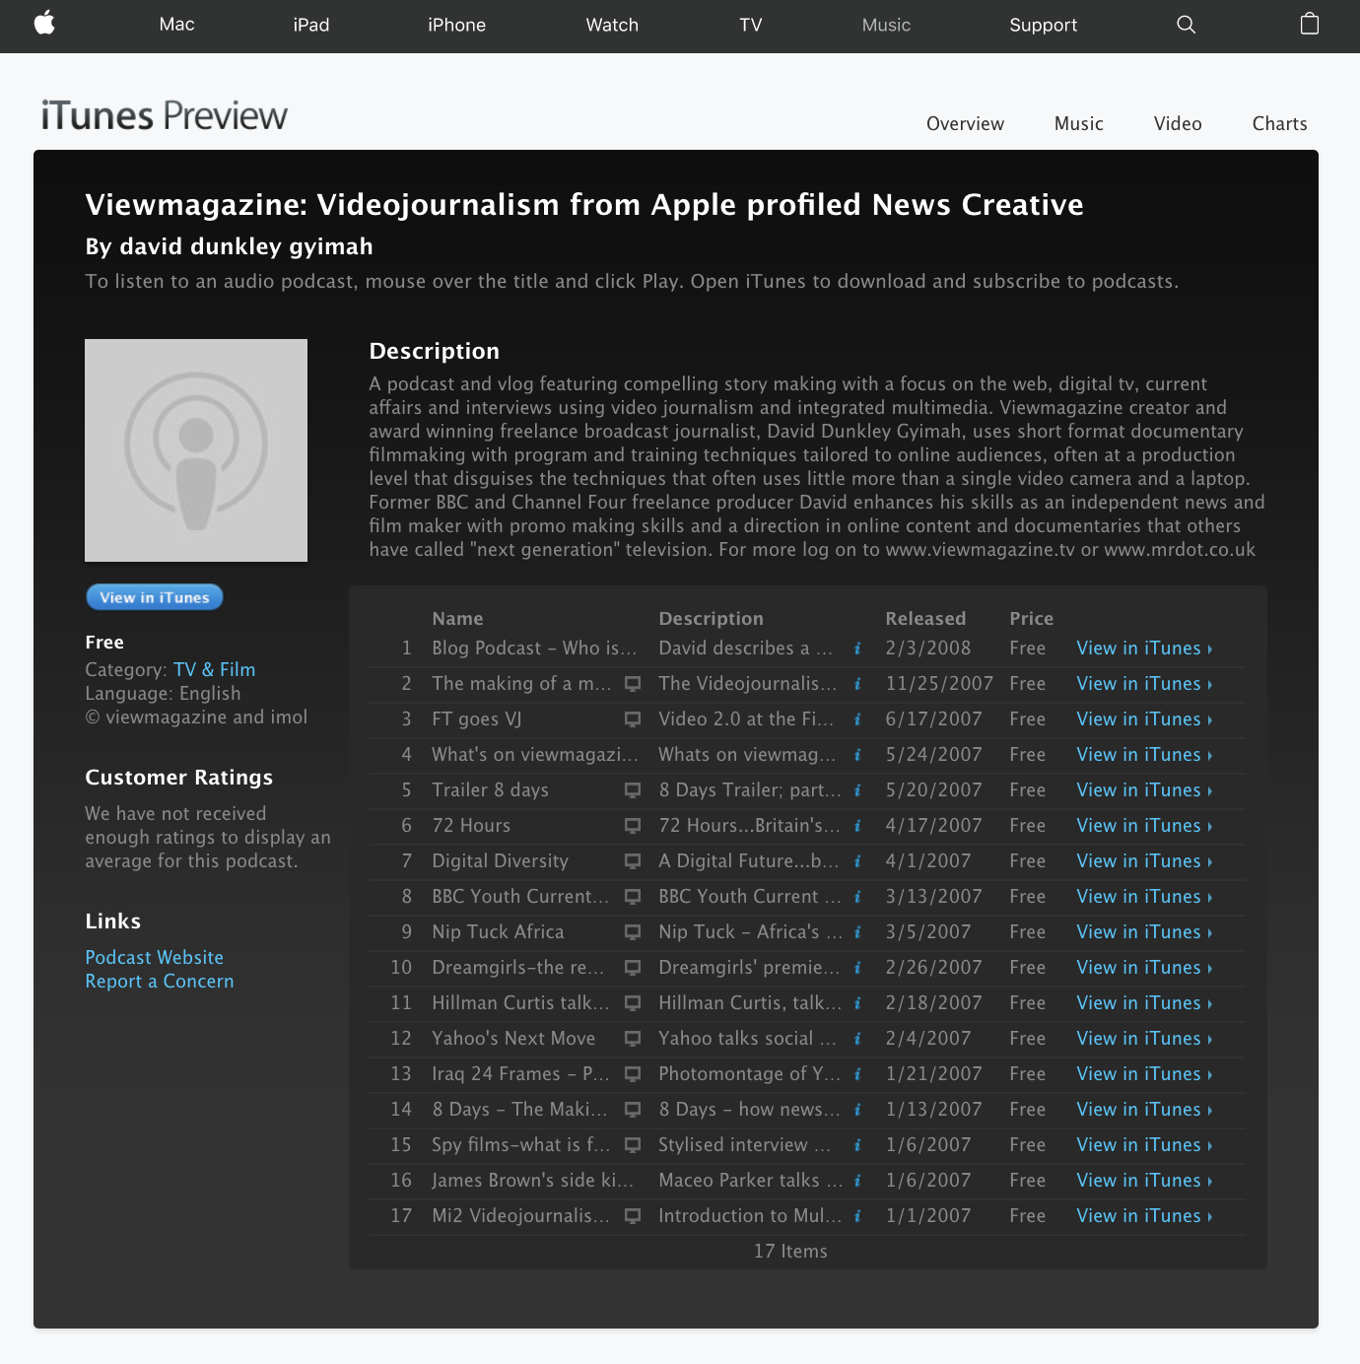
By DR DAVID DUNKLEY GYIMAH

Slide 9
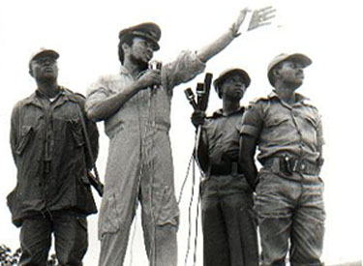
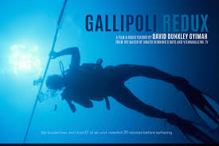
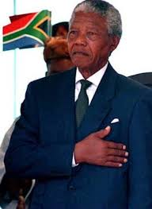
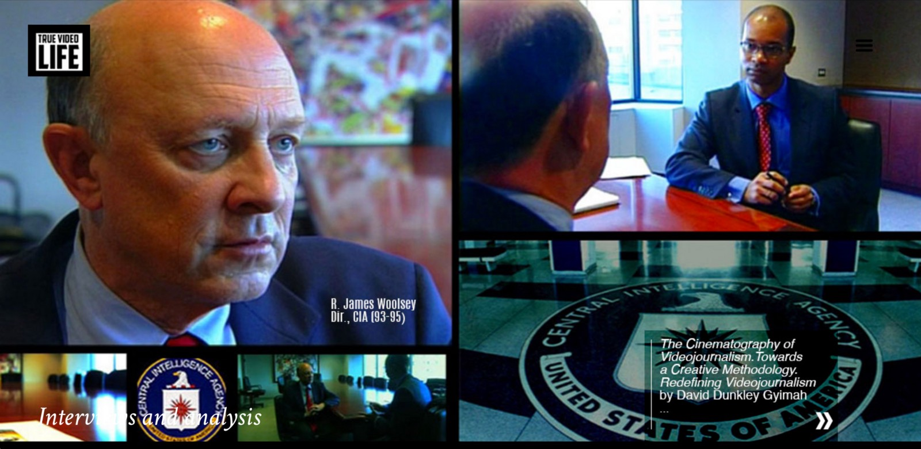
1998
Notes:
Rawlings, action, bbc world service. and War of the worlds Movement.

Slide 10
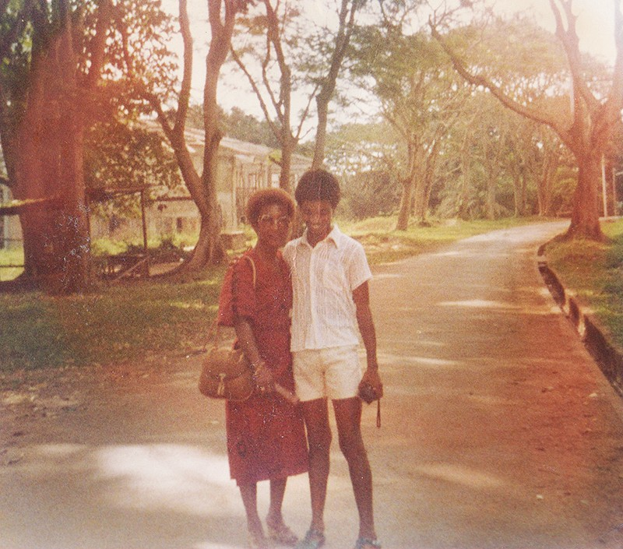
1998
INFLUENCES?
Notes:
Rawlings, action, bbc world service. and War of the worlds Movement.

Slide 11
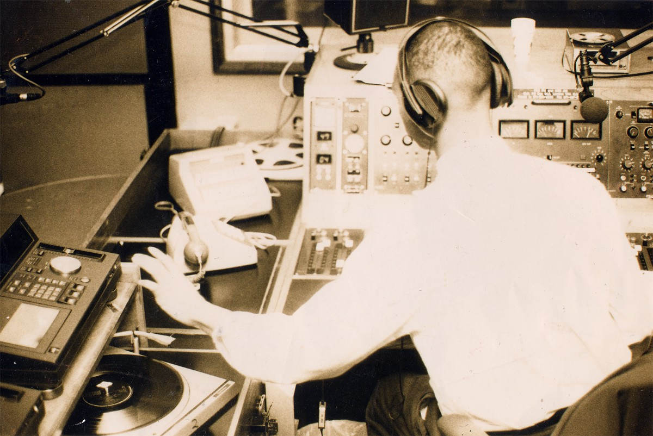
1998

Slide 12
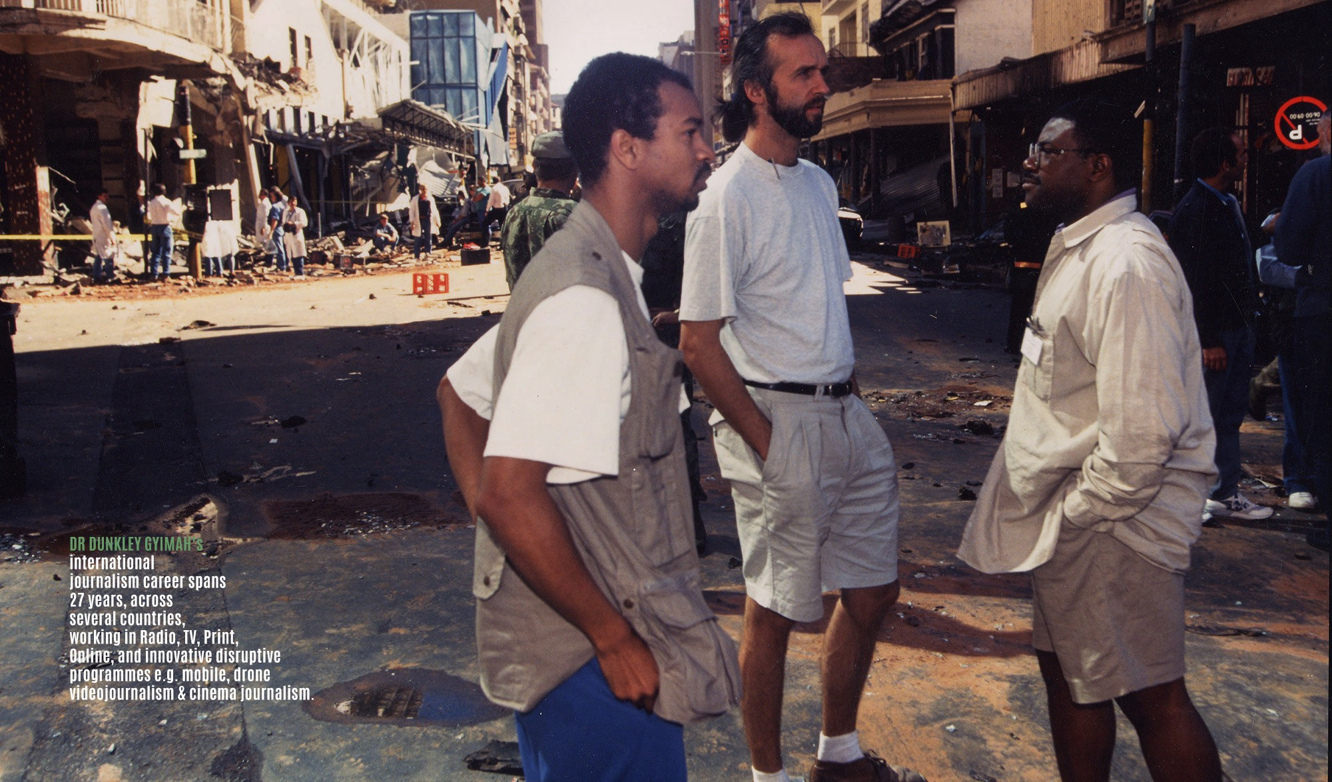

Slide 14
See this link for explanation https://medium.com/@viewmagazine/you-see-audio-podcasts-with-your-ears-6828d6993147
By DR DAVID DUNKLEY GYIMAH

Slide 15
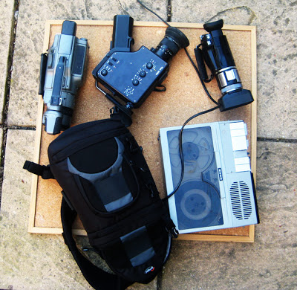
1998
WHAT KNOWLEDGE/
EQUIP YOU NEED?

Slide 16
OMG we used this huge contraption called a uher. It doesn’t really matter what you record on, as long as the quality is good.
By DR DAVID DUNKLEY GYIMAH

Slide 17
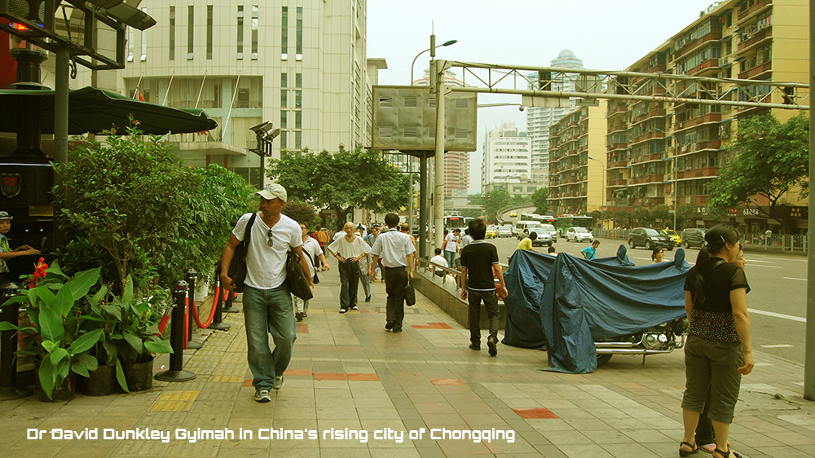
TRAVELLING - KNOWLEDGE
CHONGQING

Slide 18
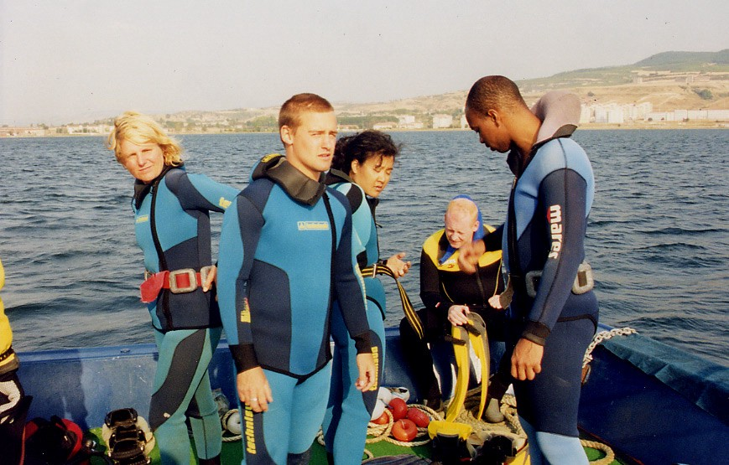
GALLIPOLI
Notes:
https://medium.com/@viewmagazine/a-dangerous-dive-to-gallipoli-but-that-s-part-of-the-story-multimedia-in-2001-and-broadcasters-5185c8ea1f38

Slide 19
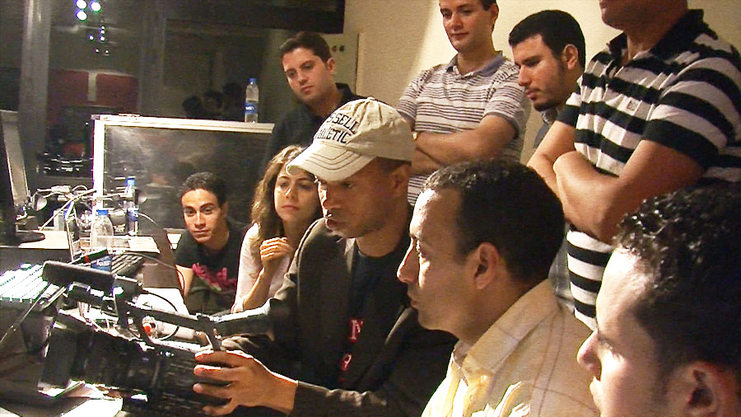
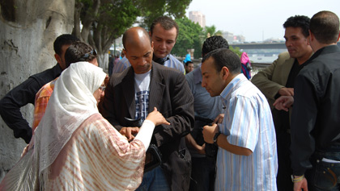
EGYPT

Slide 20
I talked about how travelling was my teacher too. It’s about human interactions and visiting new places that provide an opportunity to appreciate how people live. We should respect that. Our recorders merely allow us to capture events.
By DR DAVID DUNKLEY GYIMAH

Slide 21
Talked about how I made a brain from gelatin. You could do this too by researching online and buying the brain moulds.
By DR DAVID DUNKLEY GYIMAH

Slide 22
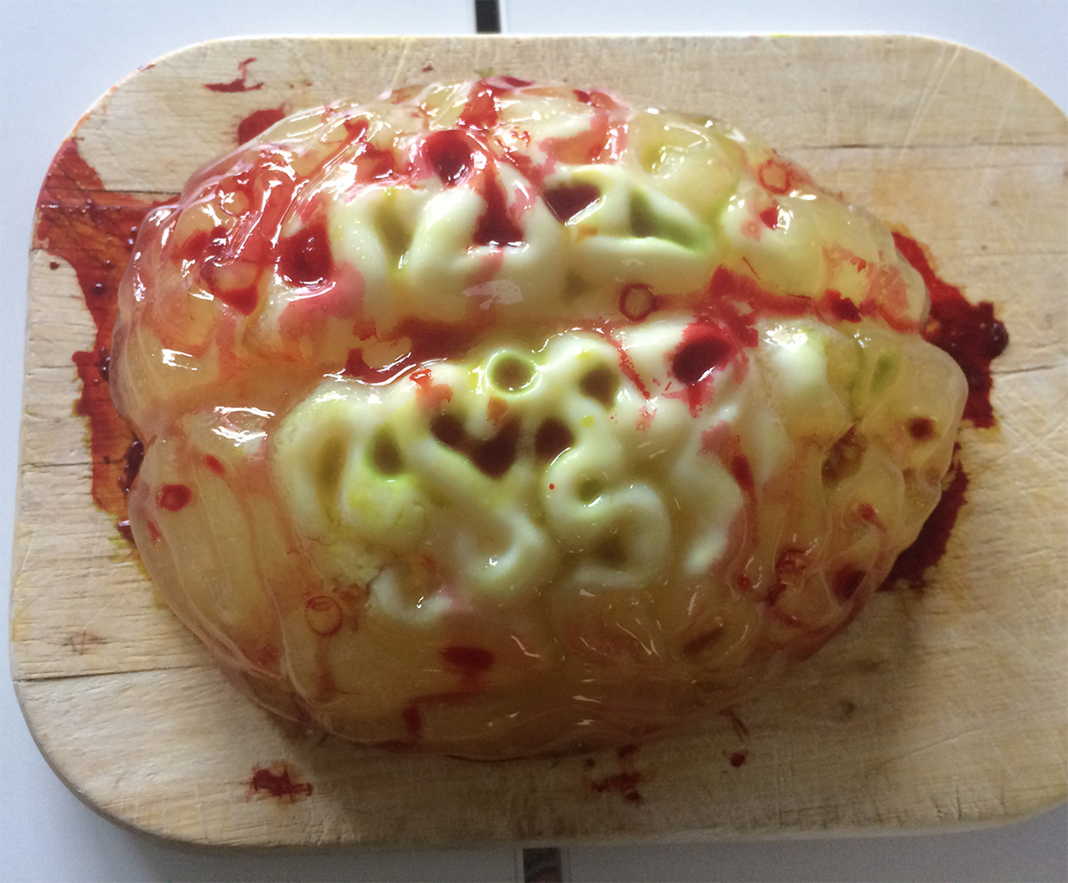

Slide 23
Our words activate different parts of the brain. Google “Brain and Storytelling” for more.
By DR DAVID DUNKLEY GYIMAH

Slide 24
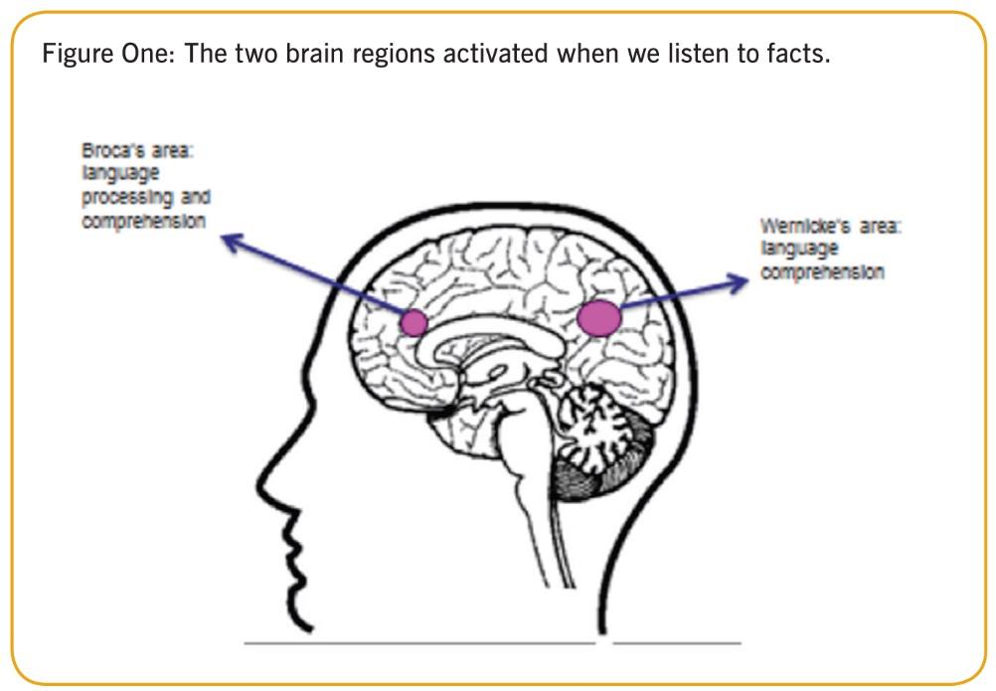
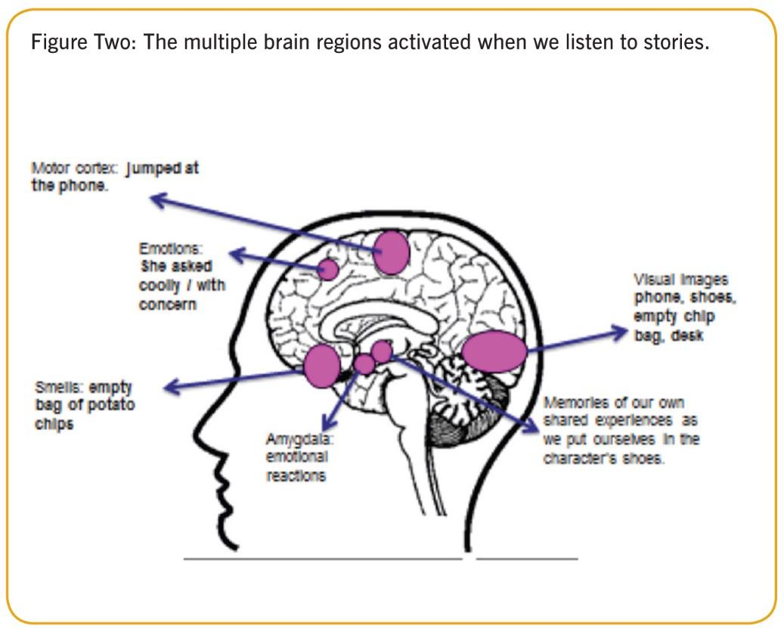
How language activates different regions of the brain. See this link for more

Slide 27
How to get good at Podcasts? Listen to exemplars. Make lots of podcasts. Fail early, fail fast and fail forward says Denzel Washington. Don’t wait to your assignment to do a podcast.
By DR DAVID DUNKLEY GYIMAH

Slide 28
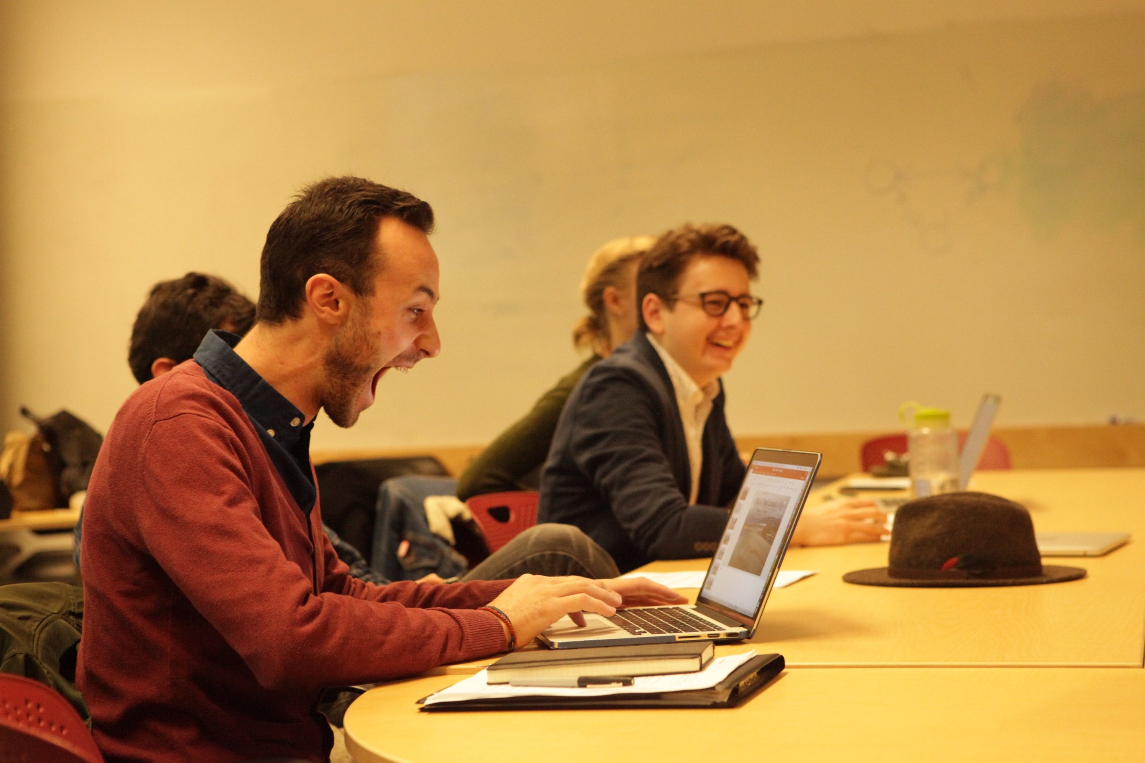
HOW TO GET GOOD?

Slide 29
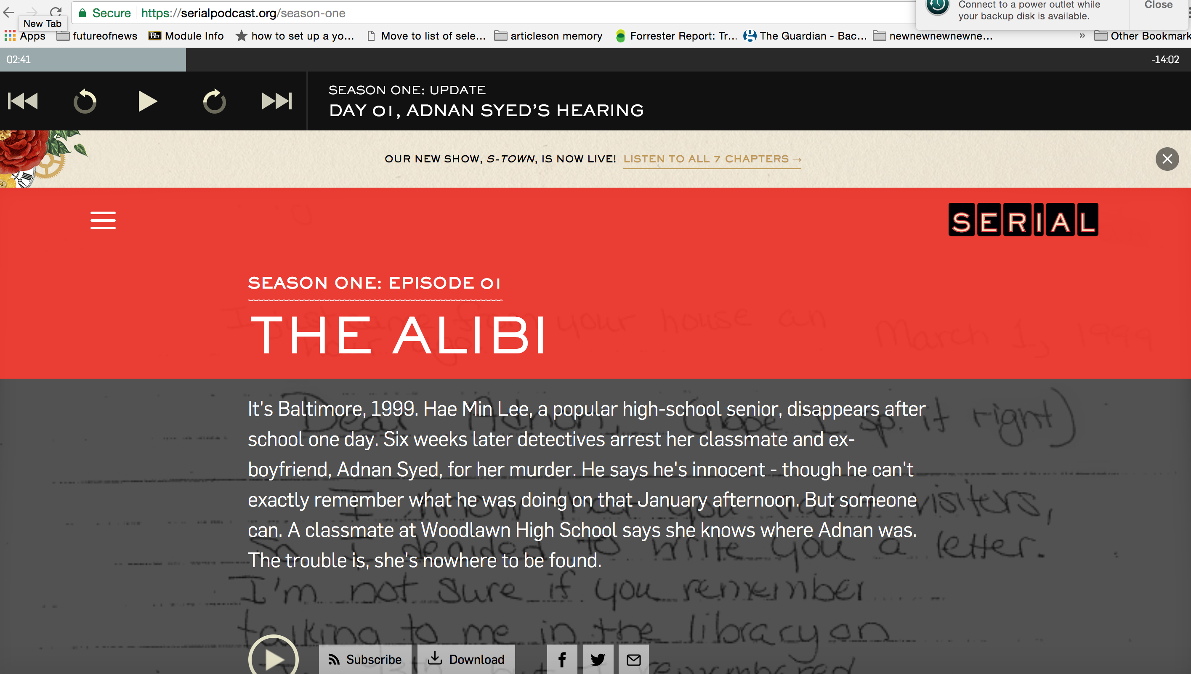

Slide 30
Follow good podcasts on Twitter, Instagram etc.
By DR DAVID DUNKLEY GYIMAH

Slide 31
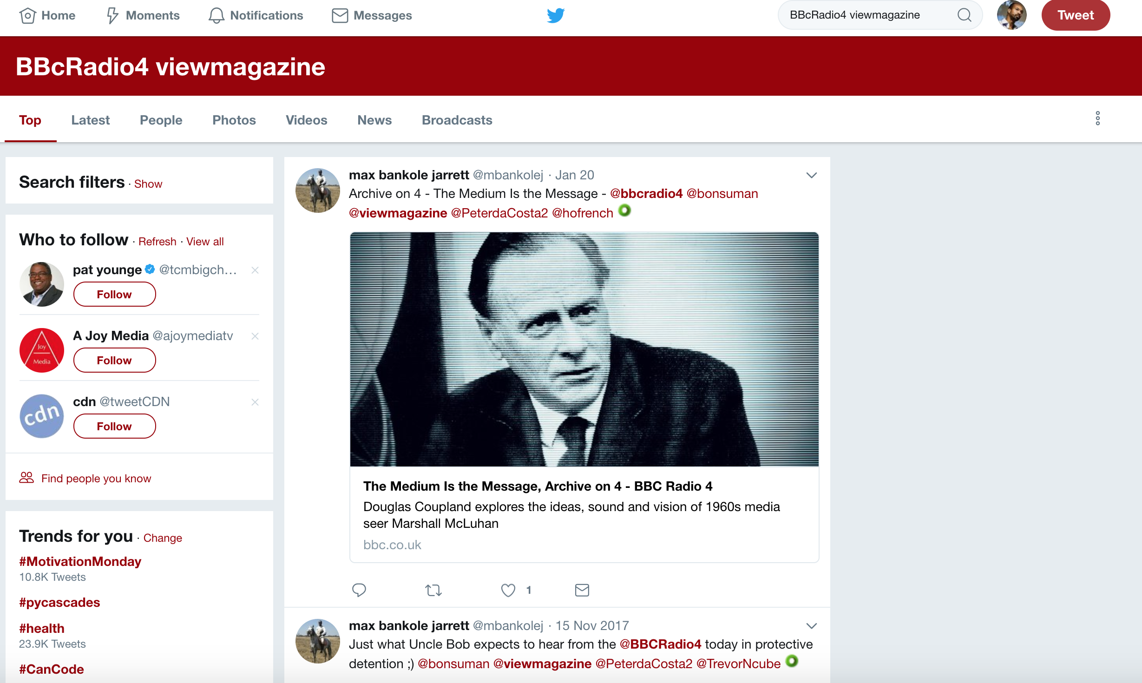

Slide 32
TIPS FOR STARTING PODCASTS 1. Good listening ear. Search character voices 2. Strong writing activates diff brain regions 3. Experiment beyond journalism. e.g. Theatre etc. 4. Foley (Jack Foley). See sfx with your ears 5. Be passionate about your subject 6. Seek out guidelines e.g. technical. Break “rules” 7. Be them (your fav podcaster), and then Be You 8. Respect the space and place you’re entering @viewmagazine Thank you

Slide 33
Goodluck @viewmagazine
Thank you

