Slide 1
CFE Final Reflection
A comparison of my experiences at a public school, and an independent school

Slide 2
Physical Education
Pinetree secondary school
St George’s Senior School
Pinetree’s P.E. curriculum was extremely progressive and what I believe to be the future of physical education. There was a large emphasis placed on emotional intelligence and every lesson had a precise emphasis outside of pure physical prowess.
The equipment was shared with a community centre and a college, which provided both a vast array of space and selection, but was also limited because of time conflicts.
Class sizes varied from 24- 60 students. On average a class needed to have 30 students or it was scrapped at the beginning of a term.
I was also the only instructor the students were taught by throughout the semester which provided a sense of conformity as the students bought into my classroom structure and expectations.
St George’s P.E. curriculum was much more traditional in the sense that the boys were divided into classes based on their “aggression” level. Emphasis is largely placed on sports performance and the boys are given a score out of 5 for the day
The equipment is top of the line and with tennis courts, 2 gyms, 3 fields, and a track, facilities are always available.
Class sizes were never more than 24 boys, and the senior classes were usually less than 15. This provides the teacher with a class that should theoretically be easier to manage.
P.E. at Saints is broken up into sports, aquatics, planning and HCE. Each section is taught by a different instructor. This proved tricky as often the boys were just getting used to my expectations, but then they would leave for a week, and expectations would have to be reestablished.

Slide 3
School Culture
Pinetree secondary school
St George’s Senior School
From what I experienced the culture was very much focused on academics, particularly on mathematics. High achievements or awards are announced on the PA system and are posted on the school website.
During my practicum, the school tried to organize a pep rally during period 3. Unfortunately, it was met with resistance from many teachers, and do to a lack of interest from pupils (they had to pay 2 dollars each), it was scrapped the day before it was meant to happen. Apparently this was not uncommon as “pride in the school” was something not many students had.
At St George’s, the students are mandated to participate in clubs and games. Assembly’s are held 3 times a week and are utilized to prepare students for upcoming events as well as to recognize both academic and athletic accomplishments.
During my short 3 week CFE students attended the May Fair, competed in a variety of athletic events, took part in academic challenges, and hosted a grandparents day.
There was also a large number of alumni that attended sporting events, and other school events. Past students were definitely proud of their school and its traditions.

Slide 4
Athletics
Pinetree secondary school
St George’s Senior School
Pinetree is currently rebuilding its athletics programs. There are programs that do quite well, and others that do not do as well and what I have found to be the biggest precipitator of this is teachers commitment. Teachers in the public sector are not required to coach and often the commitment was very poor or minimal.
I also felt that those students and coaches who did exceptionally well should be more recognized for those feats.
As the tennis coach at the school, students would occasionally not show up for practices or games because they felt that their studies or an appointment should take priority over their athletics commitment .
St George’s requires that every student have a game choice per term. Likewise, every teacher is expected to coach or lead a game at least 2 out of the 3 semesters. In return, teachers have a reduced course load (something public school teachers do not receive).
Teams or individuals that excel are rewarded in assembly's with a brief trophy ceremony and are congratulated by their schoolmates.
As a coach for both the cricket and field hockey teams, it was apparent that teachers are not necessarily the experts in the sport, but the school is able to set aside money to hire community coaches to help with the teams (i.e. the school has a full time rowing coach).
Athletics is a very proud tradition of Saints and was probably best demonstrated when the first XV rugby ran out of the tunnel for their district finals. Every Saints boy from both the junior and senior schools attending the game will form two rows which create the tunnel that the rugby team runs through.

Slide 5
Teacher Morale
Pinetree secondary school
St George’s Senior School
For the most part the teachers at Pinetree cared deeply about their students and put their best effort forth to teach the curriculum. However, there were certainly clear instances of fatigue and burnout which at times created a stressful working environment for colleagues. Teachers often complained about administrative decisions and generally had a sense of doom and gloom towards any curriculum changes.
St George’s teachers put a great pride into their work much like Pinetree teachers. The major difference (At least in the P.E department),was the reduced course load. Teachers at Saints generally worked longer hours (8-5), but because of smaller class sizes and reduced course loads the day felt significantly less stressful.

Slide 6
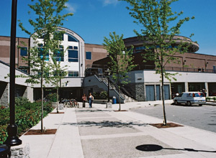
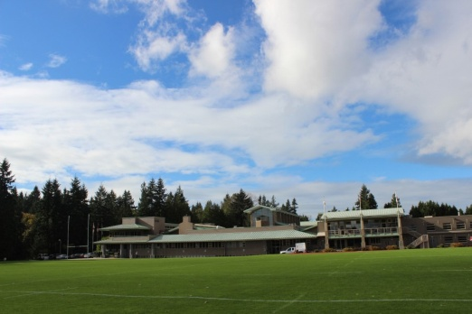
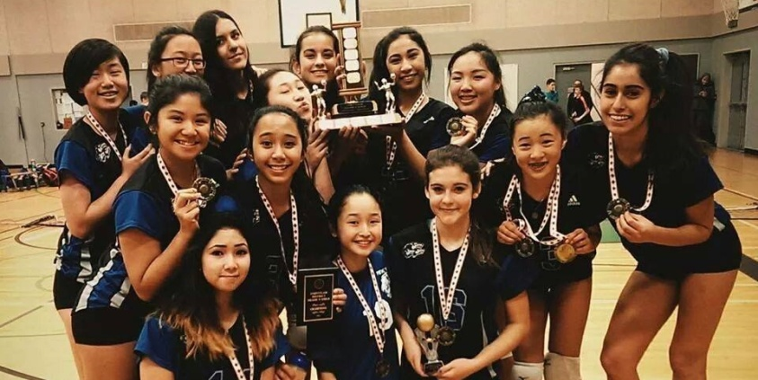
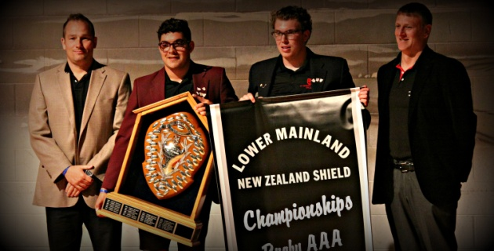
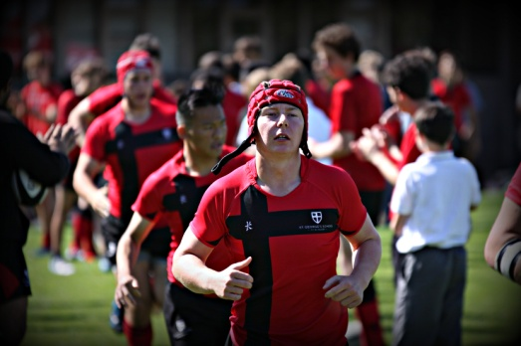
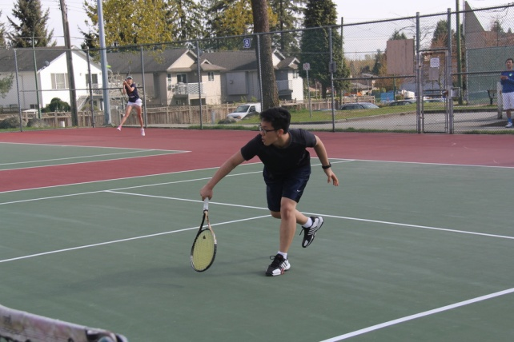
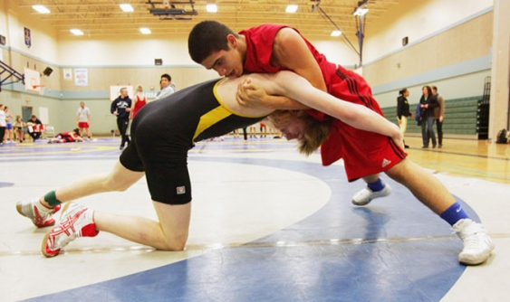
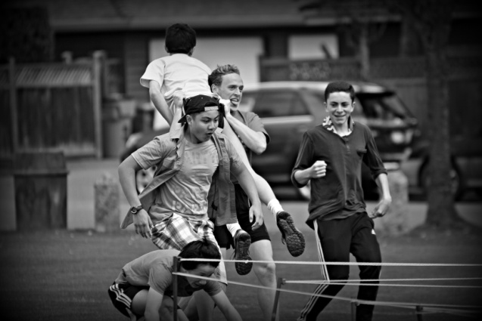
My experiences
Pinetree
St George’s

