Slide 1
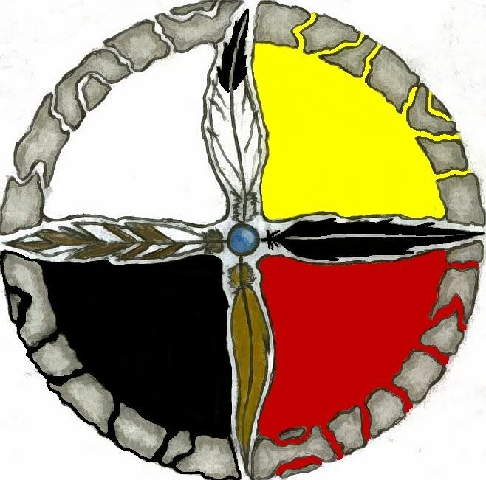
First Nations Week
Interdisciplinary studies through Indigenous Lens’

Slide 2
Agenda
The purpose of introducing “First Nations week”
Sample Day ½ Bell Schedule
Introduction to resources and ideas for curriculum implementation of specific subject areas
Department collaboration time- Utilizing resources to compose original ideas on how to implement First Nations studies into your classroom

Slide 3
Why First Nations Week?
Not just a nod to the First Peoples of our Country
Both traditional and modern techniques
An introduction to First Nations pedagogical methods.
Easing educators into utilizing and experimenting with First Nations pedagogy
Multi Dimensional learning
Much like modern domains of learning (Affective, Cognitive, Psychomotor), First nations pedagogy targets multiple domains (Mental, Spiritual, Physical, Emotional)

Slide 4
Dialectic and Dialogic
From Four Arrows “Native Studies, Praxis and the Public Good”, 2014
 | Dialectic | Dialogic
Teacher | Holds power, knows all, controls space | Shares power, shares experience, creates space
Student | Listens, follows instructions, just a student | Contributes, makes proposals, a scholar
Learning Focus | Fixed, fragmented, transmitted | Emergent, connected to the whole, created
Educational System | Protect the status quo, encourage competition | Create the future, encourage collaboration

Slide 5
Indigenous Lens
From “Haida Land Use Vision” Document on www.haidanation.ca
“In Haida culture, wealth is a different thing than money, which is a
currency for doing business in the modern economy. Wealth flows
from the well-being of the land, and from having the opportunity,
knowledge and capacity to support our families, raise healthy
children, and organize the individual collective efforts of our clans
and society. Wealth is to be shared and distributed — prestige is
gained through the ability to do so.”

Slide 6
Sample Day Plan (Day1/2)
Block | Subject Area | Lesson
1. 8:00-9:00 | Math Religious Studies | The Four directions
9:10-9:30 | Nutrition break/ Staff collaboration
2. 9:40-10:40 | Social Studies Science | Learning with the natural world
3. 10:50- 11:50 | English Art | Storytelling
11:50-12:50 | Lunch
4. 13:00-14:00 | Physical Education Home Economics | Experiential learning

Slide 7
Socials/Science
Looking at Haida Nation Environmental Management
“Learning with the Natural World”
“Gina waadluxan gud ad kwaagiida”
- Everything is dependant on everything else.
Two Documents:
Haida Land Use Vision
Towards a Marine Use Plan
http://www.haidanation.ca/

Slide 8
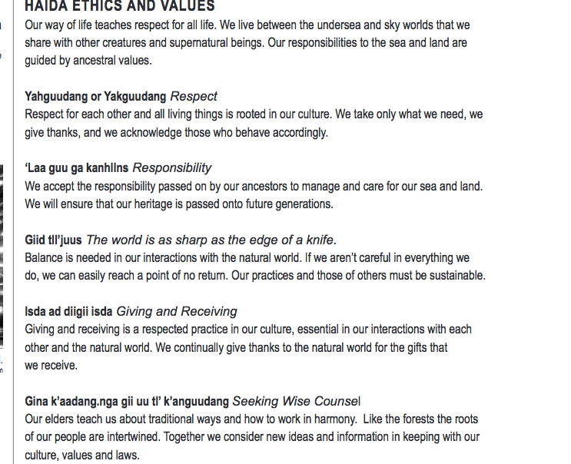
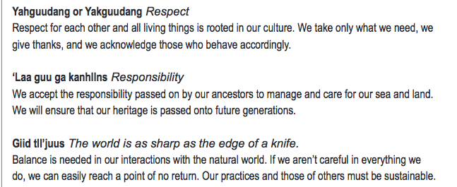
Socials/Science

Slide 9
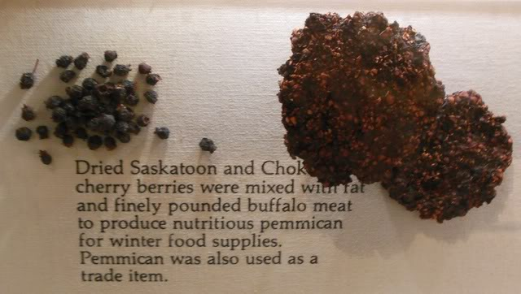
Physical Ed/ Home Ec.
Home Economics
Learning how to prepare and preserve food using traditional First Nations methods
Sample lesson- How to make Pemmican
http://tacticalintelligence.net/blog/how-to-make-pemmican.htm
Other ideas to consider
How might preservation techniques differ in modern times compared to traditional techniques?
What sort of macro-nutrients were traditional First Nations foods comprised of?
How might the shift from traditional to modern food options have an effect on a population? (Think about available resources, change in practices etc.)
Resources
First Nations ways of knowing- http://www.osstf.on.ca/~/media/Provincial/Documents/About%20Us/Common%20Threads/full-circle-first-nations-metis-and-inuit-ways-of-knowing.ashx?sc_lang=en-CA
http://www.yukonwellness.ca/traditionalfood.php

Slide 10
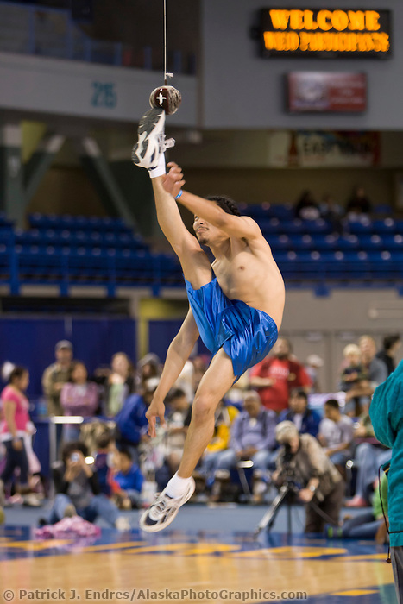
Physical Ed/ Home Ec.
Physical Education
Learning traditional First Nations Games
Sample lesson- One foot high kick
Other ideas to consider
Life management and Wellness
Creative thinking (Inventing games)
Incorporating Mental, Spiritual, Physical, and Emotional domains into lessons. How can we build a classroom community?
Resources
https://www.stf.sk.ca/portal.jsp?Sy3uQUnbK9L2RmSZs02CjV/LfyjbyjsxsQ/CsQjr87jM=F
http://www.in-motion.ca/uploads/tools/Traditional_Aboriginal_Sports_Games,_Done_June_14_PSSD_Learning_Resource.pdf

Slide 11
Physical Ed/ Home Ec.
Collaboration ideas
Including Mental, Spiritual, Emotional, and Physical domains into a combined Home Ec./ Phys Ed. lesson
Sample lesson
Nature hike
Utilizing traditional First Nations food as a fuel source for a rigorous hike

Slide 12
English/Art
Storytelling in English: Practicing the Oral Tradition
“First Nations storytelling involves expert use of the voice, vocal and body expression, intonation, the use of verbal imagery, facial animation, context, plot and character development, natural pacing of the telling, and careful authentic recall of the story.” (“First Nations Pedagogy”)
incorporate pedagogy into public speaking unit
make time for stories: importance of reading aloud in class

Slide 13
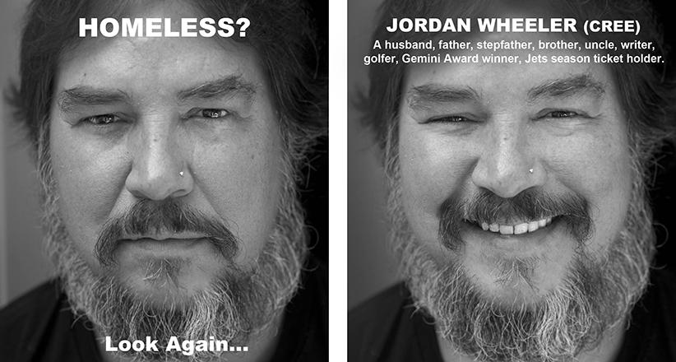
English/Art

Slide 14
English/Art
Storytelling in Art: “Perception” by KC Adams (2015)
positioned in response to Nancy MacDonald’s MacLean’s article, “Welcome to Winnipeg: Where Canada’s racism problem is at its worst” (January 2015)
“[A]n effort to challenge deeply engrained social stigma and prejudice, and show the faces of indigenous people, not as disenfranchised and helpless, but dignified and proud human beings.” (Canadian Dimension)
sample interdisciplinary project: “Capture and Caption”

Slide 15
Mathematics
for lower grades, Math Catcher is a great resource to incorporate story-telling (a chance for Indigeneous students to see themselves in the text), language, cultural values, and a math problem at the end of the story
Math Catcher is also an example of a more holistic way to educate students, as well as keeping with the oral traditions of Aboriginal Education and Culture
http://mathcatcher.irmacs.sfu.ca/
for higher grades, using the Fibonacci sequence to anticipate patterns and refer back to previous lessons where symbols and sequences were present; realizing the occurrences in the natural world can be measured and explored in this way

Slide 16
Religious Studies
an important thing to consider when studying Aboriginal Education is that “religion” for Indigenous peoples is Spirituality and that, for each Nation, the approach to Spirituality is unique
an example of what can be studied at all grade levels that is a prominent figure across all Nations, is the Medicine Wheel: what does it symbolize? how is it a prominent symbol and how is this symbol used in terms of spirituality? in what forms can we see the Medicine Wheel in the culture- both physically and culturally?

Slide 17
Interdisciplinary
You will be assigned a pair of subject areas.
As a group, come up with an interdisciplinary lesson/ focus/ unit/ project using an Indigenous Lens.
You have 5 minutes before presenting to the rest of the class.
GO!

