Slide 1
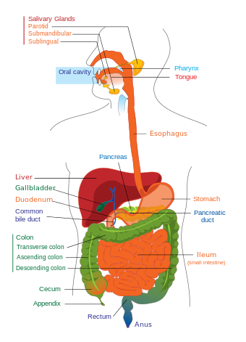
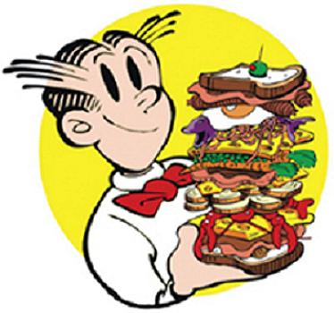
When I eat food... Where does it go... And why do people call it fuel?!

Slide 2
Pineapple Fried Rice.... Mmmmm Recipe – Serves 2
8 Shrimp 1 egg 250 grams of cooked rice ¼ cup small diced onions 1 Tbsp Thai soy sauce 1 tsp fish sauce 1 tsp sugar 1/8 tsp salt 1 tsp curry p ¼ tsp White pepper | 1 tsp prepared shrimp tomalley ½ cup Pineapple, fresh if you can, cut into small pieces ⅓ cup roasted or fried cashews, unsalted 2 green onions, chopped ½ cup tomatoes, seeds removed, cut into half inch cubes Cucumber slices for serving
http://hot-thai-kitchen.com/pineapple-fried-rice/

Slide 3
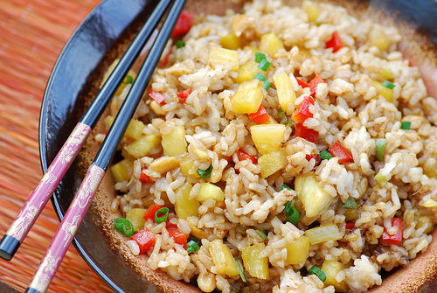
How to make it – the quick version!
https://www.youtube.com/watch?v=8lsSkjKG_G8

Slide 4
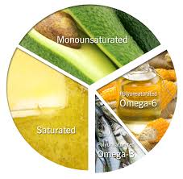
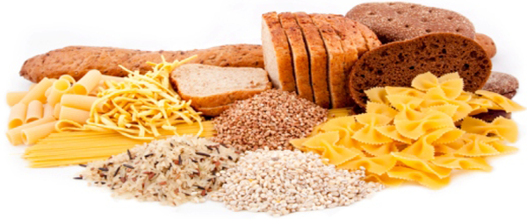
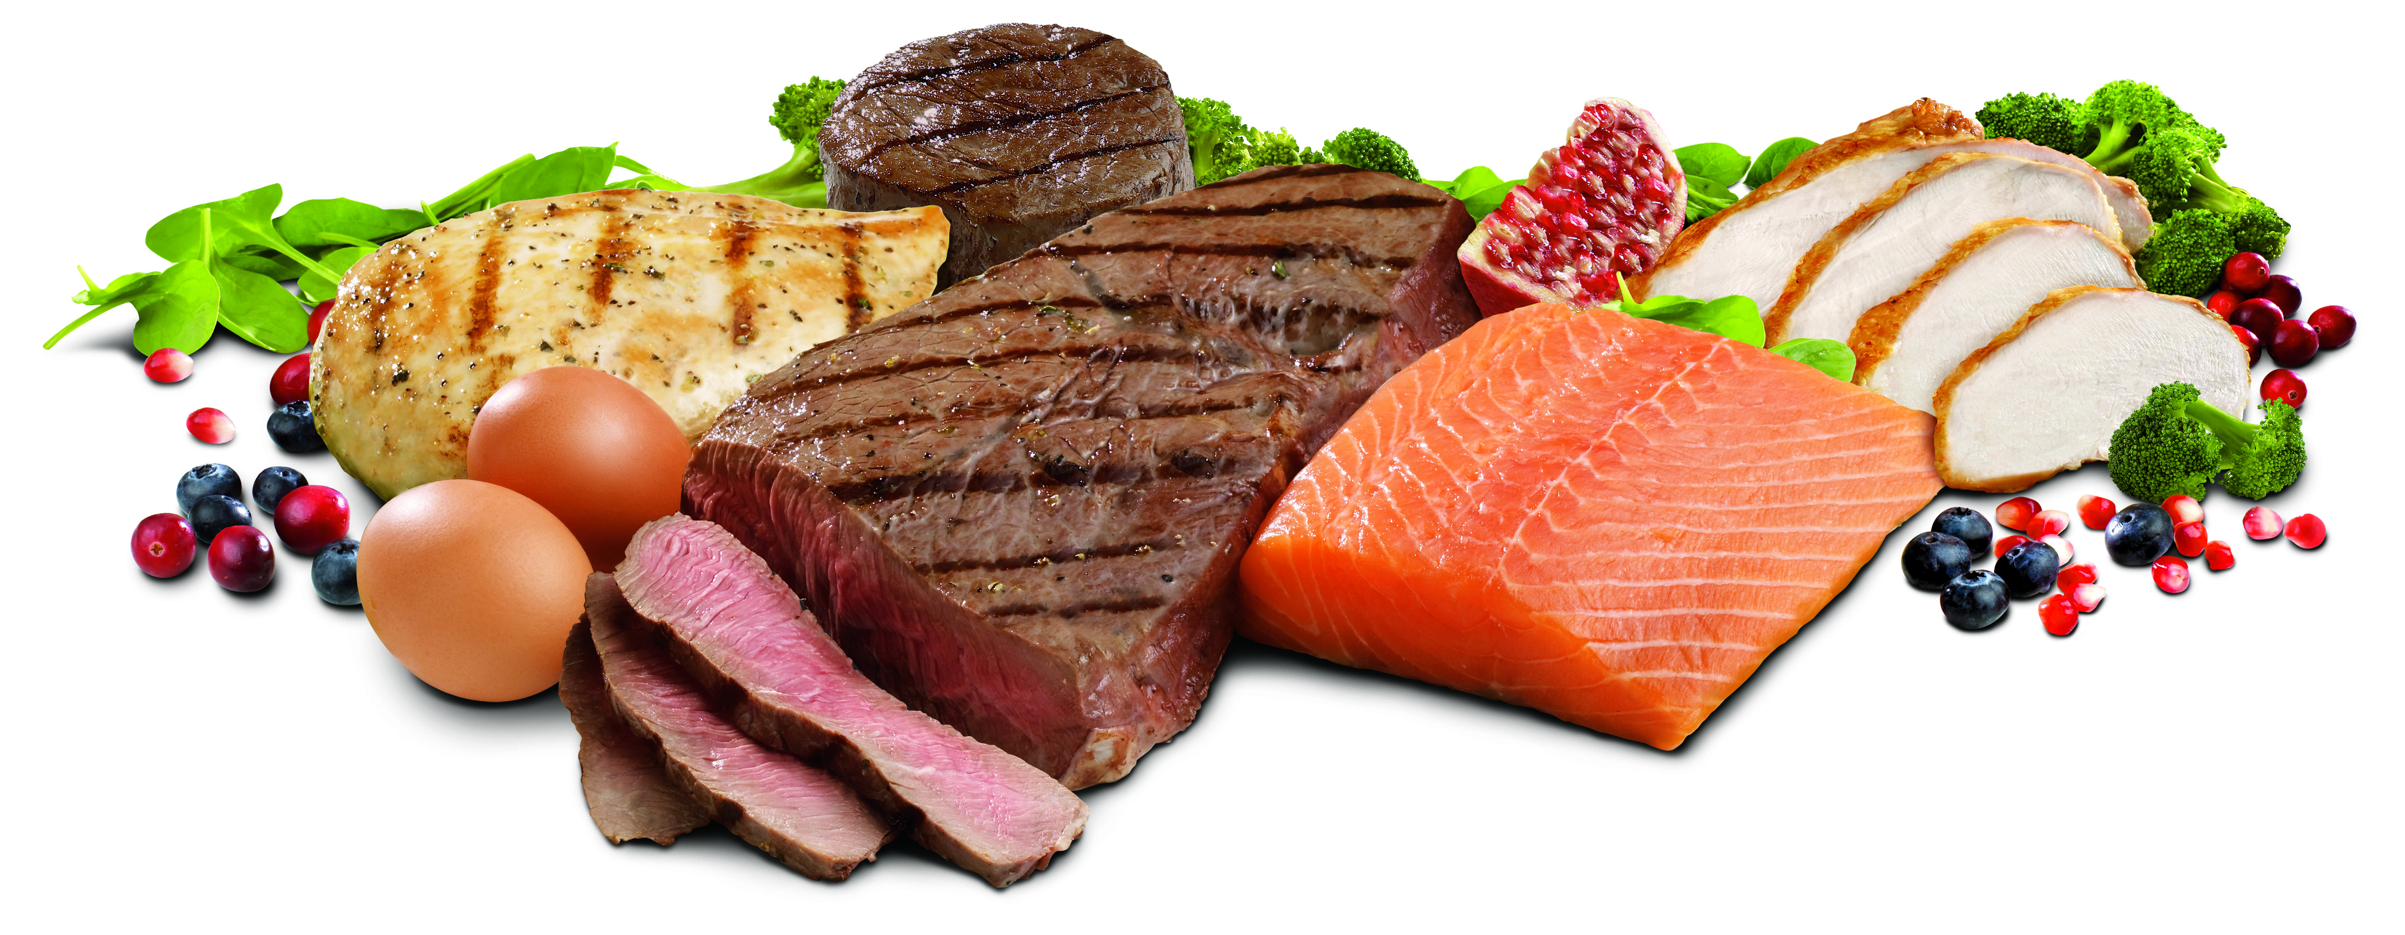
Nutritional Value
Total Fat: 22.8g/serving
Total Protein: 27.9g/serving
Total Carbs: 131.6g/serving
http://www.nutritionvalue.org

Slide 5
Digestion... Its a stomach thing... Right?!

Slide 6
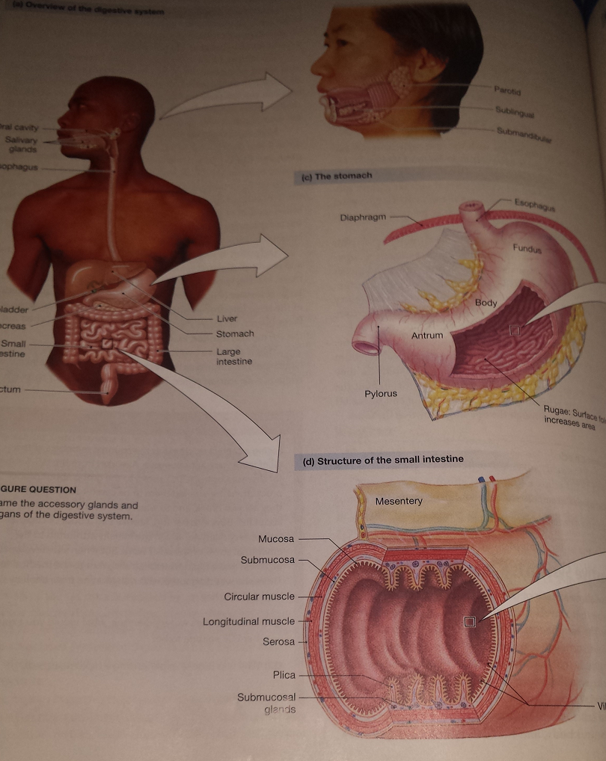
Wrong!
Mouth
Stomach
Small intestine
http://www.youtube.com/watch?v=08VyJOEcDos

Slide 7
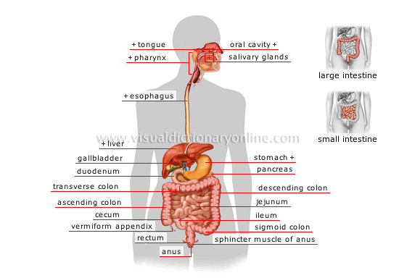
Now.... In English!

Slide 8
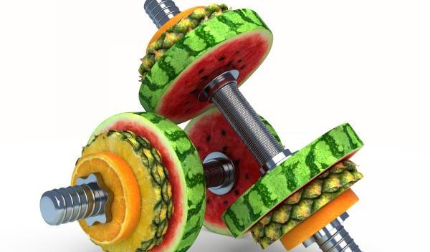
Yes… But how do we use our food as FUEL?!

Slide 9
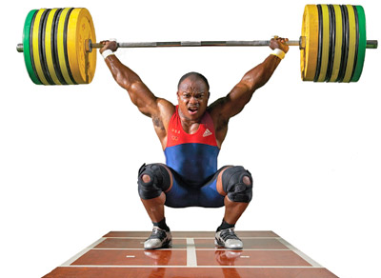
Olympic weightlifting
The Phosphagen System
Does not require oxygen
Called upon in a sudden increase in energy demand
Direct and quickest form of energy production
Can only supply enough energy for a very short period of time.
Relies on creatine phosphate which is in limited supply and is depleted quickly

Slide 10
Hockey
Glycolosis System
Provides enough ATP to fuel 1-3 minutes of intense activity
Glucose is the only fuel that can be used during glycolosis (the breakdown of glucose)
ATP is created as glucose is converted into 2 molecules of pyruvate
A bi-product of the glycolisis system is lactic acid which can cause fatigue and muscle soreness

Slide 11
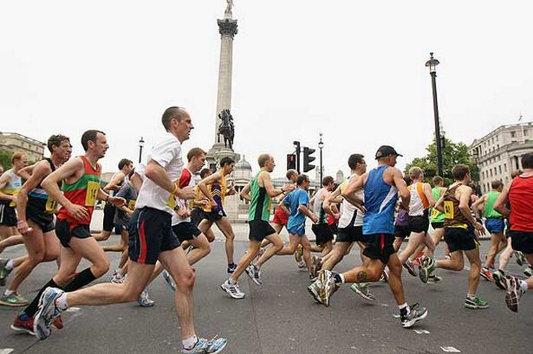
Marathon running
The Aerobic System
Used more heavily during low-intensity activity.
Can use carbohydrates, fats or proteins to produce energy
Requires adequate oxygen levels available to the working muscles
In prolonged activities where intensity is low, the body will use fat as a main energy source and spare the use of muscle glycogen and blood glucose so that it is available for use if exercise intensity increases and oxygen availability is decreased.
Notes:
One key highlight of aerobic metabolism is the ability to burn fat as fuel. Our bodies have a seemingly unlimited capacity for storing fat and fat provides over twice as much energy per gram than protein or carbohydrate, making it a very attractive choice for energy production. In prolonged activities where intensity is low, the body will use fat as a main energy source and spare the use of muscle glycogen and blood glucose so that it is available for use if exercise intensity increases and oxygen availability is decreased.
Keep in mind that aerobic metabolism doesn’t use one substrate exclusively. Although you may be burning mostly fat, a steady supply of carbohydrate is still necessary for the breakdown of fat into an energy source.

Slide 12
So why is it important that I eat a balanced diet?
All 3 systems are working simultaneously to fuel the body during exercise.
Certain characteristics such as exercise duration and intensity will determine the predominate system and thus how long the activity can be performed at that level.
One big reason for having a balanced meal before a workout, as well as a balanced diet on a daily basis, is to prevent the use of protein as a fuel source.
Protein is usually spared from being used as an energy source and is used predominately by the body for tissue maintenance, growth, and repair.
When glycogen stores are depleted, amino acids from muscle protein can be used to produce glucose.
A chronic low carbohydrate diet, or an overall low-energy diet that cannot keep up with the body’s demands. If the body consistently relies on protein for fuel, muscle protein stores will begin to decrease along with lean body mass, which can be detrimental to performance.

