Slide 1
Overnight Field trip
Garibaldi Lake & Black Tusk

Slide 2
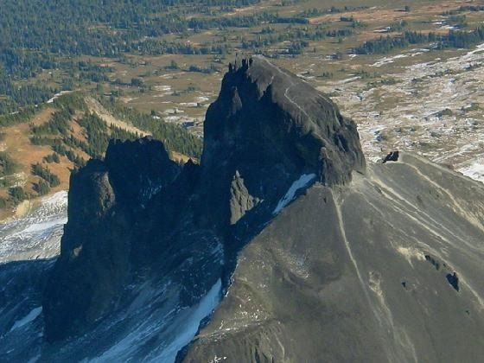
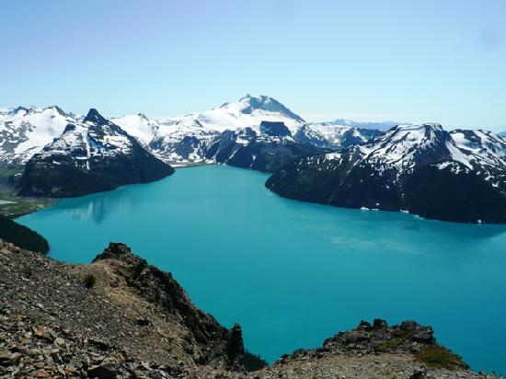
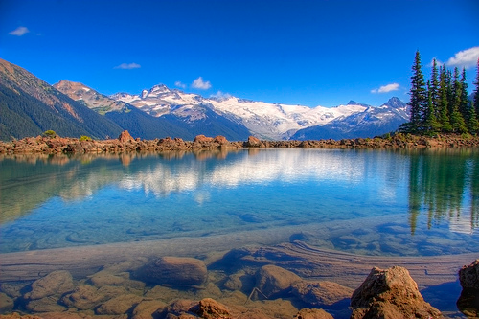
Where?
Garibaldi provincial park

Slide 3
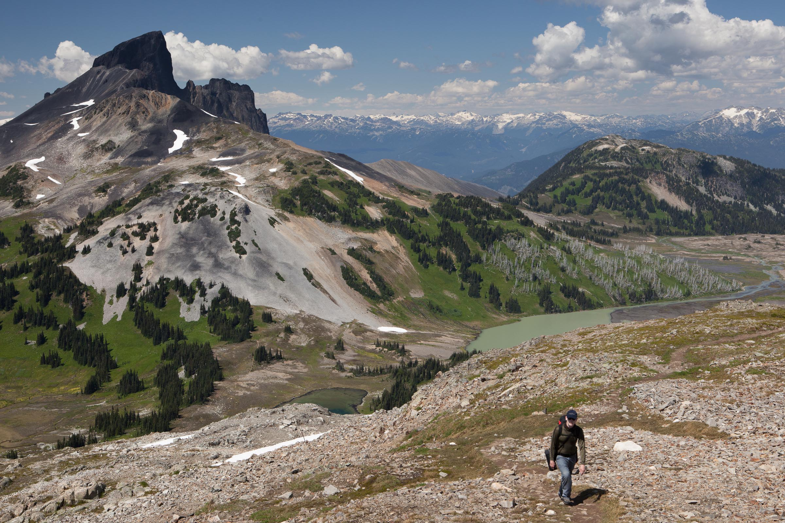
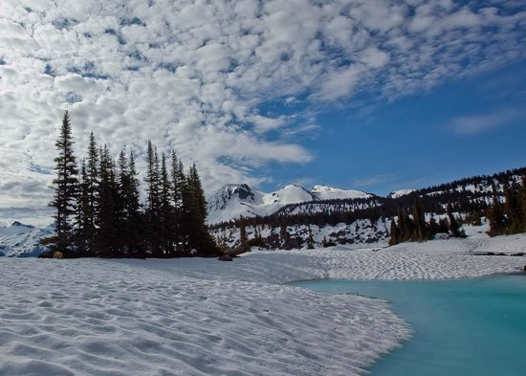
When?
Preferably in the spring (May) or early fall (September)

Slide 4
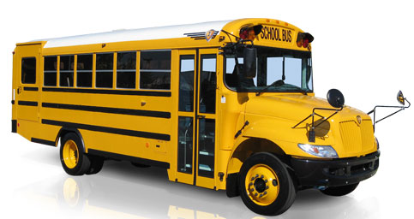
Who?
High school class
Preferably a Senior Physical Education class

Slide 5
What?
3 day trip
Day 1
Arrive at Rubble Creek parking lot
Begin hike to Garibaldi lake
Make camp
Team building games

Slide 6
What?
Day 2
Hike to Black Tusk
Geology lesson (Black Tusk is a stratovolcano) at the summit
First Nations story “The landing place of the Thunderbird”
Geocaching
Hike back to camp
Black Tusk
Region: Whistler
Difficulty: Difficult
Time: 11 hours
Distance: 29km (round-trip)
Elevation Gain: 1740 meters
Season: July - October
Camping: Yes
Dog Friendly: No
Public Transit: No
Approx. 1 hour 45 minutes from Vancouver

Slide 7
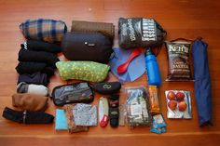
What?
Day 3
Pack up camp
Hike back to Rubble Creek parking lot
Arrive back at school for pick up

Slide 8
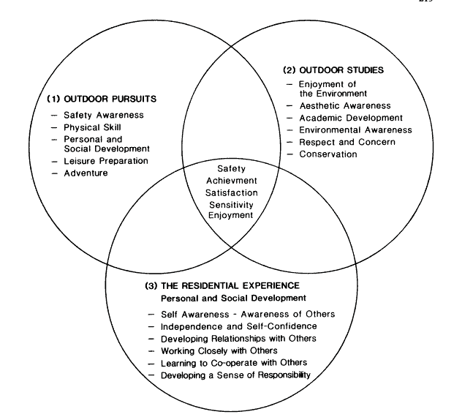
Objectives
Smith, P. (1987) Outdoor education and its objectives. Geography 72 (3), 209–16.

Slide 9
PLO’s
A5- Demonstrate a multitude of physical activities during the hike
B4- Apply principles of training into practice
B5- apply movement concepts (including concepts associated with body awareness, spatial awareness, qualities of movement, and relationships) to improve their performance in demanding or complex physical activities across the activity categories

Slide 10
PLO’s
C1- Apply safety procedures in all physical activities across the activity categories
C2- Model proper use of equipment and facilities
C3- Apply fair play conduct in all physical activities across the activity categories
C4- Apply leadership in a wide range of physical activity situations

Slide 11
Logistical Plan/Considerations
Driving Route: Sea-to-Sky Highway, take a right just past Rubble Creek Bridge
Only 50 Spots available
$10 per person
No harvesting of natural resources; this includes mushrooms
No Fires
YOUTH GROUP INFORMATION PACKAGE FOR GARIBALDI PARK

