Slide 1
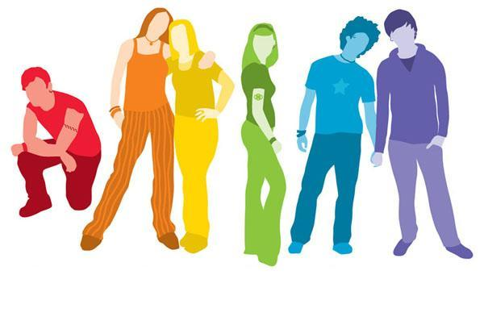
POLICY REPORT
Gender Identity

Slide 2
AGENDA
Introduction
History of Policy
Current Provincial policy
Group activity
Create a policy
Current school policies
Good vs. Bad
Conclusion
Thoughts?
Recommendations

Slide 3
Gender Identity
What is gender identity

Slide 4
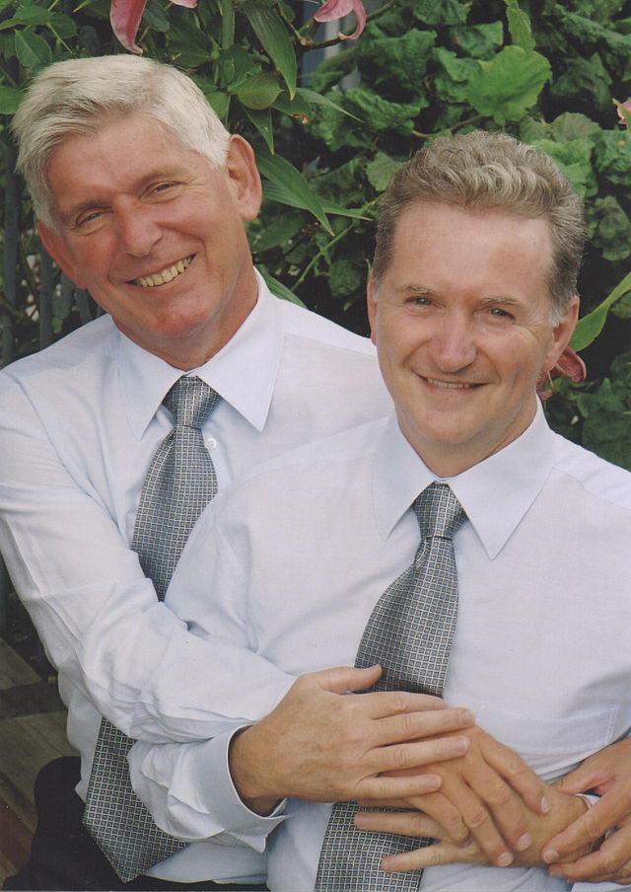
Roots of the Policy
Peter and Murray Corren
1997 - Human Rights Complaint
2006 - The Corren Agreement

Slide 5
Current Ministry policy
No standalone provincial education policy on gender identity
Only mentioned in Diversity policy: “taking into account the different beliefs, customs, practices, languages, behaviours and physical differences of individuals and cultural groups”
From the Human Rights Code:“The BC Human Rights Code identifies 13 protected grounds. People are protected by virtue of their race, colour, ancestry, place of origin, political belief, religion, marital status, family status, physical or mental disability, sex, sexual orientation, age (applies to persons 19 to 64 years of age), and unrelated criminal or summary convictions.”
Can be found in the diversity framework document, but has no specific passages that deals only with sexual orientation. Refers back to Human Rights Code.

Slide 6
GROUP ACTIVITY
Create a policy
Groups of 6 or 7 (your policy groups)
Think about how you might develop something practical using a broad existing policy
Create a mind map to put your thoughts on paper
Present your proposed policy to the class

Slide 7
CURRENT SCHOOL POLICIES
Good
SD 63
SD 48
What we think makes them good?
Not so good
SD 44
SD 33
SD 45
What makes these policies poor?

Slide 8
CONCLUSIONS
What do you think?
What type of policy would you prefer at your practicum school?
How detailed do you think the policy should be?
how does this relate to social justice

