Slide 1
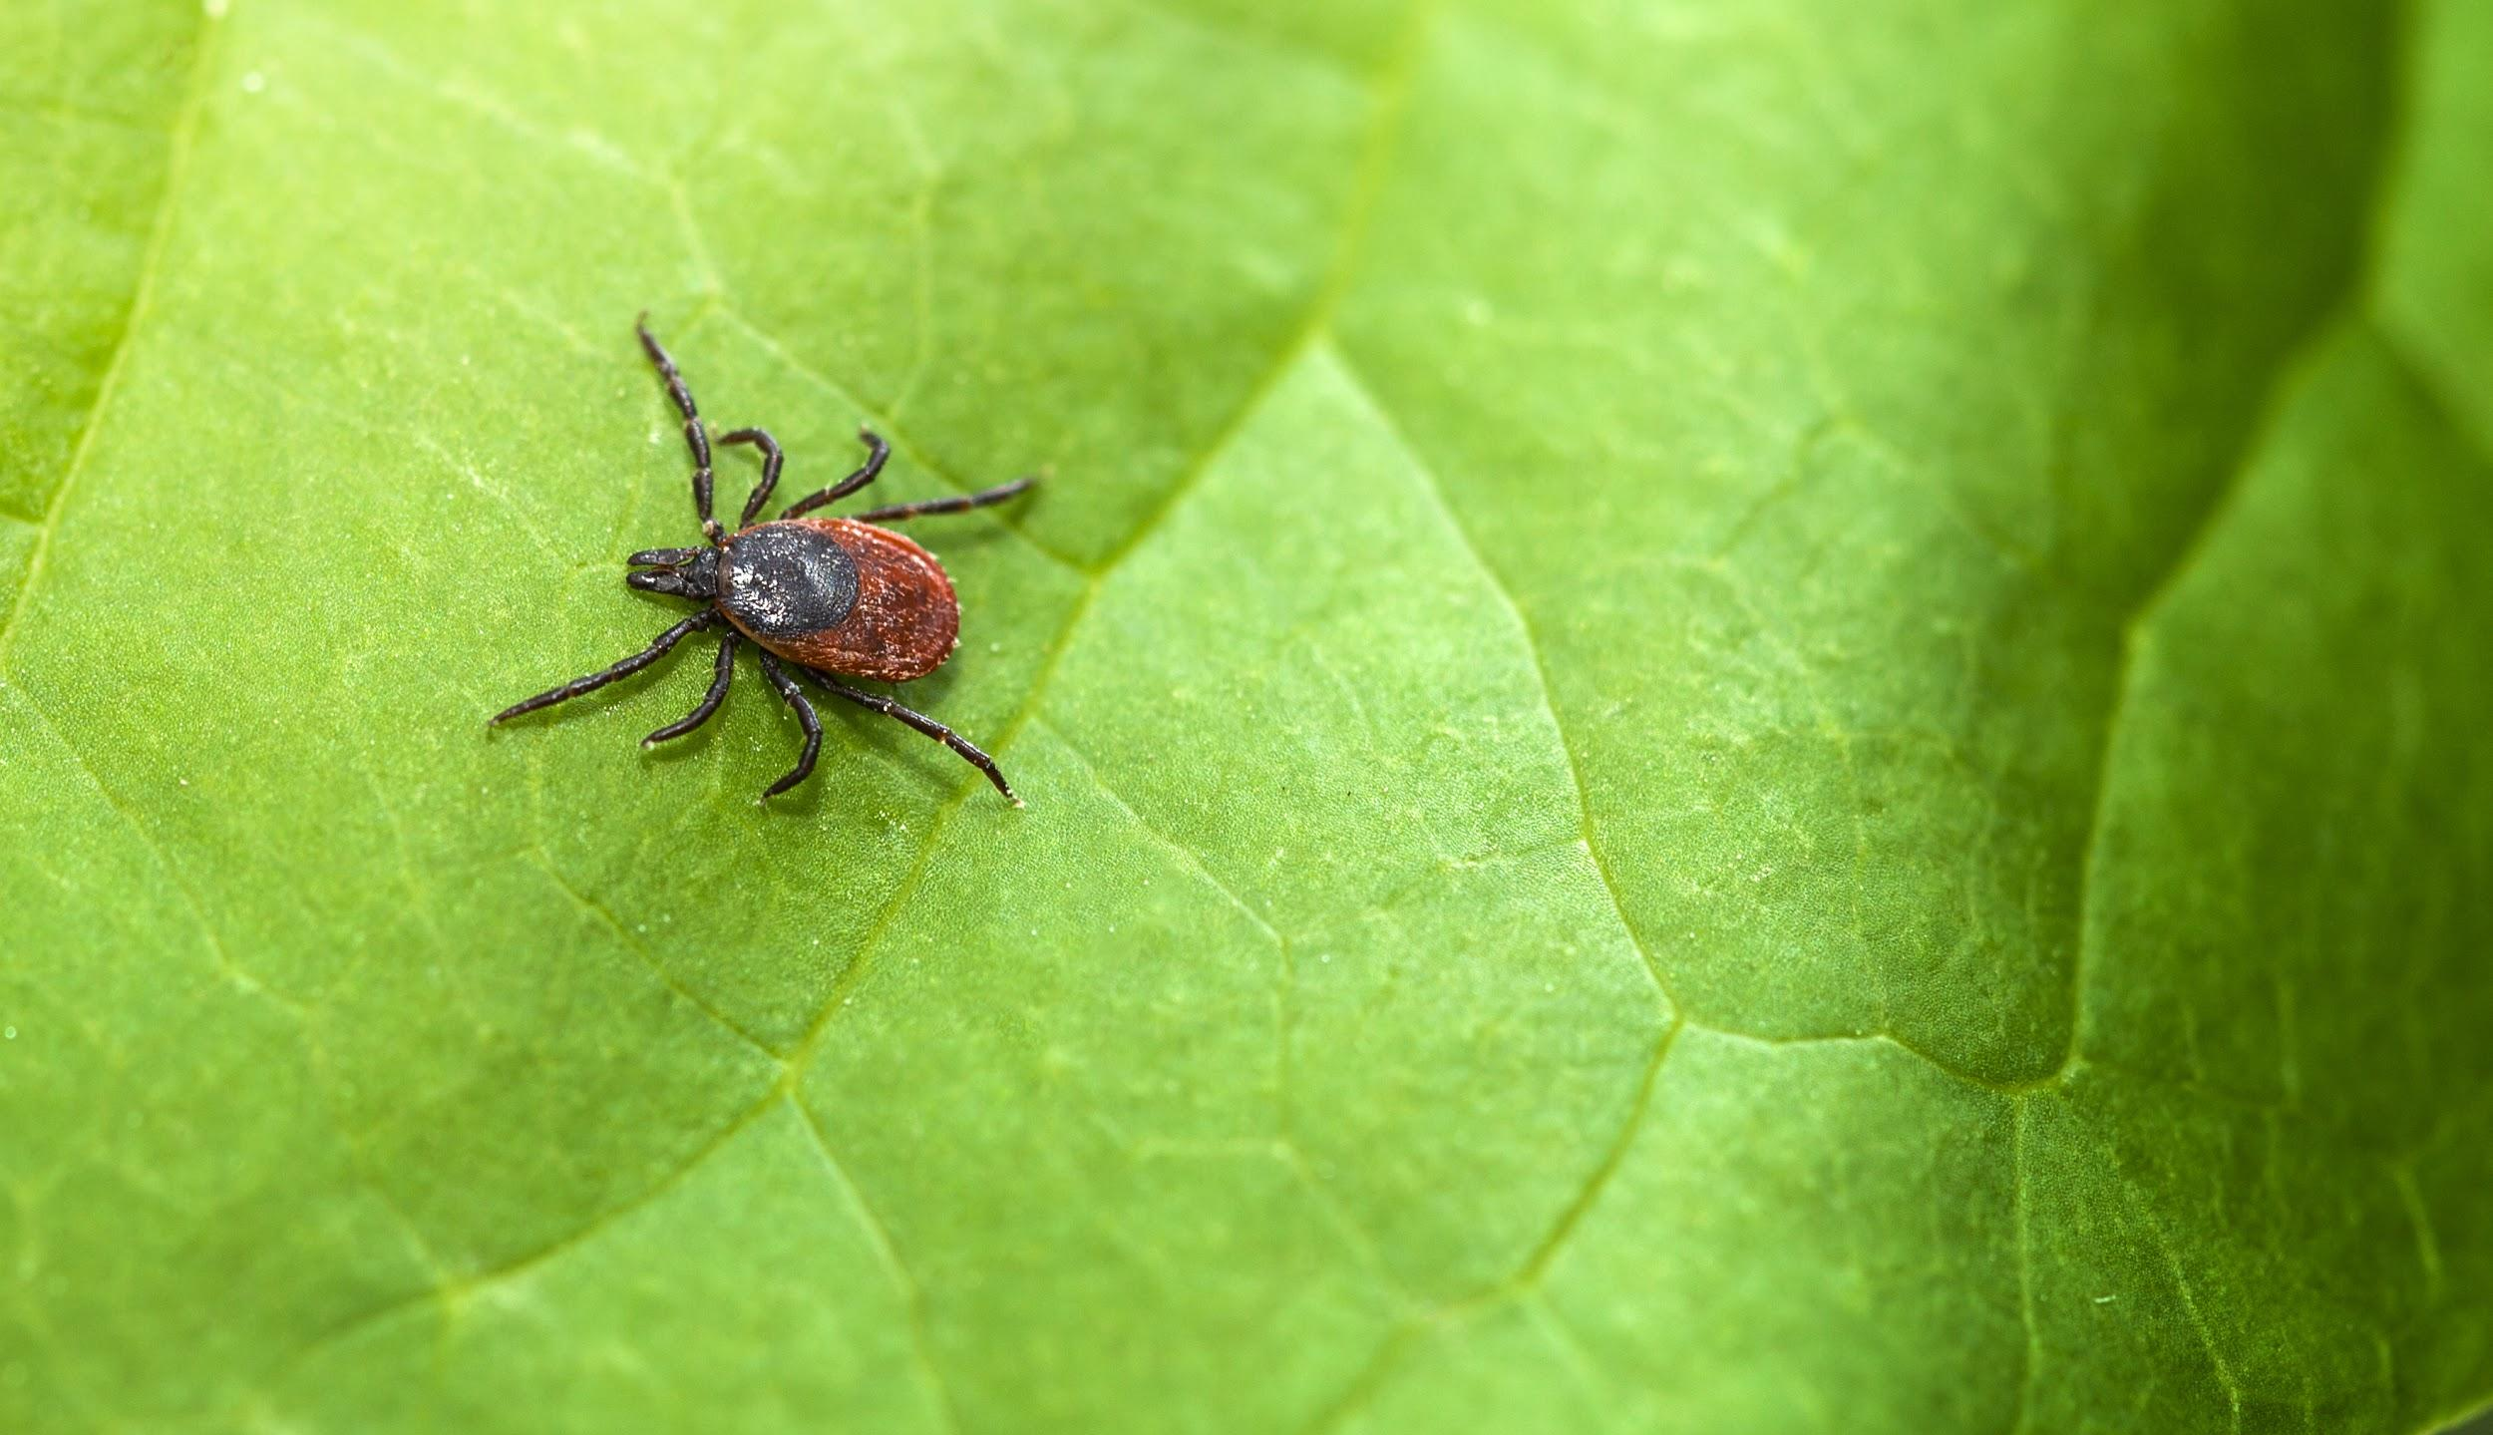
Lyme Disease in
Northeastern USA
Alexander Coster, Chelsey Cu, Kateryna Baranova, Lakshmi Soundarapandian

Slide 2
Overview
Introduction
Background Information
Methodology
Results
Implications
Conclusions

Slide 3
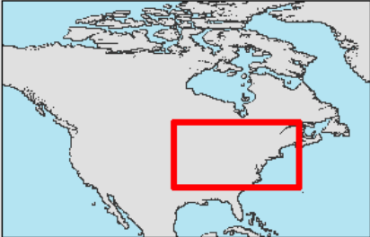
Introduction
Test the occurrence of Lyme disease in northeastern United States in relation to climate and land cover change
Focusing on 14 states identified by the Centre for Disease Control and Prevention (CDC)
Used several environmental variables and MaxEnt technology

Slide 4
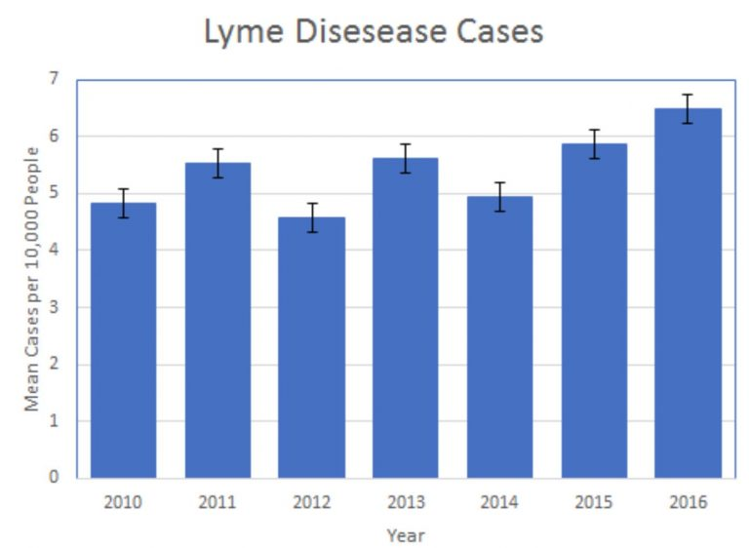
Background – What is Lyme Disease?
Largest vector-borne disease in the United States, and an endemic in Europe and Asia
Caused by black-legged ticks, which are a parasite to the host white-tailed deer
Flu-like symptoms develop into multi-organ and system issues
Has seen an increase over the last few years

Slide 5
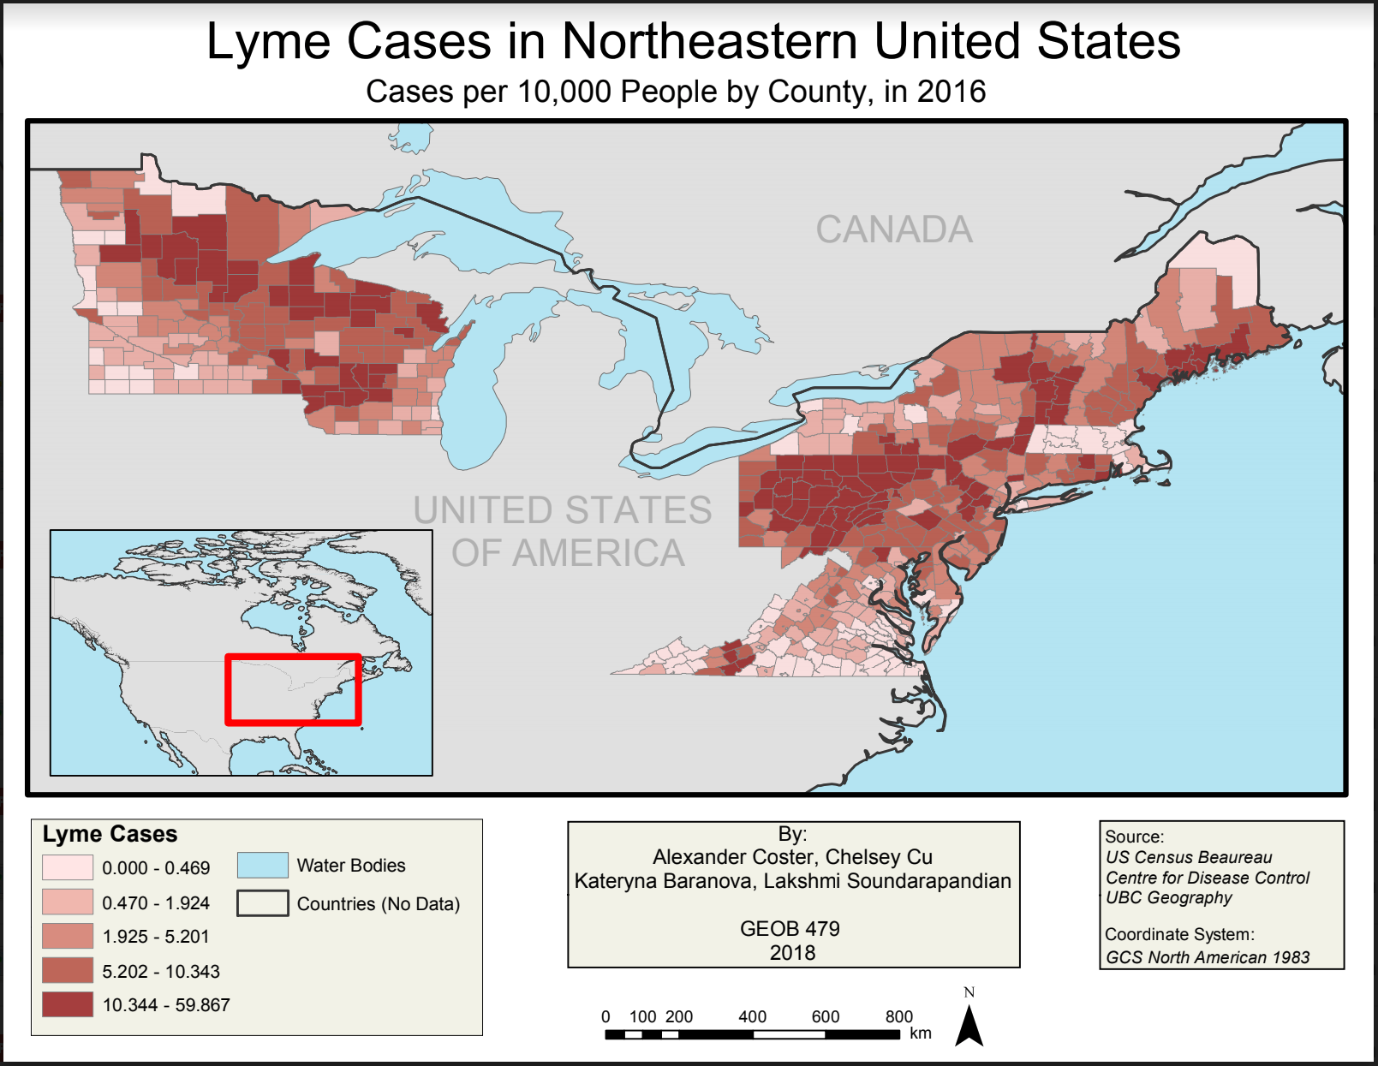

Slide 6
Methodology
Research data
Gather data
World-Clim, IPCC Climate Data, PRISM Climate Group, CGIAR, etc
Parse data
Vector to Raster
Fix cell size, projection, extent
Raster to ASCII
Model 1: Climatic Variables
Model 2: Climatic & Vegetation Variables
Model 3: Climatic, Vegetation & Host Variables
Model 4: Present & 2050 Climatic Variables

Slide 7
Results
Climatic Variables
2050 Extrapolation
04
01
03
Climatic & Vegetation Variables
Climate, Vegetation and Host Variables
02

Slide 8
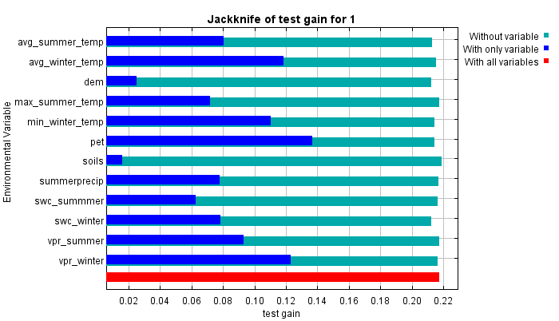
Results
Model 1 – Climatic Variables
Prediction accuracy: 68%
Individually, PET, average winter temperature, and winter vapour pressure are highest
Winter vapour pressure, average summer and winter temperature, and PET are the highest when estimating the relative contribution of variables alongside all the other variables

Slide 9
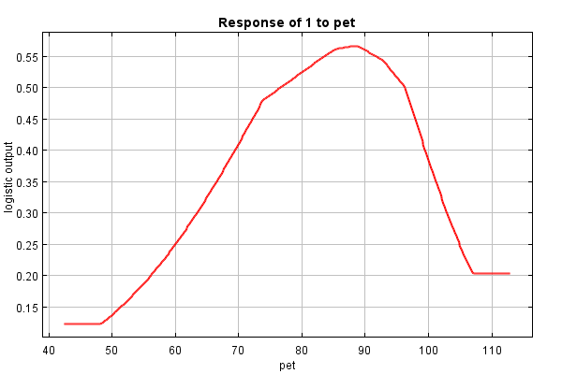
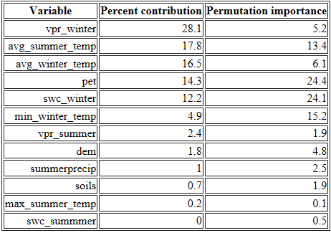
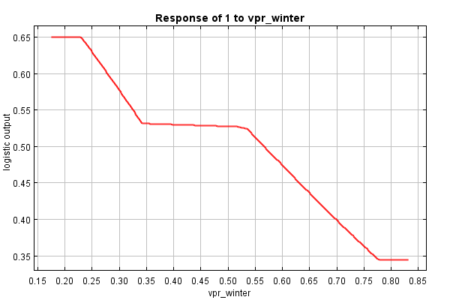
Results
Model 1 – Climatic Variables

Slide 10
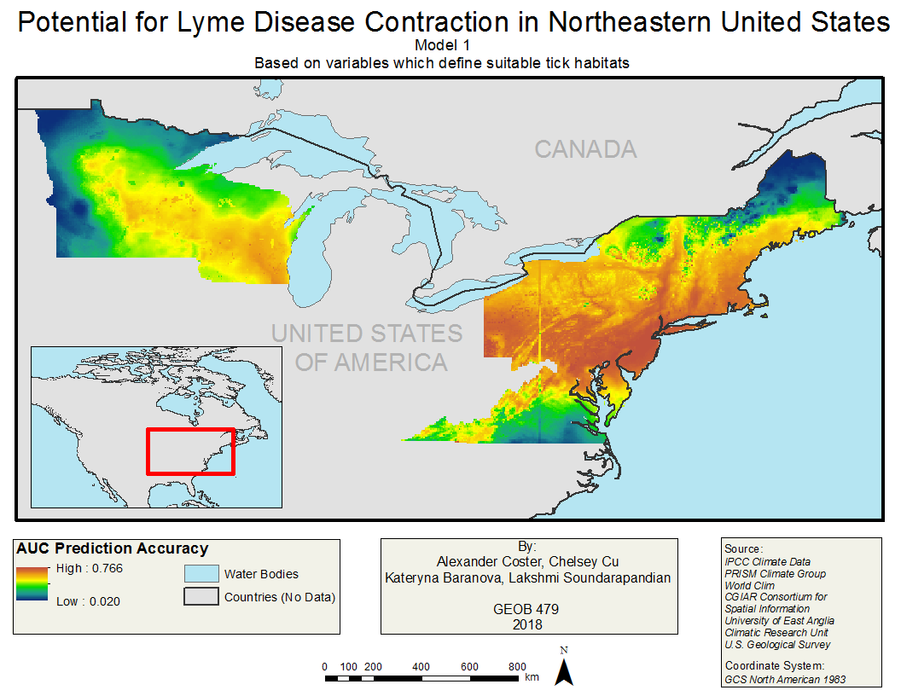

Slide 11
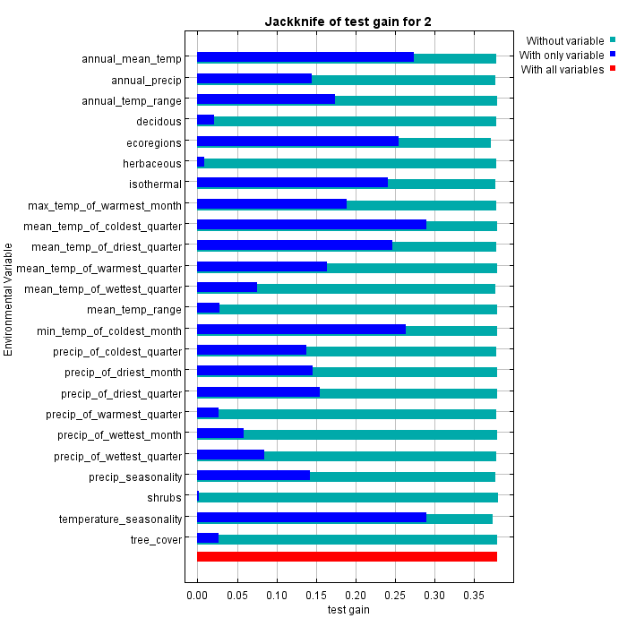
Results
Model 2 – Climatic & Vegetation Variables
Prediction accuracy: 74%
Mean temperature of coldest quarter, annual mean temperature, isothermal, and ecoregion

Slide 12
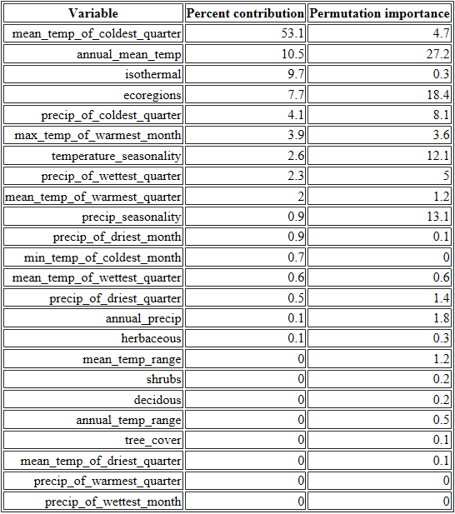
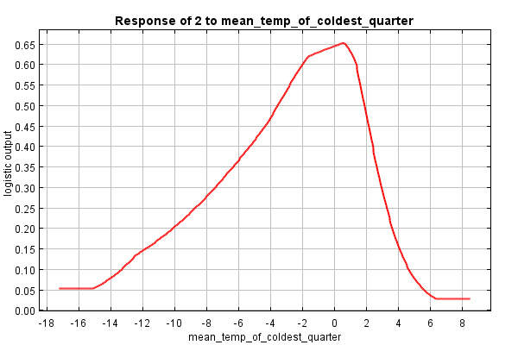
Results
Model 2 – Climatic and Vegetation Variables

Slide 13
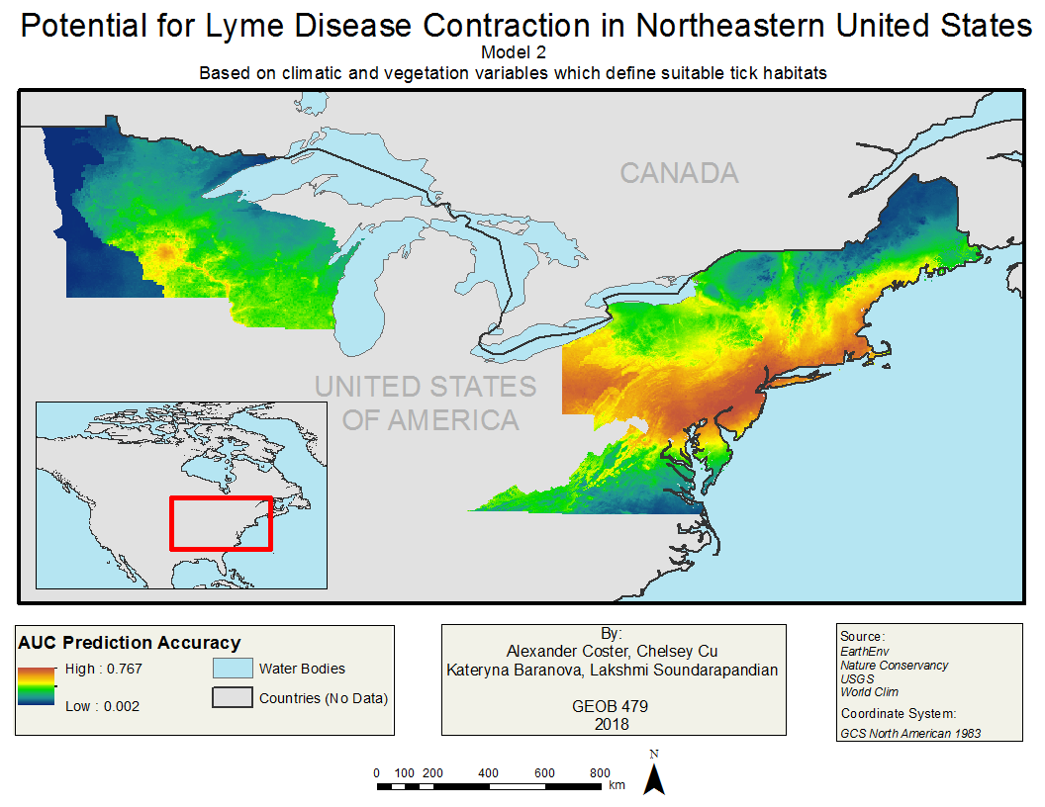

Slide 14
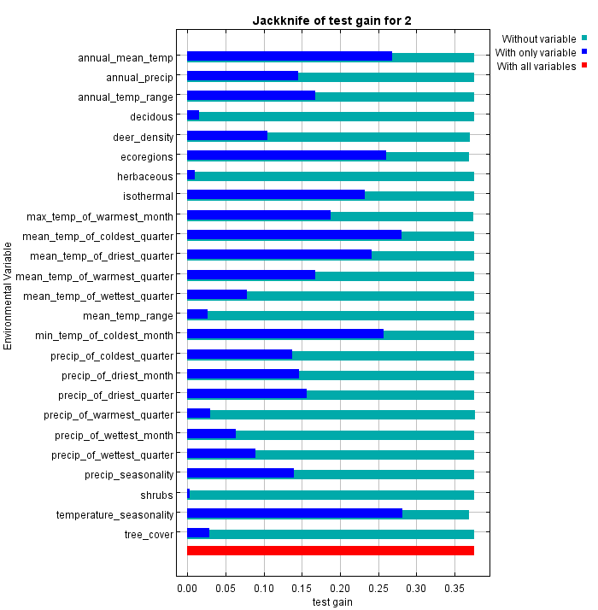
Results
Model 3 – Climatic, Vegetation & Host Variables
Prediction accuracy: 74%
Mean temperature of coldest quarter, ecoregions and isothermal are the most important when looking in tandem with other variables

Slide 15
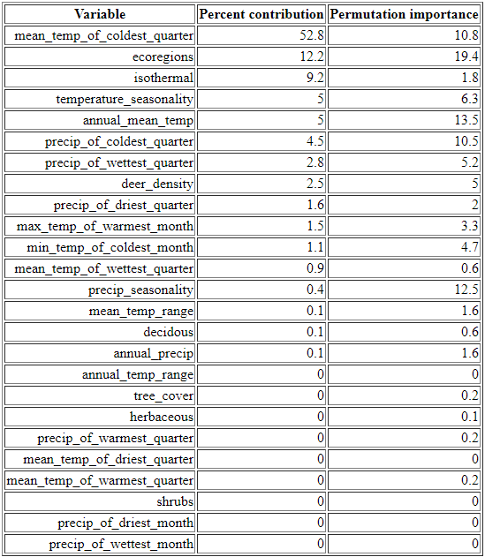
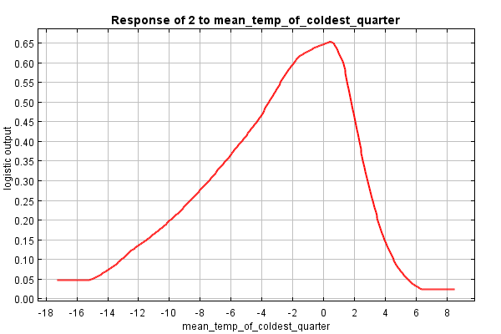
Results
Model 3 – Climatic, Vegetation & Host Variables

Slide 16
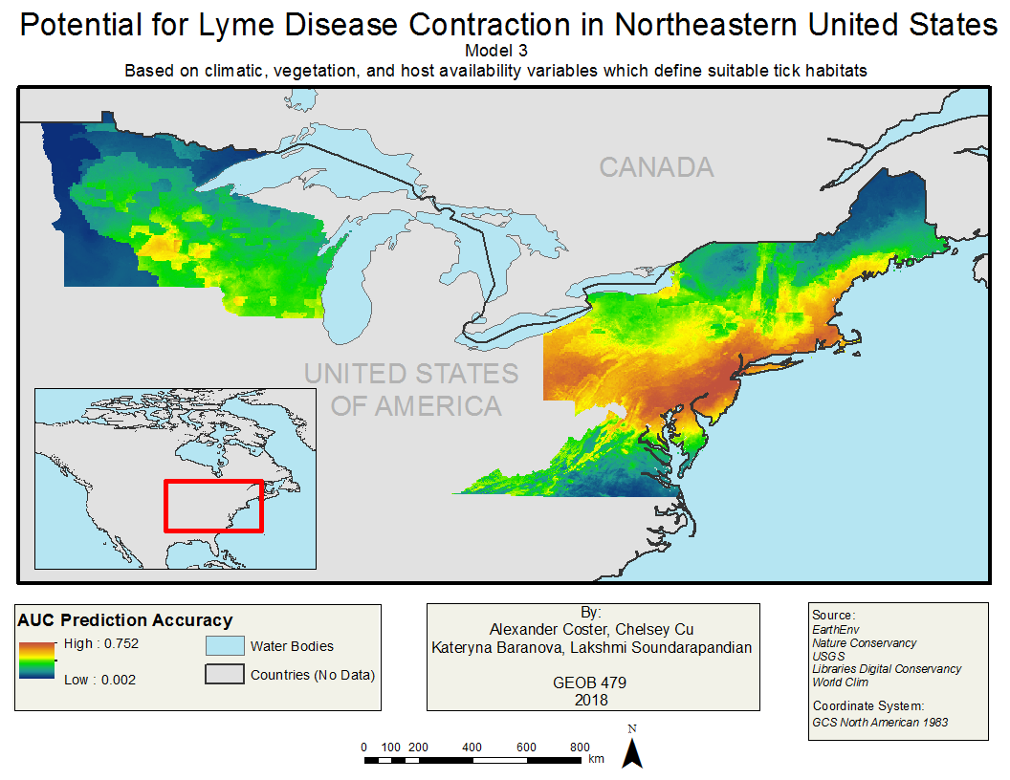

Slide 17
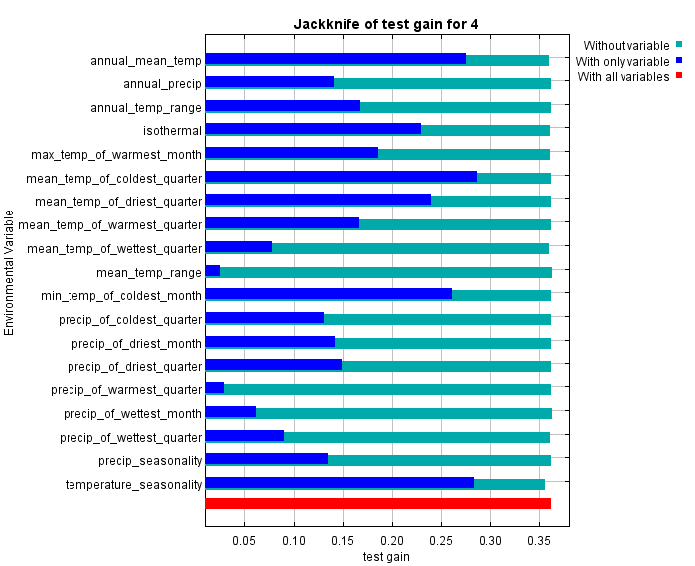
Results
Model 4 – 2050 Extrapolation
Prediction accuracy: 74%
Mean temperature of coldest quarter is still the highest variable both in isolation and with the most closely correlated variables

Slide 18
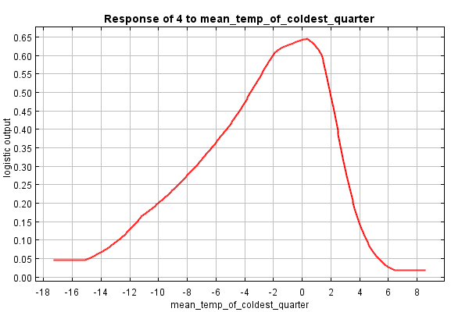
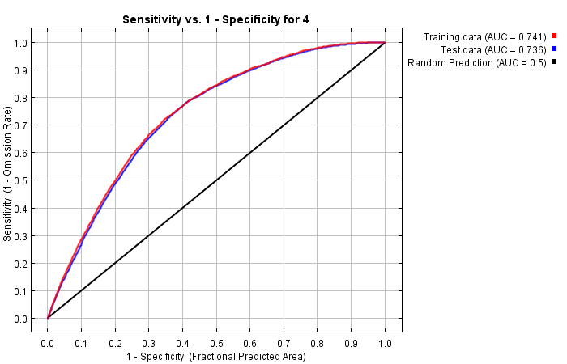
Results
Model 4 – 2050 Extrapolation

Slide 19
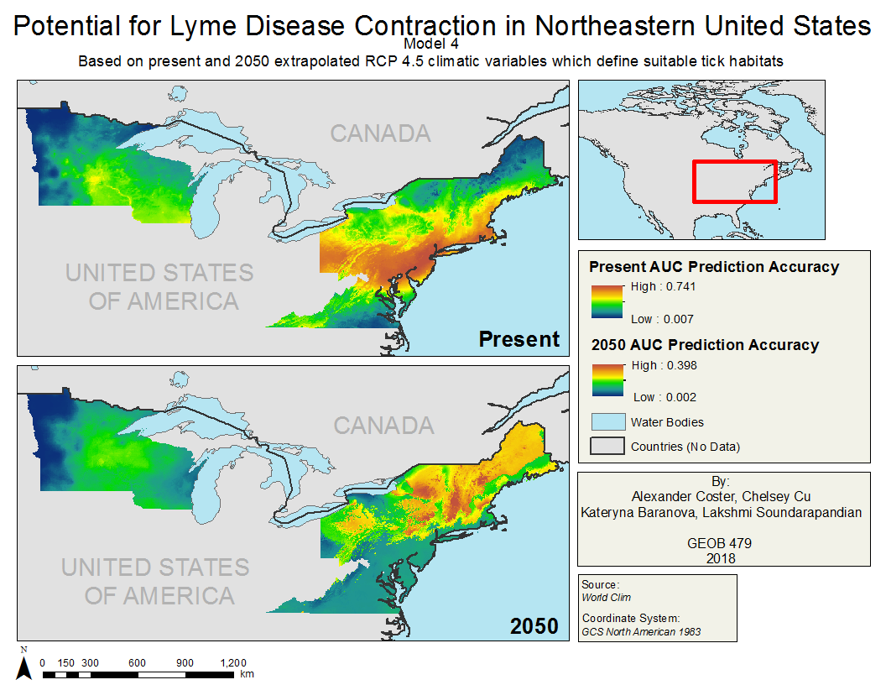

Slide 20
Discussion, Understanding the Problems and Limitations
Cases reported basis of patient residence
Time of contraction could be different from symptoms and reporting
Inconsistent methods of tracking human cases
Use of administrative boundaries for reporting
No strategic field sampling to validate current range predictions
Loss of accuracy due to data conversions
Assumption that optimal tick habitat determines lyme disease
Some variables (vegetation, host populations) assumed unchanged

Slide 21
Questions?

Slide 22
References
Adams, D. A., Thomas, K. R., Jajosky, R.A., Foster, L., Baroi, G., Sharp, P., (…), Anderson, W. J. (2017). Summary of Notifiable Infectious Diseases and Conditions – United States, 2015. Retrieved from https://www.cdc.gov/mmwr/volumes/64/wr/mm6453a1.htm?s_cid=mm6453a1_w
Aucott, J. N., Crowder, L. A., Kortte, K. B. (2013). Development of a foundation for a case definition of post-treatment Lyme disease syndrome. International Journal of Infectious Diseases, v.17:6, e443-e449. Retrieved from https://ac-els-cdn-com.ezproxy.library.ubc.ca/S1201971213000465/1-s2.0-S1201971213000465- main.pdf?_tid=ec915307-d0d8-468e-a242-c43bf9b4fb14&acdnat=1524086719_4420c1c17ab43c9701e32aabd5b8dcd0
Brownstein, J. S., Holford, T. R., & Fish, D. (2003). A climate-based model predicts the spatial distribution of the lyme disease vector Ixodes scapularis in the United States. Environmental Health Perspectives, 111 (9), 1152-1157.
Canadian Lyme Disease Foundation. (n.d.). Symptoms. Retrieved from https://canlyme.com/lyme-basics/symptoms/
Centers for Disease Control and Prevention. (2017). Lyme Disease: Data Statistics. Retrieved from https://www.cdc.gov/lyme/stats/index.html
Centers for Disease Control and Prevention. (2015). Lyme Disease: Transmission. Retrieved from https://www.cdc.gov/lyme/transmission/index.html
Centers for Disease Control and Prevention. (2017). Lyme Disease: Treatment. Retrieved from https://www.cdc.gov/lyme/treatment/index.html
Cheng, A., et al. (2017). Analyzing the potential risk of climate change on lyme disease in eastern Ontario, Canada using time series remotely sensed temperature data and tick population modelling. Remote Sensing, 9, 609.
Chen, D., et al. (2015). Analyzing the correlation between deer habitat and the component of the risk for lyme disease in eastern Ontario, Canada: a GIS approach. ISPRS International Journal of Geo-Information, 4 (1), 105-123.
Ozdeneral, E. (2015). GIS and remote sensing in the exploration of lyme disease epidemiology. International Journal of Environmental Research and Public Health, 12 (12), 15182-15203.

Slide 23
References
Malysa, S. (2017). What kind of climate do ticks survive in? Retrieved from https://sciencing.com/kind-climate-do-ticks-survive-8734880.html
Marques, A. R. (2010). Lyme Disease: A Review. Current Asthma and Allergy Reports – Springer, v.10, 13–20. Retrieved from https://link.springer.com/content/pdf/10.1007%2Fs11882-009-0077-3.pdf
Ozdeneral, E. (2015). GIS and remote sensing in the exploration of lyme disease epidemiology. International Journal of Environmental Research and Public Health, 12 (12), 15182-15203.
Phillips, S. J., Anderson, R. P. & Schapire, R. E. (2006). Maximum entropy modeling of species geographic distributions. Ecological Modelling, 190 (3), 231–259.
Phillips, S.J., Dudik, M. & Schapire, R.E. (2018) Maxent software for modeling species niches and distributions (Version 3.4.1). Retrieved from http://biodiversityinformatics.amnh.org/open_source/maxent/
Peterson, A. T., & Raghavan, R. K. (2017). The geographic distribution of Ixodes scapularis (Acari: Ixodidae) revisited: the importance of assumptions about error balance. Journal of Medical Entomology, 54 (4), 1080-1084.
Seukep, S. E., et al. (2015). An examination of the demographic and environmental variables correlated with lyme disease emergence in Virginia. EcoHealth, 12 (4), 634-644.
Stafford, K. C. & Williams, S. C. (2014). Deer, Ticks, and Lyme Disease: Deer Management as a Strategy for the Reduction of Lyme Disease. The Connecticut Agricultural Experiment Station. Retrieved from http://www.ct.gov/caes/lib/caes/documents/publications/fact_sheets/entomology/deer_&_ticks_fact_sheet.pdf
University of Rhode Island. (2018). Tick Encounter Resource Center. Retrieved from http://www.tickencounter.org/
Wormser, G.P., et al. (2007). The Clinical Assessment, Treatment, and Prevention of Lyme Disease, Human Granulocytic Anaplasmosis, and Babesiosis: Clinical Practice and Guidelines by Infectious Disease Society of America. Clinical Infectious Diseases, 45 (7), 1089-1134.

