Slide 1
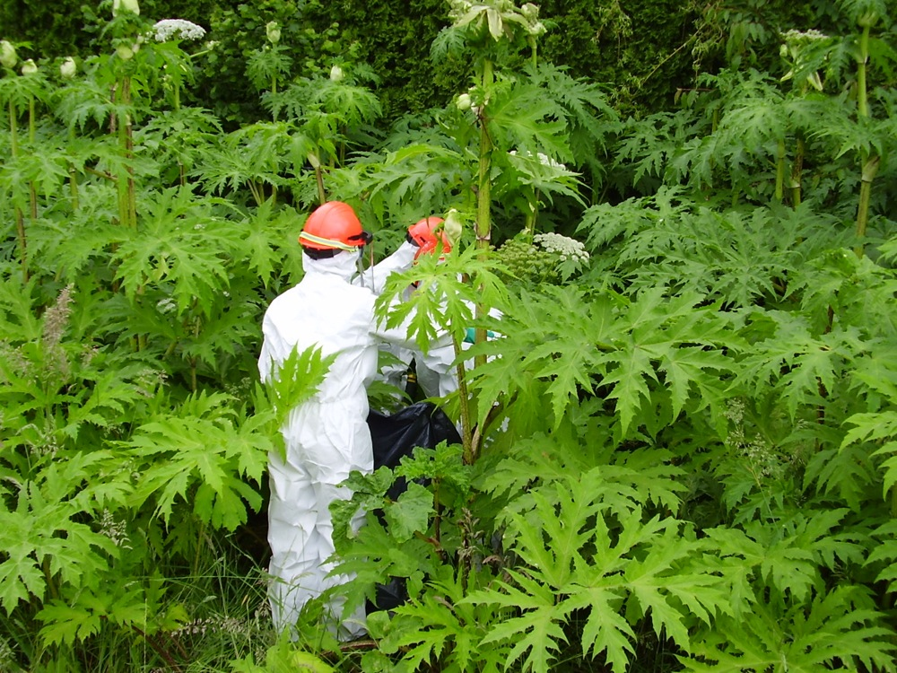
What Shapes Giant Hogweed Invasion? Answers from a Spatio-temporal Model Integrating Multiscale Monitoring Data
Sylvia Moenickes & Jan Thiele
Review by Alex Coster and Kateryna Baranova
Source: https://bcinvasives.ca/images/photos/_full/Giant_hogweed012_FrValleyRegDist_1.jpg

Slide 2
Giant Hogweed
Large flowering plant in the carrot family
Competitive invasive plant species in Europe and North America
From Caucus Mountain region
Prevalent in BC
Contains phototoxic sap, extremely dangerous
Source: https://cdn.images.express.co.uk/img/dynamic/1/590x/hogweed-827332.jpg

Slide 3
Goals of the Report
Significance of different mechanisms of invasion?
Is a model able to accurately predict invasion patterns?
How is this information useful?

Slide 4
Study Area
Western and Southern Germany
Eight 1km² sites
2002 - 2009

Slide 5
The Experiment
Spatio-temporal model with two components:
Life-cycle Matrix Model
Cellular Automaton Simulation
Demography of plants (Huls et al., 2007; Pergl et al., 2007)
Survival rate
Fecundity
Capacity limitation (competitors)
Pest management treatments (local actor interviews)
Real-world landscape (aerial imagery)
200 X 200 cells (5m) study areas
Habitat suitability (Thiele & Otte 2006 survey)
Tests efficiency of expansion factors in predicting hogweed expansion

Slide 6
Modelling Concept
Sessile population next year
Locally dispersed population next year
Total population this year
Total population next year
Corridor dispersed population next year
Mobile population next year
Long-distance dispersed population next year
Quantities observed?

Slide 7
Base Model
Quantified spread factors
Dispersal (mechanistic local and corridor, stochastic long-distance)
Habitat suitability
Species invasibility (survival rate, fecundity, pest management)
Nine modifications for hypothesis testing

Slide 8
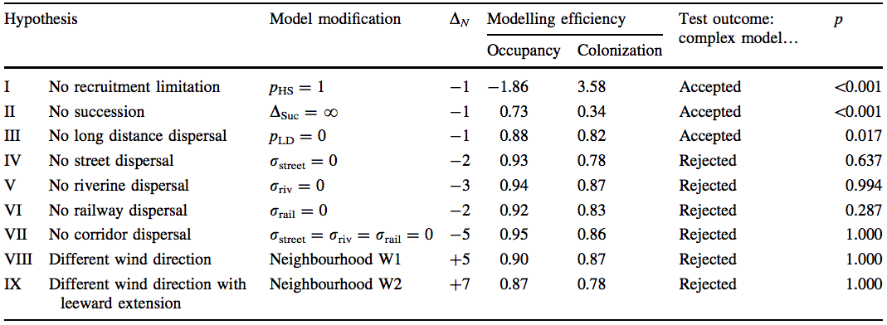
9 Hypotheses
Modifications based on:
Demographic aspects (recruitment limitation, competition due to succession
Dispersal (long-distance, corridor, local)
Survival probabilities

Slide 9
Use of GIS
Remote Sensing:
Aerial Images
ArcGIS:
Map Land Cover
Landscape Elements

Slide 10
Use of GIS
Spatial Distribution Maps
Hagen-Waterhovel Study Area:

Slide 11
Results
Base Model:
All cells occupied and vegetative stage: 0.94
Generative stage: 0.32
Total number colonized: 0.89
Dispersal via
Rivers: 0.73
Local: 0.67
Streets: 0.21
Railways: 0.21
Long distance: -0.95

Slide 12
Results
Hypotheses Testing:
Hypotheses I, II, III improved model
IV – VII: no consistent improvement
VIII & IX: did not improve model

Slide 13
Strong Points
Massive undertaking; integrated input from diverse source
Sensitivity Analysis
Well organized
Simulation was quite accurate

Slide 14
Weak Points
Pest management?
Randomized long-distance dispersal
Problem with monitoring data: young plants
Water & Nutrient factors?
Spatial distribution figures
Arguments against one-at-a-time modifications?

Slide 15
Score
7/10

Slide 16
Questions

