Slide 1
Comparative Modeling Approaches for Understanding Urban Violence
Grubesic, T.H., Mack, E. A., Kaylen, M. T.
Review by Alex Coster and Kateryna Baranova
Source: https://citygeographics.files.wordpress.com/2011/08/londonriots.jpg?w=1024&h=768&crop=1

Slide 2
Report Objectives
Provide a greater understanding of the factors that influence heterogeneous distributions of crime.
Explore the structural theories of violence in Cincinnati, Ohio by block group.

Slide 3
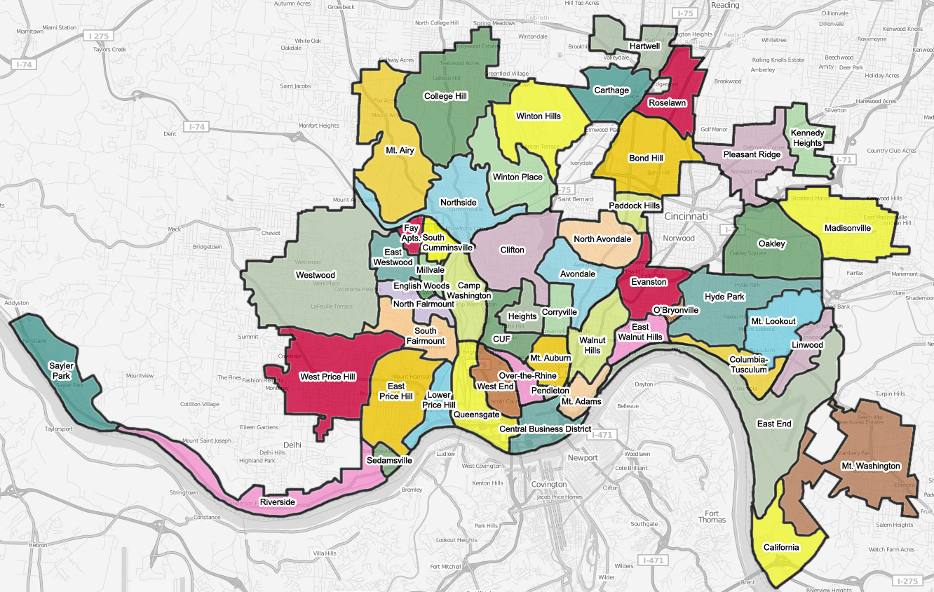
Study Area
Cincinnati, Ohio
Population: 332,000
302 block groups
Source: https://upload.wikimedia.org/wikipedia/commons/3/3c/All-Neighborhoods-Cincinnati.jpg

Slide 4
Analysis Methods
Ordinary Least Squares (OLS)
Test hypotheses, statistically measurable level of change
Geographically Weighted Regression (GWR)
Analyze how relationships vary across space
Data Envelopment Analysis
Relative efficiency of peer units at utilizing resources

Slide 5
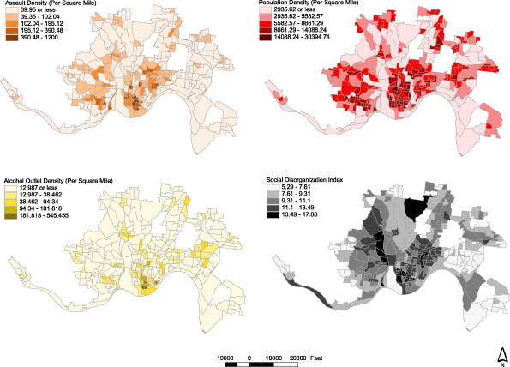
Cartographic Analysis

Slide 6
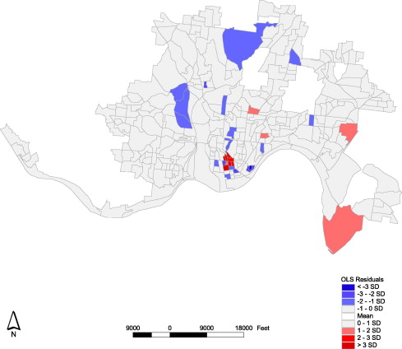
OLS Results
Model Error
Dependent Variable:
Assault Density
Independent Variables: Population density, Alcohol outlet density, Index of social disorganization

Slide 7
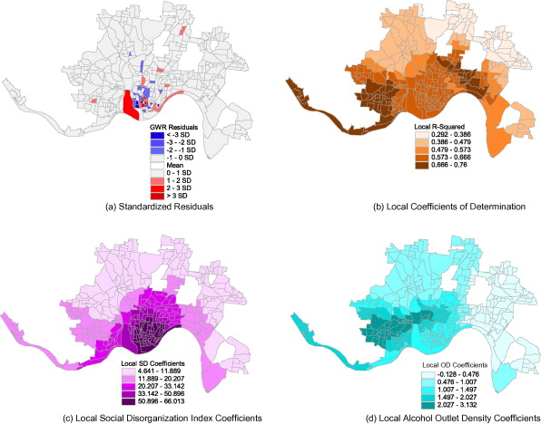
GWR Results
Adaptive kernels
AIC Method

Slide 8
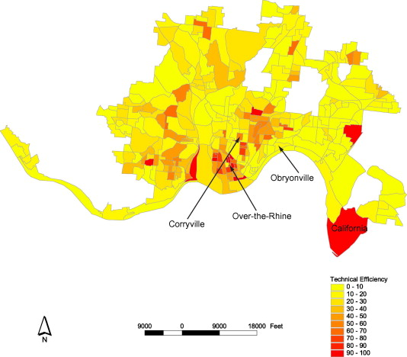
DEA Results
Block producing violent crime
Technically efficient: 11
Somewhat efficient: 19
Inefficient: 272

Slide 9
Strong Points
Easy to read maps
Cartographic representation of crime
Multiple methods used
Logical flow and lots of citations

Slide 10
Weak Points
Regression-based statistical techniques unable to factor in unique features of neighbourhoods
Each analysis method has its limitations

Slide 11
Score
10/10

Slide 12
Questions

