Slide 1
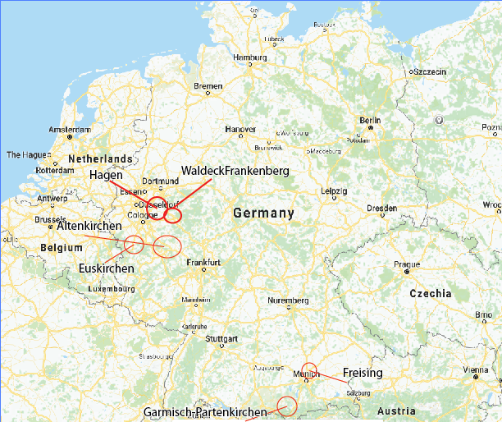
What Shapes Giant Hogweed Invasion? Answers from a Spatio-temporal Model Integrating Multiscale Monitoring Data
Sylvia Moenickes & Jan Thiele
Western and Southern Germany
Eight 1km² sites
2002 - 2009

Slide 2
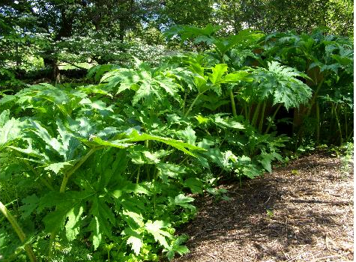
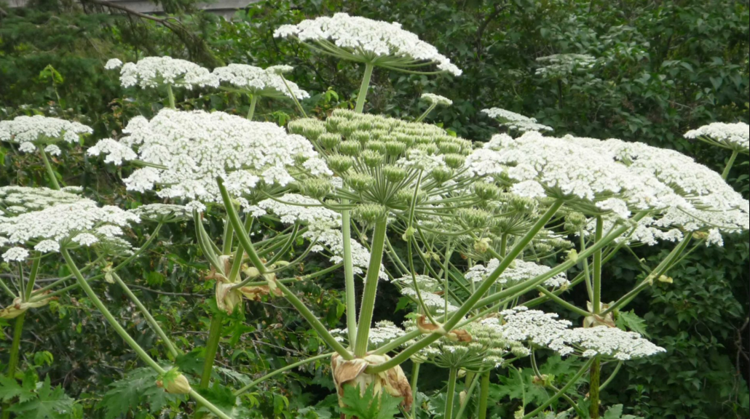
Why study Giant Hogweed/
Heraculem Mentagazzianum?
Large flowering plant in the carrot family
Competitive invasive plant species in Europe and North America
From Caucus Mountain region
Prevalent in BC
Contains phototoxic sap, extremely dangerous

Slide 3
Goal of the Report
Significance of different mechanisms of invasion?
Is a model able to accurately predict invasion patterns?
How is this information useful?

Slide 4
What is the experiment?
Spatio-temporal model; two components:
Life-cycle matrix model
Demography of plants (Huls et al, 2007; Pergl et al, 2007)
Survival rate
Fecundity
Capacity limitation (competitors)
Pest management treatments (local actor interviews)
Cellular Automaton Simulation:
Real world landscape (aerial imagery)
200 X 200 5m cell study areas
Habitat suitability (Thiele & Otte 2006 survey)
Tests efficiency of expansion factors in predicting hogweed expansion

Slide 5
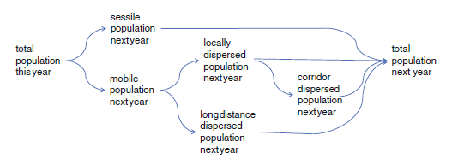
What is the experiment?
The Modelling Concept
Quantities Observed?

Slide 6
Base model & Hypotheses
Base model:
Quantified spread factors
Dispersal (mechanistic local and corridor, stochastic long-distance)
Habitat Suitability
Species invasibility (survival rate, fecundity, pest management)
Capacity limitation (competitors)
Nine Modifications for hypothesis testing

Slide 7
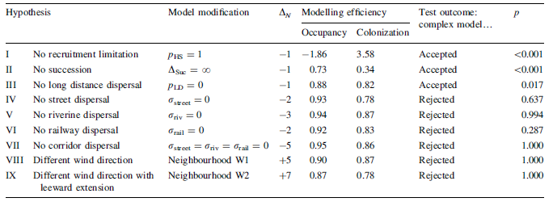
Hypotheses
Modifications based on:
Demographic aspects (recruitment limitation, competition due to succession)
Dispersal (long-distance, corridor, local)
Survival probabilities

Slide 8
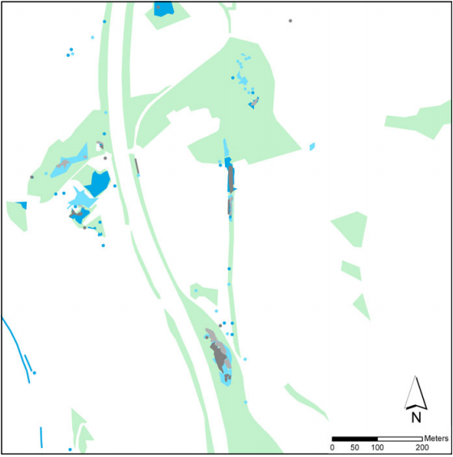
Use of GIS
Remote Sensing - Aerial images
ArcGIS - Map land cover & landscape elements
Hagen-Waterhovel study area

Slide 9
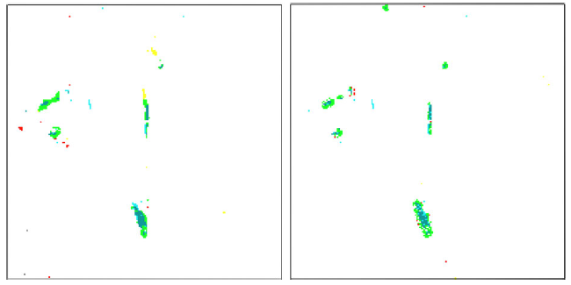
Use of GIS
Spatial Distribution Maps
Hagen-Waterhovel study area

Slide 10
Results
Base Model:
All cells occupied and vegetative stage: 0.94
Generative stage: 0.32
Total number colonized: 0.89
Dispersal via
Rivers: 0.73
Local: 0.67
Streets: 0.21
Railways: 0.21
Long distance: -0.95
Hypotheses Testing:
Hypotheses I, II, III: improved model
IV - VII: no consistent improvement
VIII & IX: did not improve model

Slide 11
Discussion
Weak Points:
Pest management?
Randomized long-distance dispersal
Problem with monitoring data: young plants
Water & Nutrient factors?
Spatial distribution figures
Arguments against one-at-a-time modifications?
Strong Points:
Massive undertaking; integrated input from diverse sources
Sensitivity Analysis
Well organized
Simulation was quite accurate
Grade: 7/10

