Slide 1
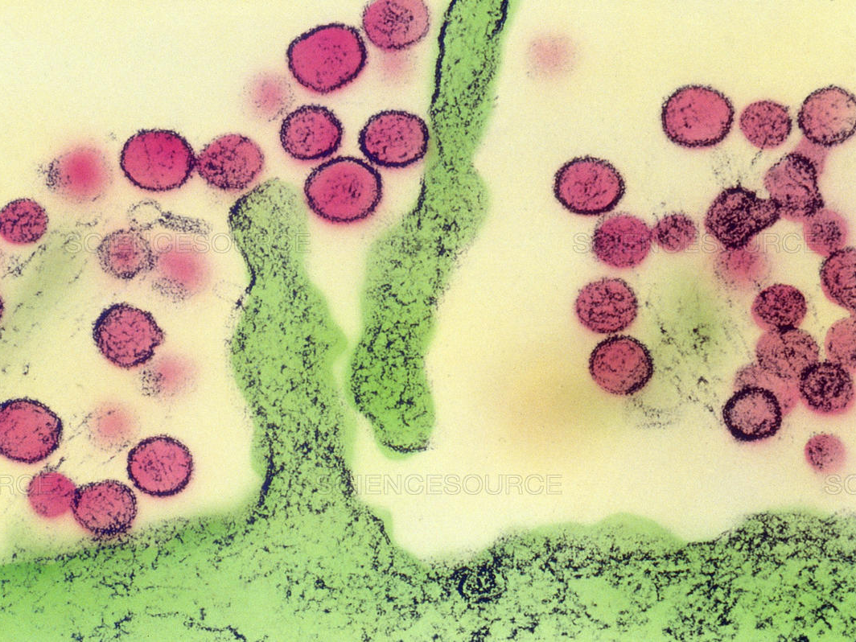
Remote Sensing and Geographic Information Systems: Charting Sin Nombre Virus Infections in Deer Mice
Boone, J. D., McGwire, K. C., Otteson, E. W., DeBaca, R. S., Kuhn, E. A., Villard, P., Brussard, P. F., St. Jeor, S. C
Review by Alex Coster and Kateryna Baranova
Source: https://sciencesource.com/archive/Hantavirus--Sin-Nombre-Virus--TEM-SS2301287.html

Slide 2
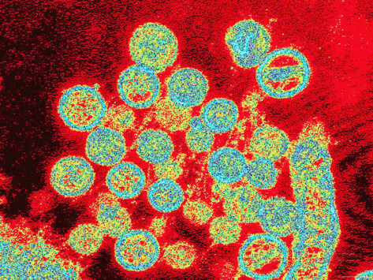
Sin Nombre Virus
Pathogen
Primary host: deer mice
Associated with hantavirus pulmonary syndrome (HPS)
Death rate in US from HPS -> 40%
Source: https://www.pinterest.ca/pin/376261743851864853/
Source: https://www.arrownj.com/deer-mice
Notes:
Since the first recognized outbreak of HPS in the southwestern United States in 1993, approximately 240 cases have occurred, with a death rate of approximately 40%

Slide 3
Report Objectives
What host-virus-environment relationships can be discovered?
Are RS and GIS data useful indicators of the spatial patterns of SNV infections in populations of deer mice?
Notes:
No simple relationships have been found between host density and antibody seroprevalence, but more complex nonlinear relationships appear to exist. SNV infections also appear to be less frequent in relatively high- or low-elevation habitats
RS and GIS are most useful if disease dynamics and distributions are clearly related to mapped environmental variables. For example, if a disease is associated with certain vegetation types or physical characteristics (elevation, average precipitation), RS and GIS could identify regions where risk is relatively high.

Slide 4
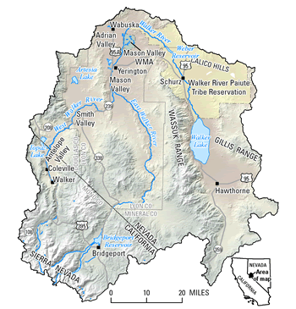
Study Area
Walker River Basin
(Nevada & California)
10,200 km²
144 (-25) sites
1995-1998
(excluding 1997)
Source: https://nevada.usgs.gov/walker/
Notes:
25 sites were excluded from analysis because no deer mice were captured
At least nine cases of HPS have occurred in the area since 1993
excluded 1997 data from all analyses because host density and infection dynamics appeared atypical and likely to obscure the baseline spatial infection patterns

Slide 5
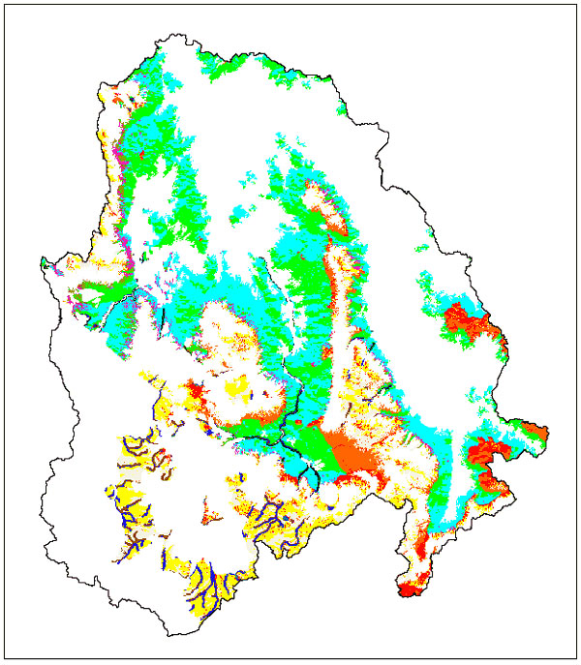
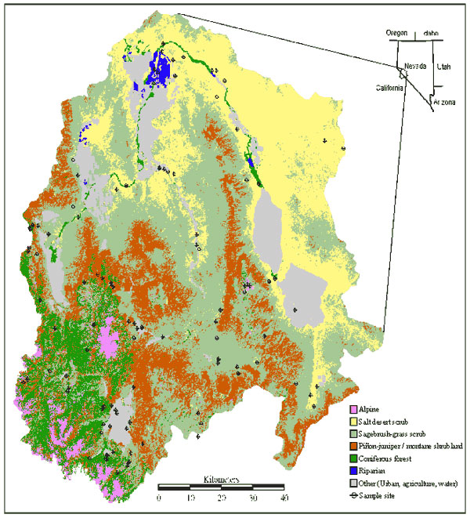
The Study
Status I & II
8 major vegetation types
NDVI for vegetation density
Elevation and slope from 2 USGS DEMs
Proximity to streams and water bodies
Distinct environmental strata
Notes:
"Status 1" classified sites with one or more antibody-positive animals as positive
"Status 2" required two or more antibody-positive deer mice or an overall antibody seroprevalence of at least 10% for a site to be classified positive
categorized each GIS variable according to its relevance to each of the eight vegetation types
relevant variables were divided into high and low ranges. The resulting binary classes for each variable were then intersected in GIS to produce distinct environmental "combinations", or strata, for each vegetation type

Slide 6
Analysis Methods
Chi-square for differences among the proportion of positive sites for each vegetation type
Canonical linear discriminant function (DFA) for infection status vs RS and GIS variables
Confidence intervals
Notes:
A normal approximation of confidence limits was obtained by multiplying the standard deviation of each estimate by the t-table value associated with 95% confidence and the appropriate number of samples. These confidence intervals also allowed us to determine whether classification accuracy differed significantly between methods.

Slide 7
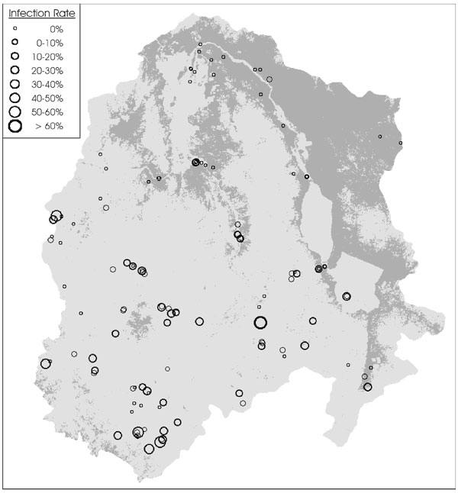
Results
Positive sites
Salt desert scrub:
Status I: 34%
Status II: 14%
Other types:
Status I: 50-100%
Status II: 50-83%

Slide 8
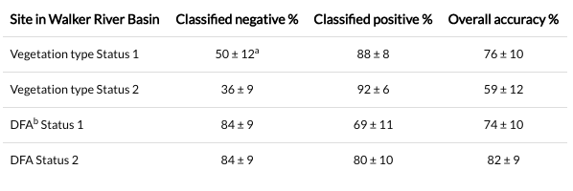
Results
Notes:
aThe error terms following each estimate are 95% confidence intervals derived from the binomial distribution.
bDFA = discriminant function analysis
By assigning the predominant infection status to all sites within a given vegetation type, overall classification accuracies of 76% (Status 1) and 59% (Status 2) could be achieved (Table 1). The Status 1 criterion resulted in better classification accuracy (for negative sites and for all sites combined) than Status 2. For both Status 1 and Status 2, positive classification was more accurate (88%) than negative classification (50%).
DFAs for both Status 1 and Status 2 produced significant canonical correlations showing that negative sites were associated with low elevations and sparse vegetation (Table 2). These qualities most often occur in salt desert scrub (24). In contrast, positive sites were higher and generally had more dense but less uniform vegetation. Slope and distance from streams were relatively unimportant factors. For both Status 1 and Status 2, negative classification was more accurate than positive classification (Table 1). Positive classification was more accurate in Status 2 than in Status 1
The canonical correlation and its significance level define the overall association between infection status and the indicator variables.
bCanonical loadings for each indicator variable indicate their relative importance in producing a significant overall canonical correlation.
cNDVI = Vegetation density
dNDVI Std. = uniformity of vegetation density
eStreams = distance to nearest mapped stream or body of water

Slide 9
Strong Points
High prediction accuracy
Large amount of sample sites
Great use of statistics in combination with RS and GIS
Logical flow

Slide 10
Weak Points
Modest degree of measurement error
Lack of weather and climate data
Difficult to read maps

Slide 11
Score
8/10

Slide 12
Questions

