Slide 1
From TC to TTOC…
Fact, Fiction, and Urban Fable
Kevin Fadum
District Principal – Human Resources

Slide 2
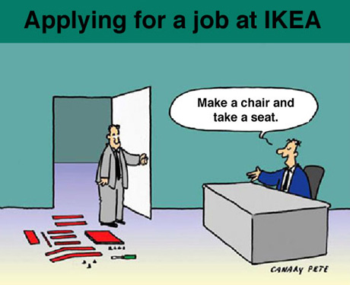

Slide 3
Purpose of the Session:
1. Provide information in 3 areas
Resume building
The application process
Working as a TTOC
2. To dispel some myths
3. To answer some questions
4. To share a caution – working in multiple districts
5. To model some very bad teaching!

Slide 4
Some “Qualifiers”
I know Surrey… not other Metro Districts
Generalizations are just that
Things change quickly (hiring patterns)
Every application is unique

Slide 5
Urban Fable #1
“I have been told that there are no jobs in…..”

Slide 6
The Surrey School District
Landmass of 316km²
140 sites
101 elementary schools
19 secondary schools
Approximately 70,000 students
Approximately 10,000 employees

Slide 7
2015 Surrey Schools Data
In 2015 Surrey hired:
288 TTOCs
126 new Teach
December 14, 2015: 622 TTOCs
School Principals hire teachers from the TTOC list – 117 TTOCs converted to Teacher

Slide 8
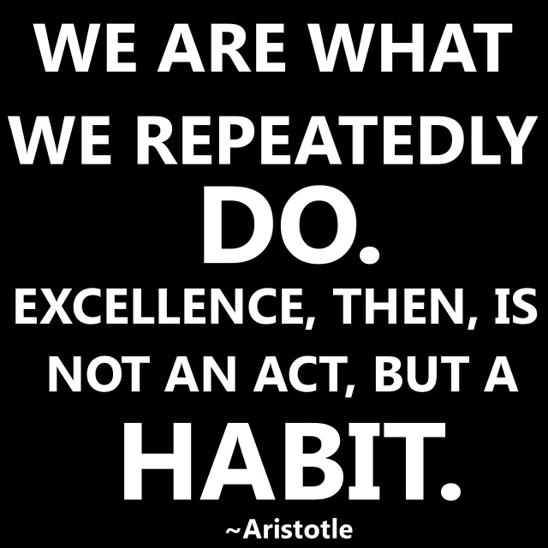
We look for excellence:

Slide 9
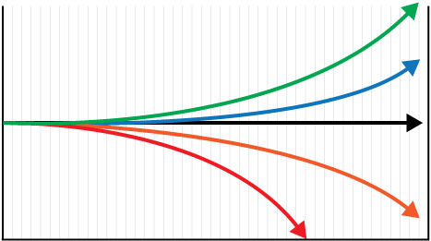
We look for a growth mindset
growth
time

Slide 10
Crafting a CV
Paper colour (cream or goldenrod)
Font (Arial vs. Courier)
To Staple or to Bind
Picture or no picture

Slide 11
The Facts
Key Components
- TTOC application
- Cover letter
- Resume
- Teaching reports
- Supporting documents
- Website for step by step

Slide 12
Urban Fable #2
“Letters of Reference are Critical…. get as many as you can.”

Slide 13
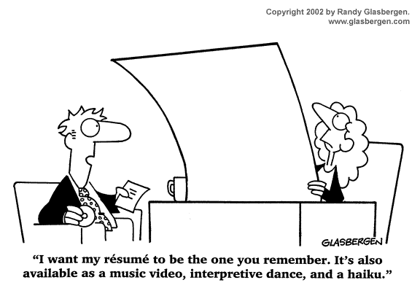

Slide 14
Some Advice
Show why your application is unique and interesting in the cover letter
Be clear and concise
What is important to include?
Proofread and spellcheck!!!
Sign the cover letter

Slide 15
Urban Fable #3
“You only get hired in Surrey if….”

Slide 16
The Hiring Process in Surrey
We hire teachers to act as TTOCs, knowing they will become teachers (sometimes very quickly)
We use the three R’s for consideration for
interview
Reports
References – one from an administrator
Resume

Slide 17
The Interview
Behaviour Based
Not a surprise quiz
Talk about your students, your practice, and your learning
Responses demonstrate alignment between beliefs and actions

Slide 18
What if I don’t get hired?
Get experience
Keep teaching
Continue professional growth
New teaching reports
Re apply
(Please don’t argue…. It really doesn’t help)

Slide 19
Working in Surrey
The dispatch process
How much will I work
How long will I TOC… road to a contract
Keys to success as a TOC

Slide 20
Urban Fable #4
“Working in multiple districts will get me more work…”

Slide 21
Working in Multiple School Districts
Why teachers work in multiple districts?
-Perception of income assurance
-Collective agreement changes
-Nice to be wanted
-Interesting to experience multiple districts

Slide 22
Working in multiple districts
Reality:
1) Pay based on increments – 170 days TTOC experience equals one increment step in a district.
Caution:
Working in multiple school district has the potential to negatively affect pay as experience points are ‘siloed’ in a district.

Slide 23
Working in multiple districts
Reality:
2) In most districts the school principal hires teachers for short term leaves. (relationships = contract)
Caution:
Working in multiple school districts can have a negative impact on TTOC relationships with schools as teachers and administration may find you less dependable, especially in districts where teachers can request a specific TTOC.

Slide 24
Working in multiple districts
Reality
3) Rapid changes in education are occurring and continuing to evolve – you are more current than the graduates of last year. The graduates of next year will be more current than you.
Caution:
We are at the beginning of one of the greatest shifts in education in a long time, there is no time like the present to pursue employment opportunities.

Slide 25
A suggestion
1) Apply to multiple school districts
2) Build a criteria for choosing your ‘main district’ – considerations:
Where do I live?
Where do I want to live?
Do I have children (do I hope to?)
Contract conversion

Slide 26
Interested in teaching in Surrey?
Application information session:
March 29, 2016
3:30 – 5:00pm
Resource Education Center
14123 – 92nd Avenue,
Surrey, BC

Slide 27
Your Questions…
General vs. Specific Questions
Going home in the car questions
stafford_d@surreyschools.ca

