Slide 1
Clyde Hertzman, MD Human Early Learning Partnership University of British Columbia, Vancouver
Early Child Development
in Richmond

Slide 2
Sensitive Periods in Early Brain Development
Pre-school years
School years
High
Numbers
Peer social skills
Sensitivity
Symbol
Language
Habitual ways of responding
Emotional control
Vision
Hearing
Low
0
1
2
3
4
5
6
7
Years
Graph developed by Council for Early Child Development (ref: Nash, 1997; Early Years Study, 1999; Shonkoff, 2000.)
Notes:
‘Sensitive periods’ in early brain development – this slide is based on the following references:
Doherty, G. (1997). Zero to Six: the Basis for School Readiness. Applied Research Branch R-97-3E Ottawa: Human Resources Development Canada.
McCain & Mustard (1999). Early Years Study. Toronto, Ontario: Publications Ontario.
Shonkoff, Jack (Ed) (2000). From Neurons to Neighborhoods: The Science of Early Childhood Development. Washington, D.C.: National Academy Press.
- change colours

Slide 3
Life Course Problems Related to Early Life
2nd Decade
3rd/4th Decade
5th/6th
Decade
Old Age
School Failure
Teen Pregnancy
Criminality
Obesity
Elevated Blood
Pressure
Depression
Coronary Heart
Disease
Diabetes
Premature
Aging
Memory Loss

Slide 4
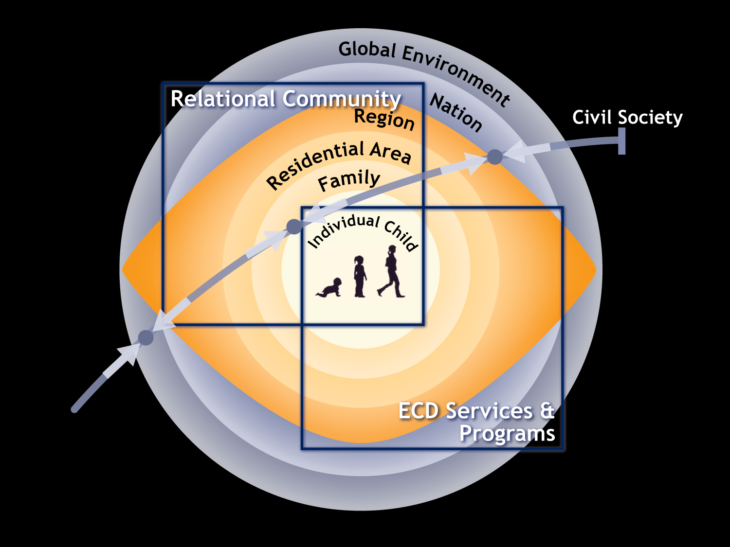

Slide 5
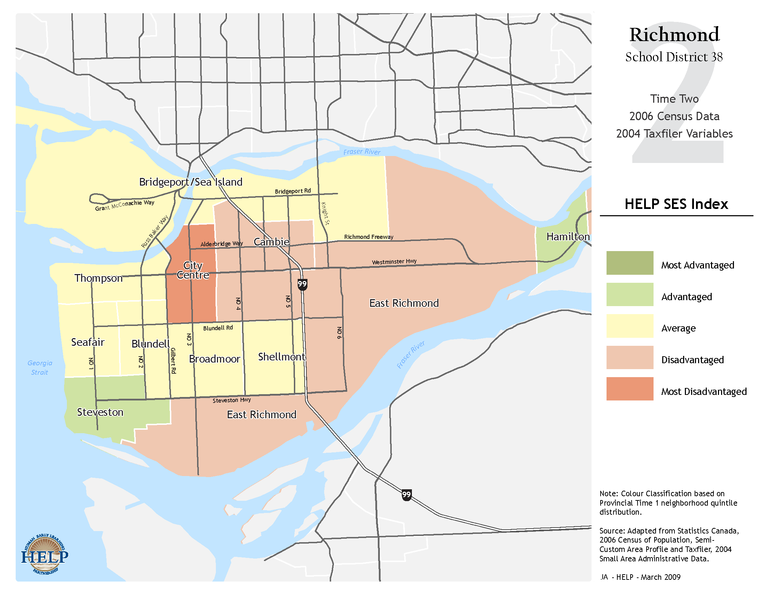

Slide 6
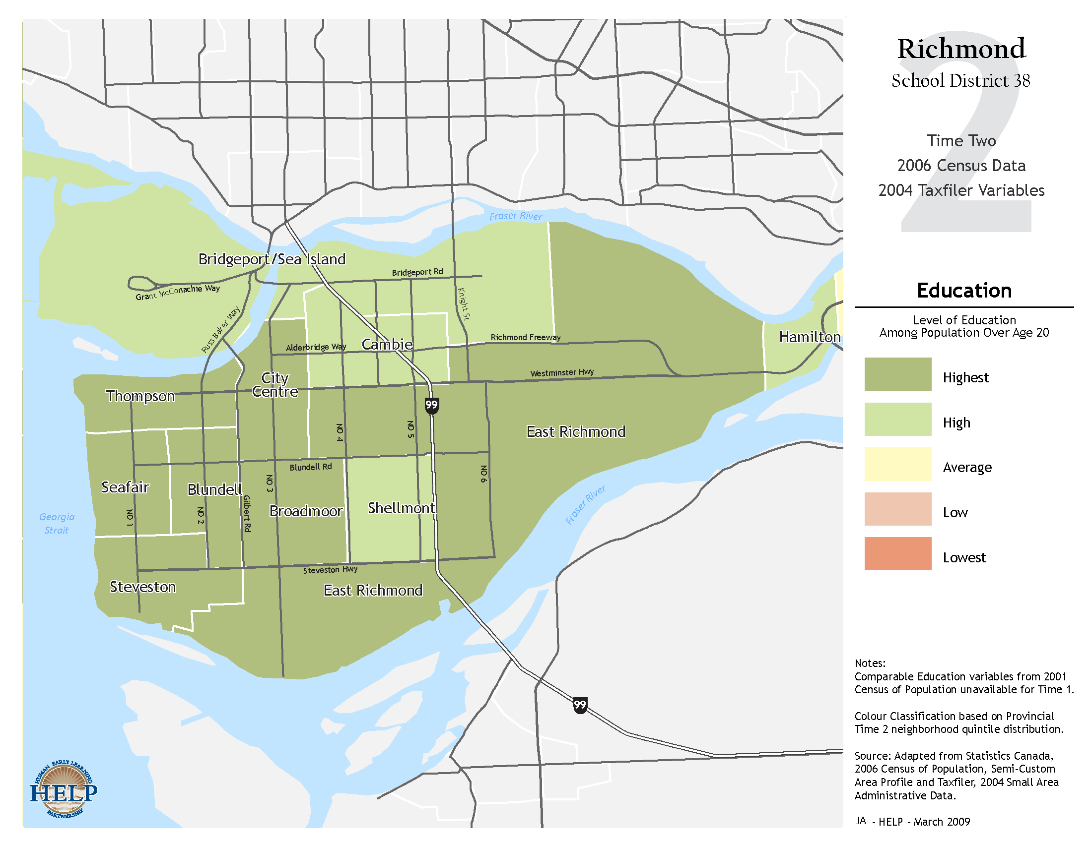

Slide 7
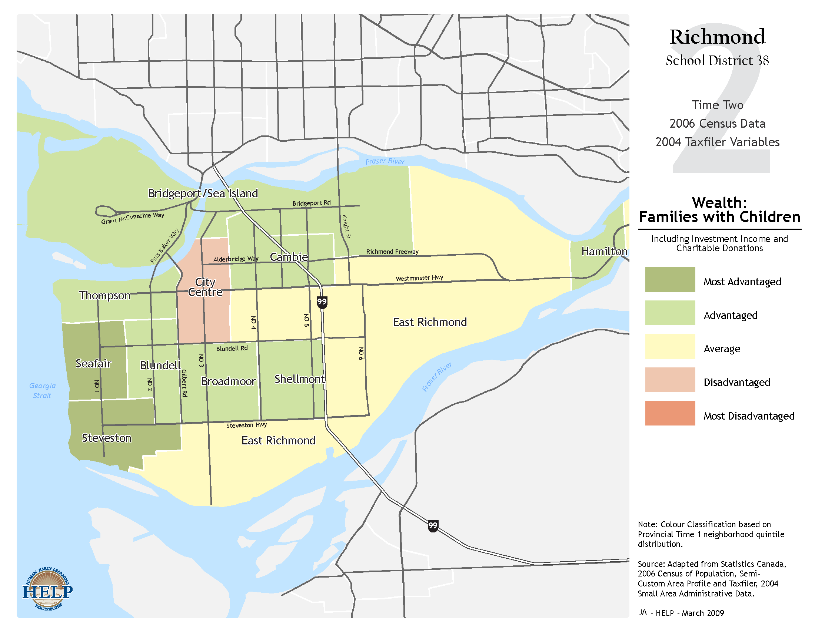

Slide 8
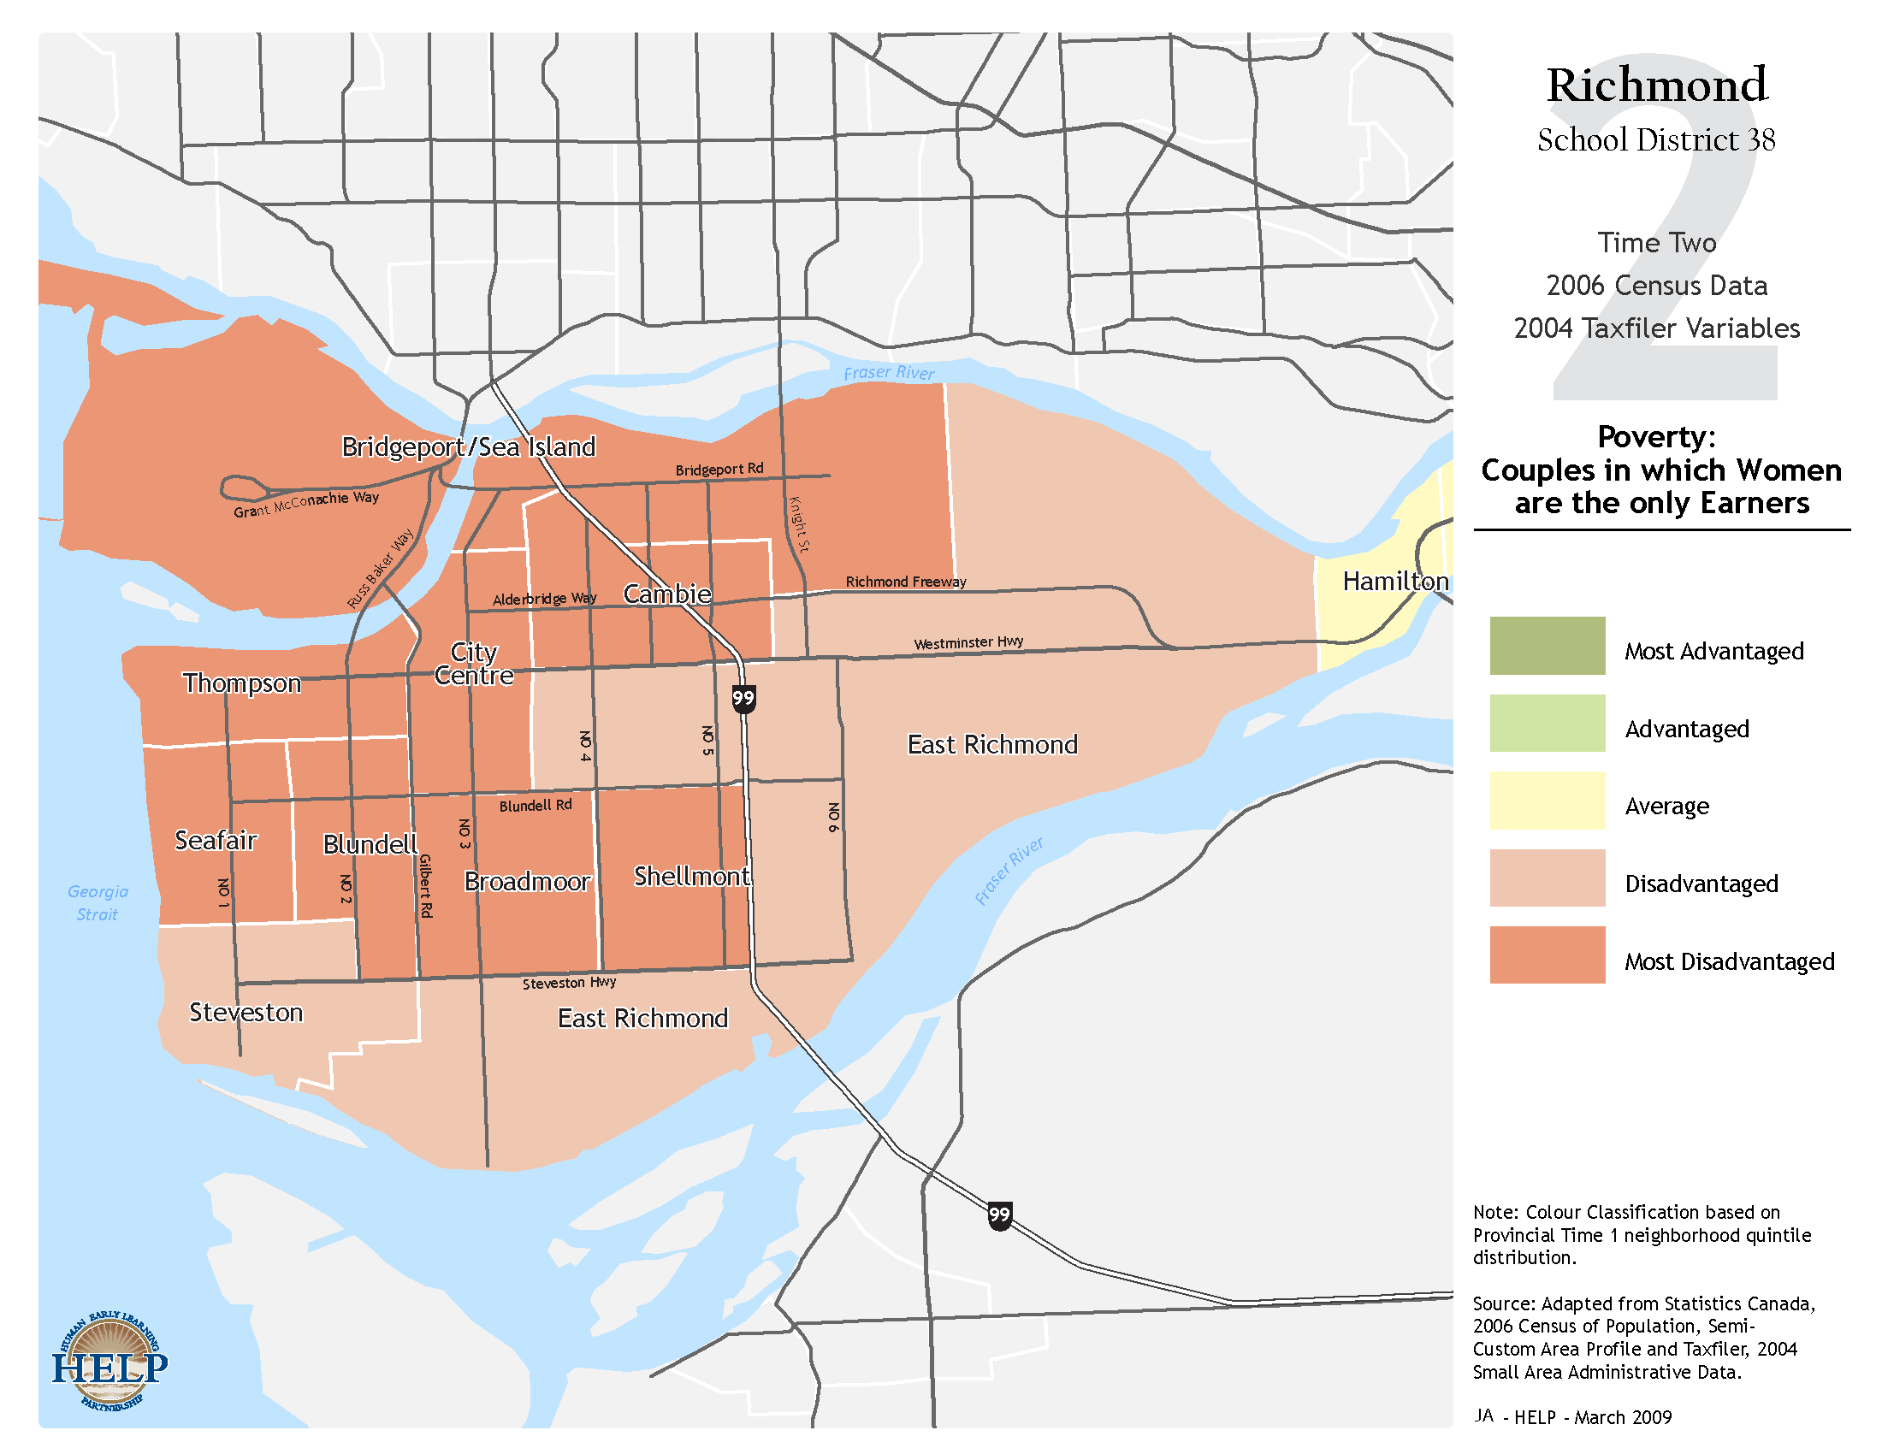

Slide 9
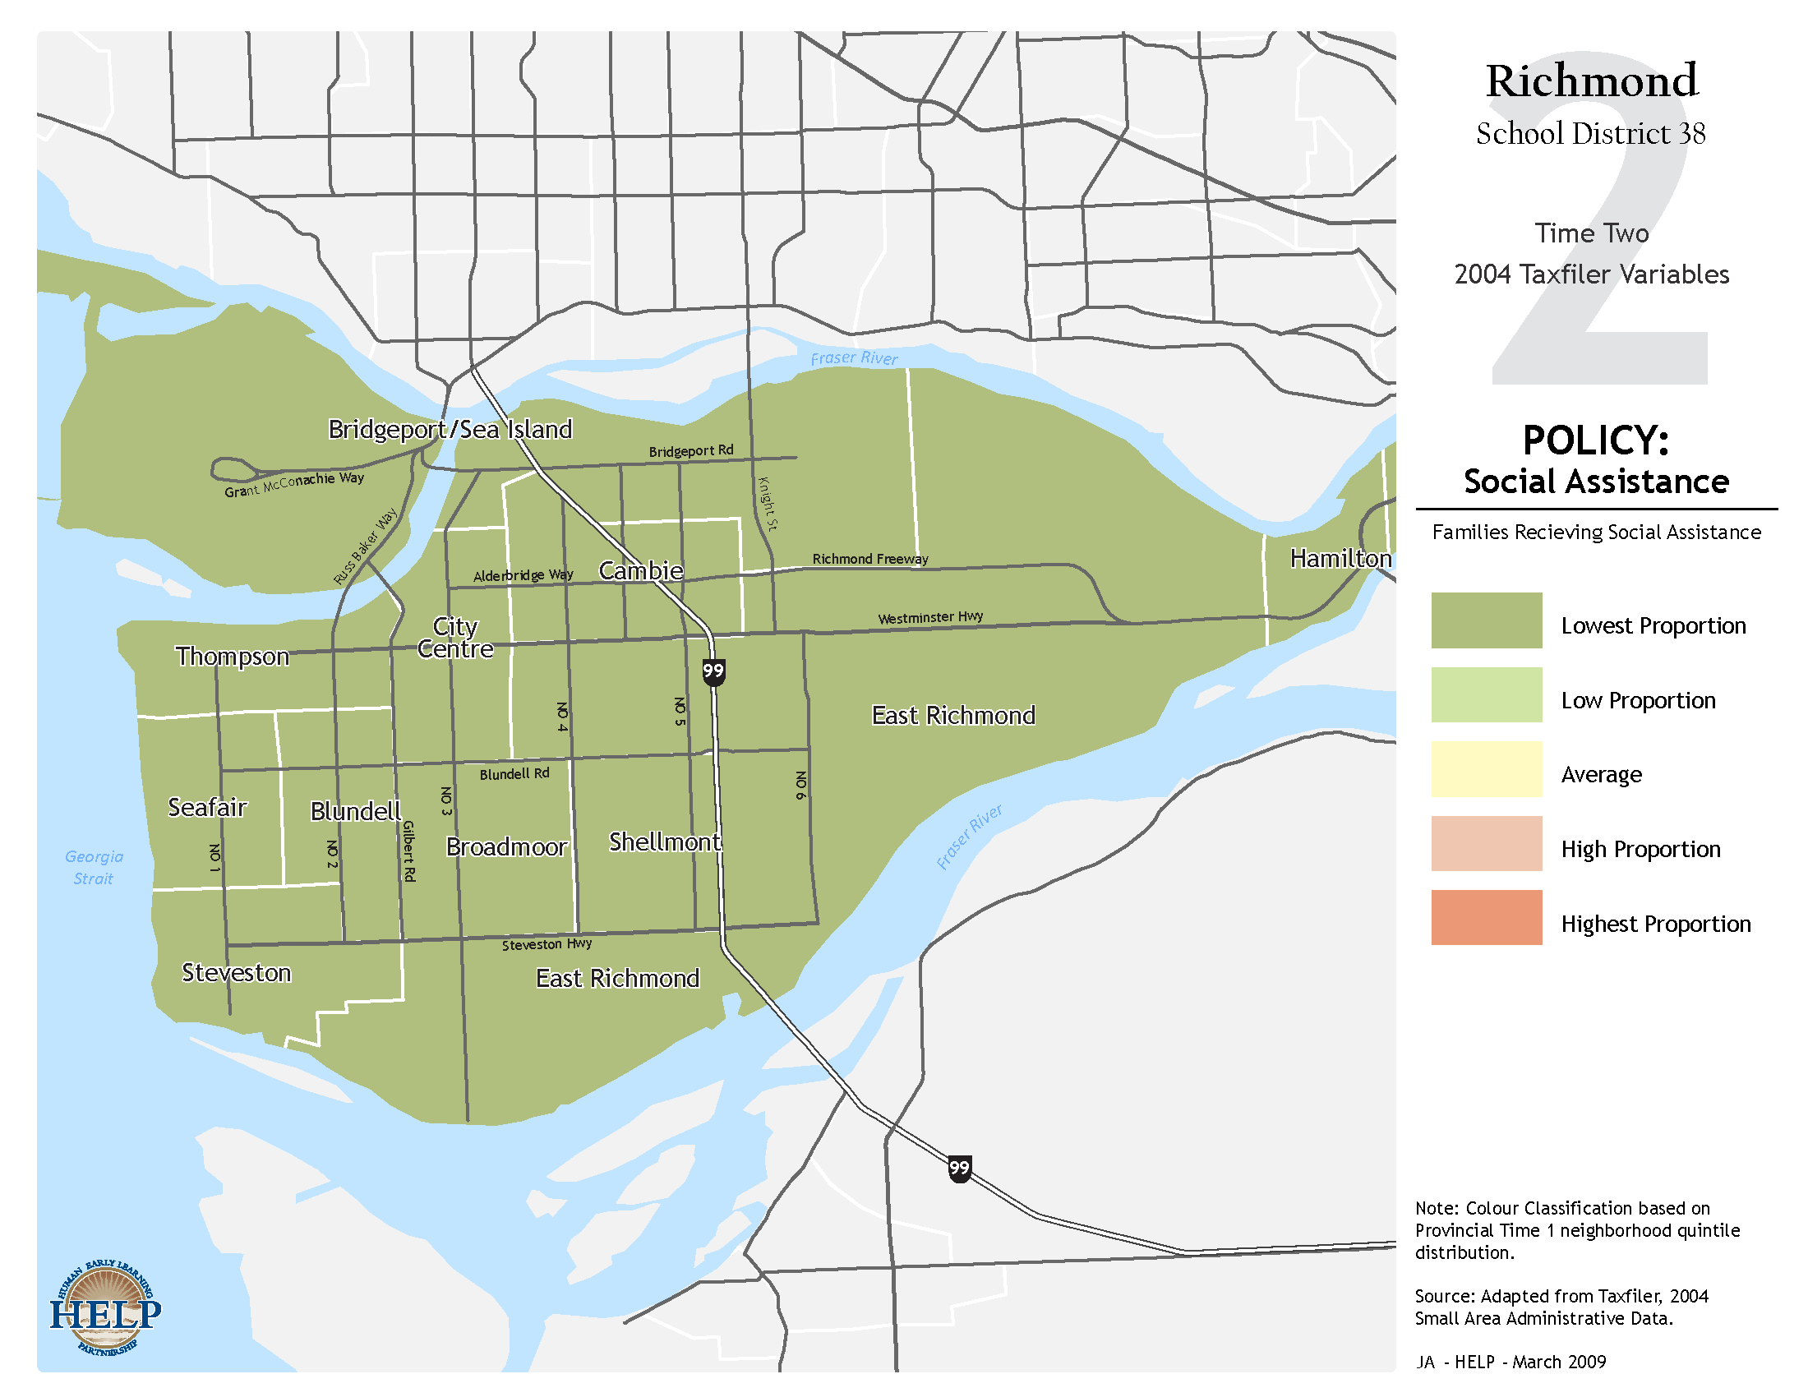

Slide 10
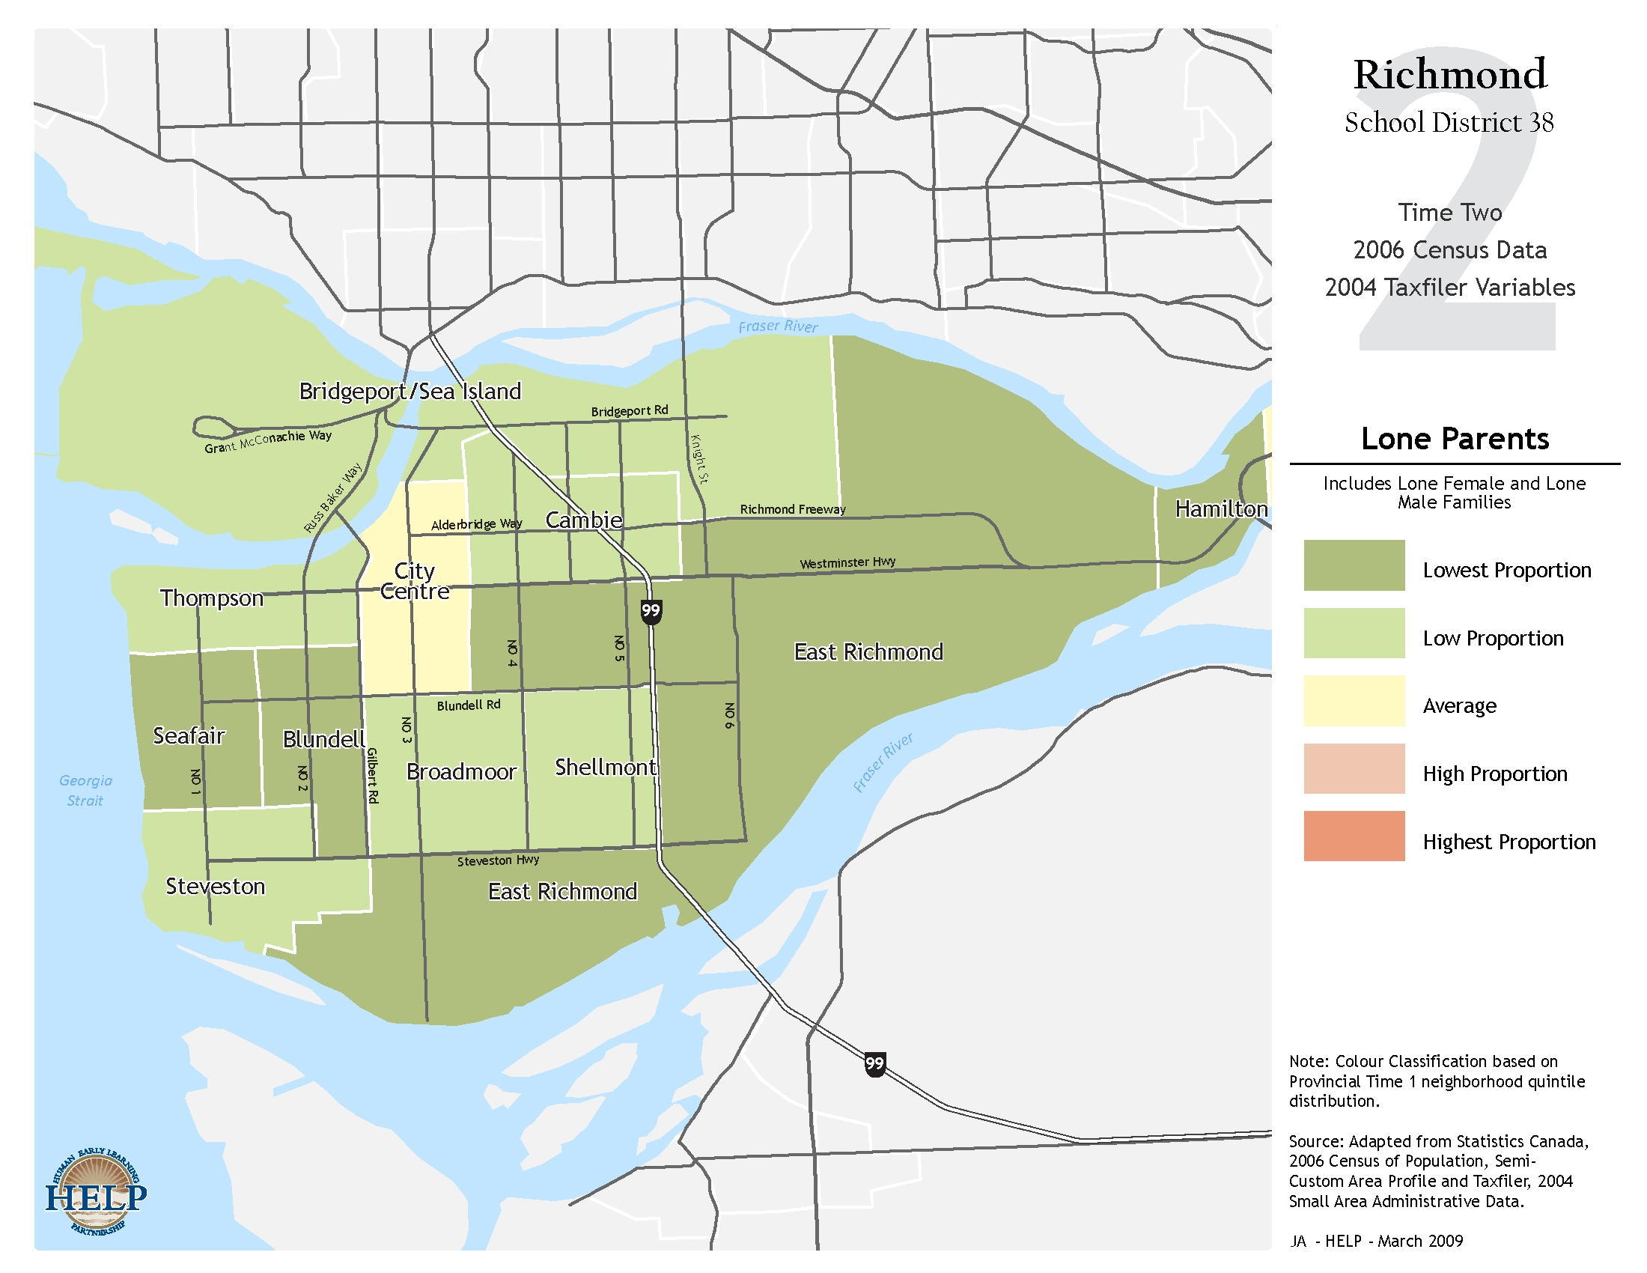

Slide 11
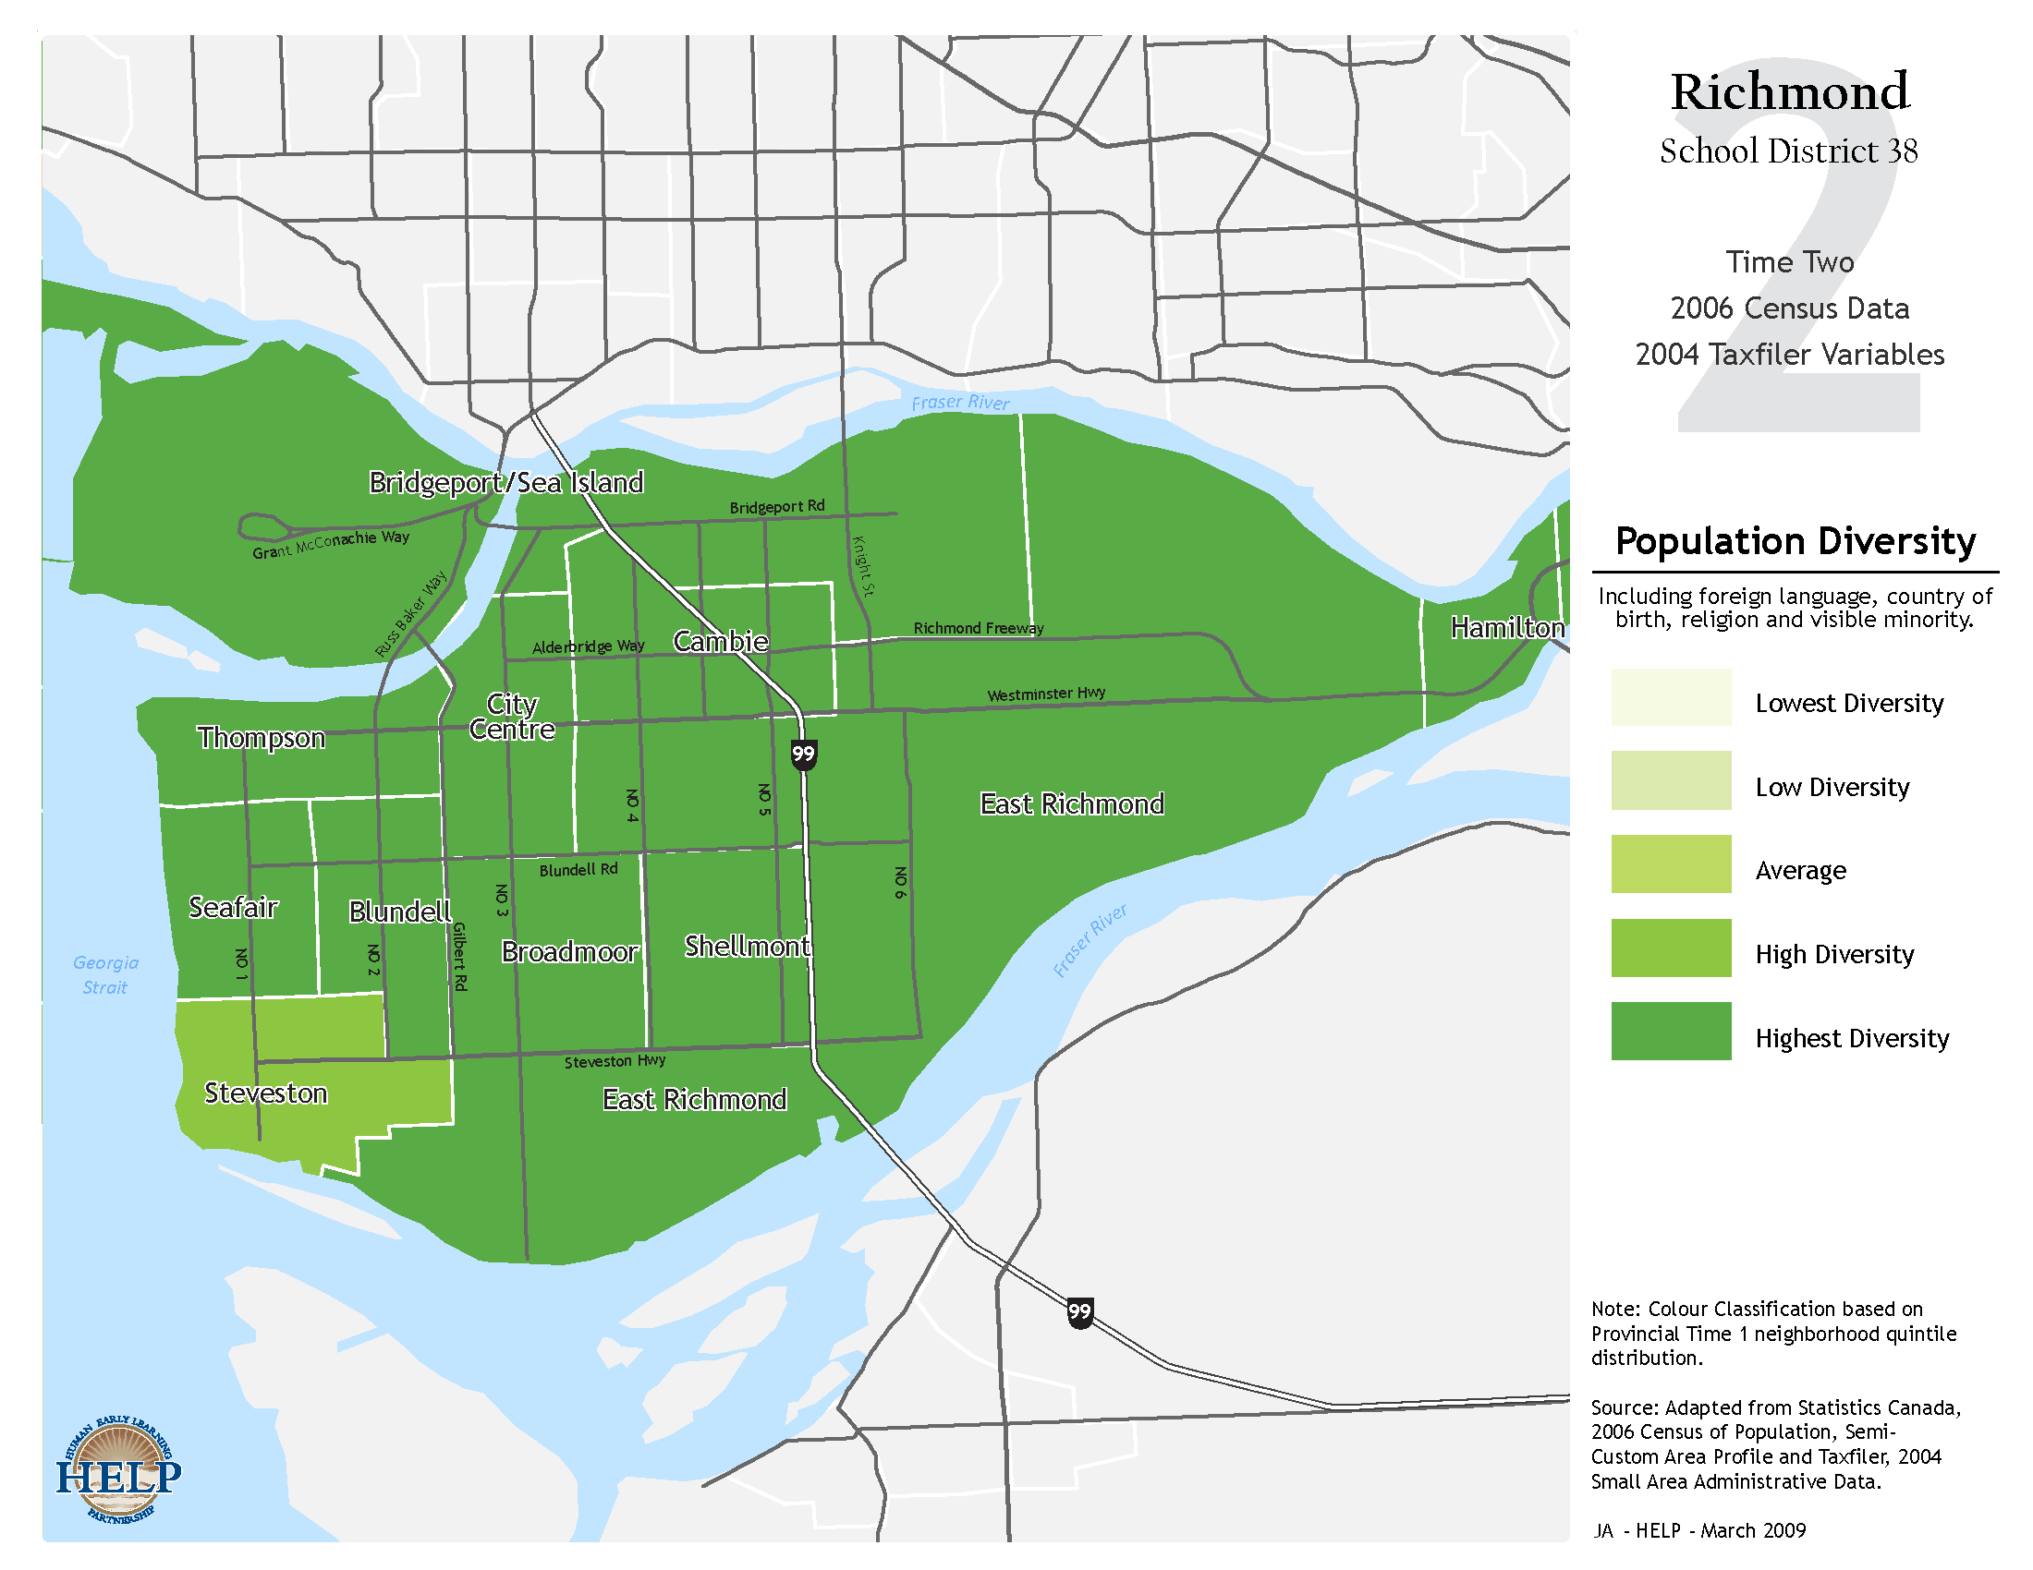

Slide 12
Monitoring the state of development at the level of the population and how it changes over time

Slide 13
Early Development Instrument
104 items
Notes:
Why is this a good time to start doing something like this? As many of you know, the EDI and related data collection efforts have been happening on more or less regular basis in many provinces and regions over the years. This map shows the progress from 2000 to 2009 collection year. The time is good because with the increased sophistication in methodologies and experience in many areas with several waves of data collection, we can bring added value to this project – in addition to, never as an alternative – to local and provincial efforts. The time is good because we are reaching a momentum – a critical mass of data and diversity of regions where it becomes possible to inform national trends. With the Council … ‘s mandate on increasing the knowledge in ECD, putting the existing data together, being able to take advantage of what is going on already at the national level – the collection of EDI – they can focus their efforts on increasing the information at other, earlier levels of development at which we have scarce coverage. Putting the EDI data on a national map shows what can be done and opens the door to population-based collection of other developmental data on young children.

Slide 14
Early Development Instrument
Teacher at age 5 is respondent
Notes:
Why is this a good time to start doing something like this? As many of you know, the EDI and related data collection efforts have been happening on more or less regular basis in many provinces and regions over the years. This map shows the progress from 2000 to 2009 collection year. The time is good because with the increased sophistication in methodologies and experience in many areas with several waves of data collection, we can bring added value to this project – in addition to, never as an alternative – to local and provincial efforts. The time is good because we are reaching a momentum – a critical mass of data and diversity of regions where it becomes possible to inform national trends. With the Council … ‘s mandate on increasing the knowledge in ECD, putting the existing data together, being able to take advantage of what is going on already at the national level – the collection of EDI – they can focus their efforts on increasing the information at other, earlier levels of development at which we have scarce coverage. Putting the EDI data on a national map shows what can be done and opens the door to population-based collection of other developmental data on young children.

Slide 15
Early Development Instrument
5 developmental
domains, with 16 subdomains
Notes:
Why is this a good time to start doing something like this? As many of you know, the EDI and related data collection efforts have been happening on more or less regular basis in many provinces and regions over the years. This map shows the progress from 2000 to 2009 collection year. The time is good because with the increased sophistication in methodologies and experience in many areas with several waves of data collection, we can bring added value to this project – in addition to, never as an alternative – to local and provincial efforts. The time is good because we are reaching a momentum – a critical mass of data and diversity of regions where it becomes possible to inform national trends. With the Council … ‘s mandate on increasing the knowledge in ECD, putting the existing data together, being able to take advantage of what is going on already at the national level – the collection of EDI – they can focus their efforts on increasing the information at other, earlier levels of development at which we have scarce coverage. Putting the EDI data on a national map shows what can be done and opens the door to population-based collection of other developmental data on young children.

Slide 16
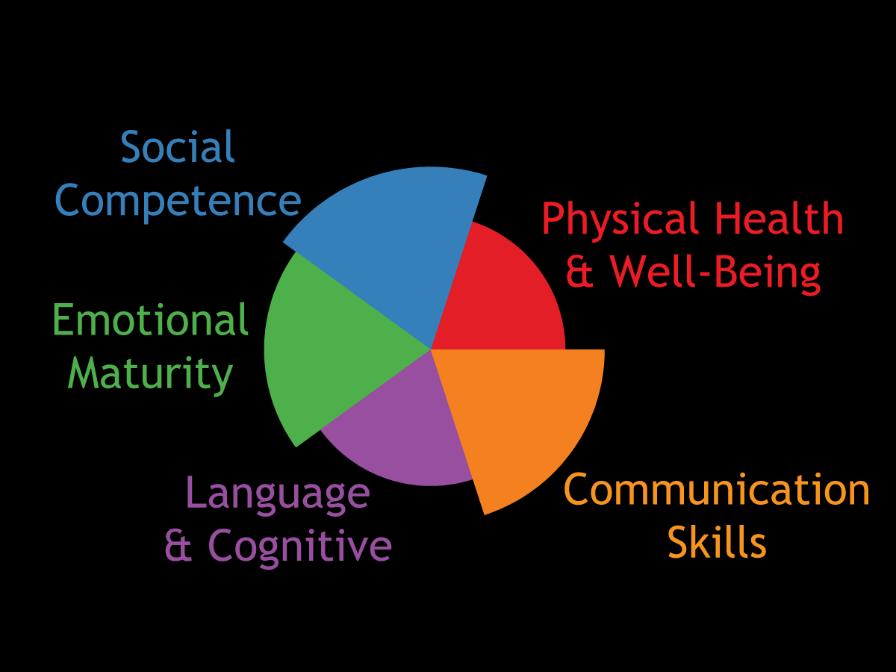
What Does the EDI Measure?

Slide 17
Early Development Instrument
Extensive Validity and Reliability data from several countries
Notes:
Why is this a good time to start doing something like this? As many of you know, the EDI and related data collection efforts have been happening on more or less regular basis in many provinces and regions over the years. This map shows the progress from 2000 to 2009 collection year. The time is good because with the increased sophistication in methodologies and experience in many areas with several waves of data collection, we can bring added value to this project – in addition to, never as an alternative – to local and provincial efforts. The time is good because we are reaching a momentum – a critical mass of data and diversity of regions where it becomes possible to inform national trends. With the Council … ‘s mandate on increasing the knowledge in ECD, putting the existing data together, being able to take advantage of what is going on already at the national level – the collection of EDI – they can focus their efforts on increasing the information at other, earlier levels of development at which we have scarce coverage. Putting the EDI data on a national map shows what can be done and opens the door to population-based collection of other developmental data on young children.

Slide 18
Early Development Instrument
Not an ‘individual assessment’
Notes:
Why is this a good time to start doing something like this? As many of you know, the EDI and related data collection efforts have been happening on more or less regular basis in many provinces and regions over the years. This map shows the progress from 2000 to 2009 collection year. The time is good because with the increased sophistication in methodologies and experience in many areas with several waves of data collection, we can bring added value to this project – in addition to, never as an alternative – to local and provincial efforts. The time is good because we are reaching a momentum – a critical mass of data and diversity of regions where it becomes possible to inform national trends. With the Council … ‘s mandate on increasing the knowledge in ECD, putting the existing data together, being able to take advantage of what is going on already at the national level – the collection of EDI – they can focus their efforts on increasing the information at other, earlier levels of development at which we have scarce coverage. Putting the EDI data on a national map shows what can be done and opens the door to population-based collection of other developmental data on young children.

Slide 19
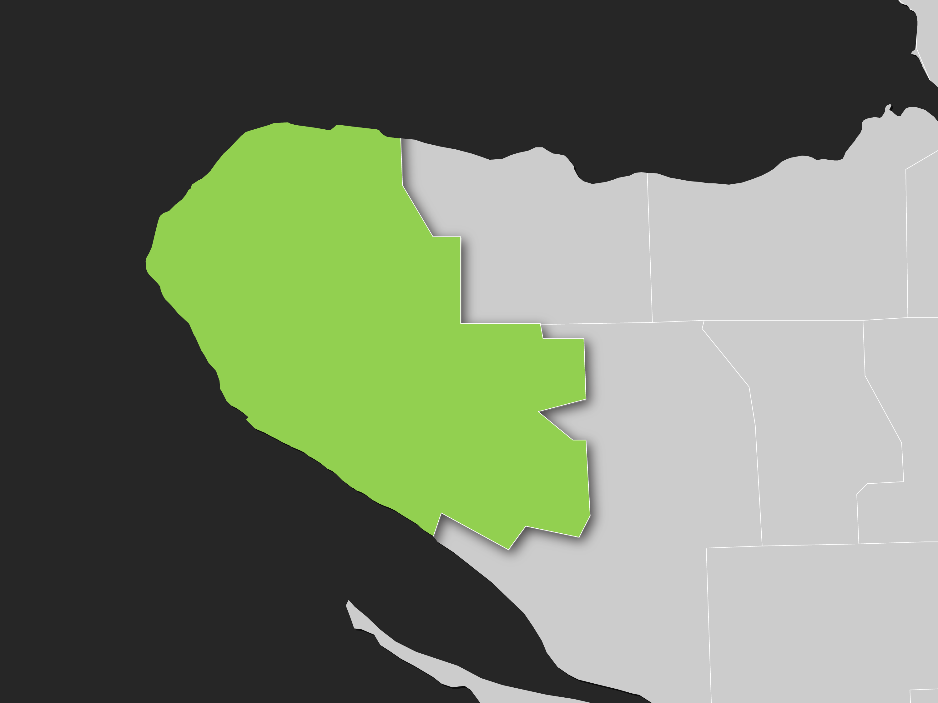
Neighbourhood

Slide 20
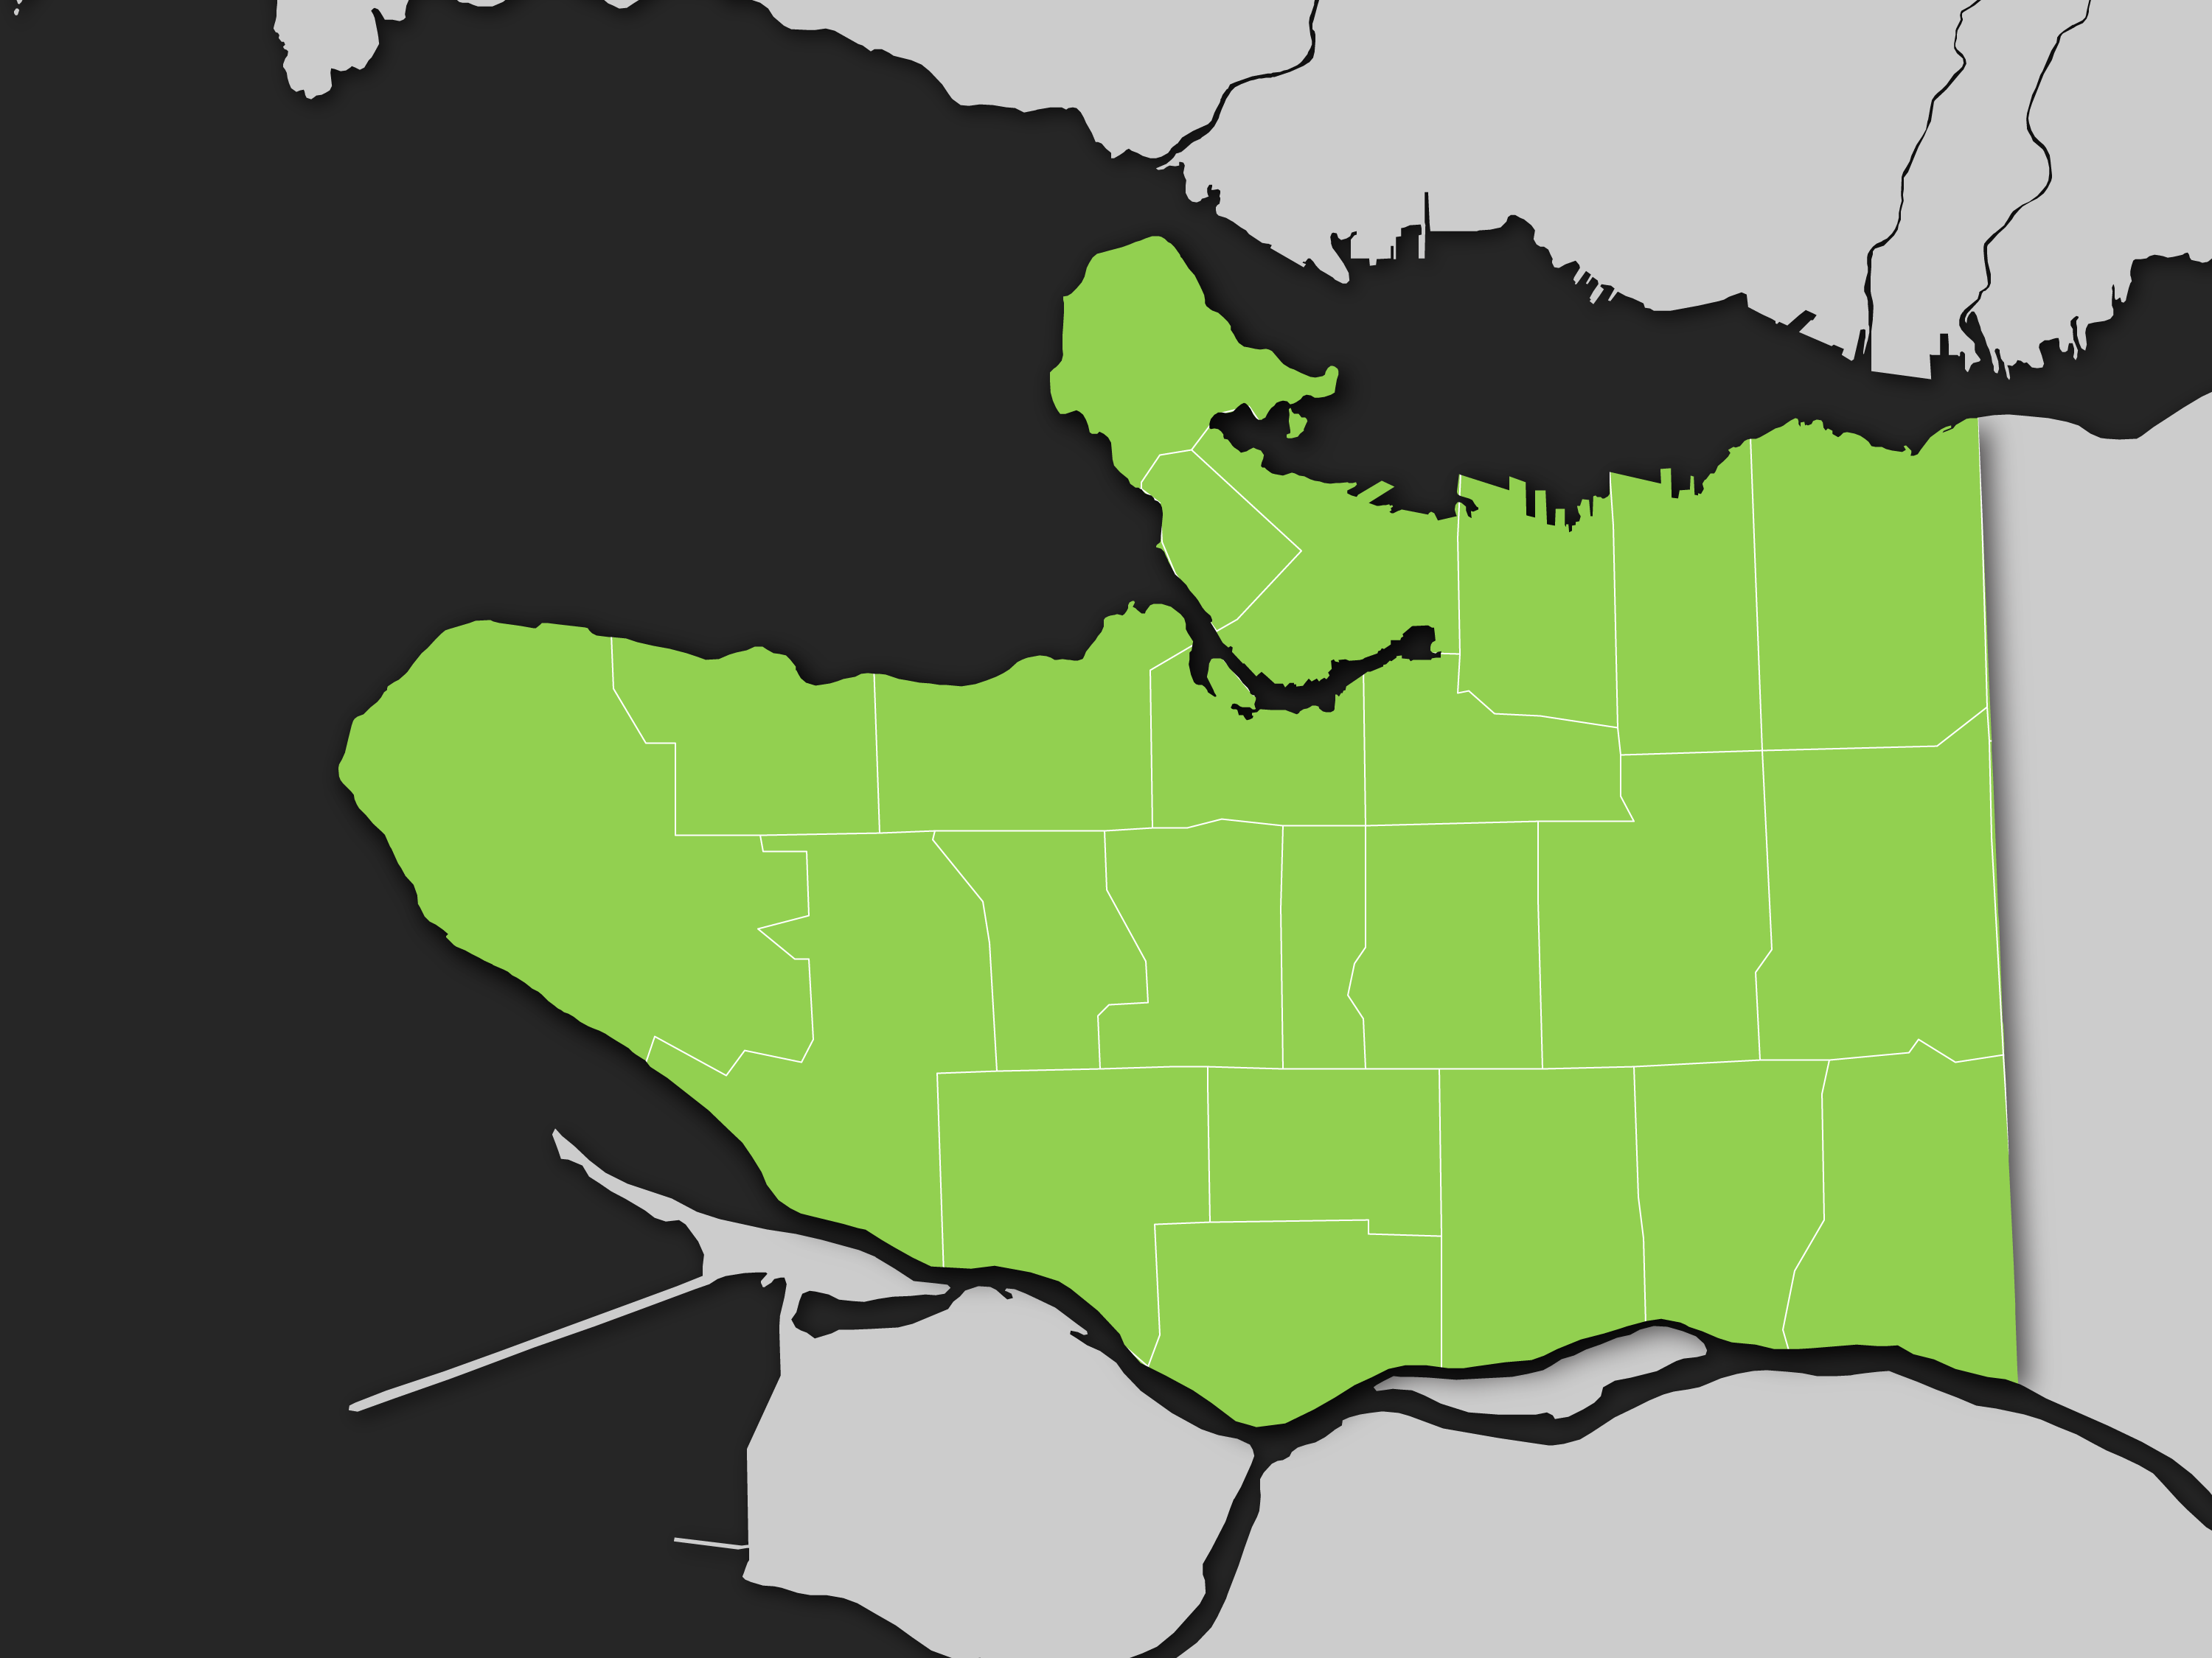
Region

Slide 21
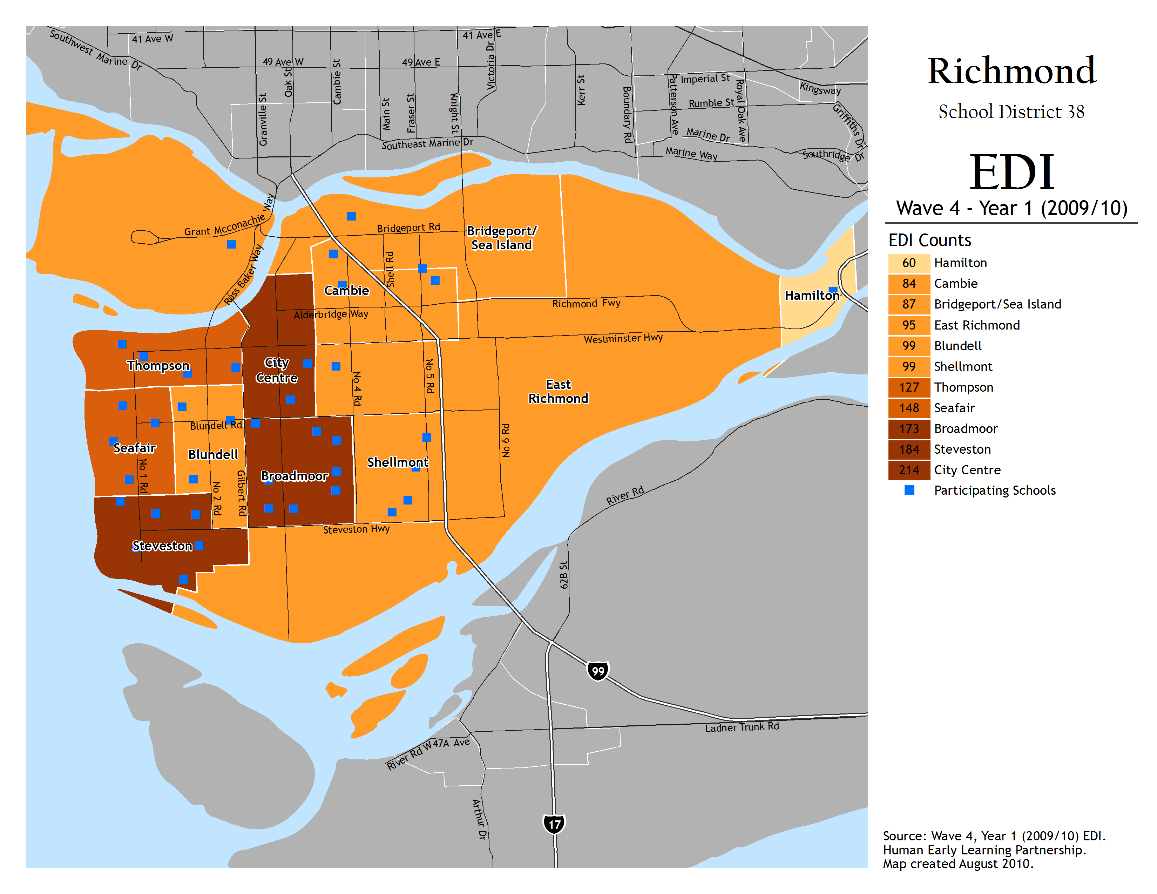

Slide 22
What the maps reveal…
Large local area differences in the proportion of developmentally vulnerable children

Slide 23
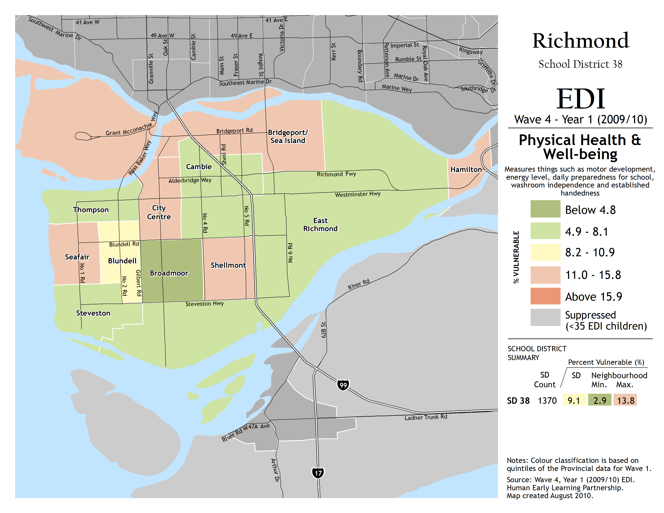

Slide 24
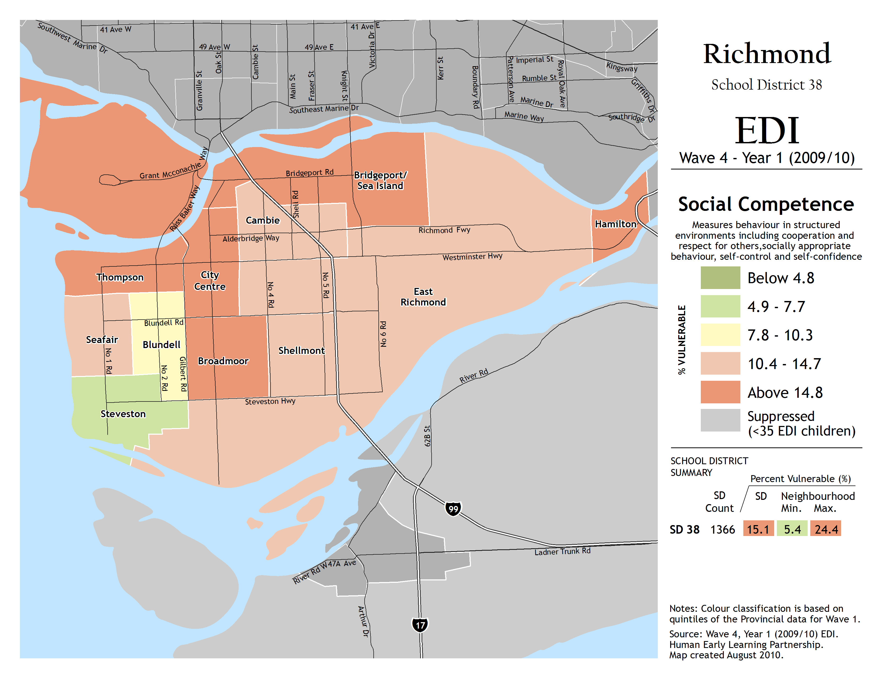

Slide 25
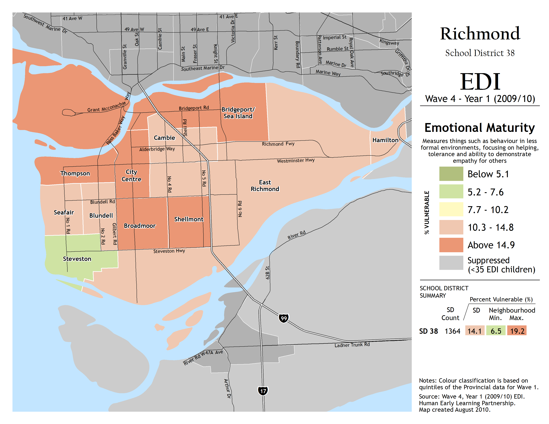

Slide 26
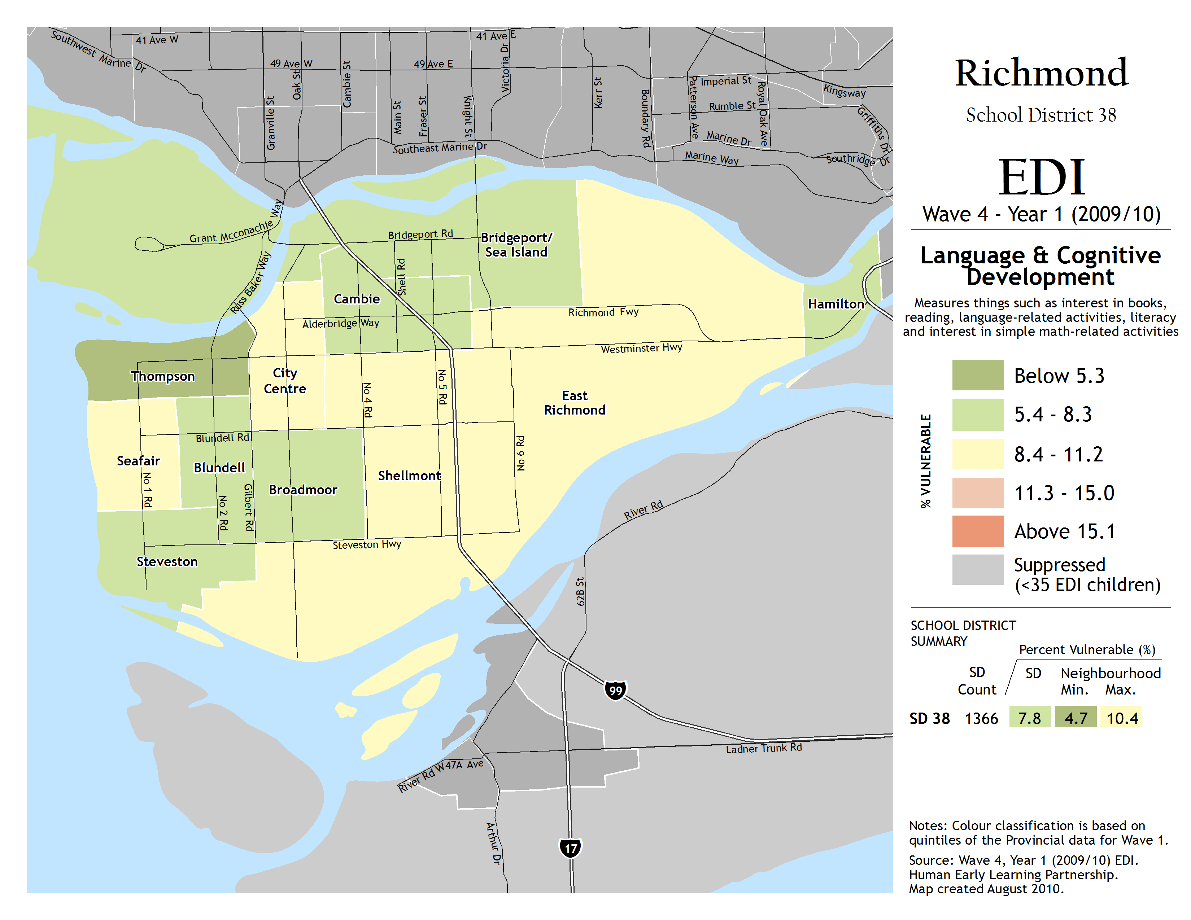

Slide 27
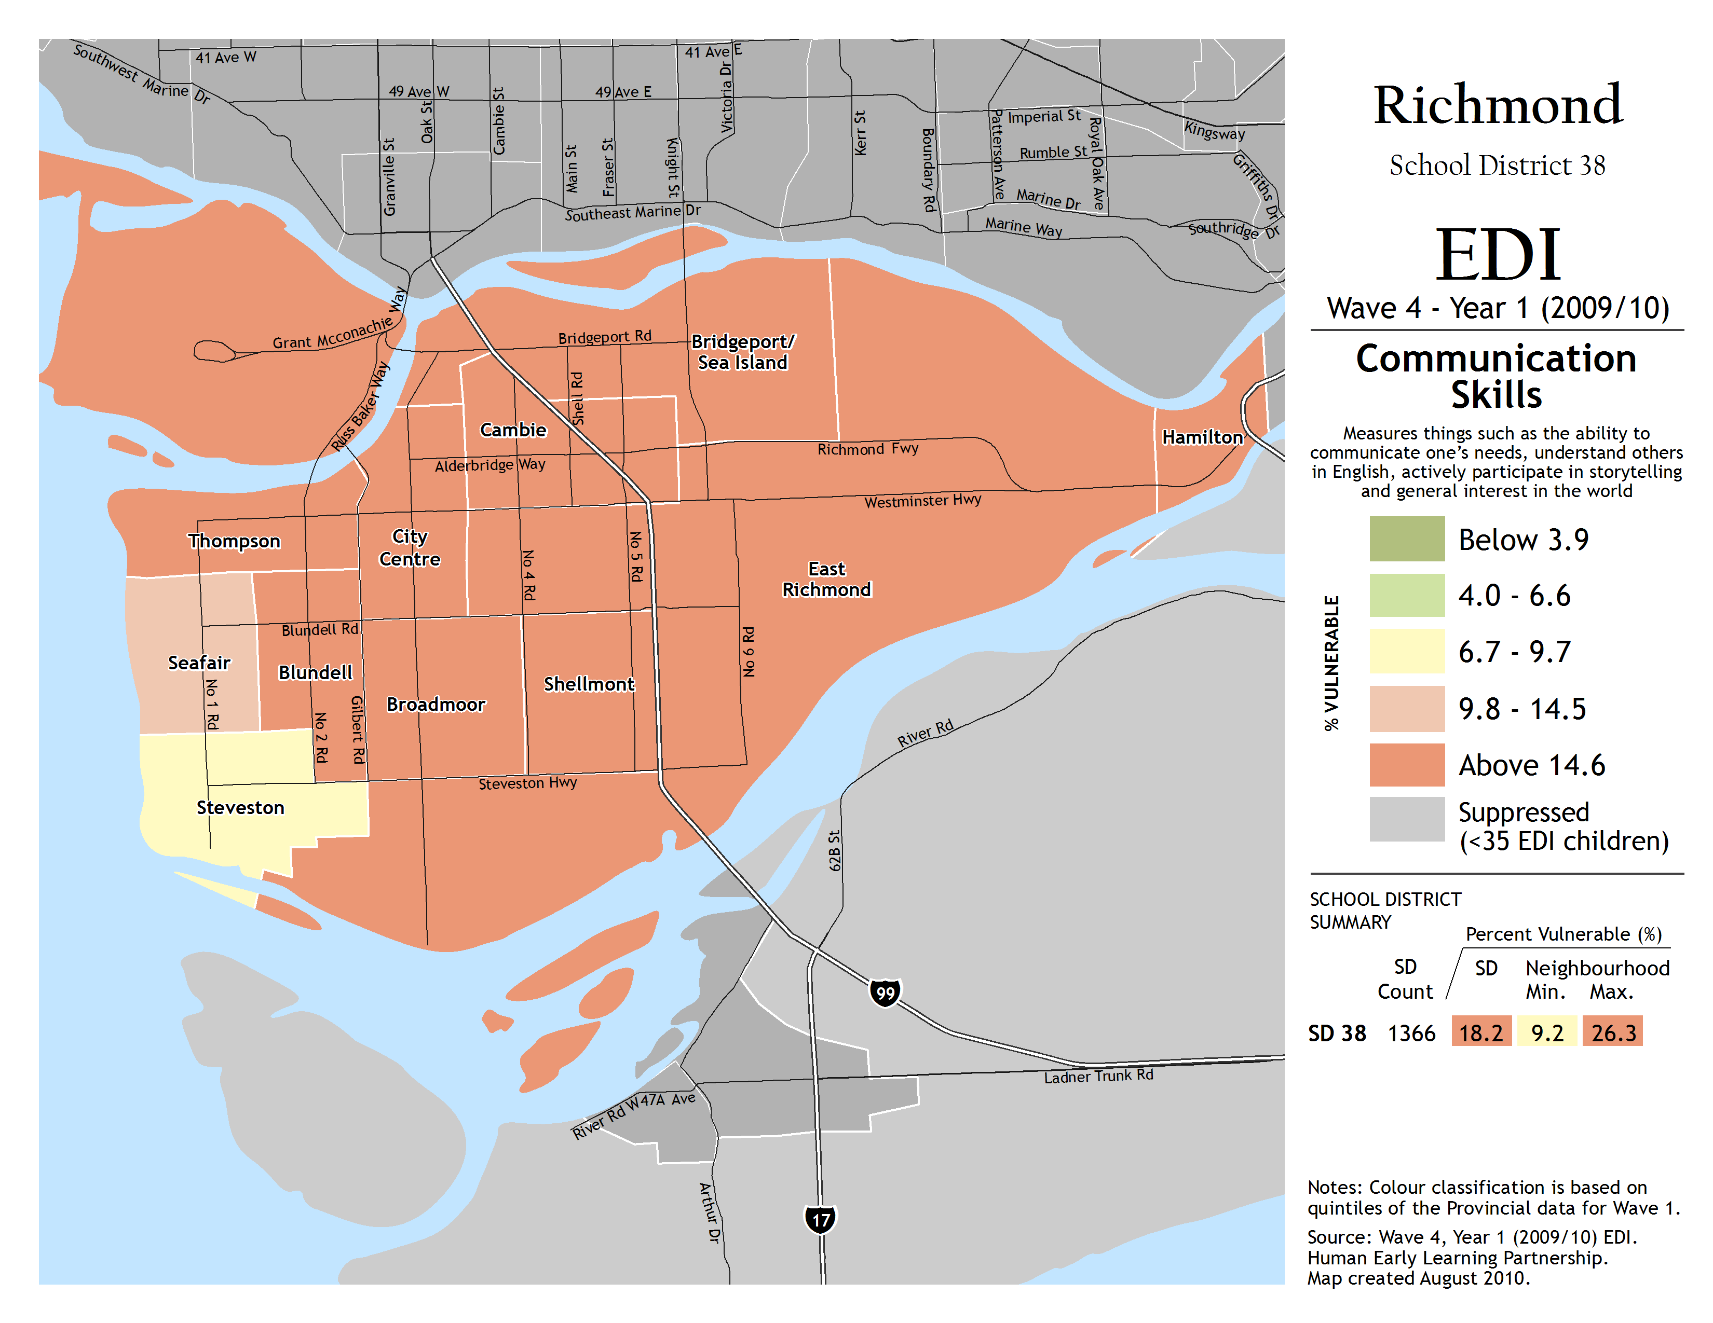

Slide 28
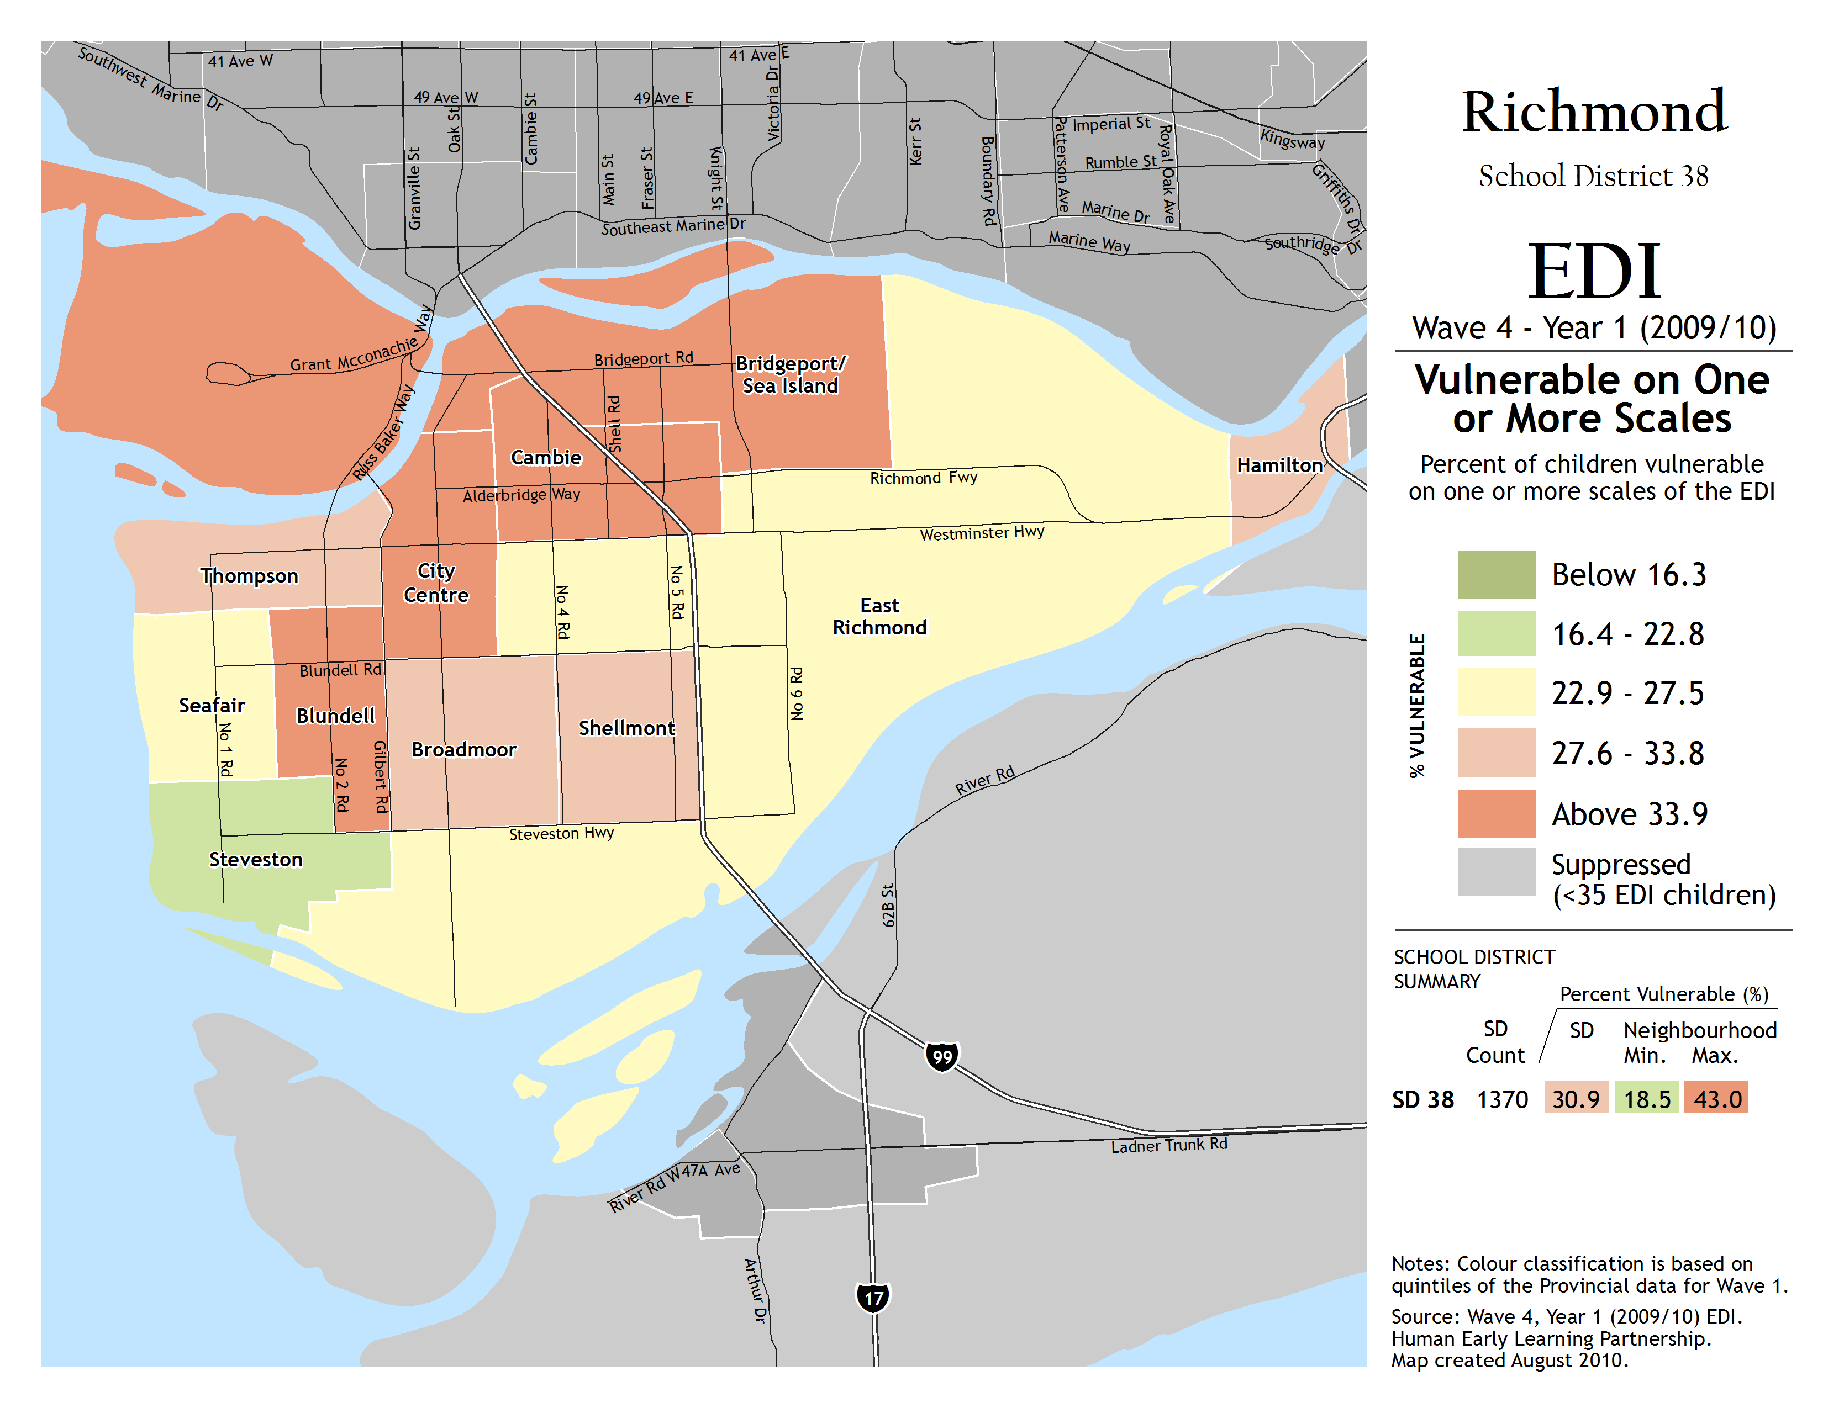

Slide 29
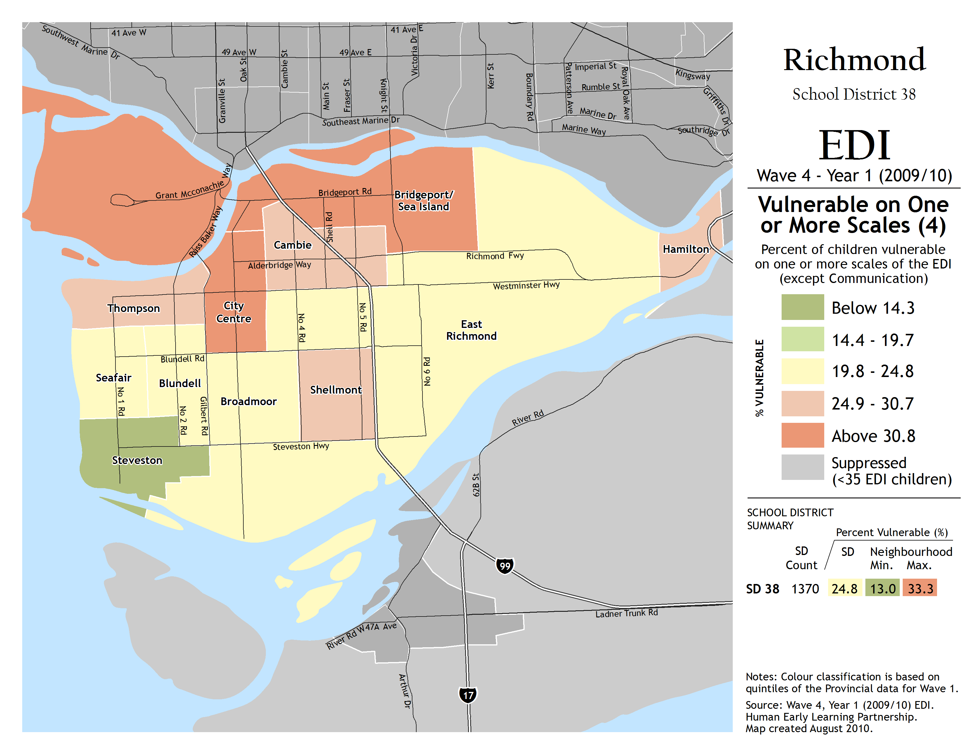

Slide 30
What the maps reveal…
The high proportion of avoidable vulnerability

Slide 31
Change over time

Slide 32
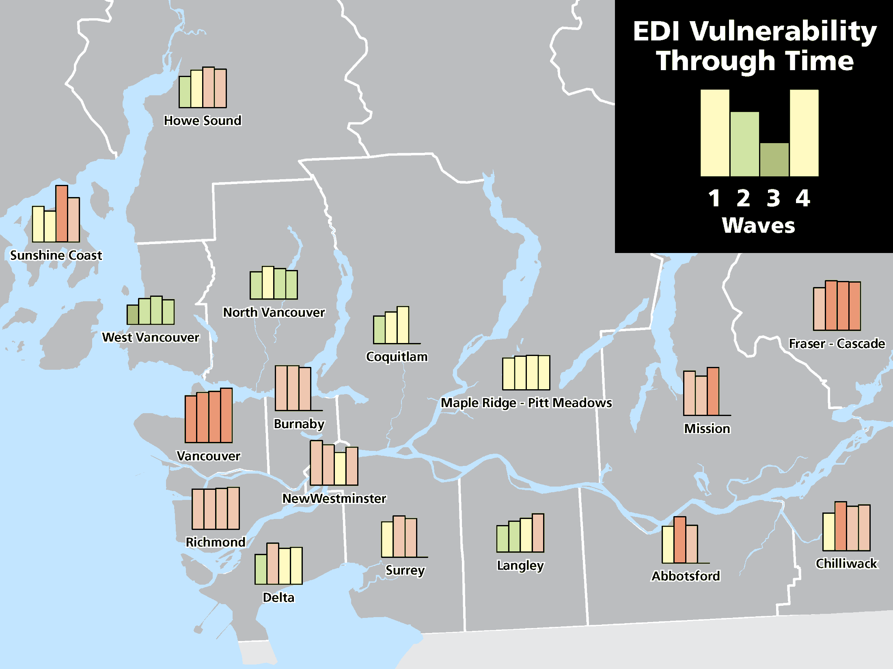

Slide 33
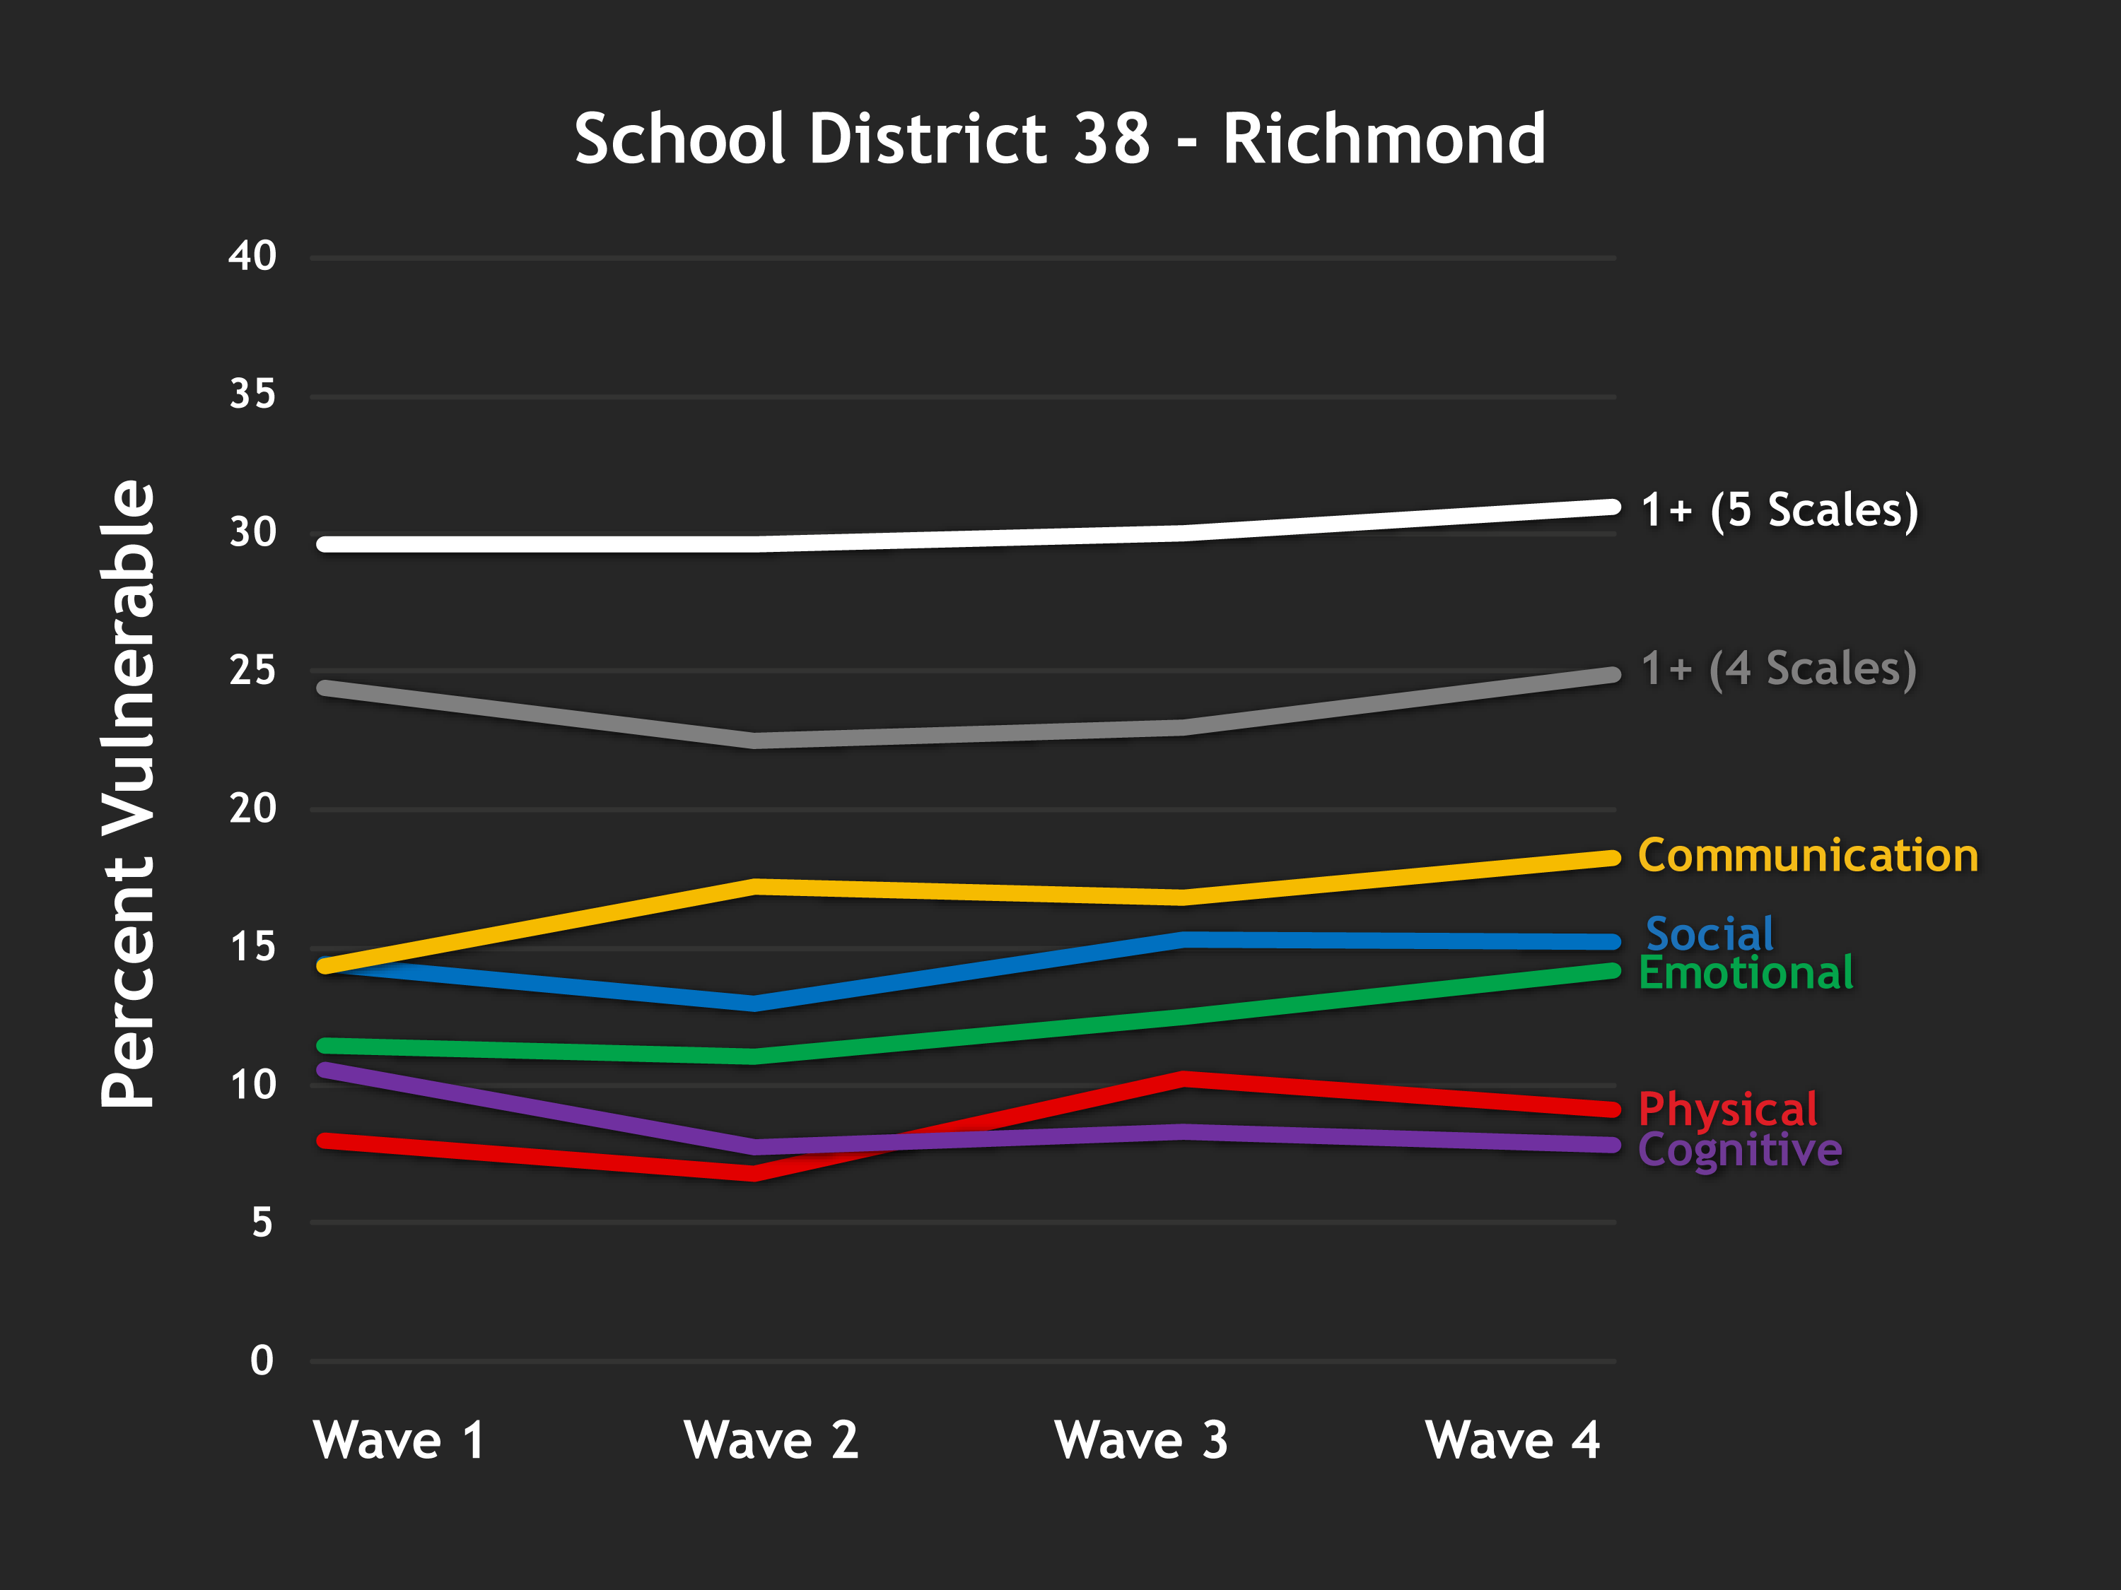

Slide 34
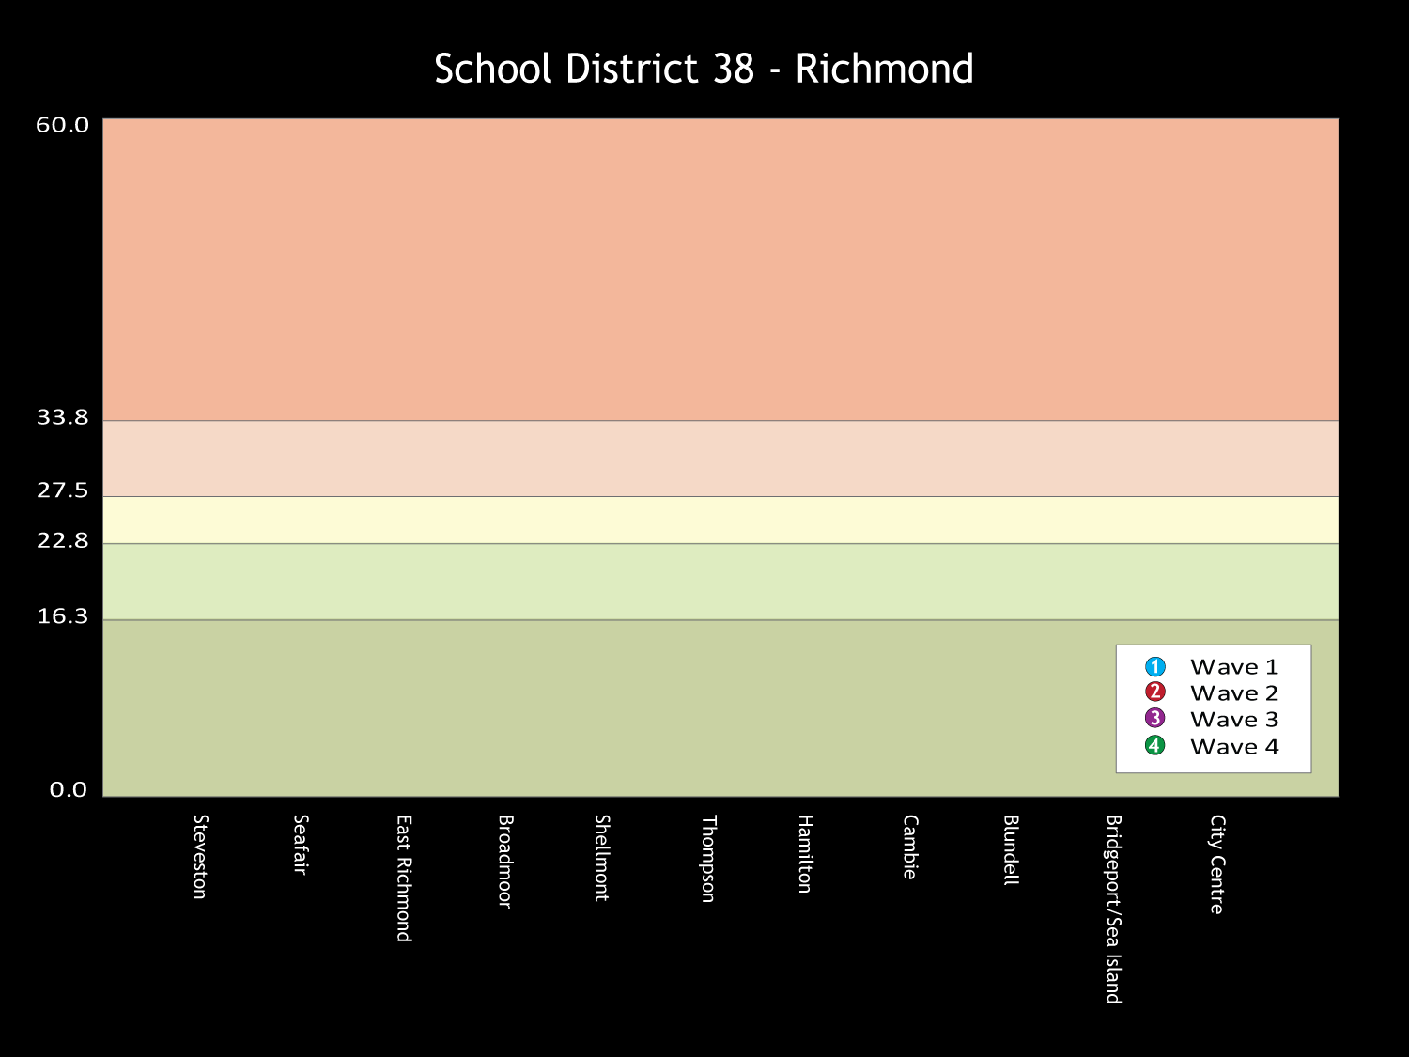
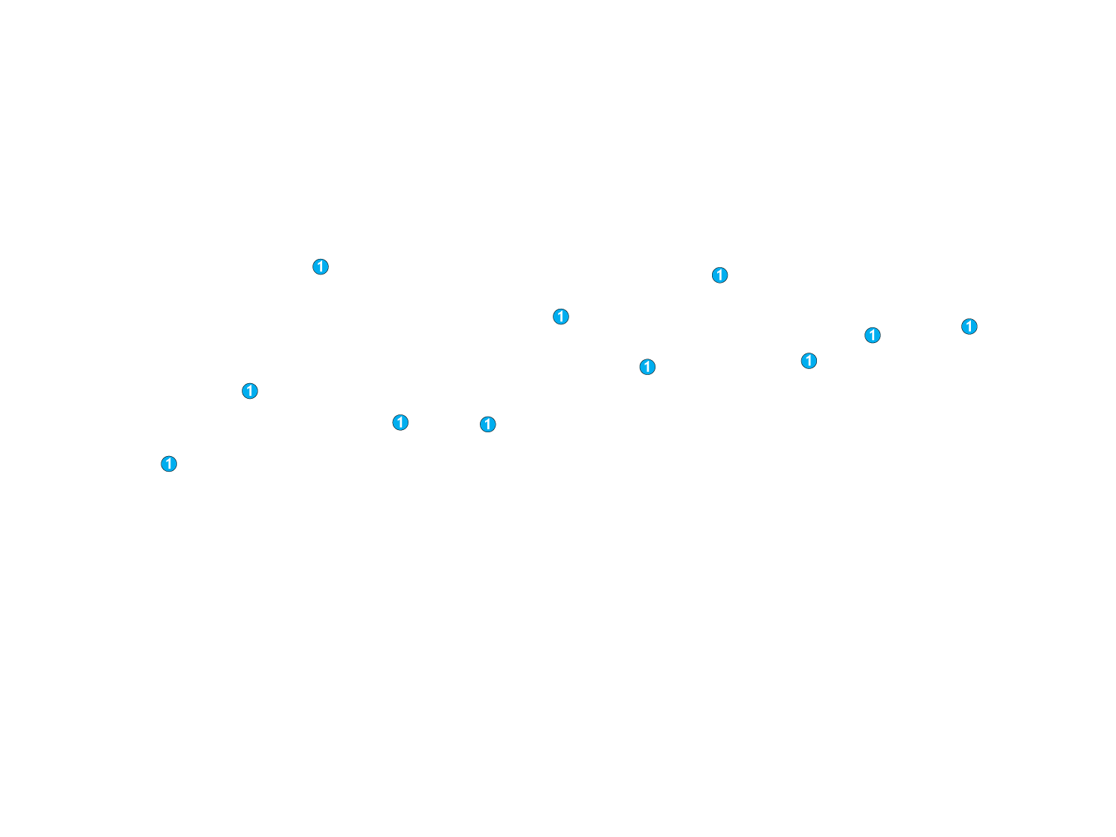
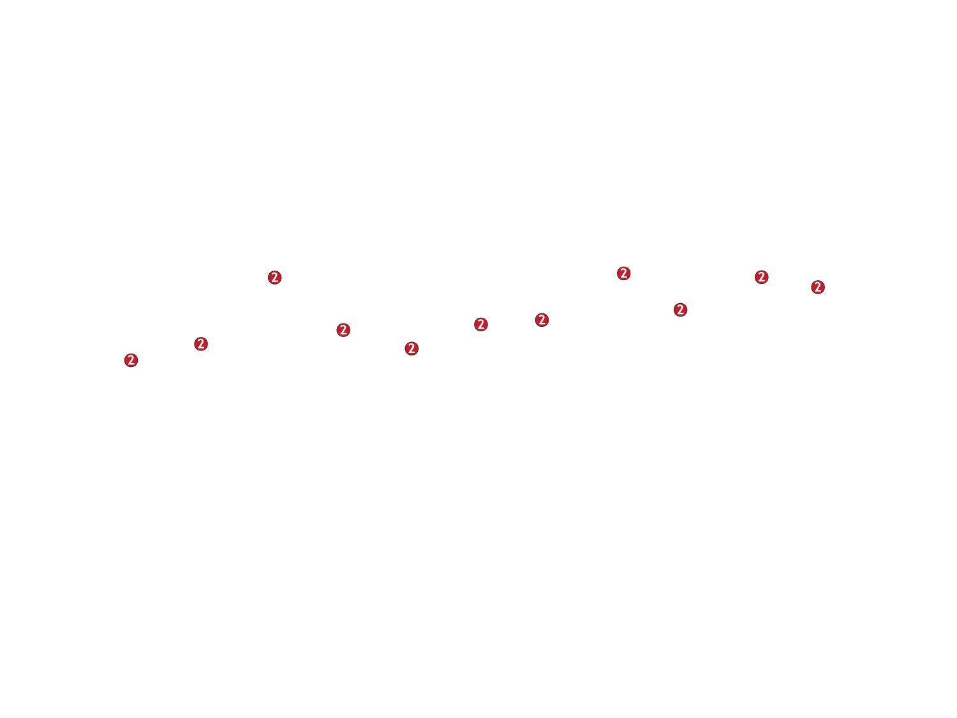
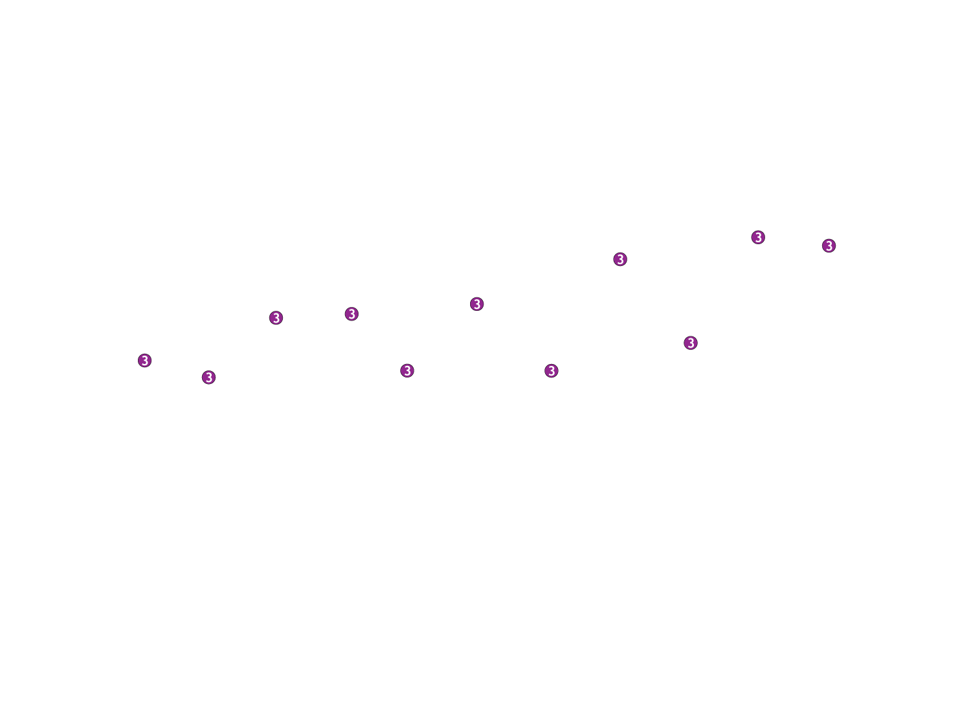
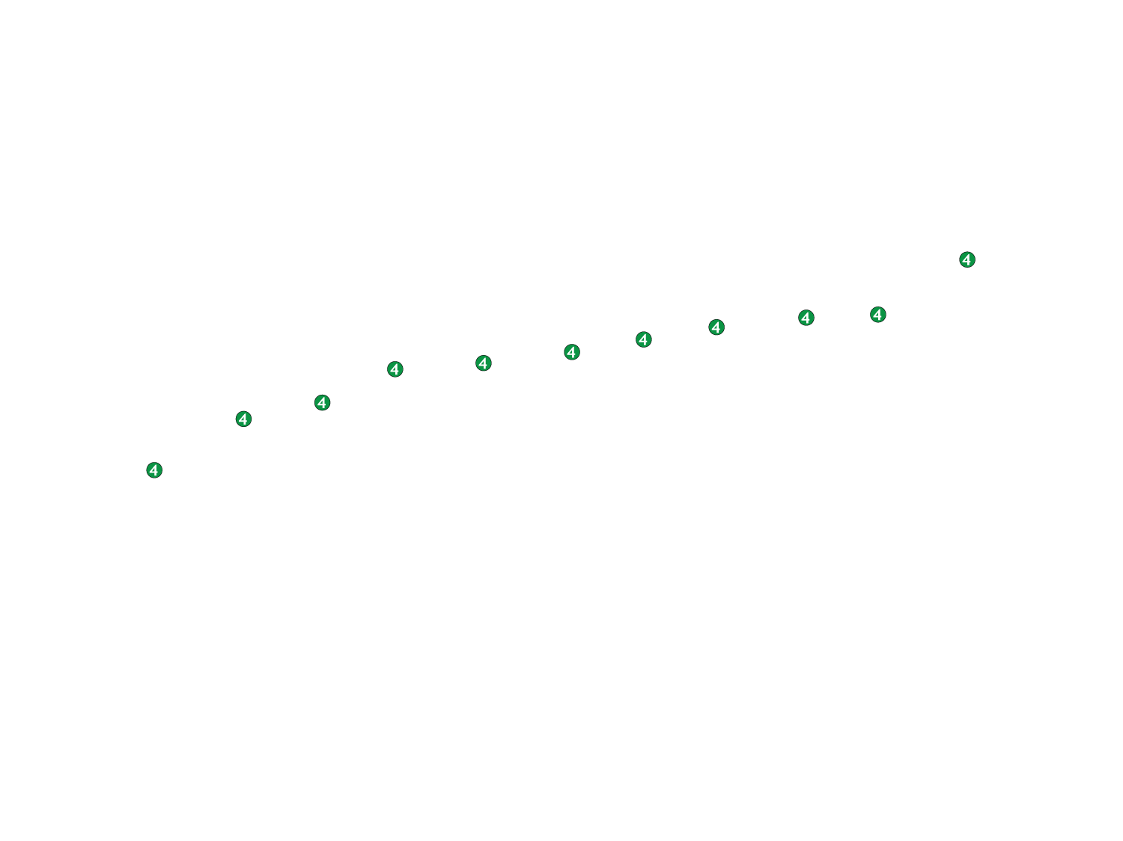
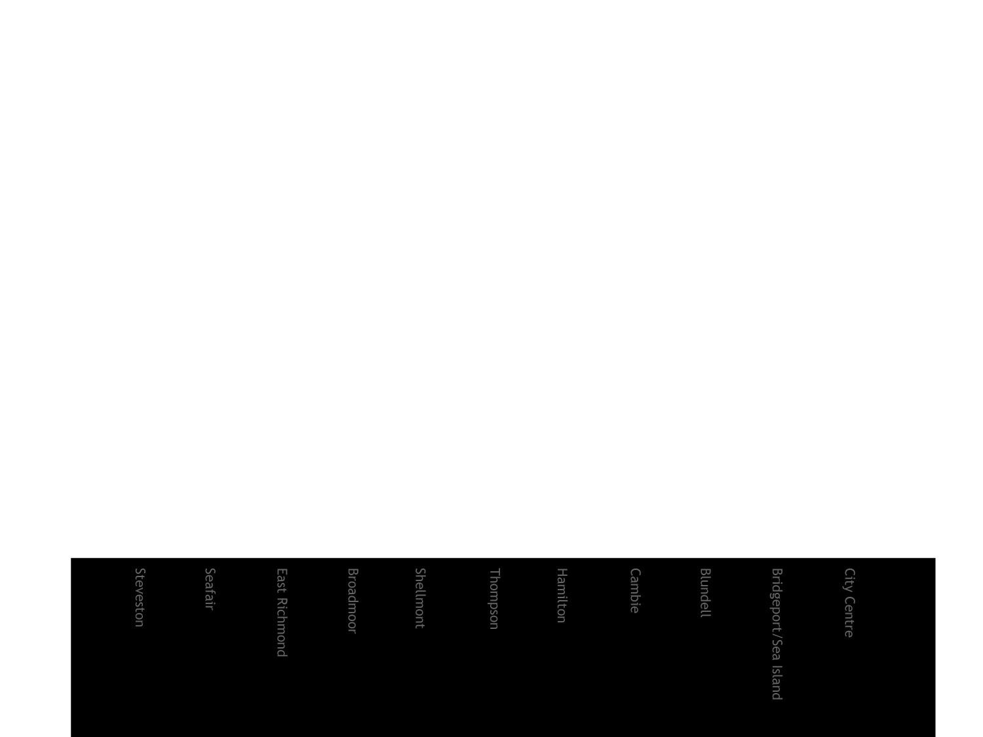

Slide 36
Lessons learned
after
a decade of engagement

Slide 37
Lessons Learned
Strong inter-sectoral leadership
Notes:
37

Slide 38
Lessons Learned
Focus on EDI outcomes

Slide 39
Lessons Learned
A focus on families that
provide equitable access
to high quality programming

Slide 40
Barriers of Access to Quality Programs
1. Program or service not there
2. Costs too much
3. Transportation
4. Time 0ffered
5. Language
6. Fragmentation
7. Lack of info
8. Conflicting Expectations
9. Social distance
10. Parental consciousness

Slide 41
Lessons Learned
Vertical coordination

Slide 42
Lessons Learned
Alignment with school system

Slide 43
The Middle Years
Development Instrument
(MDI)
Grade Four Students
Self-Report Survey
Five Critical Components…

Slide 44
Social and Emotional Development
Physical Health & Well-being
Connectedness
School Experiences
Constructive Use of After School Time

Slide 45
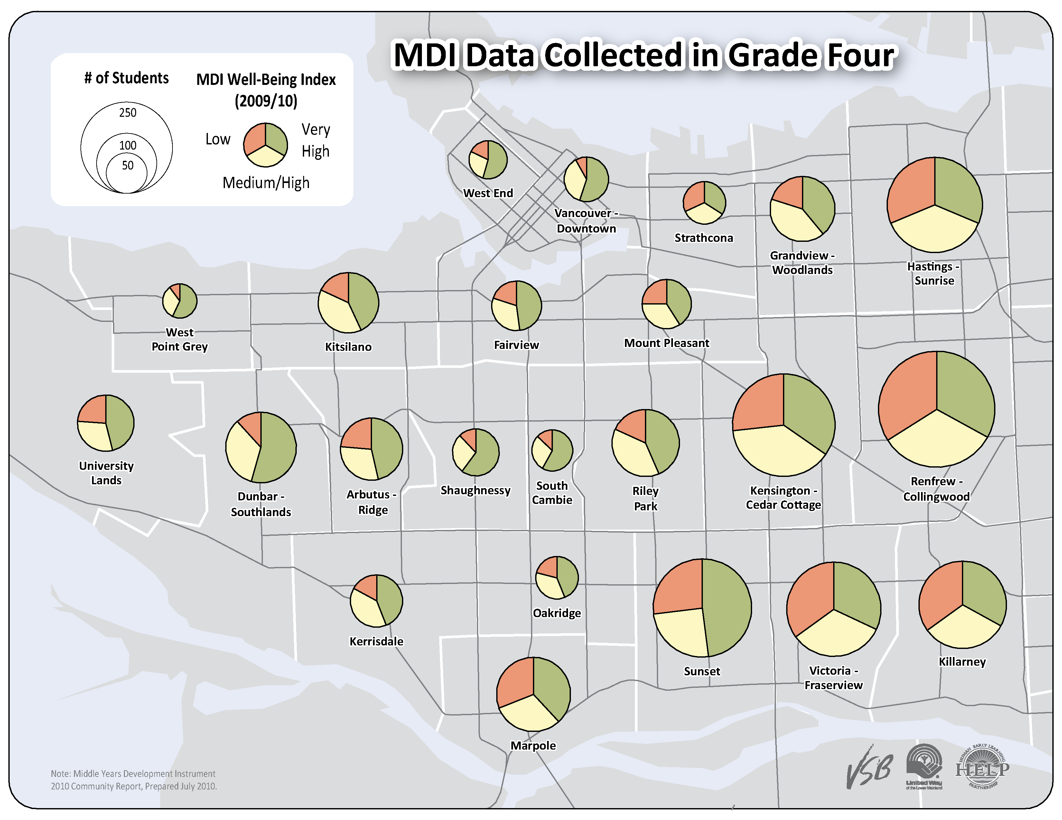

Slide 46
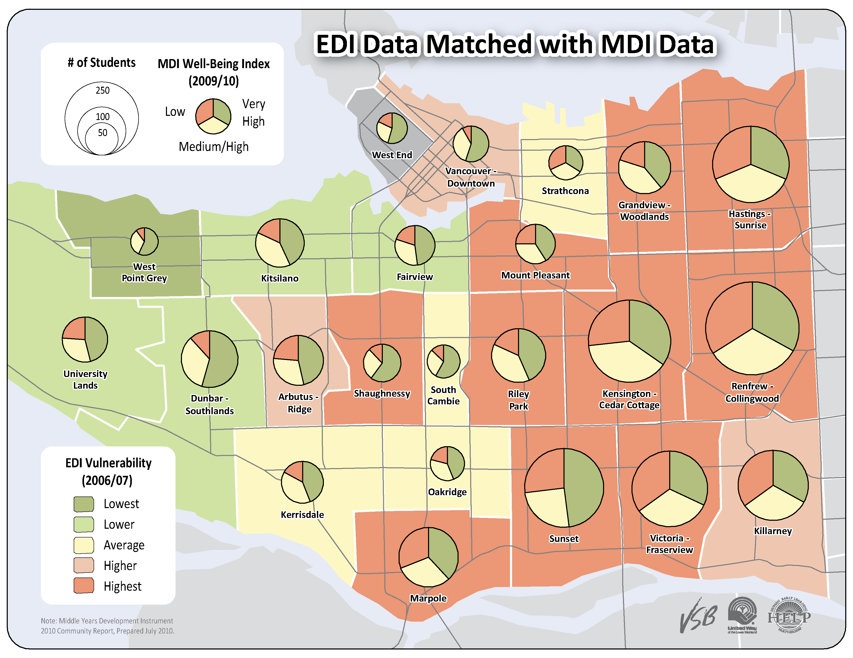

Slide 47
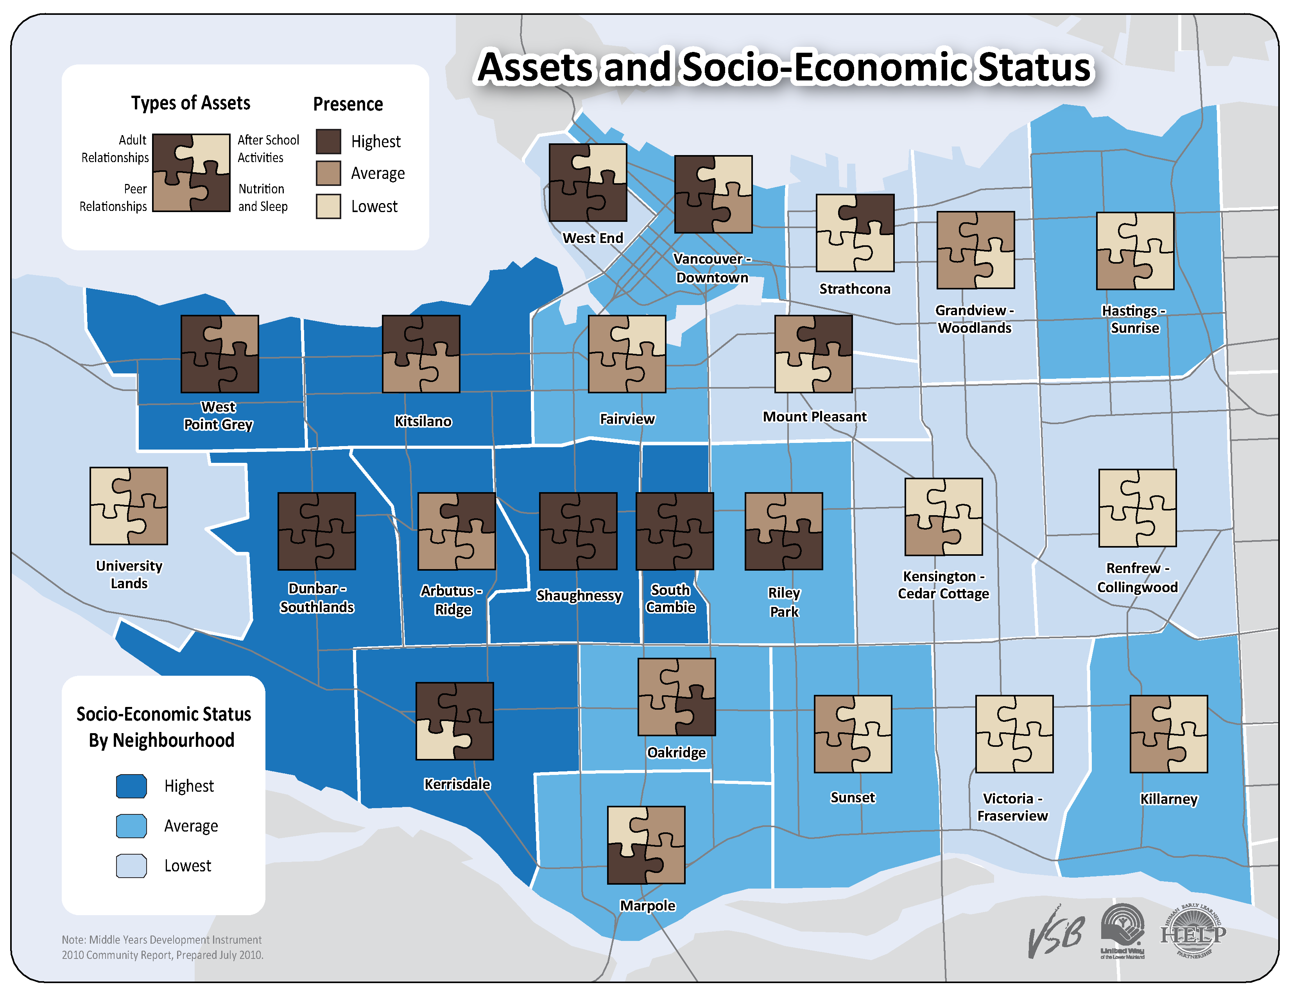

Slide 48
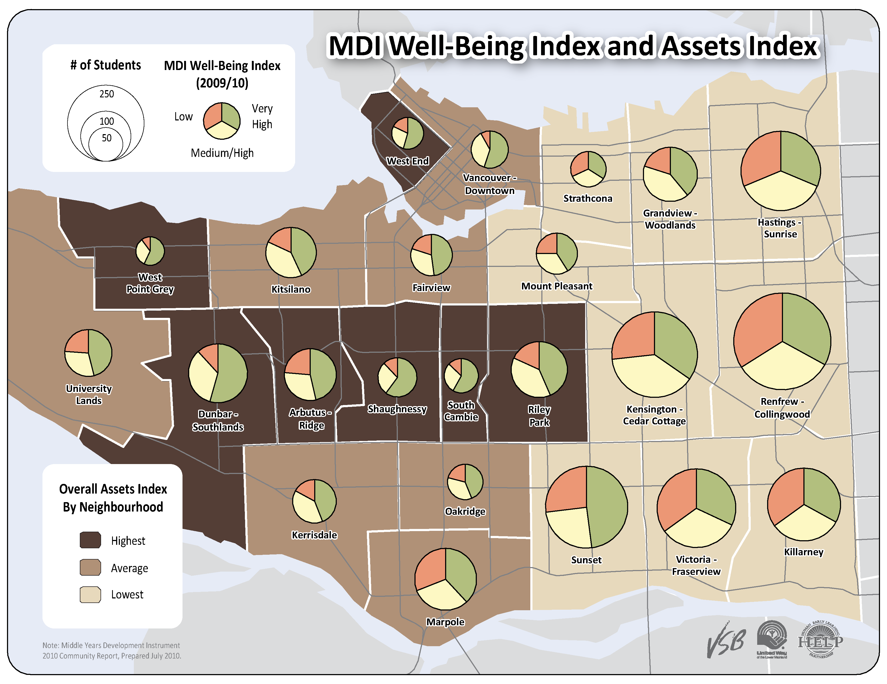

Slide 49
Thank You
www.earlylearning.ubc.ca
Our Funders:

