Slide 1
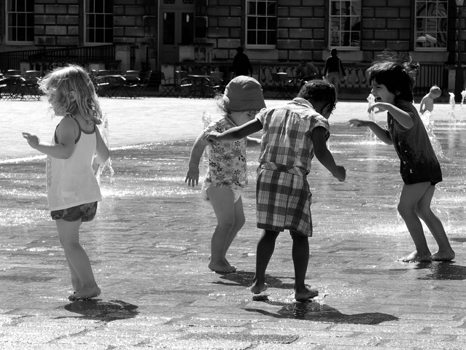
Clyde Hertzman Human Early Learning Partnership University of British Columbia, Vancouver
Many Departments, One Child

Slide 2
Sensitive Periods in Early Brain Development
Pre-school years
School years
High
Numbers
Peer social skills
Sensitivity
Symbol
Language
Habitual ways of responding
Emotional control
Vision
Hearing
Low
0
1
2
3
4
5
6
7
Years
Graph developed by Council for Early Child Development (ref: Nash, 1997; Early Years Study, 1999; Shonkoff, 2000.)
Notes:
‘Sensitive periods’ in early brain development – this slide is based on the following references:
Doherty, G. (1997). Zero to Six: the Basis for School Readiness. Applied Research Branch R-97-3E Ottawa: Human Resources Development Canada.
McCain & Mustard (1999). Early Years Study. Toronto, Ontario: Publications Ontario.
Shonkoff, Jack (Ed) (2000). From Neurons to Neighborhoods: The Science of Early Childhood Development. Washington, D.C.: National Academy Press.
- change colours

Slide 3
Life Course Problems Related to Early Life
2nd Decade
3rd/4th Decade
5th/6th
Decade
Old Age
School Failure
Teen Pregnancy
Criminality
Obesity
Elevated Blood
Pressure
Depression
Coronary Heart
Disease
Diabetes
Premature
Aging
Memory Loss

Slide 4
What drives ECD?
The experiences
children have in
the environments
where they grow up, live and
learn.
Notes:
4

Slide 5
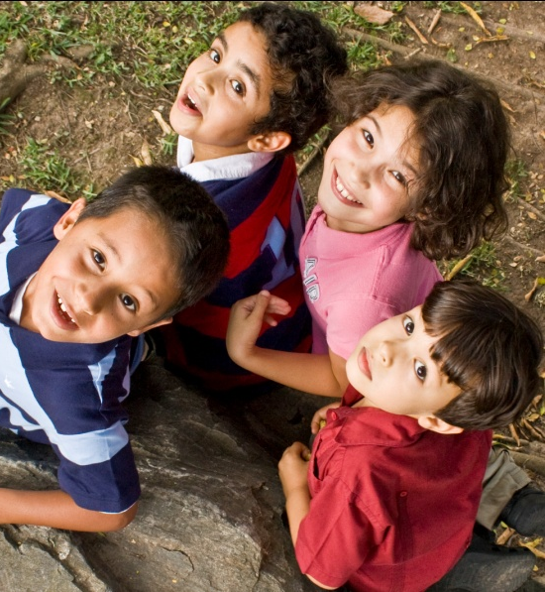
Monitoring the state of development at the level of the population and how it changes over time

Slide 6
Early Development Instrument
104 items
Notes:
Why is this a good time to start doing something like this? As many of you know, the EDI and related data collection efforts have been happening on more or less regular basis in many provinces and regions over the years. This map shows the progress from 2000 to 2009 collection year. The time is good because with the increased sophistication in methodologies and experience in many areas with several waves of data collection, we can bring added value to this project – in addition to, never as an alternative – to local and provincial efforts. The time is good because we are reaching a momentum – a critical mass of data and diversity of regions where it becomes possible to inform national trends. With the Council … ‘s mandate on increasing the knowledge in ECD, putting the existing data together, being able to take advantage of what is going on already at the national level – the collection of EDI – they can focus their efforts on increasing the information at other, earlier levels of development at which we have scarce coverage. Putting the EDI data on a national map shows what can be done and opens the door to population-based collection of other developmental data on young children.

Slide 7
Early Development Instrument
Teacher at age 5 is respondent
Notes:
Why is this a good time to start doing something like this? As many of you know, the EDI and related data collection efforts have been happening on more or less regular basis in many provinces and regions over the years. This map shows the progress from 2000 to 2009 collection year. The time is good because with the increased sophistication in methodologies and experience in many areas with several waves of data collection, we can bring added value to this project – in addition to, never as an alternative – to local and provincial efforts. The time is good because we are reaching a momentum – a critical mass of data and diversity of regions where it becomes possible to inform national trends. With the Council … ‘s mandate on increasing the knowledge in ECD, putting the existing data together, being able to take advantage of what is going on already at the national level – the collection of EDI – they can focus their efforts on increasing the information at other, earlier levels of development at which we have scarce coverage. Putting the EDI data on a national map shows what can be done and opens the door to population-based collection of other developmental data on young children.

Slide 8
Early Development Instrument
5 developmental
domains, with 16 subdomains
Notes:
Why is this a good time to start doing something like this? As many of you know, the EDI and related data collection efforts have been happening on more or less regular basis in many provinces and regions over the years. This map shows the progress from 2000 to 2009 collection year. The time is good because with the increased sophistication in methodologies and experience in many areas with several waves of data collection, we can bring added value to this project – in addition to, never as an alternative – to local and provincial efforts. The time is good because we are reaching a momentum – a critical mass of data and diversity of regions where it becomes possible to inform national trends. With the Council … ‘s mandate on increasing the knowledge in ECD, putting the existing data together, being able to take advantage of what is going on already at the national level – the collection of EDI – they can focus their efforts on increasing the information at other, earlier levels of development at which we have scarce coverage. Putting the EDI data on a national map shows what can be done and opens the door to population-based collection of other developmental data on young children.

Slide 9
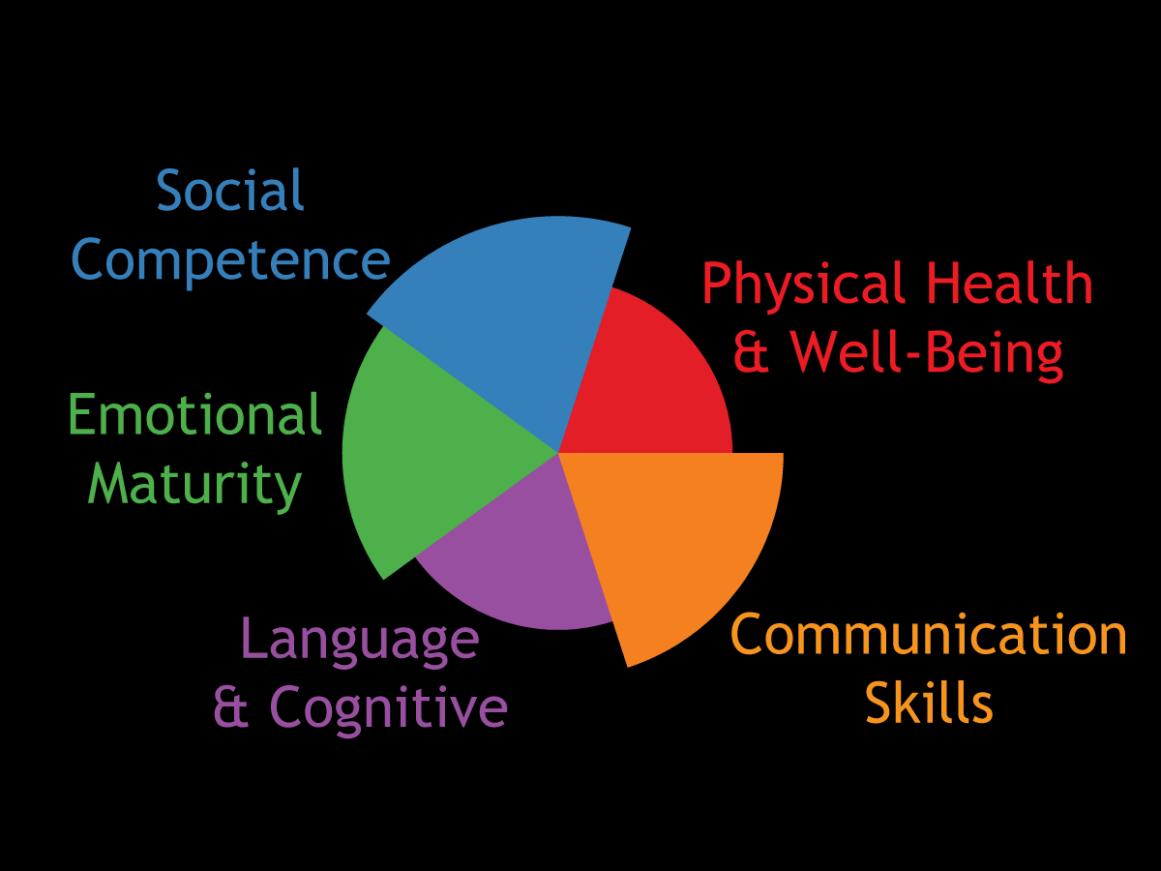
What Does the EDI Measure?

Slide 10
Early Development Instrument
Extensive Validity and Reliability data from several countries
Notes:
Why is this a good time to start doing something like this? As many of you know, the EDI and related data collection efforts have been happening on more or less regular basis in many provinces and regions over the years. This map shows the progress from 2000 to 2009 collection year. The time is good because with the increased sophistication in methodologies and experience in many areas with several waves of data collection, we can bring added value to this project – in addition to, never as an alternative – to local and provincial efforts. The time is good because we are reaching a momentum – a critical mass of data and diversity of regions where it becomes possible to inform national trends. With the Council … ‘s mandate on increasing the knowledge in ECD, putting the existing data together, being able to take advantage of what is going on already at the national level – the collection of EDI – they can focus their efforts on increasing the information at other, earlier levels of development at which we have scarce coverage. Putting the EDI data on a national map shows what can be done and opens the door to population-based collection of other developmental data on young children.

Slide 11
Early Development Instrument
Not an ‘individual assessment’
Notes:
Why is this a good time to start doing something like this? As many of you know, the EDI and related data collection efforts have been happening on more or less regular basis in many provinces and regions over the years. This map shows the progress from 2000 to 2009 collection year. The time is good because with the increased sophistication in methodologies and experience in many areas with several waves of data collection, we can bring added value to this project – in addition to, never as an alternative – to local and provincial efforts. The time is good because we are reaching a momentum – a critical mass of data and diversity of regions where it becomes possible to inform national trends. With the Council … ‘s mandate on increasing the knowledge in ECD, putting the existing data together, being able to take advantage of what is going on already at the national level – the collection of EDI – they can focus their efforts on increasing the information at other, earlier levels of development at which we have scarce coverage. Putting the EDI data on a national map shows what can be done and opens the door to population-based collection of other developmental data on young children.

Slide 12
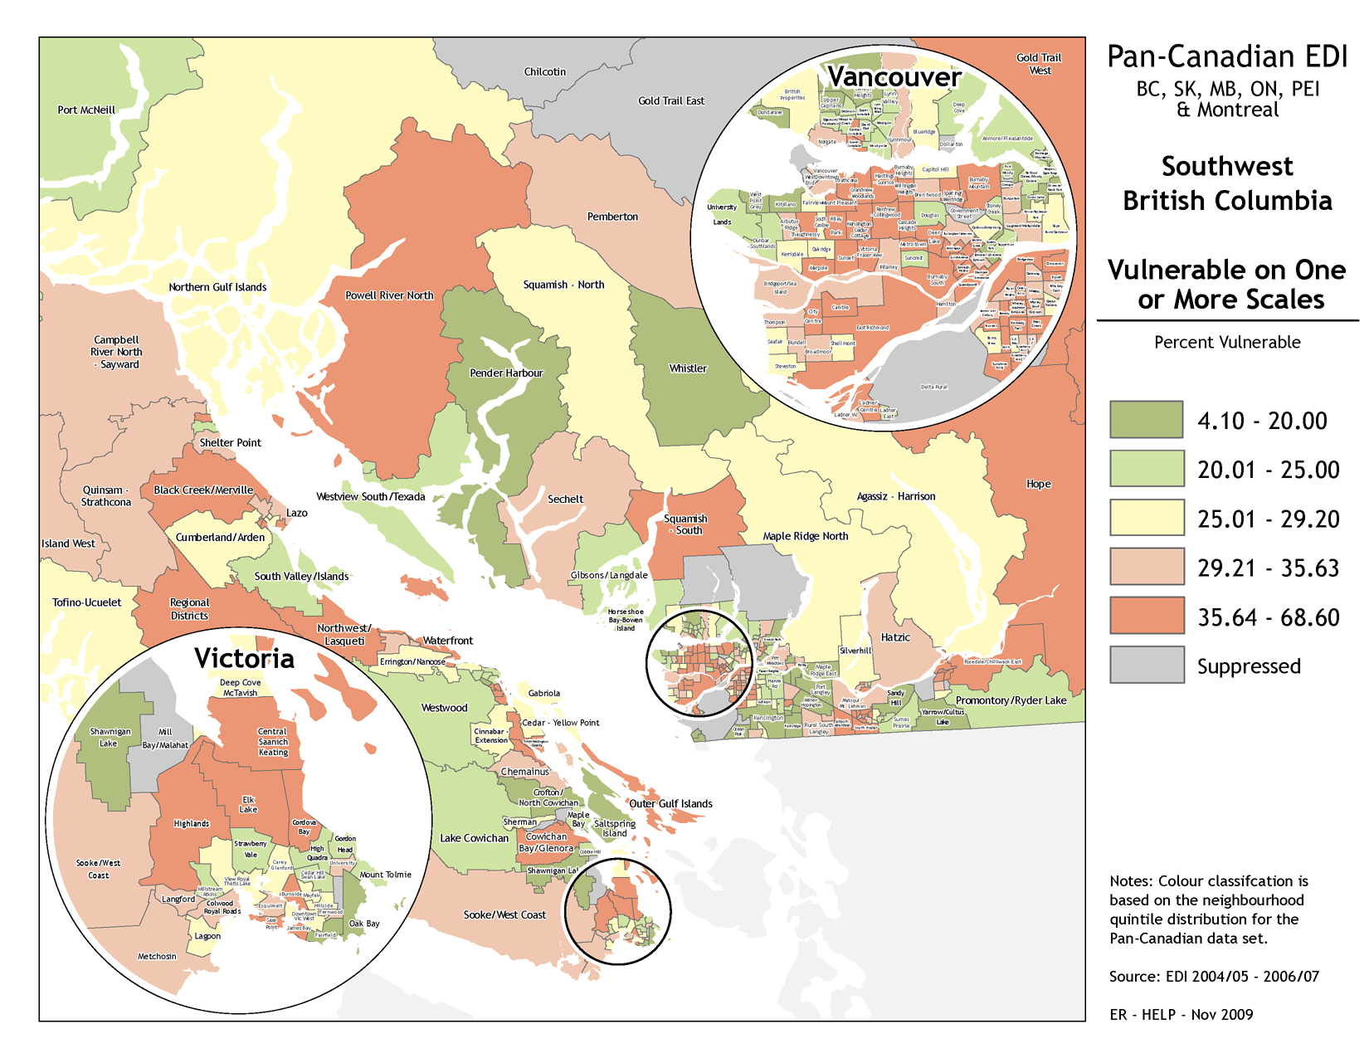

Slide 13
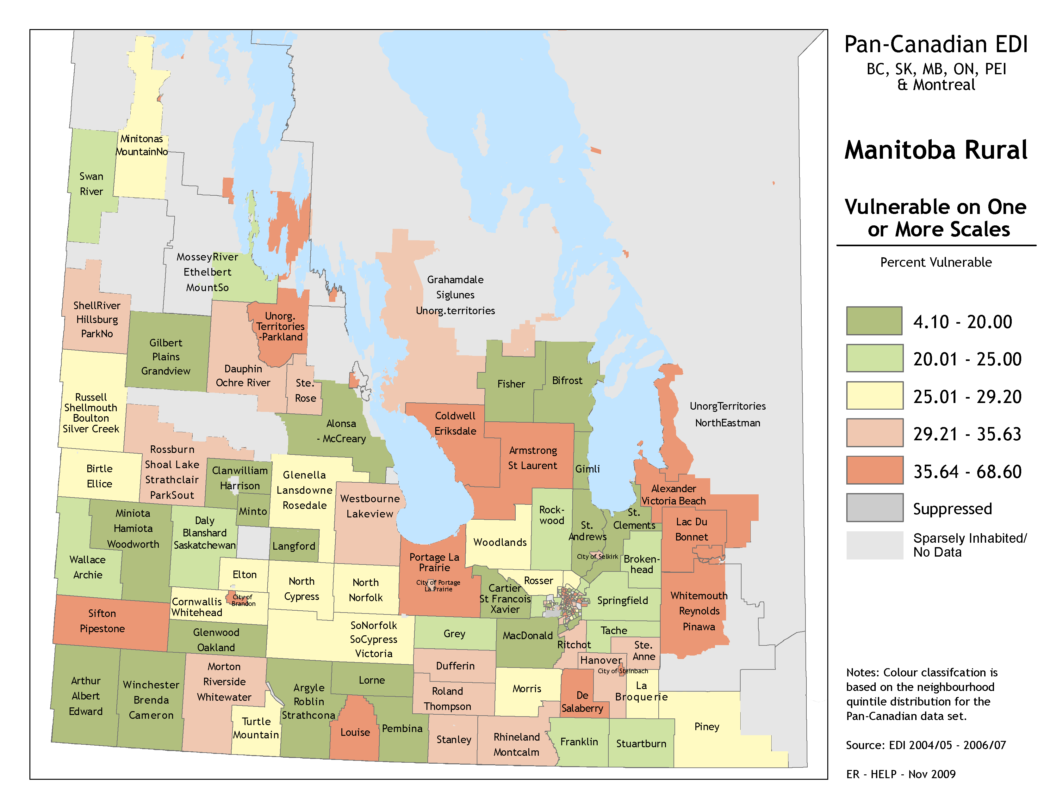

Slide 14
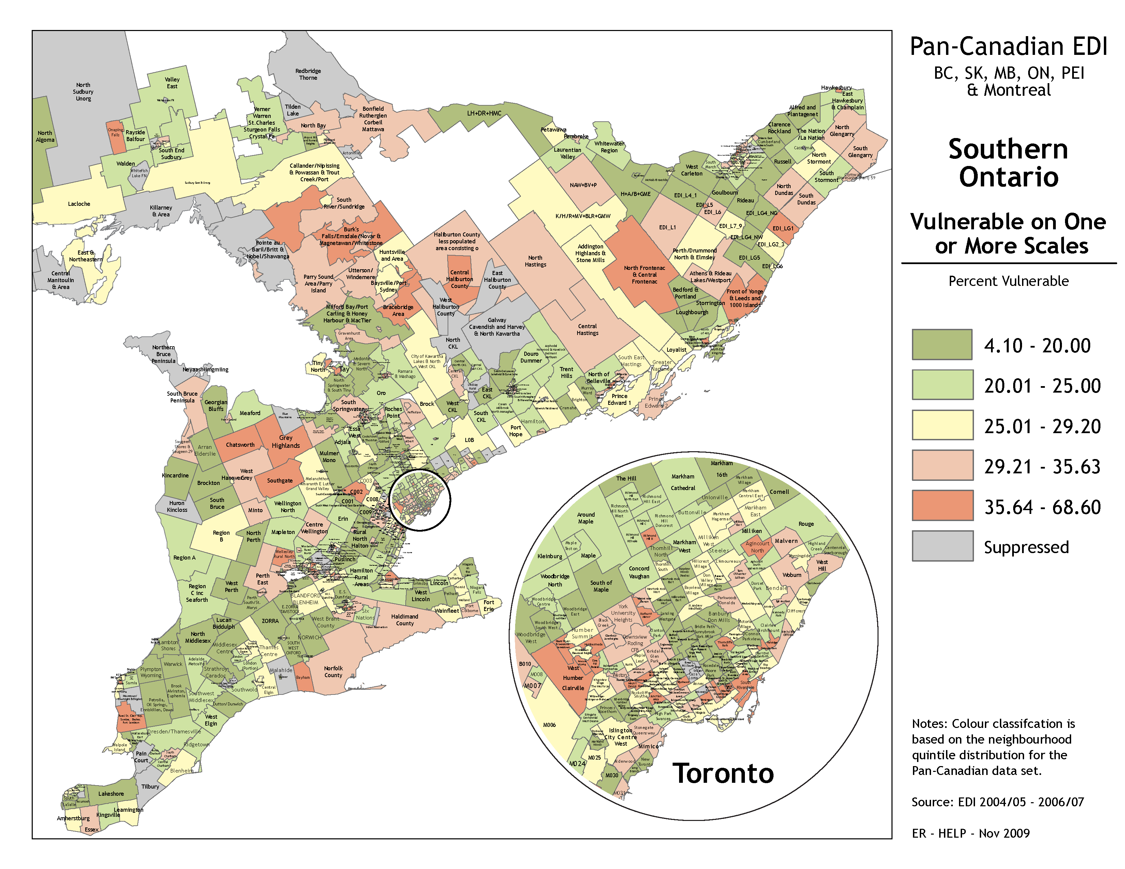

Slide 15
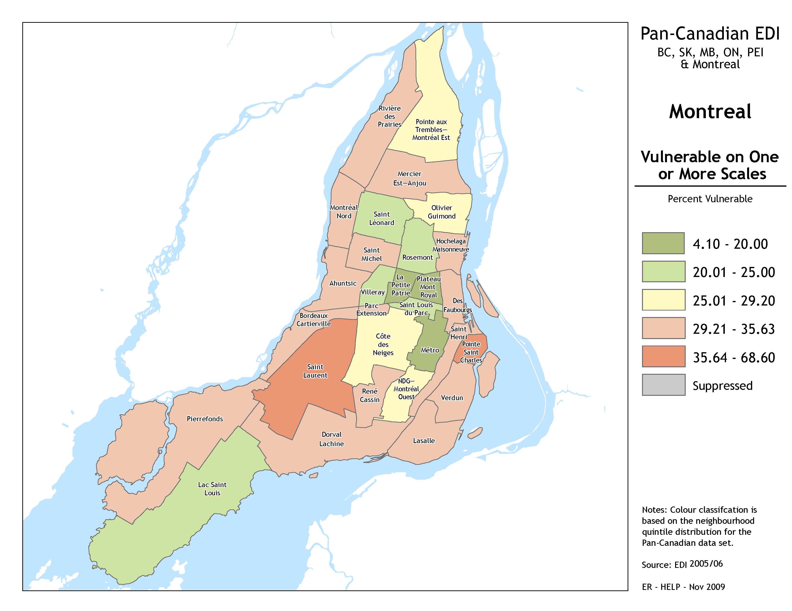

Slide 16
What the maps reveal…
Large local area differences in the proportion of developmentally vulnerable children

Slide 17
What the maps reveal…
The high proportion of avoidable vulnerability

Slide 18
What the maps reveal…
why we need ‘proportionate universality’ in service provision

Slide 19
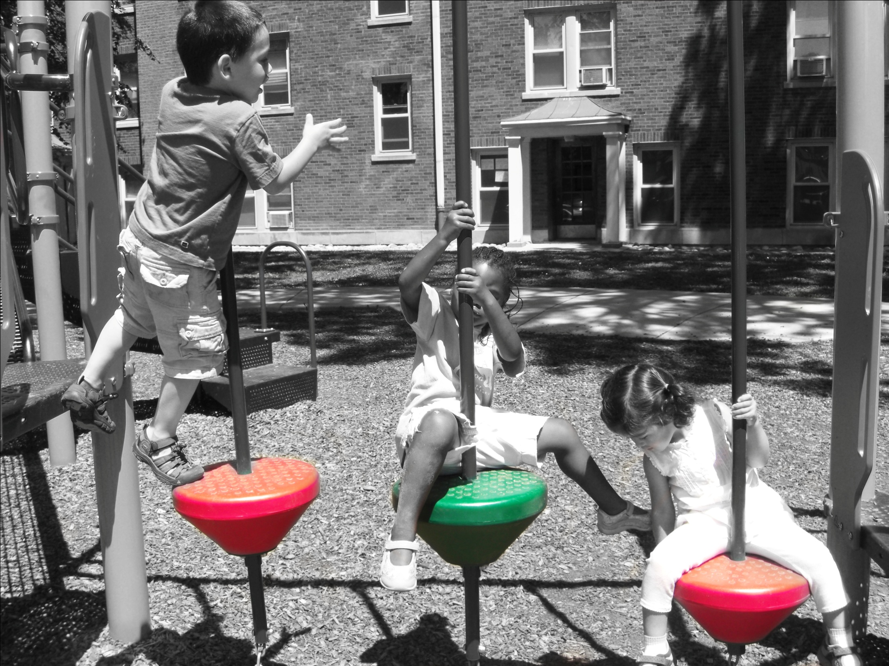
Proportionate
Universality

Slide 20
What does it take to
Reduce Vulnerability?
High
vulnerability
EDI
Low
vulnerability
SES
Disadvantaged
Advantaged

Slide 21
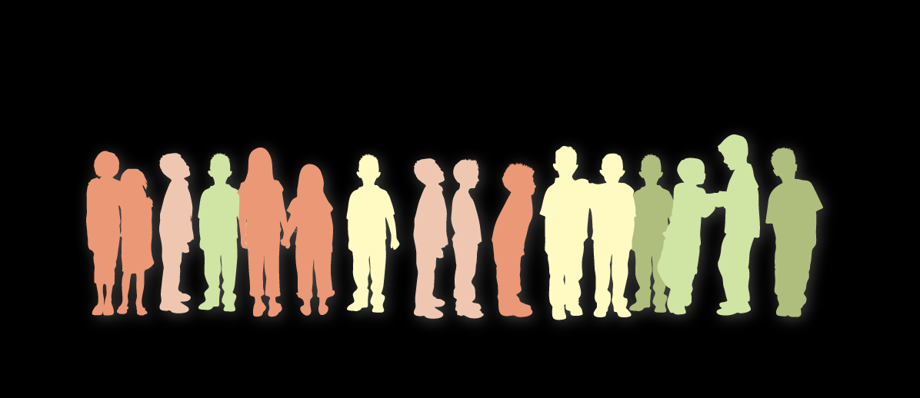
On average, disadvantaged children have poorer outcomes,
However, most vulnerable children are in
the middle class
Socioeconomic
Disadvantage
Socioeconomic
Advantage

Slide 22
Barriers of Access to Quality Programs
1. Program or service not there
2. Costs too much
3. Transportation
4. Time 0ffered
5. Language
6. Fragmentation
7. Lack of info
8. Conflicting Expectations
9. Social distance
10. Parental consciousness

Slide 23
Proportionate Universality
Universal access at a scale and intensity that addresses barriers at every level
High
vulnerability
Barriers to access
Gradient flattened at both ends of the SES spectrum, but proportionate to level of risk
EDI
10 -15%
Low
vulnerability
SES
Disadvantaged
Advantaged

Slide 24
Our evidence shows:
Children who are vulnerable in kindergarten are less likely to be job ready
Notes:
In Business Circles, What is thought to promote a strong economy?
Our Answer: STRONG FAMILY POLICY → SUCCESS BY SIX
HELP Research → A generation that underachieves compromises GDP growth by 20%.

Slide 25
Linkage of EDI to Success in Grade 4
Percent not meeting expectations
90.0
80.0
70.0
60.0
50.0
40.0
30.0
20.0
10.0
0.0
Reading
Numeracy
Number of EDI vulnerabilities
Zero One Two Three Four Five

Slide 26
Observe Transitions from EDI to School Completion
Vulnerability (EDI)
University Eligible Grades
29%
15%
10%
41.5%
50.3%
55.6%
34% increase
Source: Adapted from Kershaw et al. 2009, 15 by 15 : A Comprehensive Policy Framework for Early Human Capital Investment in BC, Table 1..

Slide 27
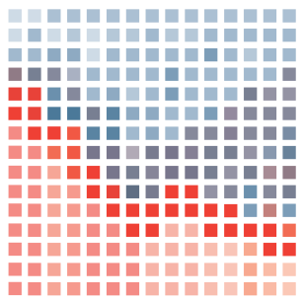
Decreased Vulnerability =
Increased Growth
Reduced vulnerability
(10%)
Reduced early
vulnerability increases GDP
by
20%
That’s throwing away $2.2 -$3.4 trillion now + interest over 60 years!
Status Quo
(29% vulnerable)
Baseline growth
First cohort graduates
Baseline growth plus 0.63% GDP per year
First cohort of 5 year olds benefit
from smart family policy
We are here
Notes:
We apply leading econometric research (Hanushek 2008) re the influence of a population’s cognitive achievement on economic growth to forecast the financial returns from reducing early vulnerability...
The net present value of a 20% increase in GDP over this period is massive; and can be calculated in the light of existing growth projections. In the absence of any change to early vulnerability levels, the federal government forecasts GDP growth of 2.84% per year between 2010 and 2015 (Government of Canada 2010, Table 2.1). Predicting that the aging population will dampen economic growth, the office of the federal Parliamentary Budget Officer (Askari et al. 2010, 10-13) projects considerably lower rates of growth than the federal government thereafter: 1.7% per year until 2030; and 1.4% annually until 2070. To be conservative, we work with the latter’s estimates, phasing-in the influence of additional human capital on the Parliamentary Officer’s baseline projections. In the light of Hanushek’s findings, we calculate that the net present value of reducing early vulnerability down to 10% of children is equal to $2.2 trillion. In other words, Canadians would need to invest $2.2 trillion today for 60 years at a rate of 3.5% interest in order to grow the economy 20% over that period, even after covering the social investment costs required to pay for smart family policy. This enormous dollar figure signals that the early vulnerability debt is nearly four times greater than the total debt load carried by the Government of Canada (Government of Canada 2010, Table 4.2.3). The benefit to cost ratio over that period is nearly 4/1.

Slide 28
Smart Family Policy
0 to18 months
Time: improve parental leave
Services: monthly access to health check-ins and parenting support 0-18 months
18 months to six years
Time: re-think ‘full-time’ work
Services: early learning and care 18 months to school entry
0 to six years
Low-income: make work pay
Low-income: eliminate family poverty

Slide 29
Thank You
www.earlylearning.ubc.ca
Our Funders:

