Slide 1
Internet Safety
Ms. Park

Slide 2
Internet Safety
Q&A: What are some Internet safety tips you already know?

Slide 3
Personal Identifying Informaiton
Your name, address, phone #, etc… should not be shared on public messages, such as Facebook, Twitter, Skype, etc…
Be sure you are dealing with someone that you trust and your parents know of before giving out any personal information about yourself via E-mail

Slide 4
Social Media
Once you post your personal information or pictures on social media, anyone can see them and have access.
People can take screenshots of your photos and keep them, even after you remove them from the site.
If someone writes mean comments about you on social media, don’t respond and tell your parents or guardians.

Slide 5
Meeting someone online
Q&A: What are dangers associated with meeting a stranger online?

Slide 6
Meeting Strangers Online
Be careful when someone offers you something for nothing
Never arrange a face-to-face meeting without telling your parent or guardian
Not everyone is as nice, cute, and funny as they may sound online

Slide 7
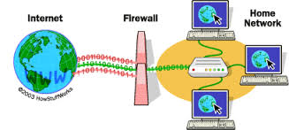
Viruses
Q&A: What is a firewall?

Slide 8
Viruses
Never open unknown emails
Never download unknown files
Keep your computer updated regularly with anti-virus software and install a firewall to protect computers

