Slide 1
Marketing Research

Slide 2
Hello!

Slide 3
What is Marketing Research?
Marketing Research is the collection, analysis, and interpretation of
DATA

Slide 4
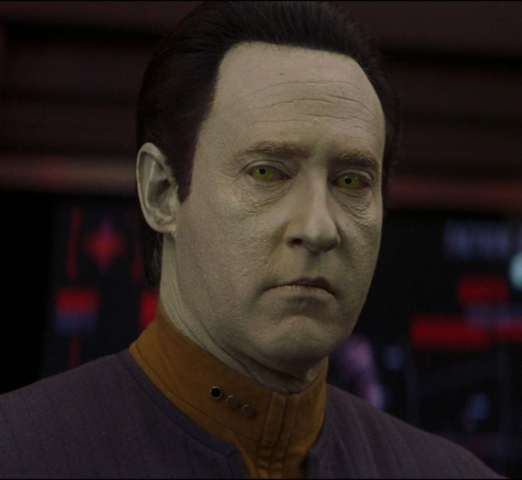
What is Data?
What does “data” mean in marketing research?
a) 3G
b) Lieutenant Commander
c) Individual facts, statistics, or pieces of information

Slide 5
Types of Data Primary Data Vs. Secondary Data
Secondary Data: marketing- research information that has been collected and published by others.
Primary Data: Unanalyzed, current information collected by a researcher him/herself for a specific purpose.

Slide 6
In-Class Worksheet
Worksheet #1
5 minutes!

Slide 7
Primary Data Qualitative Data vs. Quantitative Data
Quantitative Data: a representative sample of target-market population, numbers, statistics
➔ Measurable
Qualitative Data: people’s reactions, responses or feelings toward a given subject or problem
➔ NOT Measurable

Slide 8
In-Class Activity
Worksheet #2 Part I
3 quantitative questions
3 qualitative questions
5 minutes!

Slide 9
In-Class Activity
Worksheet #2
Interview Classmates
Gr.11s – 10 classmates
Gr.12s – 7 classmates
15 minutes!

Slide 10
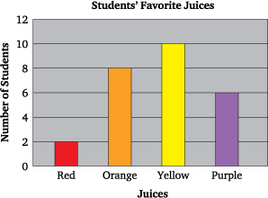
Creating a Graph

