Slide 1

BING Ads
COMM 464: Digital Marketing
Cathrine Rathje (70477161)
Jocelyn Trenaman (46257151)
Kelsey Jang (30530142)

Slide 2
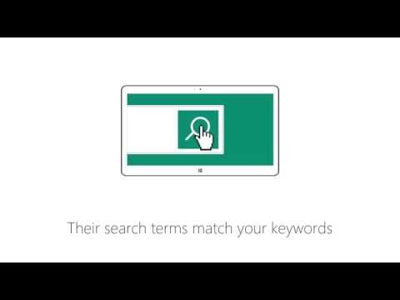
What is Bing Ads?

Slide 3
What is Bing Ads?
Bing Ads help businesses reach customers with search engine marketing (SEM), also known as pay-per-click advertising (PPC)
How it works:
Customers enter keywords into the Bing search engine
If the keywords in your ad match a search, your ad appears next to or above search results on Bing
You can configure your ad so people can call you, visit your website, or go to your location

Slide 4
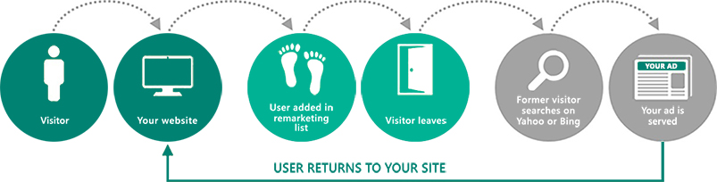
How It Works?

Slide 5
What Determines The Ad’s Position?
Relevance - keywords must fit closely to your ad and website
Bid Price - Keywords are sold through auctions, the bid is based on how much you are willing to pay per each click on your ads
Click-Through Rate - how well your ad performed in the past and how often it has been clicked

Slide 6
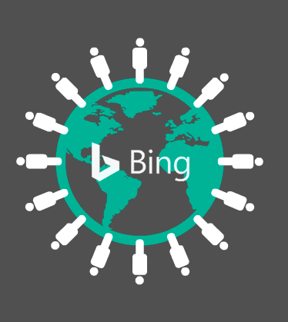
Benefits
Reach millions of searchers using Bing
Customize your location
Works on mobile devices
Manage campaigns against advertising goals
Import your current campaigns (e.g. Google AdWords) directly into Bing Ads

Slide 7
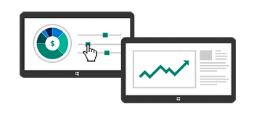
Cost
Companies can control their costs:
Free sign-up
Only pay for clicks - No click, no charge
No minimum fee
First campaign is free

Slide 8
Why Bing Ads and Not Google AdWords?
Less competition - Lower costs and better ad position
Different campaigns with different time zones
Customize your ad for specific devices
Flexibility of advertising just Bing and Yahoo search engines, just search partners or both
Shows your twitter follower count
Control demographic and geographic targeting

Slide 9

Example Success Stories
PetInsuranceQuotes.com
Led agency to make its site mobile-responsive
60 visitors to more than 5000/month
ROI grew 25% in 1 month

Slide 10
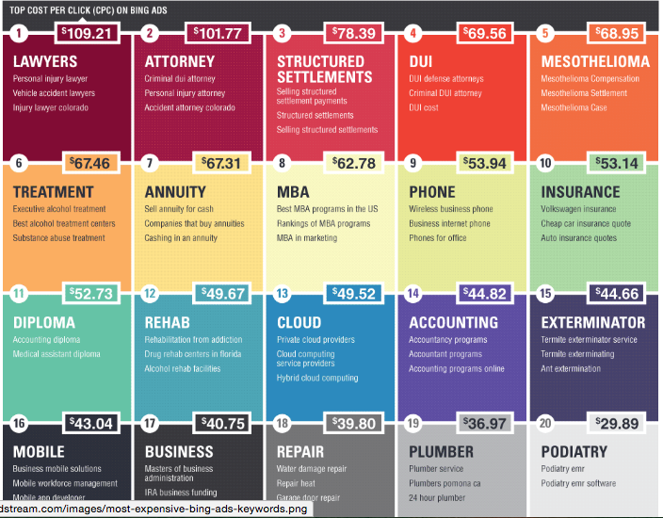
Fun Facts

Slide 11
Thanks for Listening!
Any questions or comments?

