Slide 1
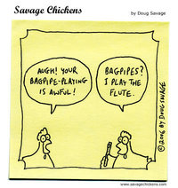

Slide 2
Writing Lesson
Plans
Karen V. Lee

Slide 3
If you’re not sure where you’re going, you’re liable to end up somewhere else

Slide 4
Teaching – PTA pedagogy
Planning – lesson plans
Teaching – executing plan
Assessing – self/peer/teacher

Slide 5
Advantages
Communicates instructional intent
Selects/designs content & procedures
Evaluates
Organizes student activities
Accomplish objectives
Decides worth of instruction
Consistent with ongoing curriculum
Clarity about goals

Slide 6
Disadvantages of no plan
No preparation
Unclear about goals
Inconsistent with curriculum
No extra resources
Tend to take tangents
Cram-jam overload of info for student

Slide 7
Lesson Objective Writing
Strategies
Verb (performance)
Evaluation criteria

Slide 8
Example - (Mager, 1984)
Given (strategies/conditions) , the student will (performance verb) as evaluated by (criterion).
Strategies/conditions
Performance verb
Evaluation criteria

Slide 9
3 Characteristics of objectives
1. Strategies
2. Verb (Performance) – what learner does
3. Evaluation criteria – acceptable level of performance

Slide 10
Example -
Given (lecture, brainstorming, partner/critique, jigsaw), the student will (write 1 lesson objective) evaluated by the instructor during a (large group sharing discussion & submitted lesson plan with no more than 2 errors).

Slide 11
1. Strategies
A list of instructional strategies where behaviour occurs
e.g. Given lecture, instruction, demonstration, call & response, small group work. . .

Slide 12
2. Other strategies
Modeling
Instruction
Demonstration
Guided Practice
Call/response
Clapping
Rhythmic dictation

Slide 13
2. Other strategies? (5 min)
(brainstorm a list in pairs)
Iist on board

Slide 14
2. Verb (Performance)
What learner performs or DOES to achieve objective
E.g. the student will write 1 lesson objective

Slide 15
Unclear Performance verbs
To know
To understand
To really appreciate
To grasp the significance of
To enjoy
To believe
To internalize
To develop

Slide 16
Clear Performance verbs
To write
To recite
To identify
To sort
To compare

Slide 17
Performance verbs (music)
To write
To sing
To play
To clap
To harmonize
To sight read
To improvise

Slide 18
Other performance verbs (music)? (5 min)
Brainstorm in pairs
List on board

Slide 19
3. Evaluation (criteria)
Standard for acceptable performance
Describe criterion of success
Not minimum criterion
Suggest desirable performance level

Slide 20
3. Criterion – 3 possibilities
a. Time limit – within 3 minutes
b. Accuracy –no more than 3 errors
c. Quality – to perform the piece at the tempo 60 BPM within 3 minutes

Slide 21
3. Other criteria ?
Brainstorm in pairs (2 min)
List on board

Slide 22
Example -
Given (lecture, instruction, small group critique), the student (write 1 lesson objective) evaluated by the instructor during a (large group 20 minute sharing discussion and submitted lesson plan with no more than 2 errors).

Slide 23
Examples
Given chord charts, demonstration of guitar chords D, A, E, the students will strum chords to a song evaluated by the instructor in 20 minutes with no more than 3 errors.

Slide 24
Activities:
Jigsaw puzzle objectives (10 min)
2 objectives
Critique objectives in pairs (10 min)

Slide 25


Slide 26
Objective?

Slide 27
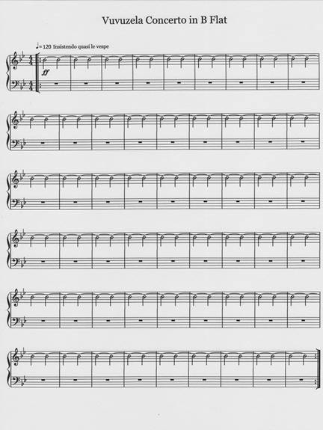

Slide 28
Lesson Plan Template –(handout)
1. Objectives
2. Equipment/Resources
3. Method – Intro
        CRAP – Check, Review, Add, Perform
Closure

Slide 29
Lesson Plan Template
Karen V. Lee

Slide 30
WRITE 1 objective (5-7 min)
Select section of piece
Write 1 objective in HANDOUT
3 sections: strategies
performance
criteria
THINK-(5-7 min) PAIR-(3 min) SHARE (5 min)

Slide 31
DRAFT lesson plan
Select band score (grade 1-2 level?)
Sign-up for microteaching session
1-2 objectives
Choose ONE section of piece
Design Lesson plan
20 minute lesson plan (10 min ques)

Slide 32
DRAFT lesson plan
Microteaching session:
Lesson plan for instructor
Lesson plan resource webct Vista
Advance parts pulled/recruit players
Organize/Collect /equipment/music

Slide 33
Lesson plan DUE
Thurs, Oct 5, 2012 :
kvlee@mail.ubc.ca
www.makeadifferencemove.com

Slide 34
Lesson plan DUE
THURS, Oct 4, 2012
kvlee@mail.ubc.ca
(

Slide 35
References:
Mager (1984) Preparing Instructional Objectives (2nd ed.). Belmont, CA: David S. Lake.

