Slide 1



Flikker: Saving DRAM Refresh-power through Critical Data Partitioning
Song Liu
Karthik Pattabiraman
Thomas Moscibroda
Benjamin G. Zorn

Slide 2
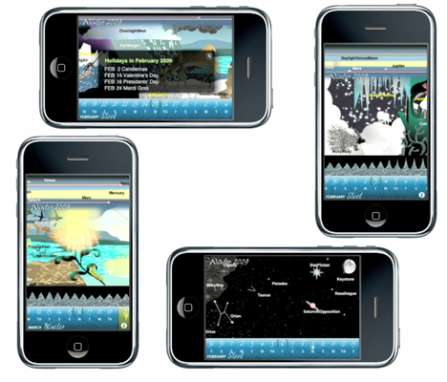
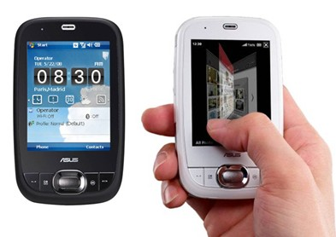

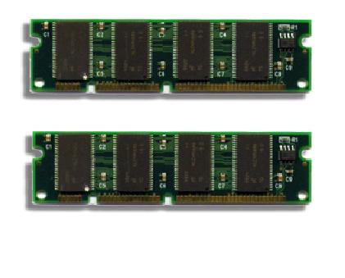
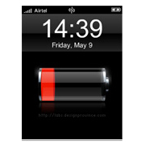
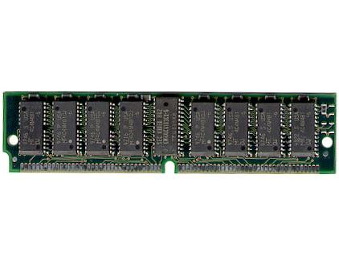
Motivation: Smartphones
Smartphones becoming ubiquitous
Responsiveness is important
Refreshing DRAM can drain the battery even when idle
Using more DRAM
Notes:
Recently, I read a special report from IEEE spectrum, titled top 11 technologies of the decade.
The first one is, smart phones. More and more people are carrying a smart phone with them any time and using them anywhere.
To be a good smart phone, responsiveness is very important, because people don’t like waiting.
One easy ways to improve responsiveness, is to use more and more and more DRAM, so more applications can fit in the memory.
However, the DRAM will drain the battery, even when idle, because of the refresh operations.

Slide 3
Motivation: DRAM Refresh
power
error rate
The
opportunity
The cost
64 mSec
refresh cycle [s]
X sec
Where we are today
Where we want to be
If software is able to tolerate errors, we can lower DRAM refresh rates to achieve considerable power savings
Notes:
Can we do something about the refresh? Of course we cannot total avoid refreshing, or we will lose the data.
But we can refresh less frequently, to get power savings.
On the other hand, because of variations in the retention time of different DRAM cells, slightly increasing
the refresh cycle, or reducing the refresh rate, will not lose all the data. Instead, the error rate increases
with the refresh cycle.
Currently, all the DRAM cells are refreshed at worst case retention time, which is 64ms.
If the system can tolerate some errors, we can reduce the refresh rate and achieve power
Savings.

Slide 4

Flikker: Approach
Critical / non-critical data partitioning
Important for
application correctness
e.g., meta-data, key data structures
Does not substantially impact application correctness e.g., multimedia data, soft state
crit
non-crit
crit
non-crit
Flikker DRAM
High refresh
No errors
Low refresh
Some errors
Mobile applications have substantial amounts of non-critical data that can be easily identified by application developers
Notes:
To help the system tolerate DRAM errors, we introduce Flikker.
The key idea of Flikker is to partition application data into critical data and non-critical data.
Critical data are important for application correctness.
While non-critical data do not much impact application correctness.
With Flikker, different data are placed in different part of the DRAM and refreshed at different rate.
Particularly, critical data is placed in high refresh part, which has no error. And non-critical data
is placed in low refresh part which consumes less power. With this partitioning, DRAM errors are exposed
to the application and handled with software techniques.
Previous work, such as Green, asks the developers to apply approximation in certain region of the application
To tradeoff quality of service for energy efficiency.
In our approach, we rely on the programmers to identify critical and non-critical data.
According to our analysis, mobile applications have substantial non-critical data, that can be easily
Identified by the developers.
Related work approximate to safe power …
Programmer to identify

Slide 5
Contributions of Flikker
Flikker is the first software technique to intentionally lower memory reliability for energy savings (with minimal hardware modification)
Flikker exposes errors in the DRAM to the application, and handles these errors by leveraging inherent error resilience of the software
Flikker allows the programmer to specify reliability of different data based on software requirement
Flikker achieves over 20% overall DRAM power reduction with negligible loss of performance and reliability
Notes:
The contribution of Flikker is as follows.

Slide 6
Outline
Flikker DRAM and software framework
Experimental results
Future work
Conclusions
Notes:
Here is the outline of this talk.
Technique, results, future work, and finally conclusion.
Let’s first review some background of Flikker.
Then I will present the Flikker DRAM structure and software framework.
I will also briefly describe our self-refresh power model.
Then I will experimental results. After discussing future work with Flikker. I will conclude this talk.

Slide 7
Partial Array Self Refresh (PASR)
Self-refresh: low power, keep the data
PASR: only refresh part of the memory array, configured among discrete levels [Samsung], [Micron]
Cons: less DRAM available in idle periods
7
Notes:
Minimizing idle power consumption is important for DRAM, especially mobile DRAMs.
Modern DRAMs switch to self-refresh state in during idle periods to minimize idle power consumption.
Some mobile DRAMs introduce partial array self refresh to further reduce power consumption in self-refresh mode.
Instead of refreshing the whole memory array, only part of the DRAM is refreshed.
Before switching to self-refresh state, the portion of refreshed part can be configured among several discrete levels.
In this example, the upper ¼ of the memory array is refreshed.
The most significant disadvantage of PASR is it reduces the size of available DRAM in idle periods.

Slide 8
Flikker Hardware
Divide memory bank into high refresh part and low refresh parts
Size of high-refresh portion can be configured at runtime
Small modification of the Partial Array Self-Refresh (PASR) mode
Flikker DRAM Bank
High Refresh
⅛
¼
½
Low Refresh
¾
1
8
Notes:
To overcome the disadvantage of partial array self-refresh, we propose the Flikker DRAM.
This figure shows Flikker DRAM bank. In Flikker DRAM, each bank is divided into high refresh part and the low refresh part.
The high refresh part is refreshed at regular rate, and the low refresh part is refreshed at a lower rate.

Slide 9
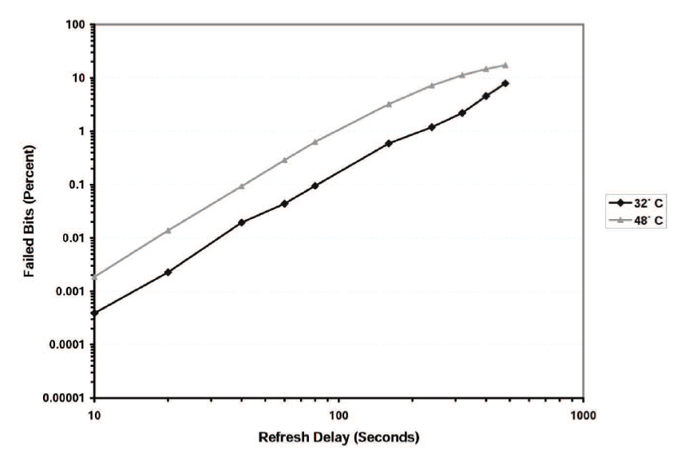
DRAM Error Rate
1s: 4x10⁻⁸
Refresh cycle [s]
Figure from [Bhalodia, Master Thesis, 2005]
Notes:
Previous work has measure the relationship between refresh cycle and DRAM error rate.
In this figure, the x-axis is the refresh cycle time from 10s to 1000s, while the y-axis is the
DRAM error rate in percentage. Both axis are in log scale.
The black curve shows the DRAM error rate under 32 degree Celsius, while the gray line shows DRAM
error rate under 48 degree Celsius.
Over all, the DRAM error rate is low, and follows a clear trend of the refresh cycle time.
In our experiment, we project this curve to the left hand side.
Particularly, we set the refresh cycle time of the low refresh part to 1s, where the error rate
is 4 times 10 to the power of negative 8.
While the high refresh part is refreshed at 64ms second, where the error rate is 0

Slide 10
Flikker Software
Minor changes to the memory allocator and the Operating System (OS)
Operating System
Programmer
Allocator
High Refresh Rows
Flikker DRAM
Low Refresh Rows
virtual pages
physical pages
critical object
critical page
non-critical object
non-critical page
10
Notes:
This figure shows the Flikker software framework.
We denote critical objects with red. And non-critical ones, with blue.
First, the programmer specify which objects are critical and which are non-critical.
Then the allocator allocates different data to separate pages, namely critical pages
and non-critical pages.
Finally, the OS map critical pages to high refresh rows of the DRAM, and the non-critical
Pages to the low refresh rows.
Of course, it is also possible to automate the identification of non-critical data through profiling.
Profiling...

Slide 11
Outline
Flikker DRAM and software framework
Experimental results
Future work
Conclusions

Slide 12
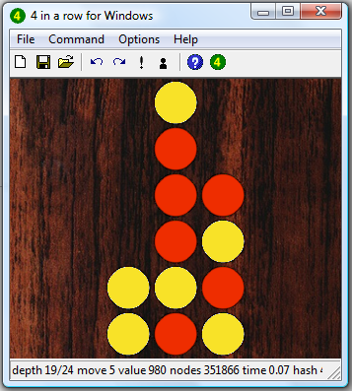
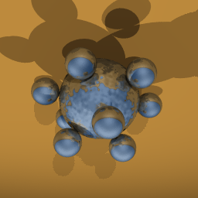
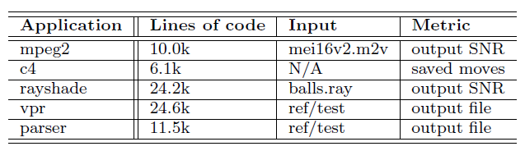
Applications
mpeg2 decoder
c4 (connect 4, four-in-a-row)
rayshade (ray-traced images)
vpr (SA based optimization)
parser
Notes:
In our experiments, we select 5 applications.
First, the mpeg2 decoder from media bench to represent mobile multimedia applications.
Second, c4, which is a game called connect 4 or 4 in a row. Here is a snapshot of the game.
In our experiments we play c4 against the computer AI.
Then we have rayshade, which generate ray-traced images of 3D objects.
Finally, we have vpr and parser from SPEC 2000 benchmark suite.
This table summarizes basic information of these applications.
To evaluate the program execution under DRAM errors, we use the following metrics.
For mpeg2 and rayshade, we evaluate the SNR of the output video.
For c4, we compare the moves through the game.
For vpr and parser, we compare the final output of the application.

Slide 13
Experiment Setup
Performance (architectural simulator)
  Impact of data partitioning
Overall DRAM power (simulator, model)
  Active power, Idle power
  Usage profile (95% idle, 5% active)
  [Karlson et.al, Pervasive’09]
Fault injection simulation (Pin)
  Simulate a self-refresh period, and inject error afterward
<0.5%
Notes:
In our experiments, we evaluate the system performance with an architectural simulator
to show the impact of or data partitioning, which is actually negligible.
Our simulator also measure the active power consumption of the DRAM.
We estimate the idle power with our propose analytical model.
Given the active power and idle power, we assume a usage profile of 95% idle and 5% active,
and calculate the overall DRAM power consumption w/ and w/o Flikker.
Finally, we do fault injection simulation, to reveal the impact of DRAM errors on application
correctness. Particularly, we simulate self-refresh period during the execution of the application,

Slide 14
Fault-injection Simulations
code
stack
global
heap
baseline
code
stack
global
heap
conservative
code
stack
global
heap
ideal
code
stack
global
heap
compiler support
custom allocator
aggressive
code
stack
global
heap
crazy
critical
non-critical
Notes:
We categorize DRAM data as code, or the instructions, stack, global data and heap data.
We assume the code and the stack is all critical; while global and heap contains both critical and non-critical data.
To support the data partitioning in global and heap data, we need compiler support and a custom allocator respectively.
In our experiment, we only implemented the custom locator, so partitioning in global data is not supported.
In order to estimate the behavior of the ideal partitioning, we simulate to different configurations,
conservative and aggressive.
All the global data is critical in the conservative configuration, and non-critical in aggressive configuration.
To show the extreme cases, we simulate the crazy configuration,
where only the code is protected against DRAM errors.

Slide 15
Power Reduction
Estimate the portion of high refresh part based on the percentage of the critical pages
  24% critical pages: ¼ high refresh rows
Overall power savings: up to 25%
Notes:
These two figures shows the standby DRAM power reduction and overall DRAM power reduction achieved by Flikker.
We estimate the portion of high refresh part based on the percentage of the critical pages.
For example, if 24% of the pages are critical, ¼ of the memory array is in high refresh.
Therefore, the critical pages could fit in the high refresh part.
In these figures, we see the power saving increases from conservative configuration to crazy configuration.
A extreme example is c4, which has 0 power reduction in conservative, because c4 doesn’t have any
non-critical heap data. However, c4 achieves over 30% reduction in DRAM standby power when
we put global data in the low refresh part. Later I will show that putting global data in the
low refresh part doesn’t incur any output degradation for c4.

Slide 16
Fault-injection Result
Output stats (1000 executions): perfect, degraded, failed (hang, crash)
c4: always perfect
mpeg2, rayshade: some degraded output
vpr, parser: some failed in aggressive and crazy
Notes:
This figure shows the output stats of 1000 execution for all applications and all configurations.
We categorize the output as perfect degraded, and failed.
Overall, conservative configuration works well for all applications.
No application fails in conservative configuration. This demonstrates the error resilience of these
applications.
On the other hand, some execution of vpr and parser failed in aggressive and crazy configuration.
This confirms the importance of protecting critical data.
C4 always gives perfect output under all configurations.
Mpeg2 and rayshade generate some degraded output for all application.
And vpr and parser fail under conservative and crazy configuration.

Slide 17
Fault-injection Result: SNR
Signal-to-Noise-Ratio (SNR): the ratio of signal energy and noise energy
SNR in logarithm scale: 3dB means double the ratio
mpeg2 encoder -> decoder: 35 dB
Flikker yields very high SNR
Configuration | mpeg2 | rayshade
conservative | 95.48 | 101.1
aggressive | 88.34 | 72.84
crazy | 88.04 | 73.63
Average SNR of degraded output of mpeg2 and rayshade [dB].
The impact of Flikker is negligible.
Notes:
One concern of mpeg2 and rayshade is the degradation in output quality.
However, we will show the output degradation is actually negligible.
We evaluate the output quality of mpeg2 and rayshade with Signal to noise ratio, SNR.
Larger SNR means higher output quality.
SNR is usually shown in log scale, where 3dB means double the ratio.
We test the SNR of mpeg2 on a video.
After encoding and decoding, the final output video achieves 35dB compared with the original video.
The SNR of Flikker is much higher than this.
As shown in this table Flikker achieves over 70dB SNR for all these configurations,
which means the output degradation is negligible.

Slide 18



Rayshade: Degraded SNR
original
degraded (52.0dB)
Notes:
This is an example output from rayshade.
It is very difficult to see the difference between the original figure and the one with 79db.
Only when we zoom in enough, we can see the difference between these two.

Slide 19
Outline
Background
  Error resilience of applications
  Partial Array Self Refresh
Flikker DRAM and software framework
Experimental results
Future work
Conclusions

Slide 20
DRAM in Data Centers
Data center applications contain soft states, e.g. index
Typical utilization of data centers is less than 30%
Notes:
Now the future works.
Besides mobile workloads, we believe DRAM also works for DRAM in data centers,
For the following reasons.
First, electricity bills dominate the maintain cost of data centers. Less power, less cost.
Second, typical utilization of data centers is less than 30%.
Finally, data centers usually use large amount of memory, which provides more
opportunity for Flikker.

Slide 21
Reduce Refresh Penalty
Refresh operation incurs performance penalty in active state
  No R/W during refresh operations
  Larger DRAM → more rows to refresh → higher refresh penalty
  [Stuecheli, MICRO’10]
Flikker reduces the number of refresh operations, and thus reduces refresh penalty
Notes:
Beside draining the battery, refresh operation also incurs performance penalty,
Namely refresh penalty.
Because the DRAM is not available for read and write during refresh operations.
Recent research shows that, the refresh penalty increases with DRAM capacity, because
Larger DRAM has more rows to be refresh in the retention time.
Because Flikker reduces number of refresh operations, it also reduces the refresh penalty.

Slide 22
Conclusions
Handles DRAM errors with error resilience of software
Specify reliability of different data based on software requirement
Over 20% overall DRAM power reduction

Slide 23
Thank you!
Questions?
23

Slide 24
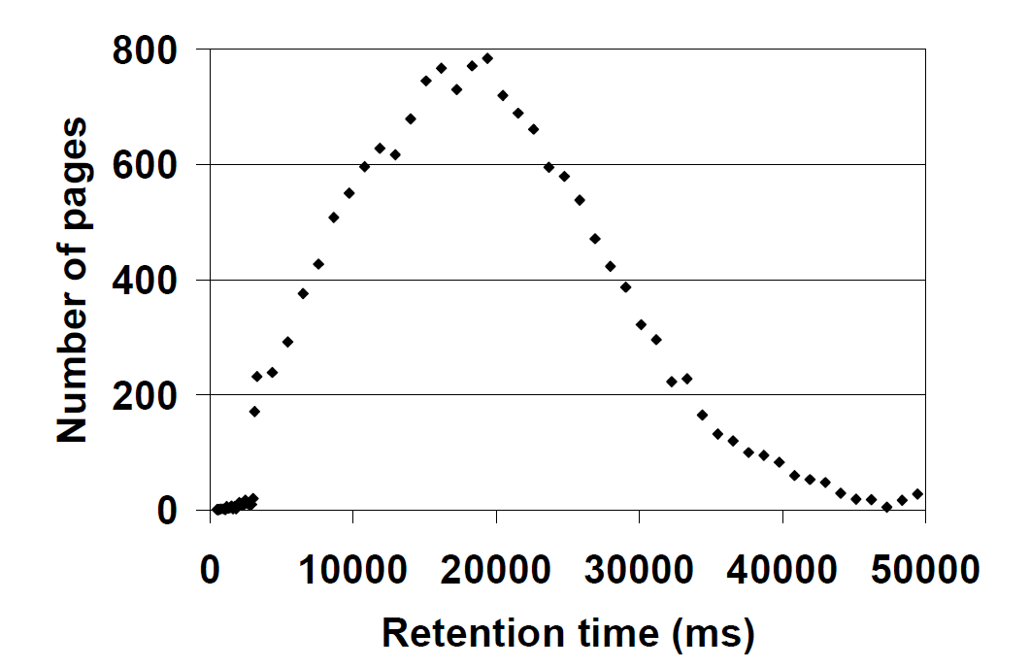
DRAM Refresh is Expensive
Refresh power consumption
Performance penalty
  Refresh penalty increases with capacity
  [Stuecheli, MICRO’10]
Variation in retention time [Venkatesan, HPCA’06]
Figure from [Venkatesan, HPCA’06]
Notes:
This figure shows the retention time of different pages in a DRAM chips. In state-of-the-art DRAM, all the DRAM cells are refreshed at the worst-case retention time of 64ms for 100% reliability. So most DRAM cells are being over refreshed.

Slide 25
Memory Footprint Breakdown
Global data is not partitioned

Slide 26
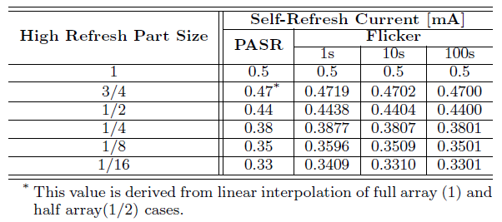
Self-refresh Power Model
Self-refresh power is not just power spent on refresh
P_{self-refresh}= P_{refresh} + P_{other}
Assume P_{refresh} is proportional to refresh rate
power
error rate
refresh cycle [s]
Notes:
It is important to notice that

Slide 27
Power Saving vs. Error Rate
1s
¼ array high refresh

Slide 28
Power vs. Output Quality
conservative: parser
aggressive: mpeg2, c4, rayshade
crazy: vpr
Notes:
Compare the power saving with reliability, we find parser performs best on conservative configuration.
Since parser has large noncritical heap data, it achieve significant power saving in conservative
configuration. Parser also have large critical global data, which leads to many failed executions
in aggressive and crazy configurations. On the other hand vpr works well in crazy configurations.
This is because a few errors in stack and critical heap data are not likely to impact the final
result of simulated annealing algorithm.
The other three applications prefers aggressive configuration,
where they achieves significant power saving and high quality output.

