Slide 1

An Empirical Study of Client-Side JavaScript Bugs
Frolin S. Ocariza, Jr.
Kartik Bajaj, Karthik Pattabiraman, Ali Mesbah
University of British Columbia

Slide 2
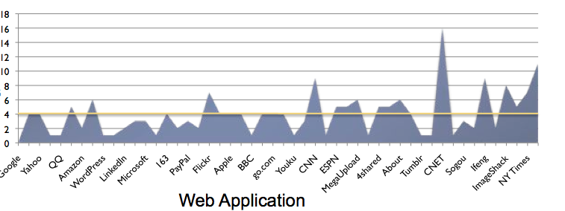
Why Study Client-Side JavaScript (JS) Bugs?
Other uses of JS: widgets, servers, hybrid mobile apps
JavaScript can be confusing!
  Weak typing, Asynchronous/Event-driven, eval()
# of
Faults

Slide 3
Goal of This Study
Better tests and analysis tools for client-side JavaScript
Goal #1: Discover the causes of JavaScript faults
Do these faults have any impact?
Goal #2: Discover the consequences of JavaScript faults

Slide 4
JavaScript Bug Sequence: Some Terminology
Programmer makes a mistake
  ERROR
Erroneous value gets used
  FAULT
Code terminates or generates wrong output
  FAILURE
x = {“foo”: “some value”};
key = “moo”;
MISTAKE!
y = x[key];
EVALUATES TO
UNDEFINED
...
...
z = y.length;
EXCEPTION!

Slide 5
What We Analyze: Bug Reports
Main item of analysis
  Bug reports contain detailed information from patches, developer comments, etc.
Console messages don’t directly tell us what the causes and consequences are of the fault

Slide 6




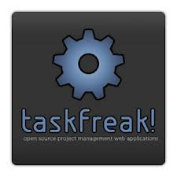







Experimental Objects
Eight JavaScript Web Applications
Reports per repository:
min{30, NumJSReports}
Total Reports Analyzed:
317
Four JavaScript Libraries

Slide 7
Bug Report Collection
DISCARD
NO
NO
Bug/Defect?
Fixed?
Bug Report
YES
YES
Create XML file for bug report
JS Fault?
YES
NO

Slide 8
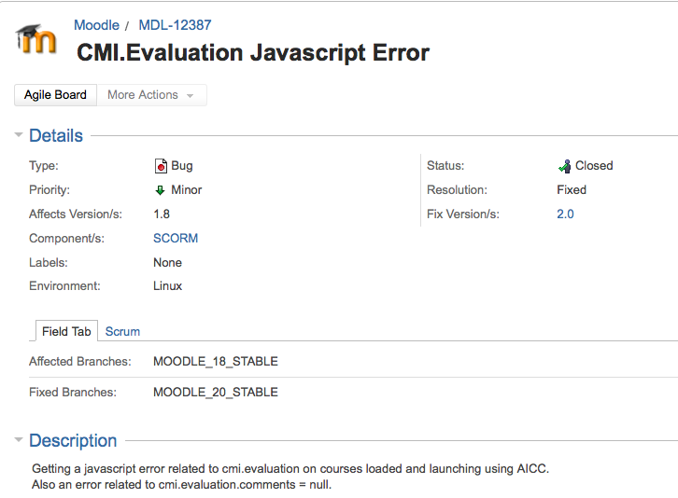
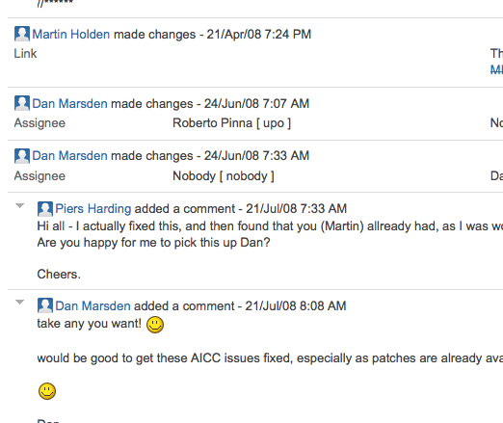
Developer
Comments
Initial Description
Classifications

Slide 9
Research Questions
What are the types of faults that exist among reported bugs, and how prevalent are they?
What impact do these JavaScript faults have on the web application?
What are the root causes of these JavaScript faults?
How long does it take programmers to fix JavaScript faults?

Slide 10
Research Questions
What are the types of faults that exist among reported bugs, and how prevalent are they?
What impact do these JavaScript faults have on the web application?
What are the root causes of these JavaScript faults?
How long does it take programmers to fix JavaScript faults?

Slide 11
RQ1 – Fault Categories: Results
Incorrect Method Parameter: Error propagated into parameter of native JS method
  → 88% of these native methods are part of the DOM API

Slide 12
JavaScript DOM API
html
body
head
table
table
p
script
Text: “Hello world”
tr
tr
12

Slide 13
JavaScript DOM API
JavaScript code:
var x = document.getElementById(“foo”);
Returns null
No longer exists
table
DOM:
id: bar
id: foo
Dynamically modified
13

Slide 14
RQ1 – Fault Categories: Results
DOM-Related Faults
65% of all JavaScript faults
What programmer expects to be in the DOM vs what is actually in the DOM

Slide 15
Research Questions
What are the types of faults that exist among reported bugs, and how prevalent are they?
What impact do these JavaScript faults have on the web application?
What are the root causes of these JavaScript faults?
How long does it take programmers to fix JavaScript faults?

Slide 16
RQ2 – Impact: Results
Impact Types
    Type 1 (lowest impact), Type 5 (highest impact)
80% of highest impact faults are DOM-related

Slide 17
High-Impact Bugs
Data loss: Save functionality not working, mail not sent
  Occurred in: Joomla, WordPress, Drupal, Roundcube, Prototype
Browser hangs: typically browser-specific
  Occurred in: Roundcube, Prototype
Information leakage: One case where server code accidentally gets displayed
  Occurred in: TYPO3
Unusable application: Login functionality not working
  Occurred in: Moodle, Drupal, WikiMedia, jQuery, Ember.js

Slide 18
Research Questions
What are the types of faults that exist among reported bugs, and how prevalent are they?
What impact do these JavaScript faults have on the web application?
What are the root causes of these JavaScript faults?
How long does it take programmers to fix JavaScript faults?

Slide 19
Finding the Error Location
Made use of patches
BUT: Patches may be workarounds, not fixes

Slide 20
RQ3 – Error Locations: Results
Error Locations
  Most errors committed by programmer in JS code itself

Slide 21
Research Questions
What are the types of faults that exist among reported bugs, and how prevalent are they?
What impact do these JavaScript faults have on the web application?
What are the root causes of these JavaScript faults?
How long does it take programmers to fix JavaScript faults?

Slide 22
RQ4 – Triage and Fix Times
Triage
Time
Fix
Time
Reported
Assigned
or
Commented
Fixed

Slide 23
RQ4 - Triage and Fix Times: Results

Slide 24
Implications
Developer tools that reason about DOM → e.g., DOM-aware IDEs
Emulate more DOM-related faults in testing
Static and dynamic analysis tools
  e.g., Vejovis (JS repair suggestion tool)

Slide 25
Threats to Validity
Two people classifying bugs → possible consistency issues
Non-deterministic and low-visual-impact faults may go unaccounted for
Delays in triage and fix times also unaccounted for

Slide 26
Conclusion
74% of JS faults → Incorrect Method Parameter faults. 88% of these are DOM-related faults.
80% of high-impact faults are DOM-related
Most JS faults are committed by programmers in the JS code itself
DOM-related faults have short triage times but long fix times compared to non-DOM-related faults
  http://ece.ubc.ca/~frolino/projects/js-bugs-study/

