Slide 1
Who flourished in the Middle Ages and who suffered?
His hood full of holes with the hair sticking through,
His clumsy knobbed shoes cobbled over so thickly,
Though his toes started out as he trod on the ground…
Two miserable mittens made out of old rags,
He wading in mud almost up to his ankles,
And before him four oxen, so weary and feeble
Once could reckon their ribs, so rueful were they.

Slide 2
“If feudal society was a house with many rooms, then loyalty was the set of beams that held it up”
Homage- means to show honour and respect
Vassals paid homage
An oath of fealty, which happen in a formal ceremony, bound the king to the lord, or the lord to the knight…

Slide 3
The Survey
King William and his Norman lords set out to make all of England under the feudal system
King William order a survey of all the land in England
The results of the survey were written in “The Great Domesday Book”
This book became a valuable source of information for the king’s tax agents.
William distributed the land as fiefs to his Norman lords.

Slide 4
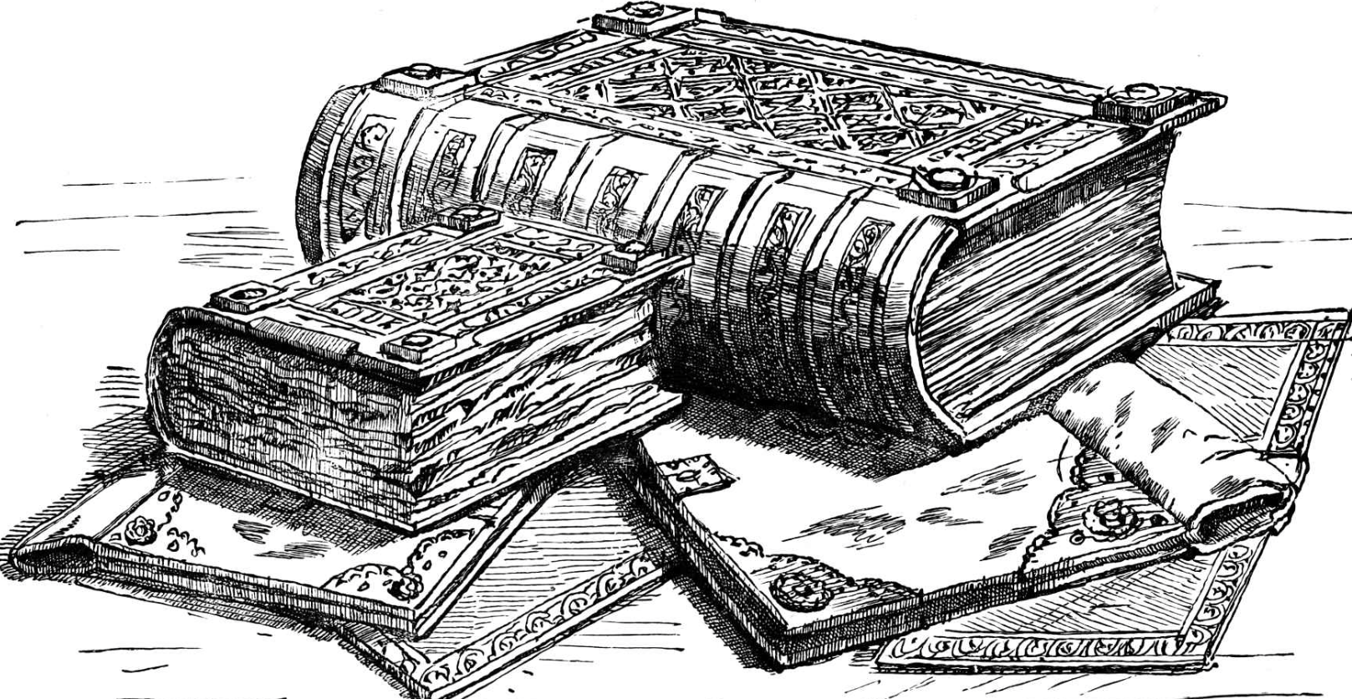
The Great Domesday Book”

Slide 5
The Castles
Lords built castles on their land- defensive structures. Top of hill with moat.
By 1100, several hundred castles had been built throughout the countryside
Castles helped to shaped lives during medieval times.
Home for the lord and nobles
Place of safely for others during battle
center for feudal life

Slide 6
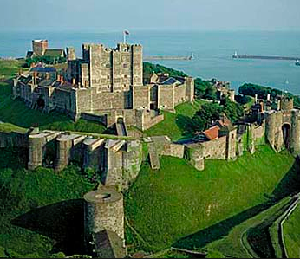
Dover Castle

Slide 7
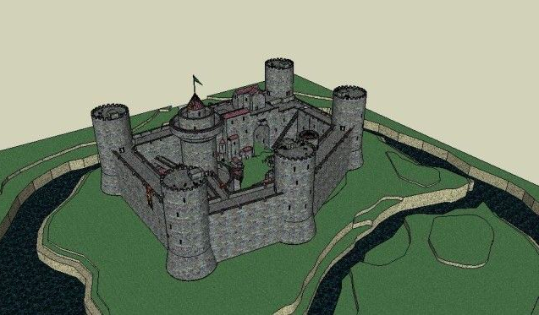

Slide 8
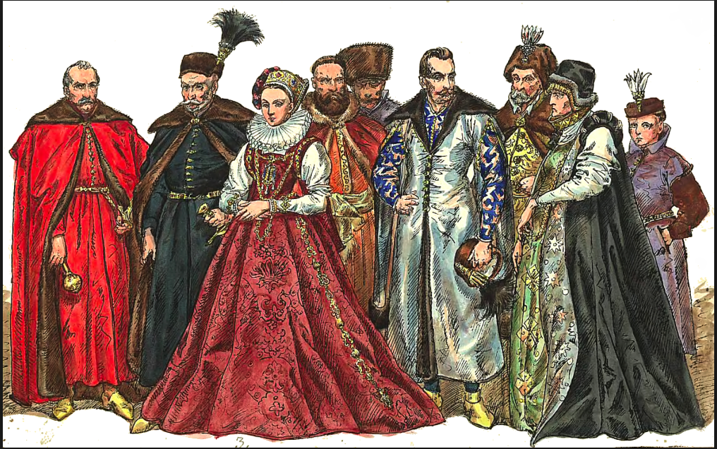
The Nobility

Slide 9
The Nobles
Lives in the castle- NOT built for comfort!
Life was not glamorous
Lord and lady slept behind a curtain in main dining hall
Knights, guests, servants and dogs also might have slept in the hall
In the winter, inhabitants would wash by plunging their arms though ice crusted water in buckets
Duties included military protection, agriculture, industry and trade on his lands

Slide 10
A Noble’s Life
You probably get up around 4 am and eat a piece of bread and some wine. Then you will go to mass. Next you will probably go hunting or fishing, practice jousting or fencing, play chess, go beat some serfs, generally hang around. You do have some duties: checking on the workings of the lands, giving directions, holding court for the peasants. You will have dinner at 9 or 10 pm.

Slide 11
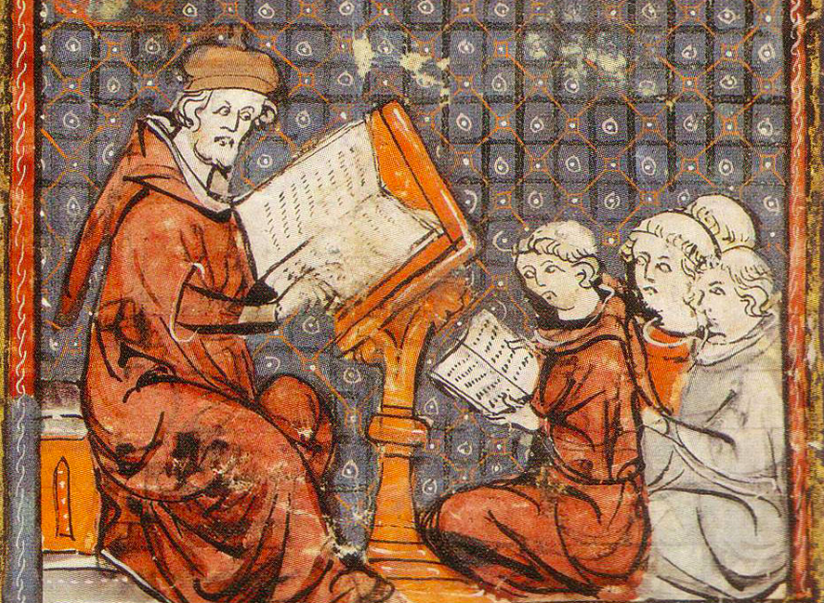
The Clergy

Slide 12
The Clergy
Pope, archbishops, bishops, priests, monks and nuns- many people joined looking for refuge from the sinful world around them, status and influence.
Had the most comfortable life during the middle ages- however worked long hours and reaped few worldly benefits.
most manors had a church- conducted many ceremonies. Others lived in monasteries.
Copies manuscripts, taught children, fed the poor, cared for the sick, and provided shelters to travellers

Slide 13
The Knights
William could call on about 500 knights after feudal system was introduced. Usually landless younger sons of a lord’s vassal.
the knight was an essential part of Norman society and his training was taken very seriously. Training from a squire to become a knight could take many years. They needed to be highly skilled in weapons and military tactics to ensure that they survived battles as well as defeated the King’s enemies.
A knight would go through a knighting ceremony where they would kneel before the King who dubbed them on the shoulder with the flat side of a sword. Once they were knighted they could carry a sword and a kite shield and wear their own armour with their personal coat of arms. They would design the coat of arms following the rules of heraldry and taking part of their designs from that of their parents if they had one.

Slide 14
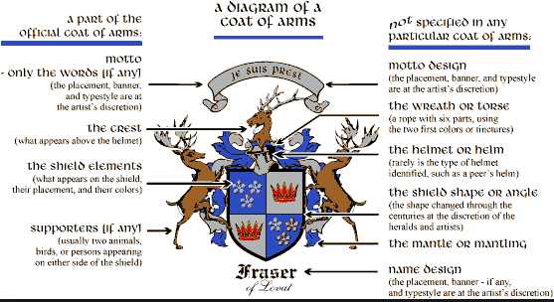
Coat of Arms

Slide 15
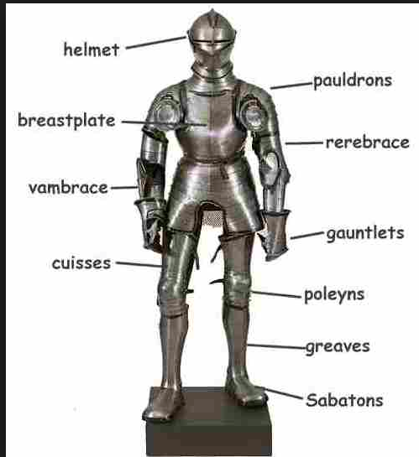
What a Knight wore:

Slide 16
Reading questions:
What are the steps to becoming a Knight and what do the stages entail?
How did the quality of the Knights armor improve over time?

Slide 17
Why do we know so little about medieval women?
Sources were written by men→ church documents
Very little power- they spent their lives under the guardian ship of men
Subject to their husbands and fathers, just like vassals are to lords
HOWEVER, most of the daily life in the castle was within the women's domain
When men were at war women took over the manor and were in control of the entire estate.

Slide 18
Piers the Plowman
-William Langland
What they save from their spinning they spent on house rent,
On milk and oatmeal to make porridge to fill their children when they cry for food.
They themselves suffer the sting of hunger and of winter misery, rising at night to rock the cradle in its cramped corner,
To card and comb wool, to mend and wash, to scrub and wind yarn, to weave rush lights.
Its painful to read to write verses on the hard lives of women who live in hovels…

Slide 19
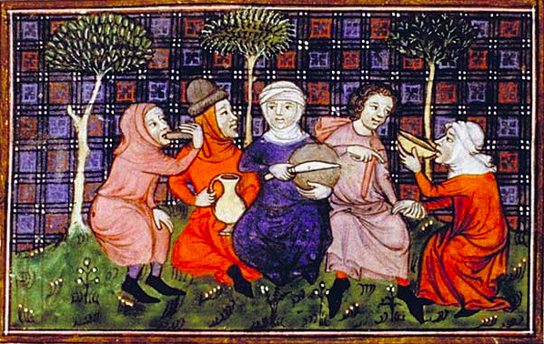
The Peasants

Slide 20
The Peasants/Serfs
Harsh conditions of peasants were not improved at all for hundreds of years.
Did not live in the castle. Lived in straw roof huts with animals on the manor→ need permission to leave the manor
William the conqueror established a system where peasants were at the bottom.
THINK: how fast society changes nowadays (your parents didn’t grow up with cell phones or the internet)….things stayed the same for generations and generations

Slide 21
What images come to mind when you think about characteristics of peasants?

Slide 22
Video:
How are stereotypes of the peasants challenged in this video?

Slide 23
Video: Terry Jones Medieval Peasant

