Slide 1
Common saying that started in the Middle Ages
Can you guess the story behind the saying???

Slide 2
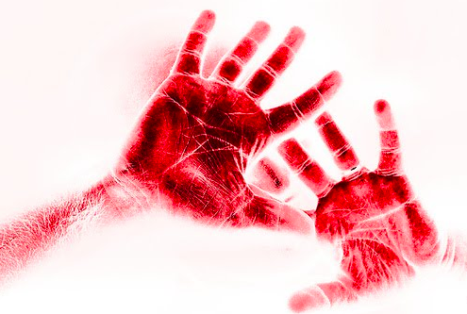
"CAUGHT YOU RED-HANDED”

Slide 3
“CAUGHT RED-HANDED”
This phrase comes from the 12th Century practice of dipping a thief's hand in berry-dye. The dye would soak into the skin and stain the hand for several weeks and as such, serve as an act of public humiliation of being convicted. All who saw the 'red-handed' person knew he was a thief and a criminal.

Slide 4
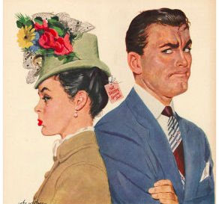
"GIVE SOMEONE THE COLD SHOULDER"

Slide 5
“GIVE SOMEONE THE COLD SHOULDER”
In The Middle Ages, lords and nobles were often faced with the common problem of getting rid of unwanted or obnoxious guests at feasts and gatherings. A unwanted guest was served a cold shoulder of meat; the toughest and most undesirable portion of a roast. Receiving this token symbol often resulted in giving the guest enough of a hint that he or she over-stayed their welcome.

Slide 6
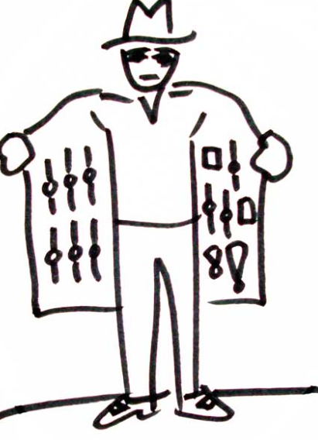
BLACK MARKET

Slide 7
Black Market
Nomadic mercenaries wandered the country side to sell their services to the highest bidder. These were hardened fighters who lived solitary lives in the wilderness. They did not have the luxury of servants to polish their armor and it would oxidize to a blackish hue, and they came to be known as black knights. At local town festivals they would have exhibition jousting matches in which the winner of the fight would win the loser's weapons and armor. The local gentry, softened by the good life, would lose to these black knights. The nomadic knights didn't have much use for an extra set of armor and would sell it back to them immediately after the fight. The losing nobility would be forced to buy back their armor and this after market came to be known as the "Black Market”

Slide 8
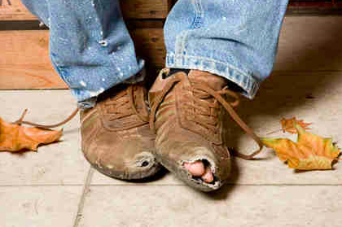
Dirt Poor

Slide 9
Dirt Poor
The floors of commoners homes were made of dirt. Only the wealthy had something other than dirt, hence the saying "dirt poor." The wealthy had slate floors that would get slippery in the winter when wet, so they spread thresh (straw) on the floor to help keep their footing.

Slide 10
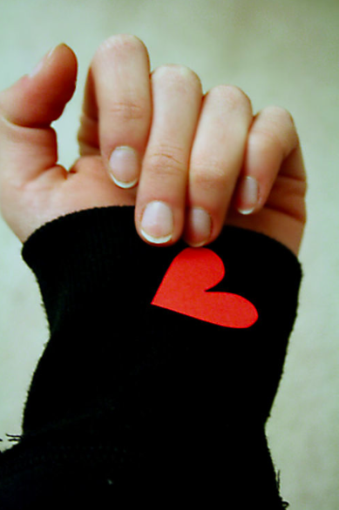
"WEAR YOUR HEART ON YOUR SLEEVE"

Slide 11
"WEAR YOUR HEART ON YOUR SLEEVE"
This phrase is commonly used to express one who is openly showing love for someone, or toward one whom is trying to impress a person of the opposite gender. Records indicate that it in fact originated during 1255 when knights would wear the symbol of their family crest on their sleeves when they went into battle. The symbol was an insignia of the love and devotion that encouraged the knight to defend his family's honor.

Slide 12
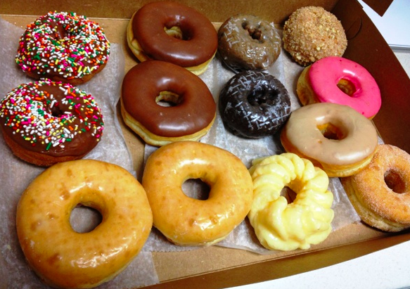
"BAKER'S DOZEN"

Slide 13
"BAKER'S DOZEN"
Sometimes we refer to '13' as being a "Baker's Dozen". In Medieval times, bakers would often attempt to save materials and ingredients by cheating the consumer. Instead of wrapping the purchased dozen, bakers would often only sell 10 or less of an item. Once the customer realized the indiscretion, it was too late to prove the baker had cheated them. The problem became so bad that eventually laws were passed with strict punishments being enforced on bakers who cheated their customers. The penalties were so harsh that instead of the standard '12' in a dozen, bakers began inserting a 13th loaf or cake to ensure they were within the law.

Slide 14
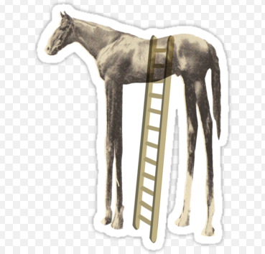
"GET OFF YOUR HIGH HORSE!"

Slide 15
"GET OFF YOUR HIGH HORSE!"
This phrase is commonly used toward someone who is acting pompous, arrogant or lofty. In the Middle Ages Nobles were given a taller breed of horse to ride to signify their status and authority. Often commoners would tell each other to "Get off their high horses" when one was acting more authoritative than he had a right to.

