Slide 1
The All Powerful Church
Middle Ages

Slide 2
What did a church in the middle Ages Look Like?

Slide 3
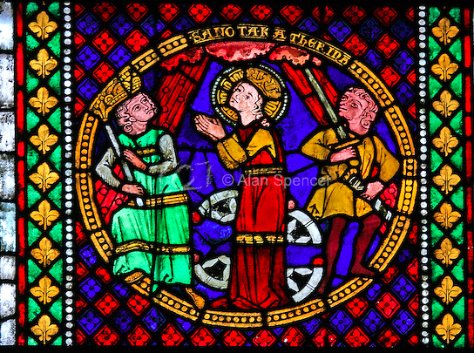
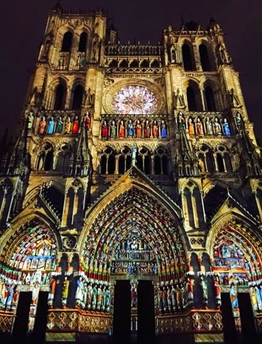
They were colourful!

Slide 4
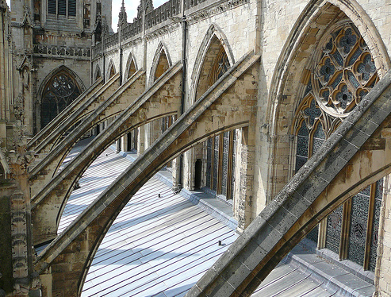
1. Cathedrals took As many as 100 years to complete!
Flying Buttresses- a character-defining feature of medieval Gothic cathedrals.
made up of two parts: the buttress, a large masonry block; and the “flyer,” an arch spanning between the buttress and the exterior wall. A flying buttress works by transferring forces from vaulted ceilings and wind that push against an exterior wall across the “flyer” and then down the buttress to the ground
would keep churches from collapsing

Slide 5
2. The Western Church between 1000-1300
Effective unifying force in Western Europe- spiritually and politically. People were deeply religious!
Headed by the pope in Rome- reinforced people should accept and be happy with their position in life while remaining very wealthy itself→ church tithe or tax
By 1050, largest landowner in Western Europe
The Church clergy was the most literate group of people during the middle ages
People in Western Europe during the Middle Ages trusted the Church completely. It was the only religious institution

Slide 6
3. Church- Christendom
Christendom was mainly based in Europe. Catholic Church
Other parts of the world believed in other religions just as firmly
Islam was the religion of the Arabs empire that stretched from Spain to India
Throughout Europe there were Jews who believed in Judaism

Slide 7
4. Western Christianity
Christians saw the world from entirely from their point of view- Jerusalem was in the center of their maps→ idea would lead to crusades because Jerusalem was part of the Arab Empire.
Thousands of churches were built in the middle ages- look grey today but were bright and colorful then- painted and stain-glass
People attended mass every Sunday- in Latin

Slide 8
Individual work
The power of the Church- In the West
Read Textbook pages 282-287
Fill in the Worksheet
20 minutes

Slide 9
Vocabulary
Clergy- ordained members of the Church
Excommunication- expelling someone from the Church
Salvation- Saving the soul so that it will go to heaven rather than hell
Tithe- one tenth of the produce of lands paid to the Church

Slide 10
Stained Glass Window
People did not understand Latin: So how did they know what to do?
Pictures relayed messages to people. They told them how the Church wanted them to behave and what it wanted them to believe.

Slide 11
Make a Stain Glass Window
Things Christian People Believe In
Things Christians Should do | Things Christians Should Not do

Slide 12
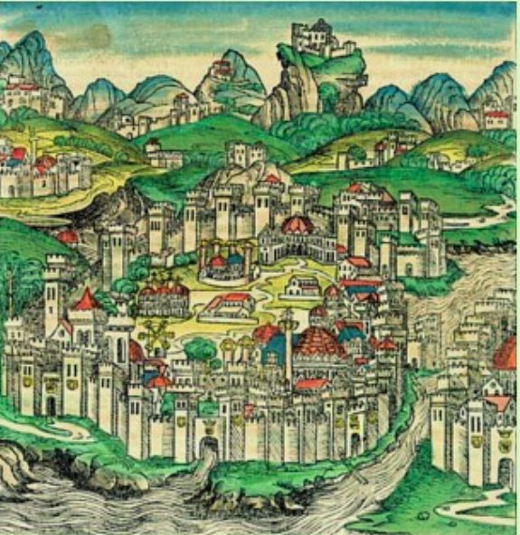
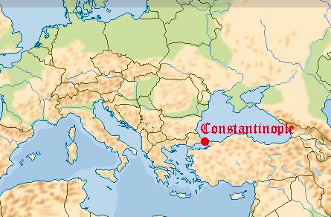
What about Eastern Europe?

Slide 13
5. What about Eastern Europe?
The Byzantine Empire- Constantinople- a magnificent center of the Christian Faith
The church had a powerful influence on the lives of Byzantines
Tolerated more discussion and debate on religious matters compared to the West- had a better understanding of the religion because services were in Greek.
Conflict between Western and Eastern→ the pope in Rome still claimed authority over Byzantine Empire. However serious difference of opinions existed (like icons)
Became hostile between west and east and west aligned with Franks. Crowned Charlemagne emperor of the holy roman empire- East was outraged because the the Byzantine Emperor was the true Emperor!
Eventually a split (or a schism)→ 2 separate churches “the Roman Catholic Church” and the “Eastern Orthodox Church”

Slide 14
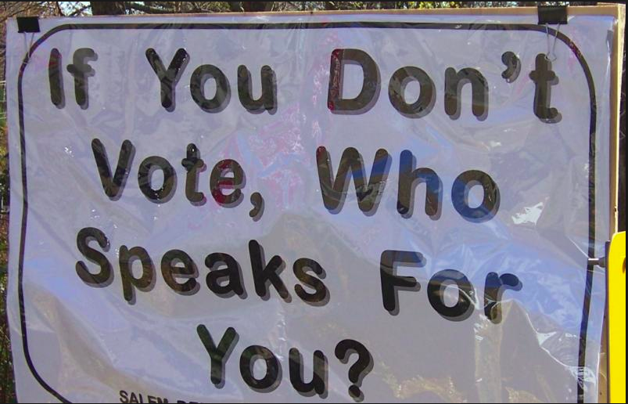
6. Royal Power
Canada has a constitutional democracy which means that is citizens have the right to elect their leaders. Medieval people did not have this luxury.
The medieval or feudal Monarch had almost unlimited power as long as he or she stayed within the Feudal contract

Slide 15
7. Royal Power
Once King William died in 1087, his followers took over and grew more and more powerful
Their wealth increased from payments they demanded from towns → wealth grew substantially!
When Williams great-great grandson John took over in 1199 landowners were outspoken→ rebel nobles
King John was not popular
King John lead series of losing battles and lost lands in N. France and increased ever-higher levels of taxation→ angered vassals with fiefs there.

Slide 16
8. Forces of Change
ALSO, John had lost the support of the Pope and churches shut their doors to the people of England!
Many lords renounced allegiance to John
In June 1215, after days of argument they forced him to affix the royal seal to the Magna Carta→ a ‘charter of liberties’

Slide 17
9. What was the Magna Carta
Gave rights to Nobles → gave the lords certain rights that the King could not take away
King had to respect the rights of English nobility and made it illegal for a King to raise taxes without approval of a parliament
By subjecting the King to the rule of law the Magna Carta became the basic for future reform

Slide 18
Magna Carta, 1215
28. No constable or other royal official shall take corn or other moveable good from any man without immediate payment…
38. In the future no official shall place a man on trial unless he can produce believable witnesses to support his accusation
39. No free man shall be seized or imprisoned, or stripped of his rights or possessions, or outlawed or exiled, or deprived of his standing in any other way, nor will we proceed with force against him, or send others to do so, except by the lawful judgment of his equals or by the law of the land
61. The barons shall elect twenty-five of their number to keep, and cause to be observed with all their might, the peace and liberties granted and confirmed to them by this charter. Any man may take an oath to obey the commands of the twenty five barons for the achievement of these ends…

Slide 19
10. What happened to the Magna Carta
Johns charter did not last long. Nobles never really expected he would keep his word and he was right
John felt he gave away to much power
Civil War broke out and John died in 1216
William Marshal took over and re-issued and saved the Magna Carta
Signaled decline of feudalism because of ideas of personal freedom and liberty
Bill of rights and the concept of “due process of the law” in Canada grew out of the Magna Carta

Slide 20
UN universal declaration of Human Rights, 1948.
Article 3: Everyone has the right to life, liberty, and security of person.
Article 7: All are equal before the law and are entitled without any discrimination to equal protection of the law.
Article 9: No one shall be subject to arbitrary arrest, detention or exile.
Article 10: Everyone is entitled in full equality to a fair and public hearing by an independent and impartial (fair) tribunal (court)

Slide 21
a CLASSROOM Magna Carta
The Magna Carta guaranteed lords certain rights under laws that even a king had to obey. Think about the elements of respect and consideration that go into running a contented classroom. In partners draw up a household Magna Carta
Must have 5 elements outlining respect and consideration!

