Slide 1
What was the Scientific Revolution, the scientific method and the accomplishments of the leading figures of the Scientific Revolution?
The Renaissance

Slide 2
What's wrong with saying the Sun is rising in the morning?

Slide 3
Job Fair: Copernicus

Slide 4
Job Fair: Galileo

Slide 5
Job Fair: Bacon

Slide 6
If you had to give a good explanation of what science is to an interested fourth-grader, what would you say?

Slide 7
What will fall to the ground first? The grapefruit or the grape?

Slide 8
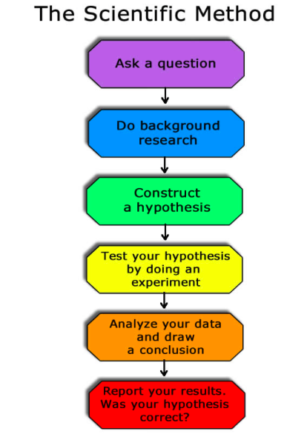
We must consult experience in the variety of cases and circumstances until we can draw from them a general rule that is contained in them. And for what purposes are these rules good? They lead us to further investigations of nature and to creations of art.
-Leonardo da Vinci

Slide 9
The Scientific Revolution (15th and 16th century)
In the Middle Ages, the word “science” was used to mean ”knowledge” in a general sense.
The Scientific Revolution emphasized careful observation of the natural world which marked a new era in scientific thinking
A big shift from looking for answers from the church or ancient roman and Greek civilizations to looking for answers from scientific observation and reason. People began to reexamine their spiritual and physical worlds. Freed from having to rely on accepted theories and beliefs, they sought new answers to old questions.
In the mid-nineteenth century, the word “scientist” was first used to replace the earlier term “natural philosopher;” and “science” referred primarily to the, well- differentiated fields of physics, astronomy, chemistry, and biology.

Slide 10
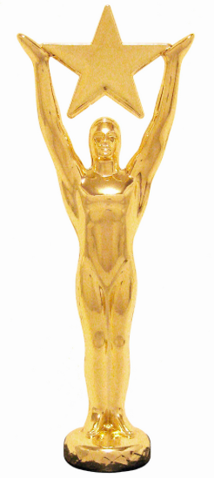
Who should win the “Scientist of the Renaissance” Award?
Individually read the handout and fill in the chart on the “Scientists of the Renaissance”
Afterwards: In pairs discuss who should win the “Scientist of the Renaissance” Award. Come up with an answer- it is okay to disagree with your partner but make sure you are able to support your answer!!

Slide 11
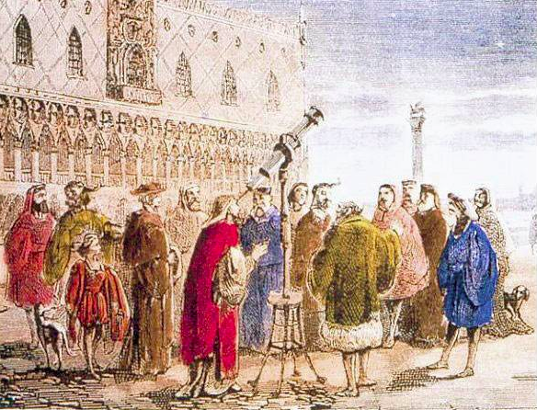

Slide 12
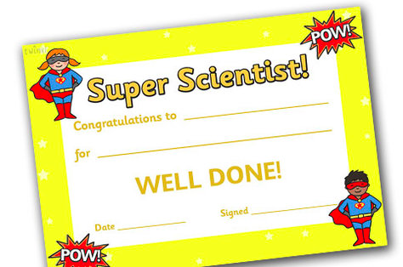
Lets Vote!
WHO SHOULD WIN THE SCIENTIST OF THE RENAISSANCE AWARD???
COPERNICUS
VESALIUS
GALILEO
BACON
NEWTON

Slide 13
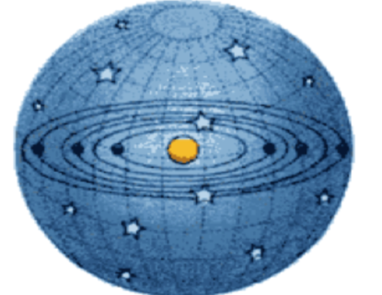
Why did the Scientific Revolution threaten the Catholic Church?
Church officials banned books whose ideas threatened the church’s power and authority. By reading the books listed in the Index of Prohibited Books, modern scholars have determined which ideas were considered most dangerous. For example: Galileo's publication on a sun-centered universe was placed on the Index of Prohibited Books.

Slide 14
How does the Scientific Revolution fit in with the idea of Humanism?

Slide 15
Humanism and Science
The humanist acceptance of curiosity and experimentation were important for the future of science
The humanist attempted to be objective and use experience and experiments to observe their world
This was often in stark contrast to the past when it was acceptable to say something is the way it is because God made it that way- post Scientific Revolution needs to be able to be explained though the scientific method to be accepted

Slide 16
Unit Test on the Renaissance: April 21st
45 items on 2 column study notes
Section 1: Multiple Choice
this will cover the interview presentations. You will be allowed to use your note sheet. Once everyone is done the multiple choice section I will collect it and your interview sheets and hand out the rest of the test
Section 2: Matching
Section 3: Short Answer
Section 4: Long Answer

