Slide 1
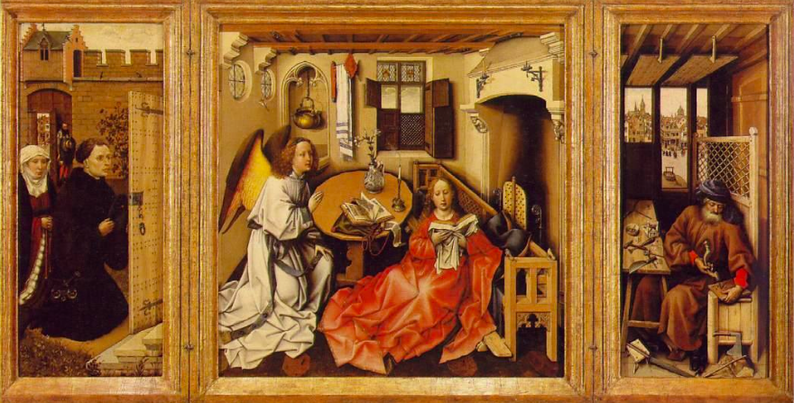
How the Italian Renaissance Spread to the North?
The Northern Renaissance

Slide 2
Job Fair: Gutenberg

Slide 3
Job Fair: Durer

Slide 4
Discuss with your partner!!
What do you know about how book are made?
What are some things that are made possible because of books, newspapers, and magazines?
What communication technologies do you use today to learn and share information?

Slide 5
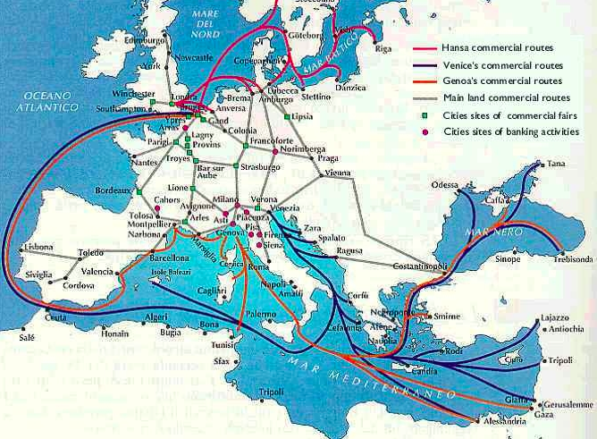
The Spread of Ideas
Renaissance ideas began to spread to Northern Europe in the late 1400s. HOW???
Trade and Travelers
a. Italian business men had offices in cities throughout Europe and lived in Italian Renaissance style wherever they went
b. Other Europeans began to appreciate the emphasis on beauty, wealth and personal achievement
c. Other Europeans would travel to Italy- attracted artists, scholars and foreign visitors

Slide 6
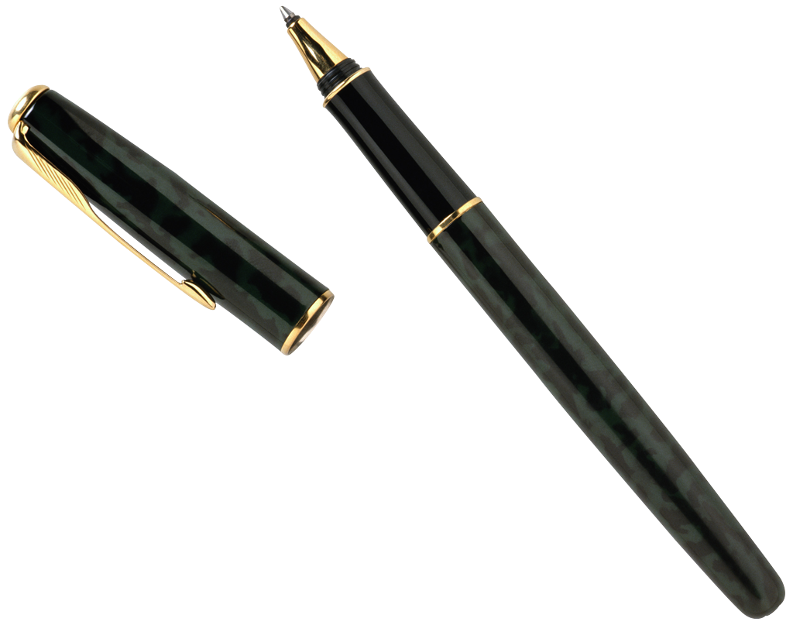
2. Words and Books- writing:
Every copy must be written by hand
Books wear out eventually and are vulnerable to the elements
It takes a large number of literate scribes simply to maintain a sizable collection
Mistakes are made when copying
→Lead to block printing

Slide 7
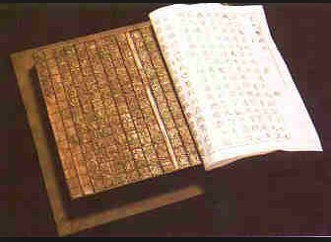
Words and books- block printing
A single craftsman could create a block and that block could make as many copies as necessary
It does not matter if one copy is lost, because there are plenty of backup copies
Mistakes are less likely
Limitations:
Carving legible letters into wood required a skilled craftsman and takes much longer than it does to write
Fonts vary greatly
A mistake or misspelling means you need to create the entire block over again
When a block broke or wore down, it would need to be laboriously recreated
A block was only useful for a single page of text
Blocks take up an incredible amount of space
→ Lead to Movable Type Printing

Slide 8
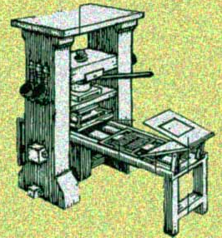
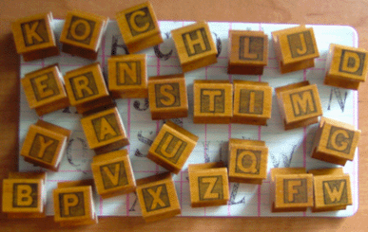
Words and Books- the movable Type Printing Press
Anyone can set type, and it was much faster than carving wood, almost as fast as writing
Fonts are standardized
A mistake can easily be fixed
Metal type pieces are more durable than wooden blocks
A single type piece can be reused for multiple texts
Type pieces are easy to store

Slide 9
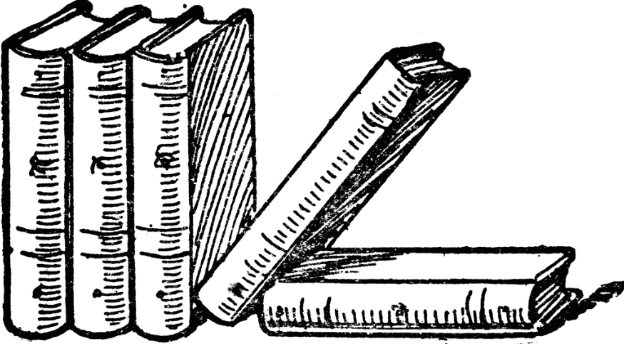
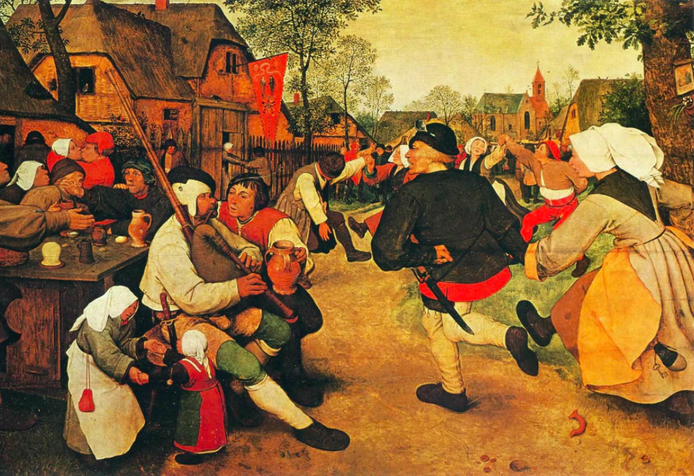
Words and books
Books were cheaper to buy, therefore it was easier for people to access existing information. Because books were cheaper to publish, it was easier for people to share new information
Literacy rate increased steadily
Oh No! people could read the bible and start question was the church was saying! Easy for this information to move across Europe
By mid 1500’s renaissance values and ideas had become firmly rooted in northern Europe

Slide 10
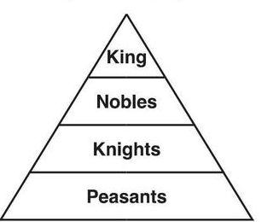
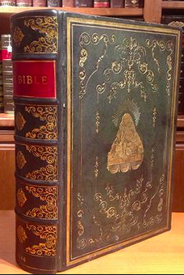
How was the Northern renaissance different?
Feudalism was stronger in the north therefore nobles and royalty had the most money and power, not wealthy families – therefore nobles and royal became patrons of the arts which focused on royal courts not homes of families
Role of the Church was stronger and more active in the north, therefore stronger emphasis on spiritual life. Northern humanist learnt Greek and Hebrew to study ancient bibles
Northern humanist began to question the role of the church as they started studying the bible

Slide 11
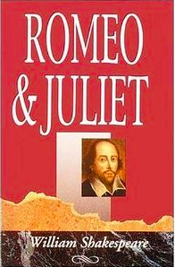
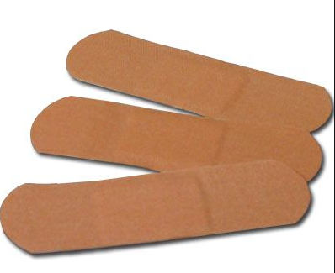
Northern Achievements
Arts and Literature
Many artists expressed religious themes in their work but they began to represent them in a more realist way.
Realism was also important to writers, who wrote about religion, politics and behavior of their fellow human beings
Erasmus wrote about individual worth- all men should be treated equally
William Shakespeare was a Northern Renaissance writer who tried to entertain as well as educate his audience. His characters were full of life, wit and passion
Medicine
Discovered that treating patients with tiny does of poison would destroy diseased tissues
Used bandages instead of cauterizing or burning the edges of the wound- also first time used thread was used to close a wound

Slide 12
Writing A Strong Paragraph
Claim/ Topic Sentence- what is your paragraph about- I don’t want to guess!!
Premise 1- this is your first main point you would like to discuss
Proof A and Proof B- give reasons or examples for your first premise
Conclusion to Premise 1- Wrap up this thought
Transition- Furthermore, However, In addition, Secondly, Moreover…
Premise 2- this is your second key idea or point
Proof A and Proof B- Back up your point!
Conclusion to Premise 2- Wrap up this thought
Conclusion to claim/ Topic Sentence- concisely conclude your paragraph referring back to your main claim.
Why was the printing press an important technological advancement of the renaissance?

Slide 13
Exchange paragraph Worksheets
Read your partners paragraph sentences
Are there full sentences? Is the grammar correct? Did they include key concepts?
Give feedback to your partner. Suggest…
One thing that they did great
Two things that could be improved
Write your name at the bottom of your partners page

Slide 14
TEST: April 21st
45 items on 2 column study notes
Section 1 Multiple Choice
this will cover the interview presentations. You will be allowed to use your note sheet. Once everyone is done the multiple choice section I will collect it and your interview sheets and hand out the rest of the test
Section 2: Matching
Section 3: Short Answer
Section 4: Long Answer

