Slide 1
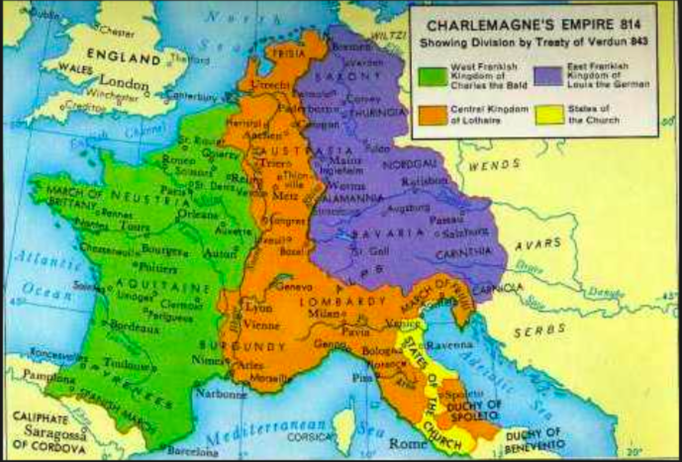
Review from last class!
After Charlemagne's death his kingdom was divided up amongst his three sons. None of them could effectively govern Charlemagne's empire, therefore it was falling apart. At this point, who saw Europe ready for the taking?

Slide 2
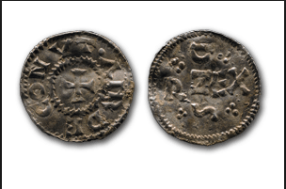
The Vikings
The Invasions of the ‘Northmen’

Slide 3
What images come to mind when you think of Vikings?

Slide 4
They NEVER wore horns!!

Slide 5
Introduction
A Viking was actually a verb, not a noun
People went on a ‘Viking’, it was not actually what they called themselves- they were Scandinavians.
Vikings that stayed were called Normans- contraction of ‘north man’, example Normandy, France.

Slide 7
1) When did the Viking raids happen?

Slide 8
1) When did the Viking raids happen?
From the 8th to the 10th century
Year 700 to 900
For about 200 years!

Slide 9
2) What were the Vikings great at making? Hint: they needed them for their voyages.

Slide 10
2) What were the Vikings great at making?
The Vikings were advanced seafarers- their amazing boats are called longboats and were ideal for Viking invasions.
Superior building technology and wind and ore technology
Created shallow boats. They followed the rivers and the coastlines all over Europe
Viking culture was rich with artistry, they left evidence of their skilled woodwork and metalwork

Slide 11
A Viking Longboat

Slide 12
These boats were easier to use on narrow fjords and in rivers

Slide 13
The Ships could be moved forwards or backwards without having to turn around

Slide 14
3) The Vikings spread through Europe using 3 tactics:
1. Plunder
Plunder is like hit and run tactics, grab money, valuables and people (that they sold into slavery).
2. Conquest
Conquest means to take control over a region for a while.
3. Colonize
why go back home when we can just stay.

Slide 15
4) Potential reasons why the Vikings raided Europe
1. Internal conflict around Europe made it available to be challenged.

Slide 16
4) Potential reasons why the Vikings raided Europe
2. Is it just a coincidence the early Viking activity occurred during the reign of Charlemagne? The penetration of Christianity into Scandinavia led to serious conflict dividing Norway for almost a century

Slide 17
4) Potential reasons why the Vikings raided Europe
3. The home land in Scandinavia was over populated and had little land to harvest food

Slide 18
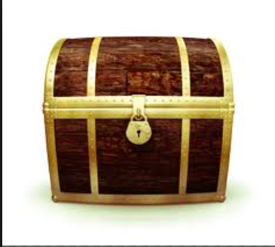
4) Potential reasons why the Vikings raided Europe
4. Younger sons needed money because in the Viking culture older sons inherited all the money.

Slide 19
5) Why did Vikings often raid monasteries?

Slide 20
5) Why did Vikings often raid monasteries?
Typically raided monasteries because they contained a lot of valuable and monks were not trained to fight/didn’t have weapons.
Vocab: A monastery (plural: monasteries) is the building or complex of buildings comprising the domestic quarters and workplace(s) of monastics, whether monks or nuns.

Slide 21
6) How did medieval Christians in Europe feel about the Vikings?

Slide 22
6) How did medieval Christians in Europe feel about the Vikings?
Medieval Christians in Europe were totally unprepared for the Viking incursions and could find no explanation for their arrival and the accompanying suffering they experienced.
The Vikings were brutal and Medieval Christians would have lived in fear!

Slide 23
Ask your partner:
If this was to happen to our society today where would we look for protection and answers?

Slide 24
NEED FOR PROTECTION
The Vikings were a feared people that terrorized most of coastal Europe for 200 years.
Medieval people looked to their government. But it was weak and Charlemagne’s empire was crumbling under his sons!
They needed to find new forms of protection…
Common people and landowners alike needed to be protected

Slide 25
7) Why did the Viking’s raid end in the 10th century? 2 ideas:
1. England was saved by the tough resistance of the Anglo-Saxon king, Alfred the Great. From his base in Wessex, Alfred fought the Vikings for three decades.
2. Britain used Viking lords to protected from other Vikings by giving them land and power, and the people of Norway and Denmark became Christians which helped dissolve the Vikings traditional beliefs and violent way of life.

Slide 26
The Vikings in North America???
It is believed that the first Europeans to settle in North America where the Vikings.
Lief Erikson, Viking Explorer, established a Viking settlement in Newfoundland

Slide 27
The Vikings to N. America

Slide 28
Blood of a Viking: The Invasions
Question: How do we know what we know about the Viking invasions today? What evidence do we have!?

Slide 29
How do we know what we know about the Viking invasions today? What evidence do we have!? What is an example of a primary and secondary source???

Slide 30
Do you remember???
Primary source: original records of a specific historical period. Sources were used or created by someone with firsthand experience and/or created at the time of the event.
Secondary source: sources created about a time or event by someone who used primary sources for their information.

Slide 31
How do we know what we know about the Viking invasions today? What evidence do we have!?
Monks writing and oral narratives
Archaeology
Dating the silver coins
Forensic tools
Carbon dating bones and artifacts
a technique used by scientists to learn the ages of biological specimens – for example, wooden archaeological artifacts or ancient human remains – from the distant past.

Slide 32
Activity:
Individually: Read the handout and answer the attached questions on the back.
Read the instructions to the questions: Especially the map question.
This worksheet is for marks!

