Slide 1
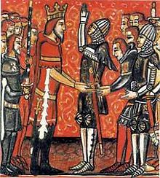
Feudalism in Medieval Time

Slide 2
Discuss with your neighbor
What is hierarchy?
Definition: a system or organization in which people or groups are ranked one above the other according to status or authority.

Slide 3
What is Feudalism?
A political, military and social order that lasted until the 1200’s. It is rooted in people’s need for protection against invaders and landowners needs for defense.
***do you remember who helped establish this in England?

Slide 4
Vassals? Fiefs? 2 key terms
Vassal: a person granted the use of land, in return for rendering homage (a medieval oath of allegiance), loyalty, and usually military service.
The king had vassals, and his vassals had vassals of their own
Fief: large estates (land) which was held by the lord and which the serf worked.

Slide 5
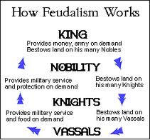
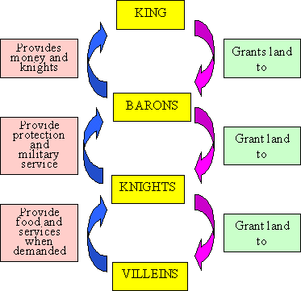
How Feudalism works
The king gives land to lords, who swear an oath of fealty (loyalty).
Lords (or nobility) are the vassals of the king.
Lords give land to their knights, who swear to serve their lord.
Knights are the vassals of the Lord
Knights give land to peasants, who swear to provide food and service.
Peasants are the vassals of the knights.

Slide 6
What is an Oath of Fealty?
The promise of faithful service to the lord was called the Oath of Fealty.
"I promise on my faith that I will in the future be faithful to the lord, never cause him harm and will observe my homage to him completely against all persons in good faith and without deceit."

Slide 7
Who got what in the feudal system?
Fill in the chart on the backside of your note sheet.
Use pencil so you can erase if you are wrong

Slide 10
Feudalism Causes
King William the conqueror- ruled in France where feudalism already existed and won at the Battle of Hastings and established feudalism in England.
People felt the need for protection against invaders like the Vikings and land owners’ felt like they needed defense. Farmers turned to powerful landowners for protection.
People receive protection in return for service as soldiers or for turning over title and ownership of their land to the larger landowners.
This causes changes and new establishments in social structures and hierarchies.

Slide 11
Talk to your partner.
What do you think were some the consequences of the feudal system??

Slide 12
Feudalism Consequences
Hierarchies- ranked authority (fiefs, vassals, knights)
All level of society were bound by loyalty and need
Harsh conditions for peasants
Vassals paid homage (showed respect for superior)
Castles- built for safety
Women had little formal power but a lot of influence.
Strong devotion to the church

Slide 13
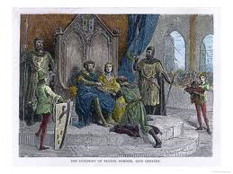
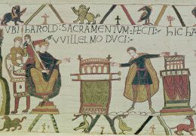
Feudal Ceremony
The transaction of loyalty was formalized in ceremony.
Vassal kneels before lord, hands in his, swears to serve lord in loyalty and love.
Vassal and lord kisses, and lord gives vassal a piece of dirt to symbolize the fief that would be his to use.
When a vassal died, the ceremony would occur again with the eldest son.

Slide 14
How did feudalism feel?
Check under your seats!! One of you is King! 2 are nobles, 6 are knights, the rests are peasants…
rearrange your desks to make the following shape! Knights are to sit where it says vassals
A’s go to one side of the classroom, B’s go to another, king sits in the middle.
DON’T EAT THE CANDY!!!

Slide 16
How feudalism works!
It is year 1351. The 5 pieces of candy represent the harvest that you reaped this year. Good Job!
Since the peasants are paying for their protection with their crops, the Knights will confiscate 3 candies
Knights- you must give 2 of those candies to the Noble/Lord as a payment of fidelity (loyalty), food and training.
Nobles/Lord- you must give one of those candies to the King for your land and loyalty.
Lucky King get to keep all his candies

Slide 17
Discussion:
Is this fair?
How do the serfs/peasants feel? How do the knights feel? How do the nobles feel? How does the King feel?
Do you think serfs would have ever tried to revolt? Would you have tried?
Why did the serfs stay? what would happen if they left?

Slide 18
Class work/Homework
COMPARE: the oath of Canadian citizenship and the medieval oath of allegiance
COMPARE: your school, home, or animal kingdom… with hierarchy.
Multiple Choice Quiz: beginning of next class- on everything we have studied so far (Dark ages, Charlemagne, Vikings, Battle of Hastings, Feudalism…) Homework will be checked next class and I will give you bonus marks on your quiz if fully completed!

