Slide 1
The End of the Middle Ages
What would come next?

Slide 2
First Things First
NEW PARTNERS!!
Rules:
You MUST move
You MUST have a new partner that you have never sat with before
You MUST move to the back of the class if you are currently at the front and VICE VERSE (the students at the back must move forward)

Slide 3
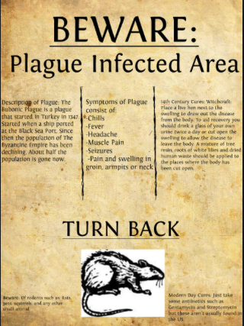
With your new partner come up a definition of a PLAUGE.

Slide 4
Definition: Plague
Noun.
a contagious bacterial disease characterized by fever and delirium, typically with the formation of buboes and sometimes infection of the lungs. “An outbreak of plague"

Slide 5
The Black Death
Swept like wildfire through Europe beginning in 1347
“Black Plague” because black spots under the skin from internal bleeding
Affected rich and poor alike
During the 350 years before the plague the population of Europe doubled in size- farmers struggled to feed population
From 1315-1319- heavy rain fall caused famine- 1000’s starved to death

Slide 6
Things are changing
The plague struck in 1347- in areas already weaken by famine
New outbreaks of the plague hit Europe in 1360 and 1374
Caused ¼ to 1/3 of the population in Europe to die!
Not enough people to do all the work with so many gone- therefore peasants demanded better wages and lower rents
Landlords tried to resist but peasants broke their ties and the feudal system began to falter

Slide 7
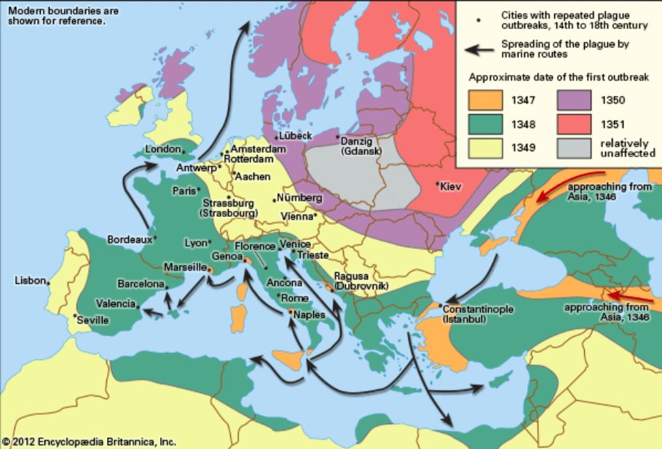

Slide 8
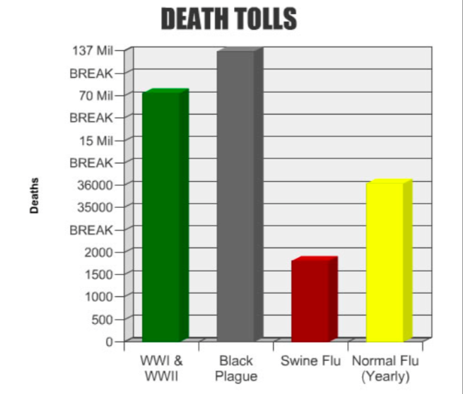

Slide 9
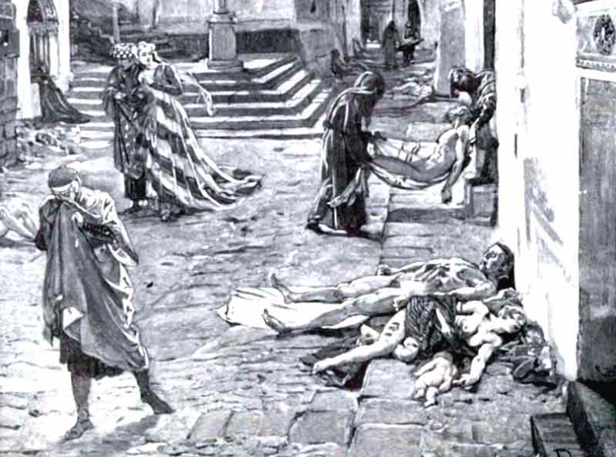
Reading
Once you are finished reading discuss the following questions with your partner

Slide 10
Consider the Consequences
What will happen to the fields?
The buildings?
The children as they grow up, if they do?
Who of the survivors can make a profit if he or she dares?
Who is likely to be taken advantage of?
Who will lose power? Who will gain it? Who will lose trust of the masses?

Slide 11
Do you represent a Victim?
Check under your seats!
Stand up if you represent a victim of the Black Death!
Of those standing:
Tell me what symptoms victims would have experienced
How do you believe the victim caught this terrible disease?
How long you expect to live before the victim dies?
Of the whole class:
What changes would happen in your school community if this type of plague were to occur? Consider the bus drivers, custodians and cafeteria workers.
Would it affect the city? Sales of certain merchandise?
The existing power structure?

Slide 12
What Actually Happened? I need 5 readers!!!

Slide 13
Rise of central governments
Power began to shift from the nobles who owned feudal estates to kings
Kings were attempting to form monarchies: strong central governments ruled by a King or Queen
Revolts by many nobles against kings, and between kings for territory causes constant wars from 1300’s- 1400’s
Longest war was the Hundred Years’ War- lasted 116 yrs
King of England claimed to be King of France- French troops finally defeated English

Slide 14
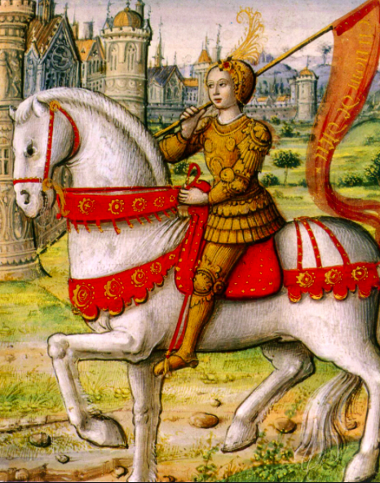
Joan of Arc
During a low point in the Hundred Years’ War a young women brought about a remarkable reversal
Joan of Arc was a peasant- could not read or write
Age 17- received message from God to help drive the English out of France
Once Joan passed Charles’, heir to the thrown, test he gave her soldiers and supplies and she her off to Orleans
She engaged in battle for months- she won along with 4 others
Joan was captured by the English at age 19 and was convinced of heretic (someone who has beliefs that oppose the church’s position) and was tired as a witch→ she was burned at the stake

Slide 15
Introduction of Guns
Before 100 years war warfare by knights in heavy armor with weapons like shields, axes and lances
In 1330’s English used longbows→ knights were more vulnerable: heavy amour made them helpless off the horses on the ground
1400’s soldiers carried handguns known as harquebuses
Gave foot soldiers a strong advantage and made medieval knights out of date

Slide 16
Trade and Commerce
Despite famine, plague, and wars trade flourished
Plague made serviced in higher demand
Merchants, shopkeepers and artisans were socially above labouring class and below nobility
Commercial class did not rely heavily on church→ focused more on earthy success and wealth
Italy dominated trade (location, business sense..)
Wealthiest merchants were bankers and money exchangers
Trade brought new ideas and exotic goods
Lure of success and ability to work for one self encouraged individualism: the ideas that each person should be free to develop and pursue his or her own goals.

Slide 18
The Renaissance?
A Latin word that means “rebirth” or “revival”
A period in European history from 1300-1600
Spectacular achievement in arts and sciences
Began in Italy where trade was flourishing by the end of the Middle Ages and then spread to the rest of Europe
People had more faith in individual achievement. Instead of looking to the church to find meaning in their lives they looked to their own powers of observation and reason

Slide 19
Assignment: The INTERVIEW!
Have you ever wanted to interview someone fascinating from the past? Well here is your chance!
Plus, you are going to learn some of the key skills that will help you get a job in the future! For example, making a cover letter and resume, along with learning some key interviewing skills that will ensure you land for first job!

Slide 21
