Slide 1
WHY ITALY??

Slide 2
The Renaissance?
A Latin word that means “rebirth” or “revival”
A period in European history from 1300-1600
Spectacular achievement in arts and sciences
Began in Italy where trade was flourishing by the end of the Middle Ages and then spread to the rest of Europe
People had more faith in individual achievement. Instead of looking to the church to find meaning in their lives they looked to their own powers of observation and reason

Slide 3
Discuss with your Partner
What are some examples of wealthy cities today?
What factors influenced the development of powerful and wealthy cities? What about Vancouver?

Slide 4
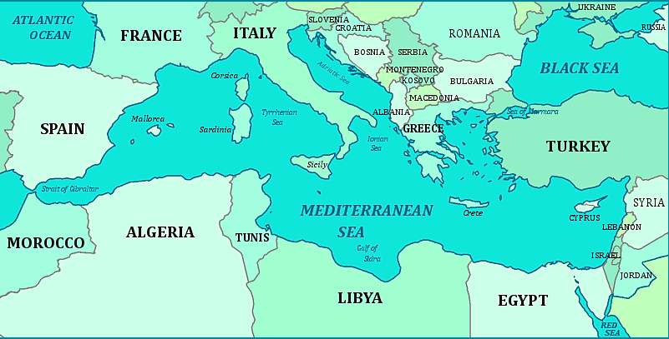
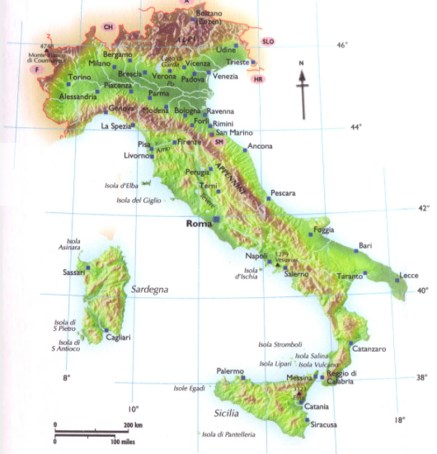
By yourself
How would you describe Italy's location?
Come up with a list of 2 geographic advantages and 2 geographical disadvantages of Italy

Slide 5
What role did Italy's geography play?
Mountains and Rivers:
Italy is a mountainous peninsula
Make communication and trade difficult
Mountainous countries usually have only a few trade routes
Old Roman roads developed into trade routes→ cities on these routes became rich from trade
Florence is located on a hub of trade routes→ became most powerful city
Navigable rivers are corridors of trade

Slide 6
What role did Italy's geography play?
Climate:
Mild climate→ weather does not disrupt travel and trade
Long growing season for crops→ important for trade for example wine and olive oil
Location:
Close to Northern Africa and Eastern Mediterranean Sea→ quick and easy trade
Trade= Wealth

Slide 7
What role did Italy’s history play in the birth of the Renaissance?
Mediterranean region was the site of two of the world’s most influential civilizations→ ancient Greece and Rome.
Renaissance artists were inspired by the Greek and Roman cultures and wanted to revive and renew them
Italy was the heartland of the old Roman Empire
Classical writings inspired ideas that people could shape their lives though effort and ability, though learning and through reason.

Slide 8
Why Italy?
During the Middle Ages, northern Italy developed into a collection of independent city states.
As trade increased cities near or on a good harbor became large and powerful because they were centers for trade, and also ideas (because of contact)
The two largest port cities were Venice, on the east coast and Genoa, on the west coast

Slide 9
Italian City-States
Feudalism did not have a strong hold in Italy as it did in the rest of Europe. Nobles tended to live in towns, they were the upper classes of urban society → involved in business and politics
Where other countries had strong central governments, Italy was made up of 250 small states→ ruled by cities called “city-states”
Each city- state was independent
Republican form of government
Aka a government whose head of state is not a monarch
Some ruled by a tyrant, or absolute rules, some by wealthy families

Slide 11
How did Italian city states promote the Renaissance?
The Renaissance came about as a result of the individuality of the Italian city-states
The city-states promoted trade and business!
Wealthy families where often ruling class which promoted artists and scholars in their city
Unfortunately there was also a thirst for wealth that led to conflicts between city-states. Rulers gathered large troops called mercenaries, paid soldiers, for defensive and battles

Slide 12
Can you think of Modern City- States?

Slide 13
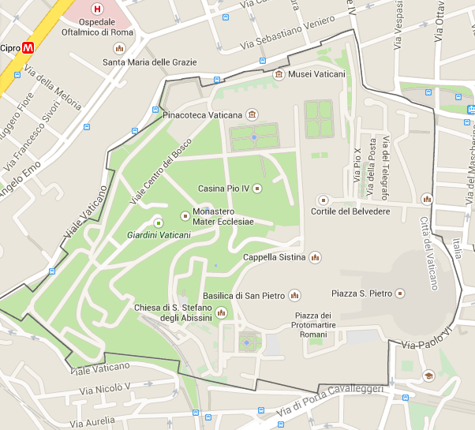
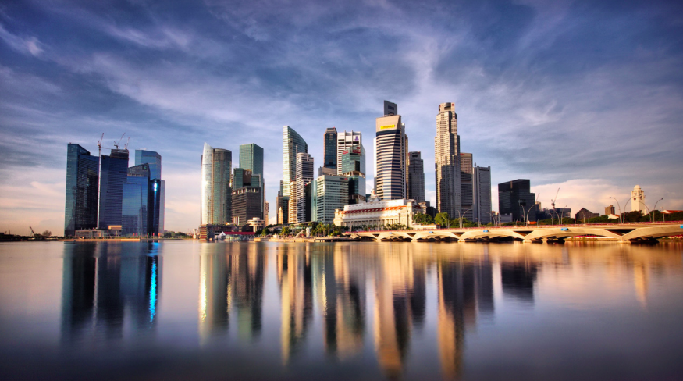
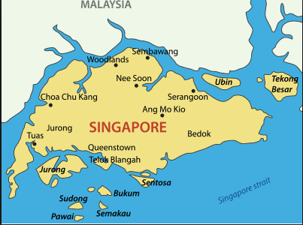
Can you think of modern city- states?
Vatican City
Singapore
Monaco

Slide 14
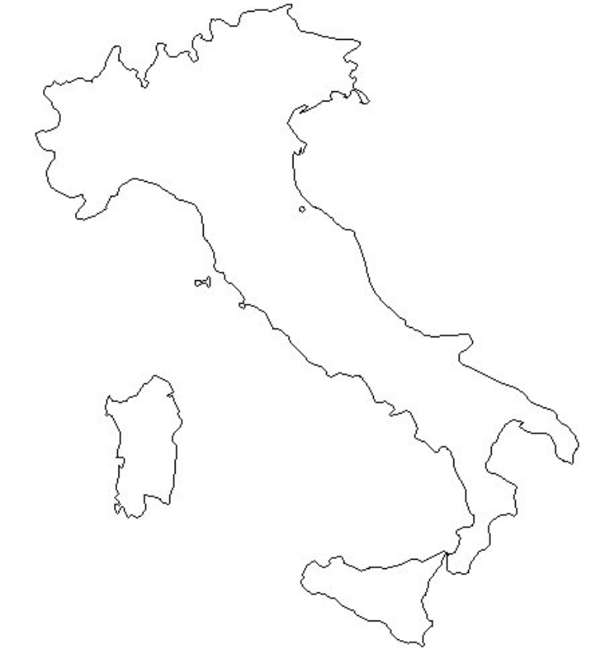
Map!
As you are labeling your map consider the following question:
How does the physical geography of Italy help to explain where cities were built?
Consider landforms and bodies of water

Slide 15
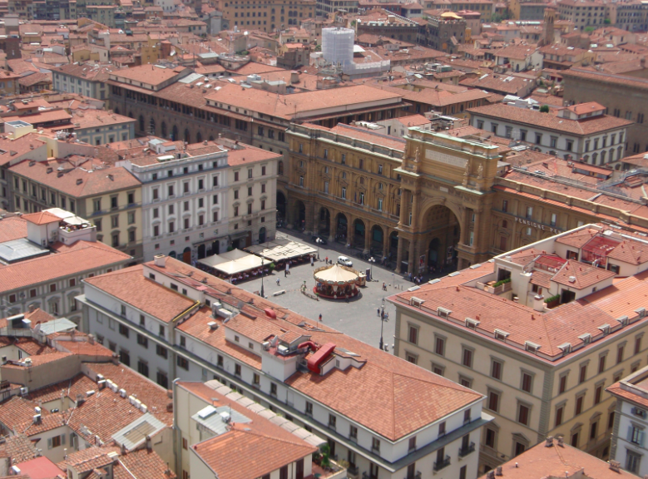
Life inside the Renaissance City?
Cities were colourful and lively places
Twisting streets, crammed with tall, narrow buildings with shops below living quarters
Wealthy lived in palaces right beside run-down houses of the lower classes
Large open plazas, or squares
People worked hard to make cities beautiful
Overcrowding led to friction, and feuds between families
Lower classes peoples lives remained poor (2/3 of pop) where wealthy peoples lives reaped benefits of prosperity

Slide 16
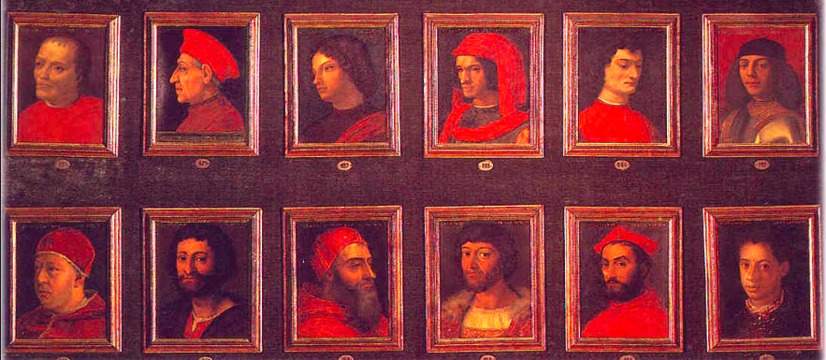
The Power of the Medici Family
Dominated the ruling class in Florence
The richest most powerful family during the Renaissance
Controlled an international network of banks

Slide 17
Florence and Venice City States
Florence was the most successful city state because of its wool trade and banking industry
Florentine bankers spread over all of Europe and helped introduce the idea of a single currency
Florentine Florin and Venetian ducat became the standard currency throughout Europe
With a standard currency in Europe, trade in goods, services and even ideas spread rapidly
Venice was another great city who quickly gained control of the Mediterranean sea trade.

Slide 18
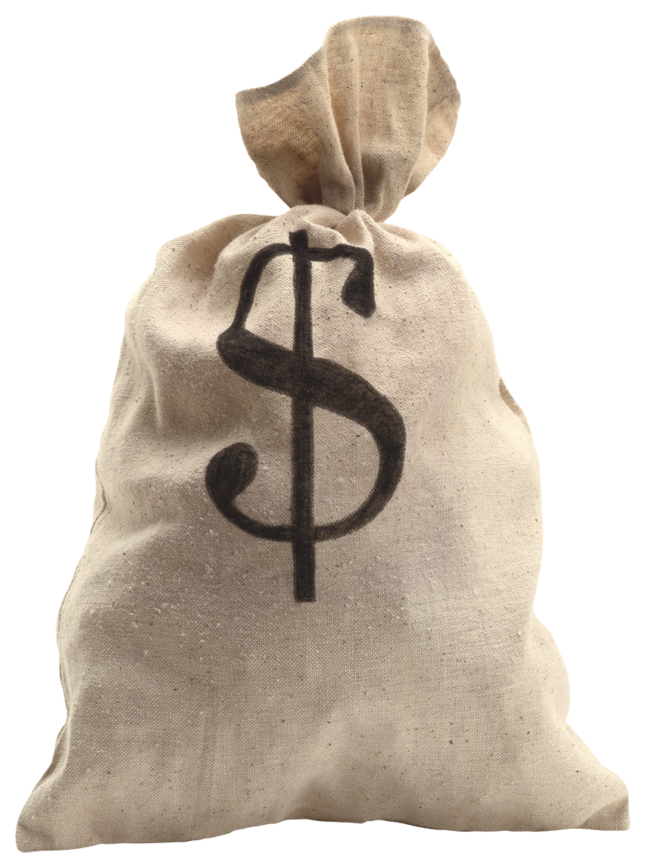
How did the Medici Family get rich off of banking?

Slide 19
Homework
Answer the following questions USING COMPLETE SENTENCES.
Both Florence and Venice were large banking cities, whose currency was accepted all over Europe. Why do you think having a common currency is important?
Venice was a very successful port city. Describe two things that helped Venice gain control of the sea trade in the Mediterranean.

