Slide 1
Geography Urban Tour
Kevin Chang, Tony Liu
2-1

Slide 2
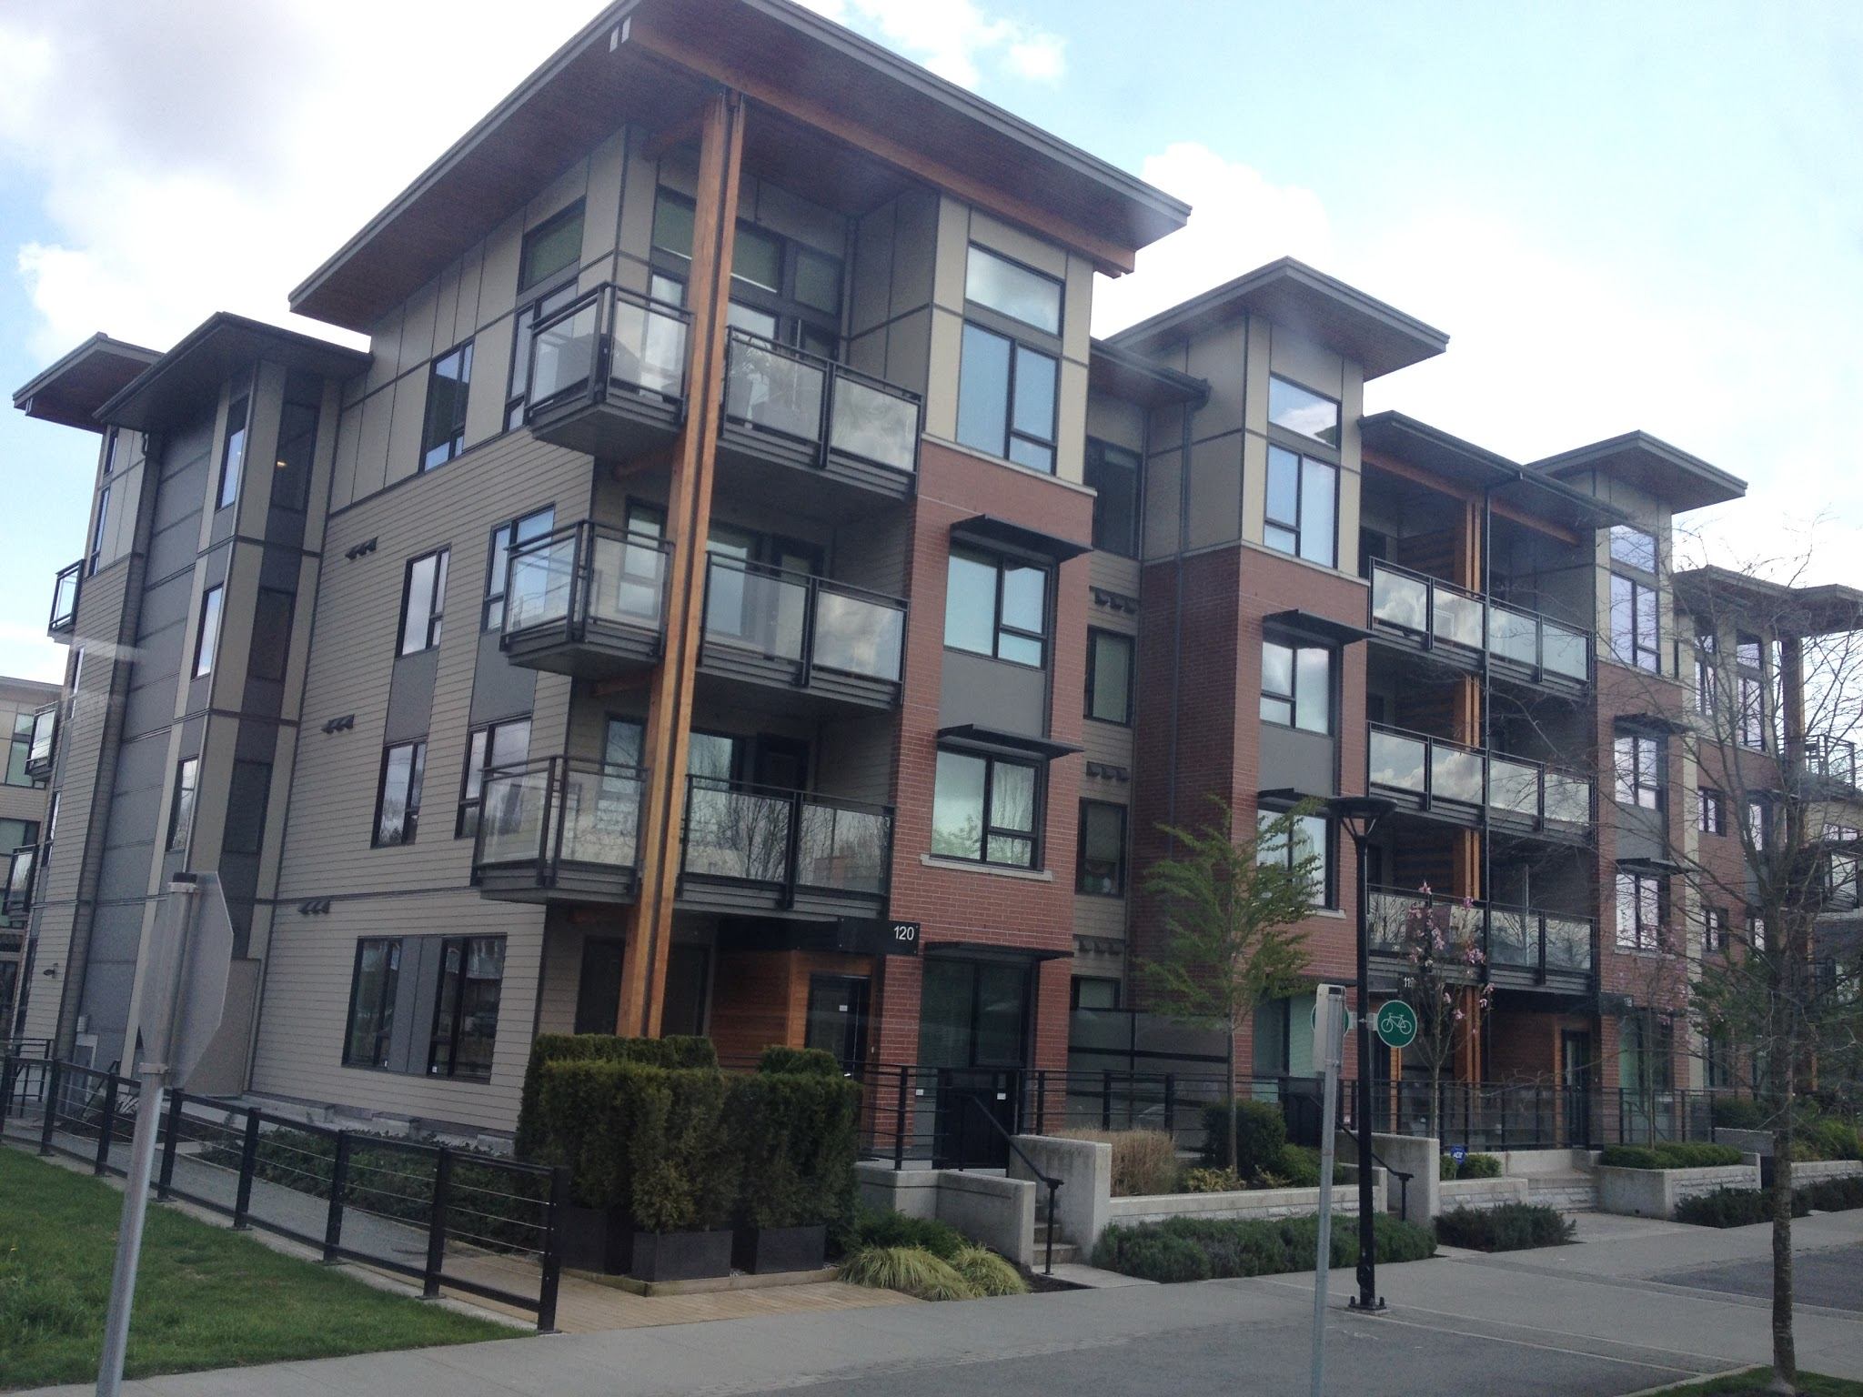
Reurbanization
The land has an increase in residential density due to redevelopment projects. This place is used to be a brownfield site, but now new townhouses are being built to increase the density and population.

Slide 3
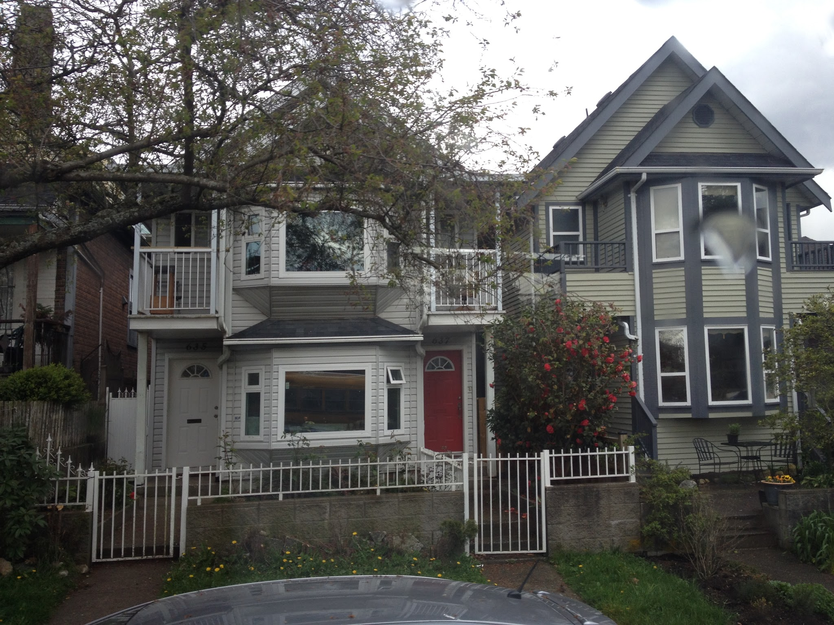
Gentrification
repaired
Gentrification is the process of renewal and rebuilding accompanying the influx of middle-class or affluent people into deteriorating areas. Here, mose of the hoses on the sides are very old, but some of them got rebuild and repaired.

Slide 4
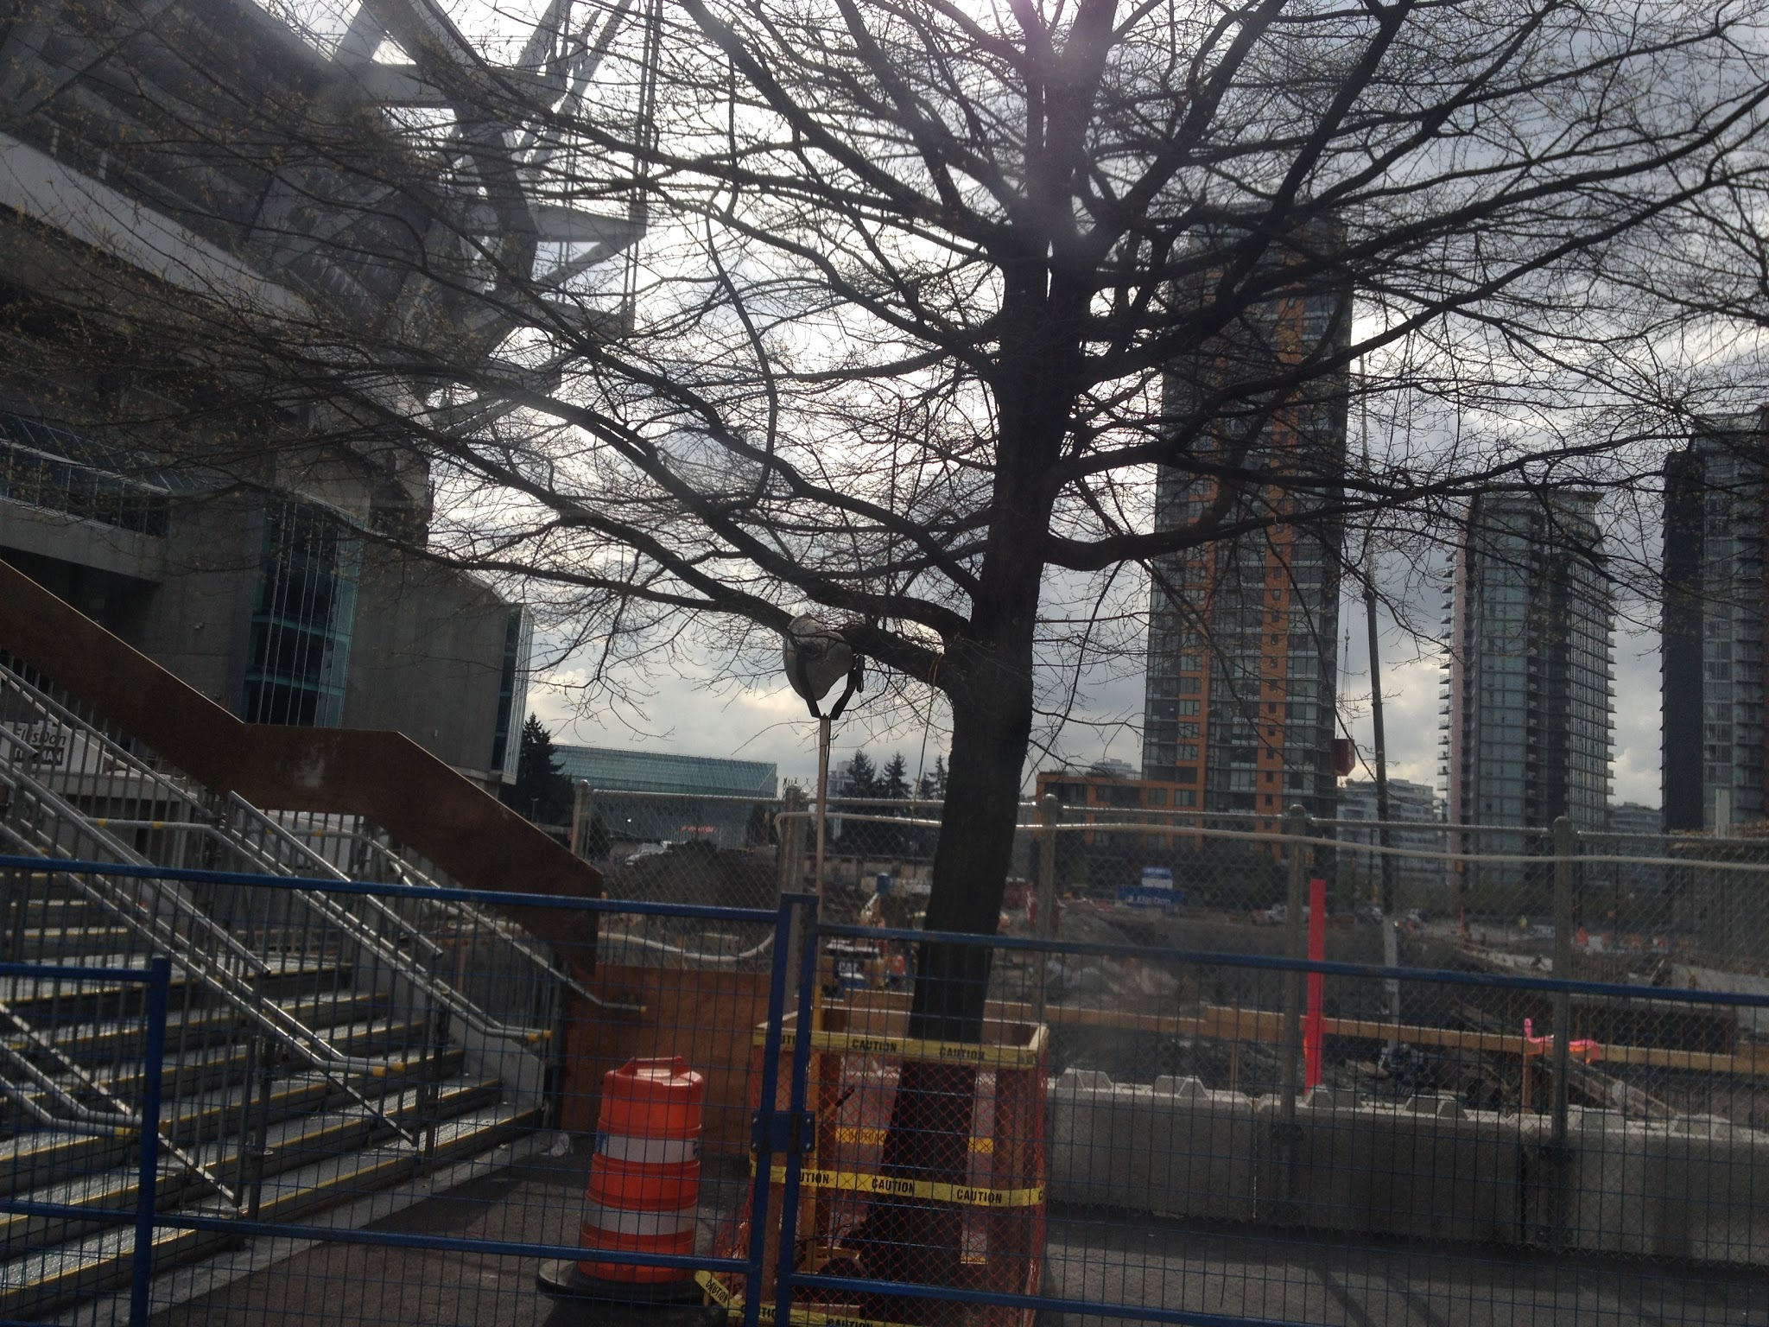
Infill
Infill is the development of an empty space in the urban areas. The new apartment that’s being build beside the arena is an example of infill because the project further increase the density of the area.

Slide 5
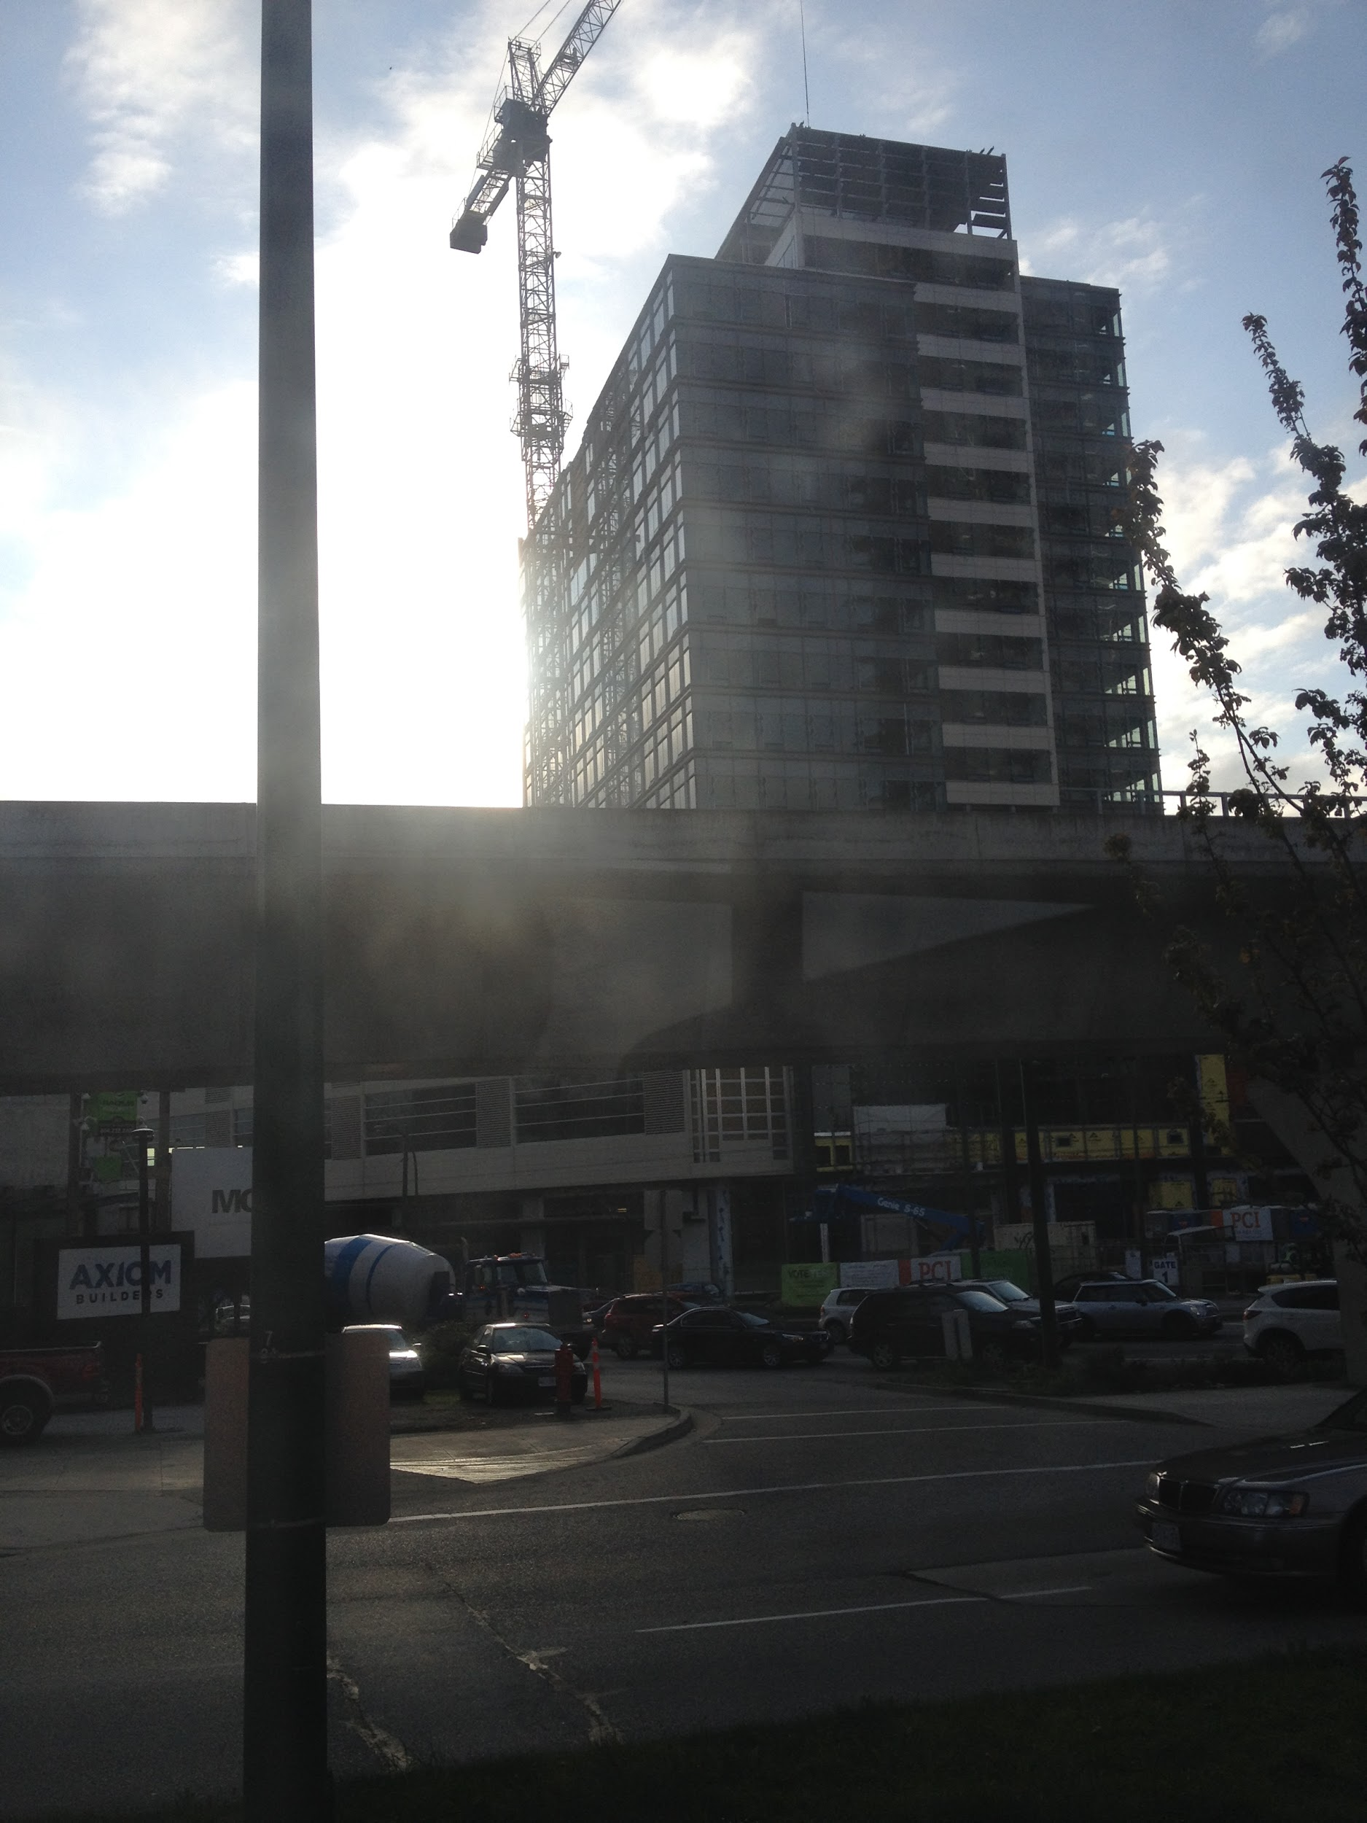
Densification/Industrialization
Construction of residential highrise
This is an example of densification because apartments, which are vertical developments, are being build here. The density will also increase because a Translink station nearby is turning the area into a major intersection.

Slide 6
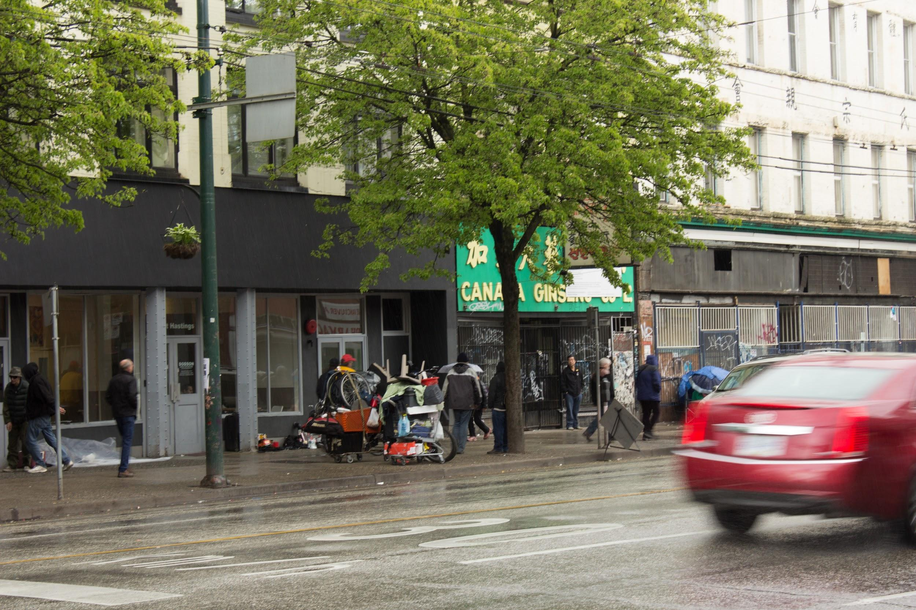
Deprivation
Deprivation: The degree to which an individual or an area is deprived of services and amenities
The informal economy shows the existance of poverty, and the barred windows as well as graffitis show lack of security.
Barred windows and graffities
Informal economy

Slide 7
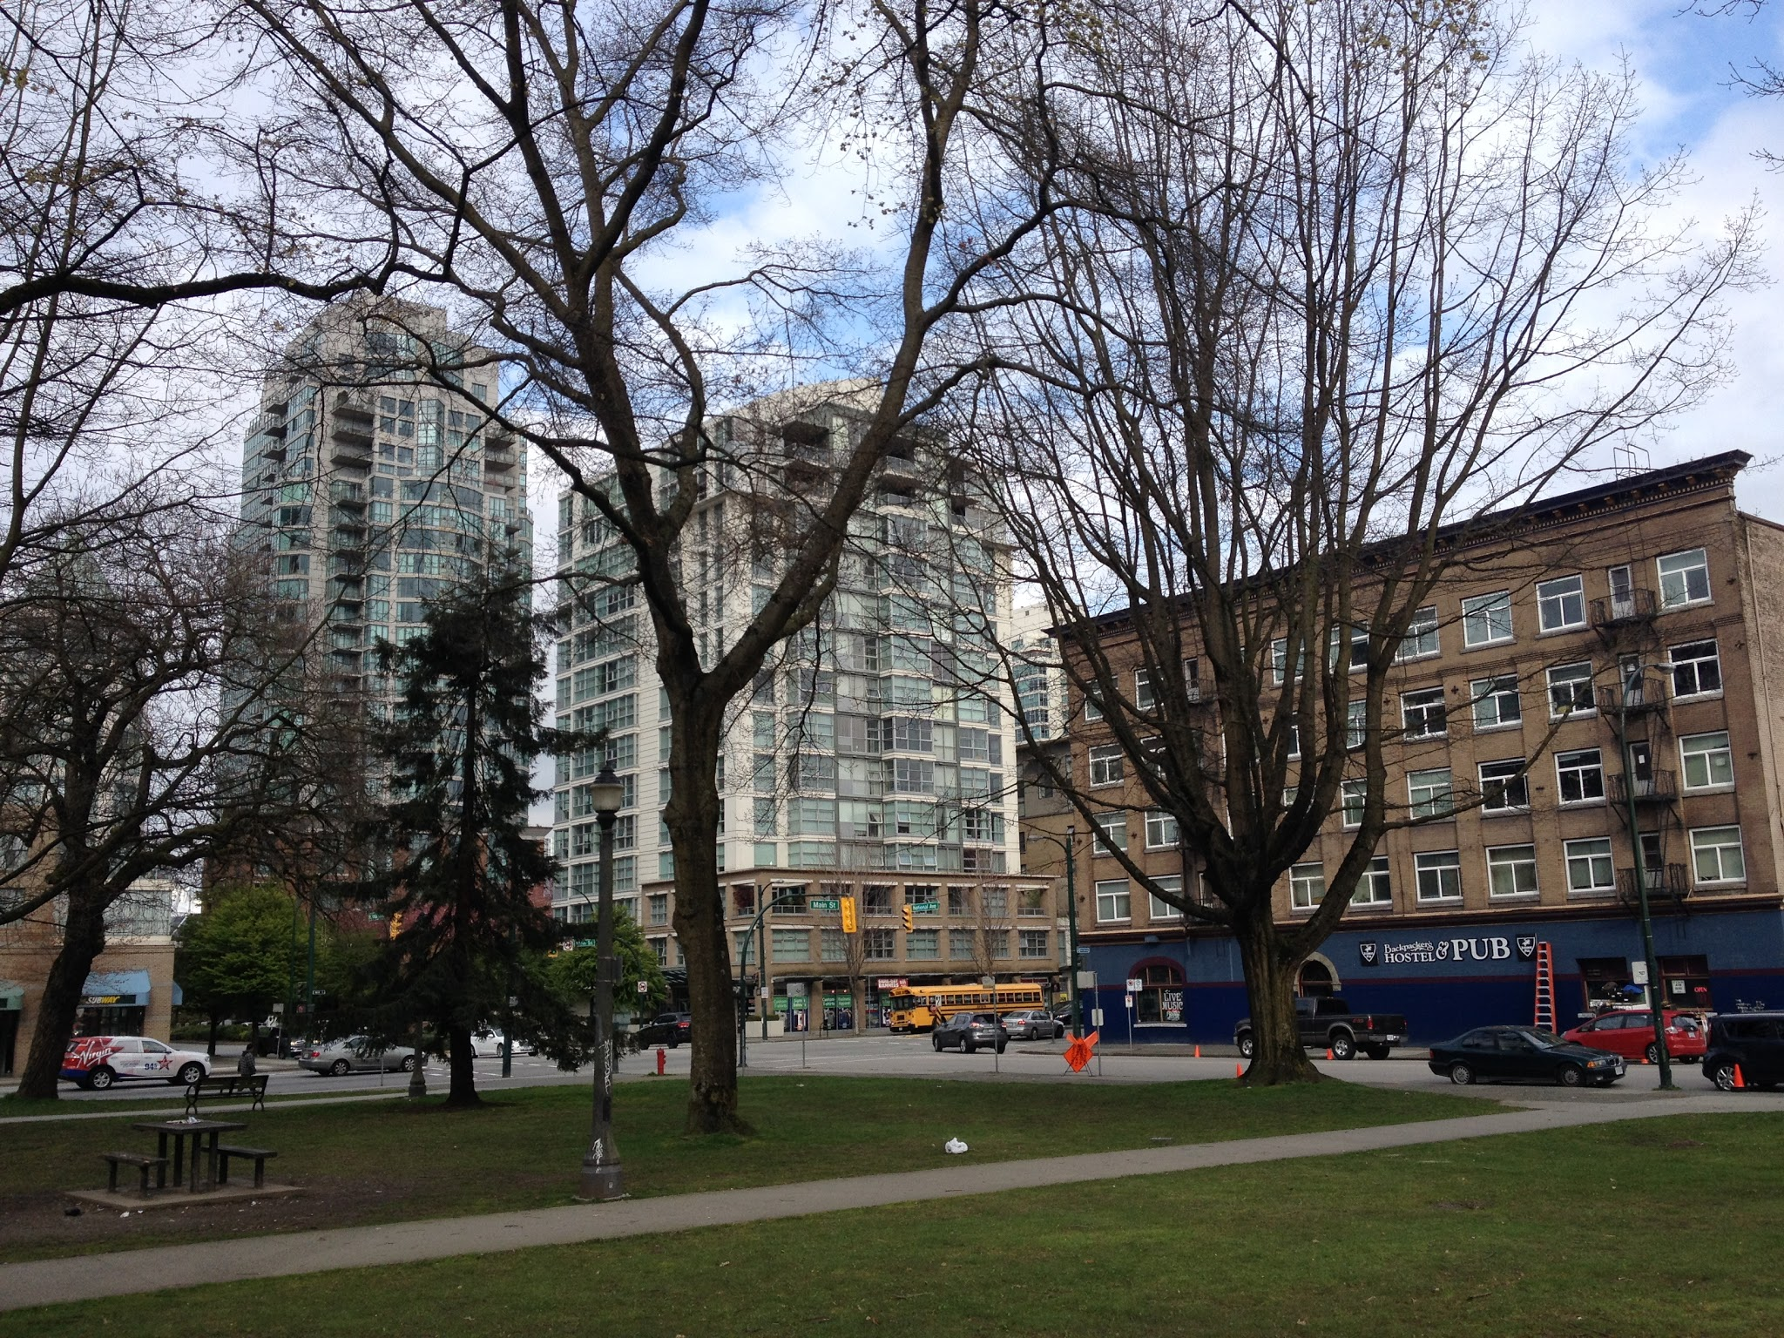
Zone of assimilation
Zone of assimilation are areas which are increasingly develops as the functions of the CBD
The area in the picture is going to be developed into more of a business district.

Slide 8
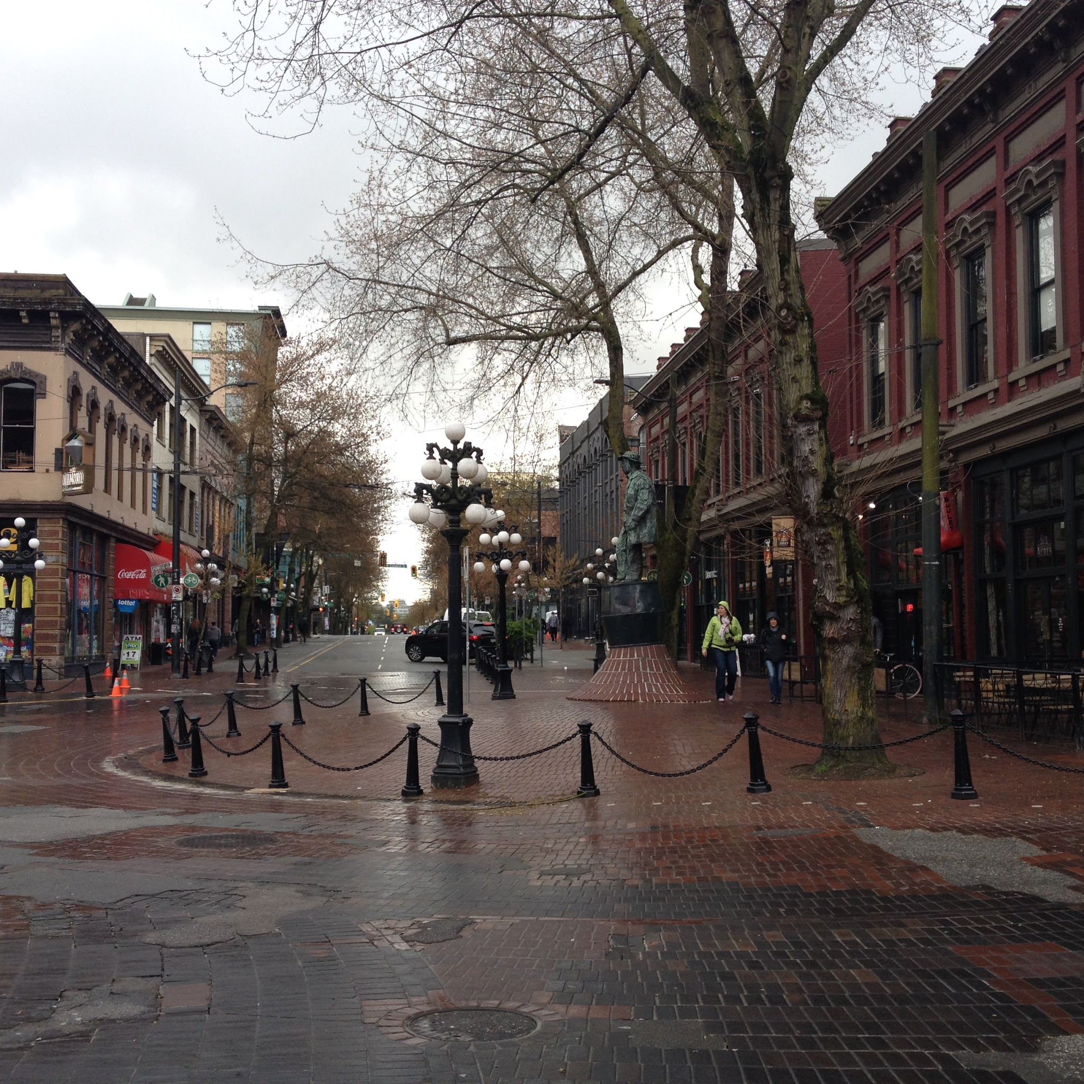
Zone of discard
The zone of discard is an area which used to be the CBD but is in decline and characterized by small shops and warehouses. Gastown used to be the downtown of Vancouver, but the businesses shifted out and only gift and furniture shops are left.

Slide 9
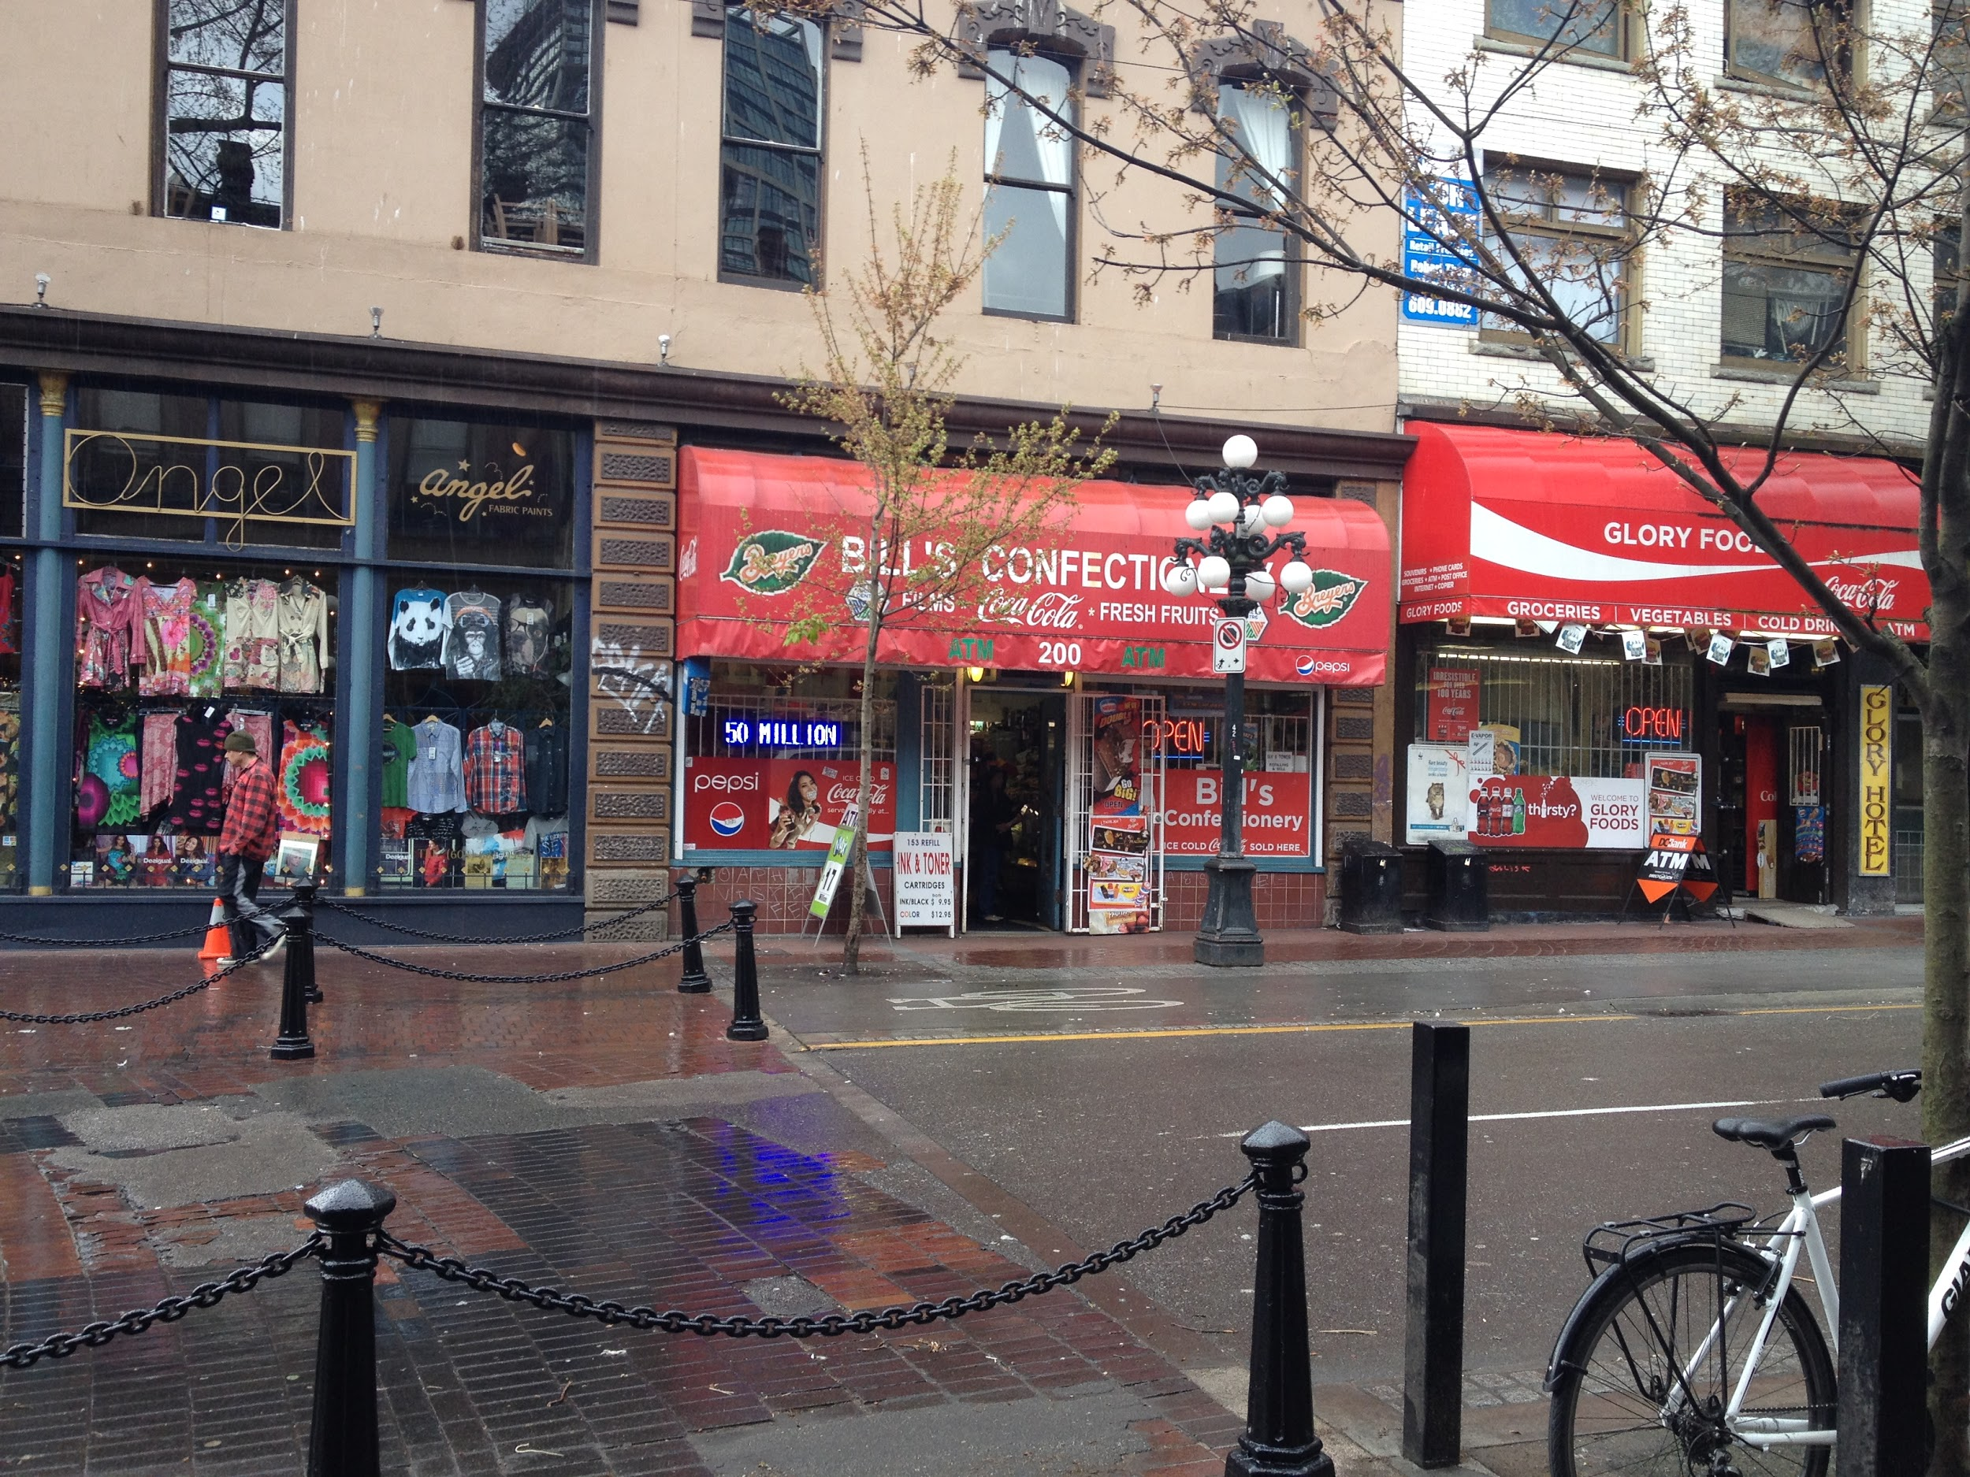
Retail: variations in scale
(9-1)
Large scale retail: Superstore
(9-2)
The difference of scale between these two retails can be shown by theit physical appearance
The size of supestore is far larger it also has its dedicated parking lots
The small retails are located in undesirable areas and are far smaller in size
Small scale retails

Slide 10
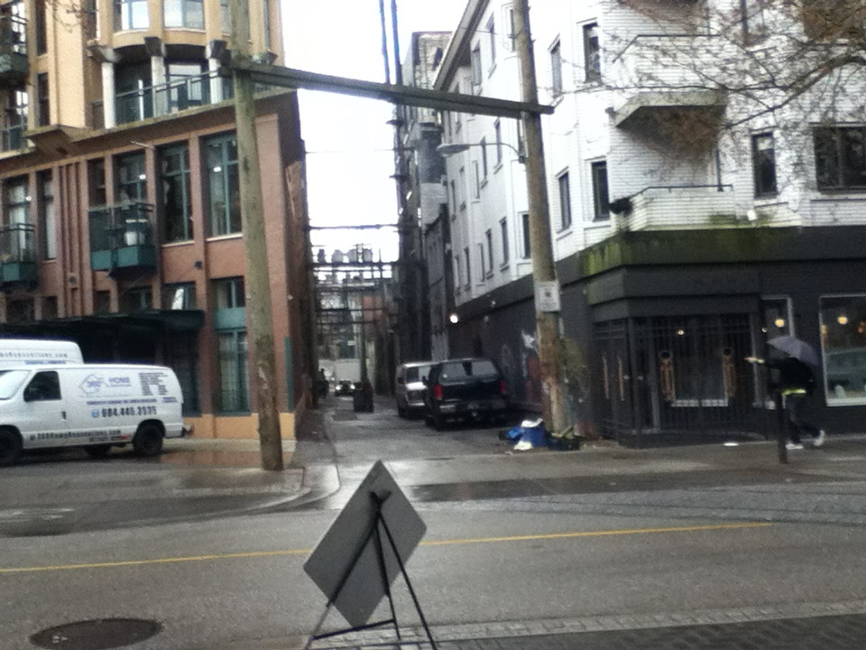
Low income residential
Low income residentials are likely to be located in undesirable areas with low land value, or government issued social housing.
The residential area in the picture is located in an undesirable area, where the barred doors and graffitis show signs of deprevation.
Low income residential

Slide 11
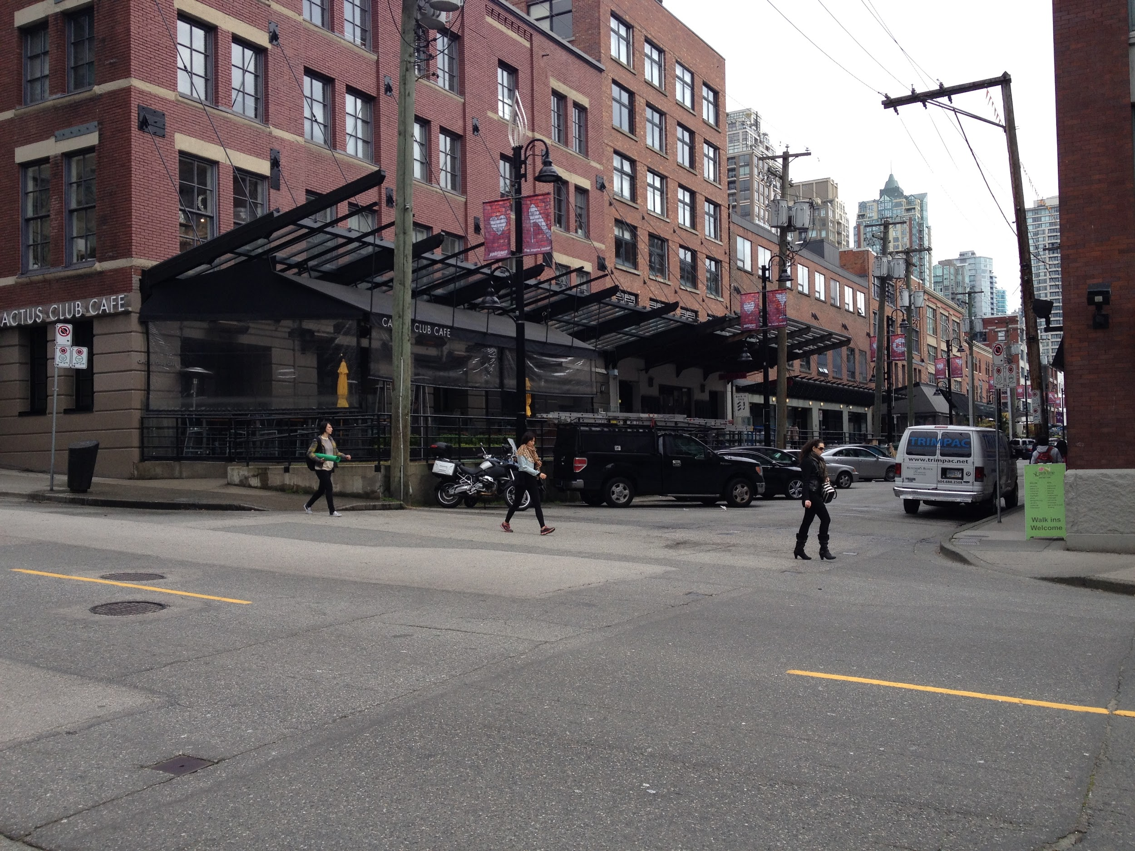
Medium income residential
Midium income residentials are located in areas in which are desirable for living, but the cost of living is not as high as that of high income residentials.
The residential area in the picture has good access to transportation, but not an area with good view, in which lowers its value.
Medium income residential

Slide 12
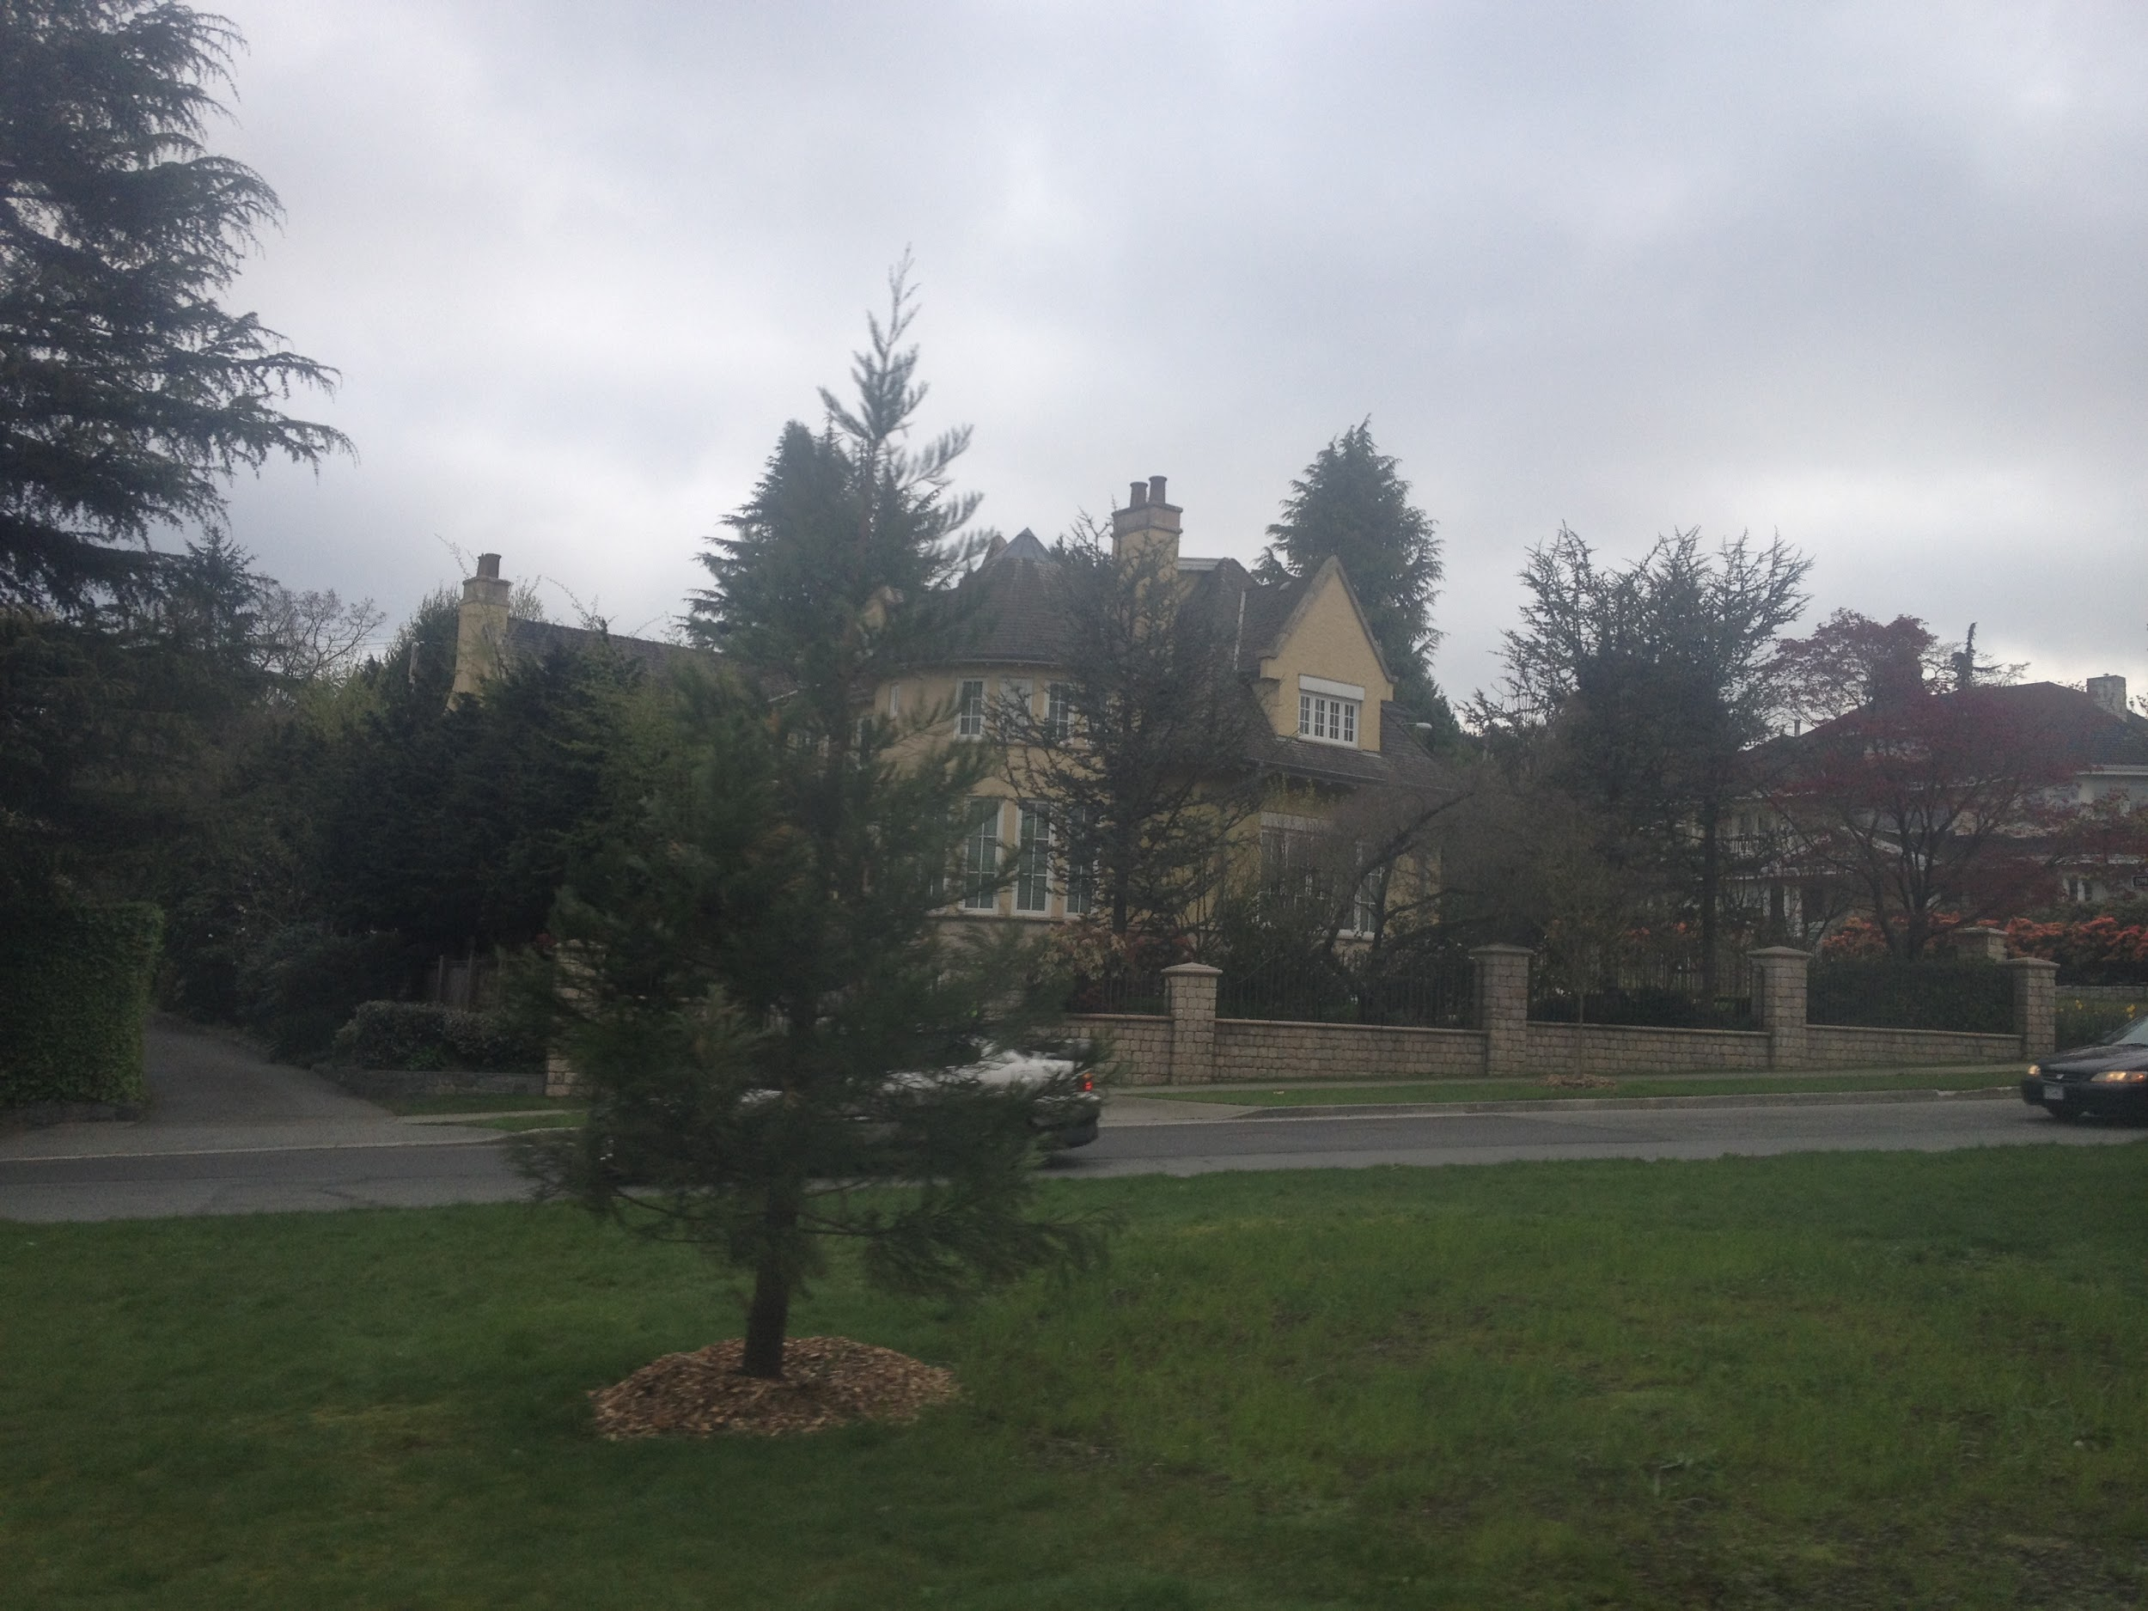
High income residential
High income residentials are located in most desirable areas for living in the city.
The massive size of the houses and the amount of green space surrounding it indicates this is a high income residential area.
High income residential

Slide 13
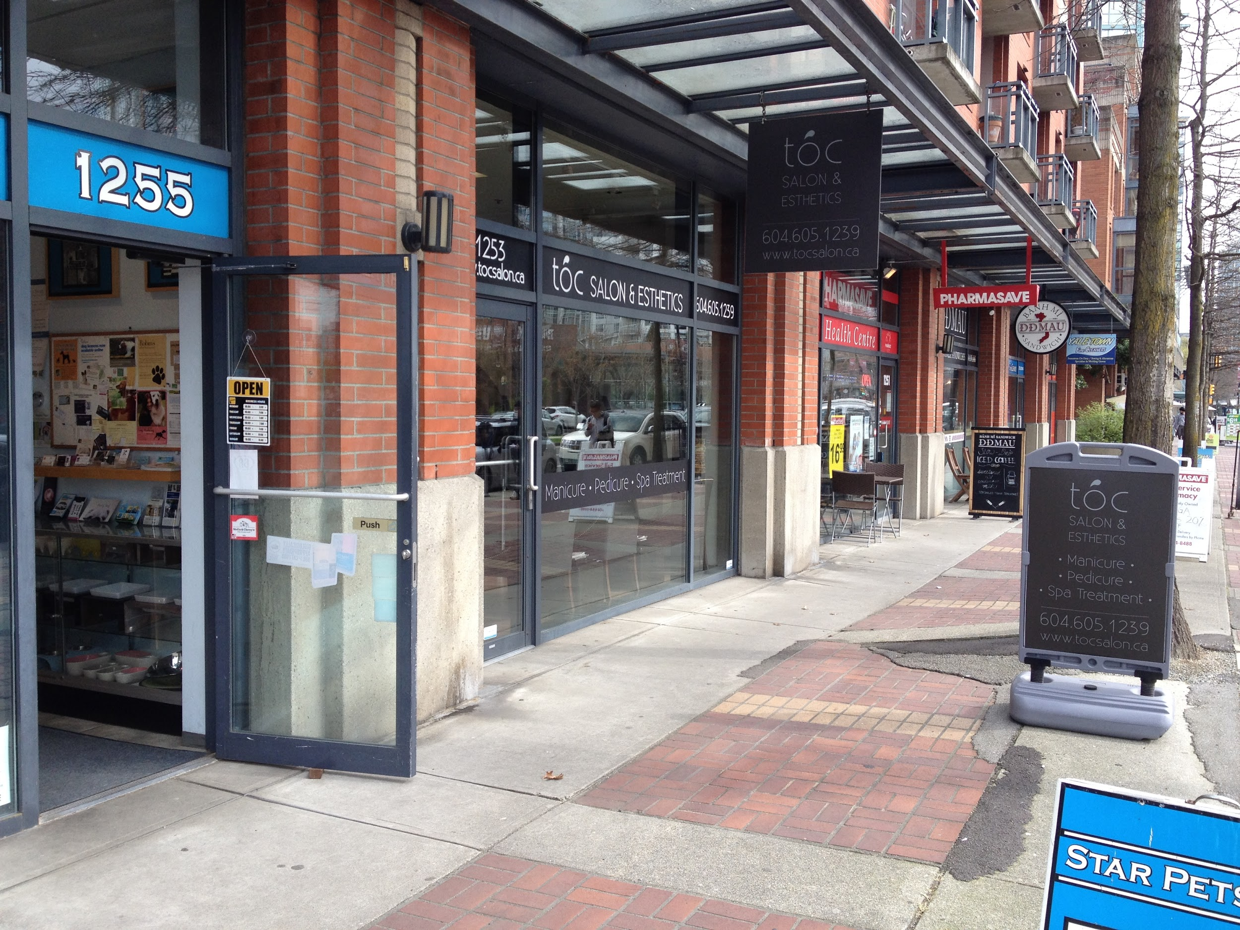
Commercial ribbon
Commercial ribbon is where various commercial buildings are built along a stretch of road.
The stores in the picture are built along the side the street Pacific Boulevard.

Slide 14
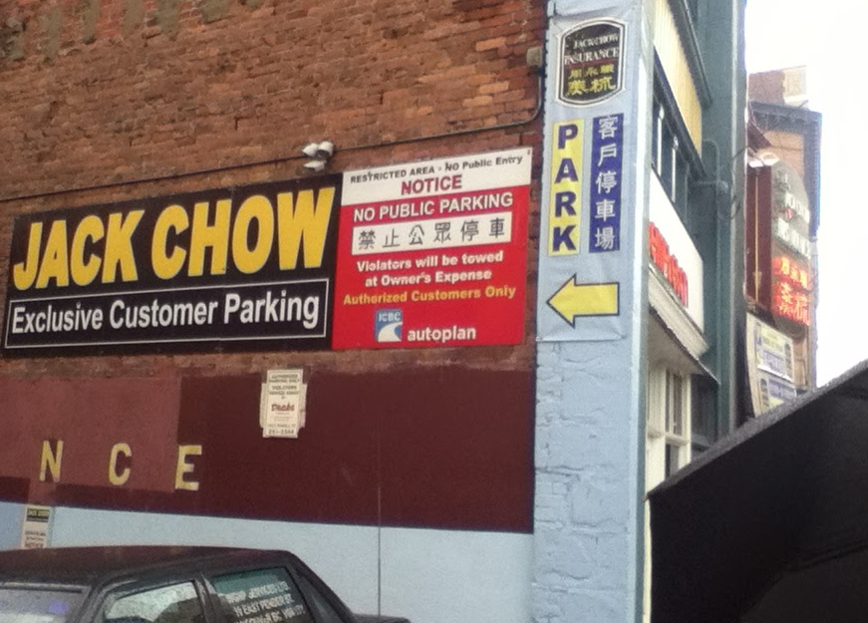
Ethnic clustering
Ethnic clustering is the gathering of an ethnic group within an area.
The numerous Chinese signs indicates a cluster of Chinese population within the area.

Slide 15
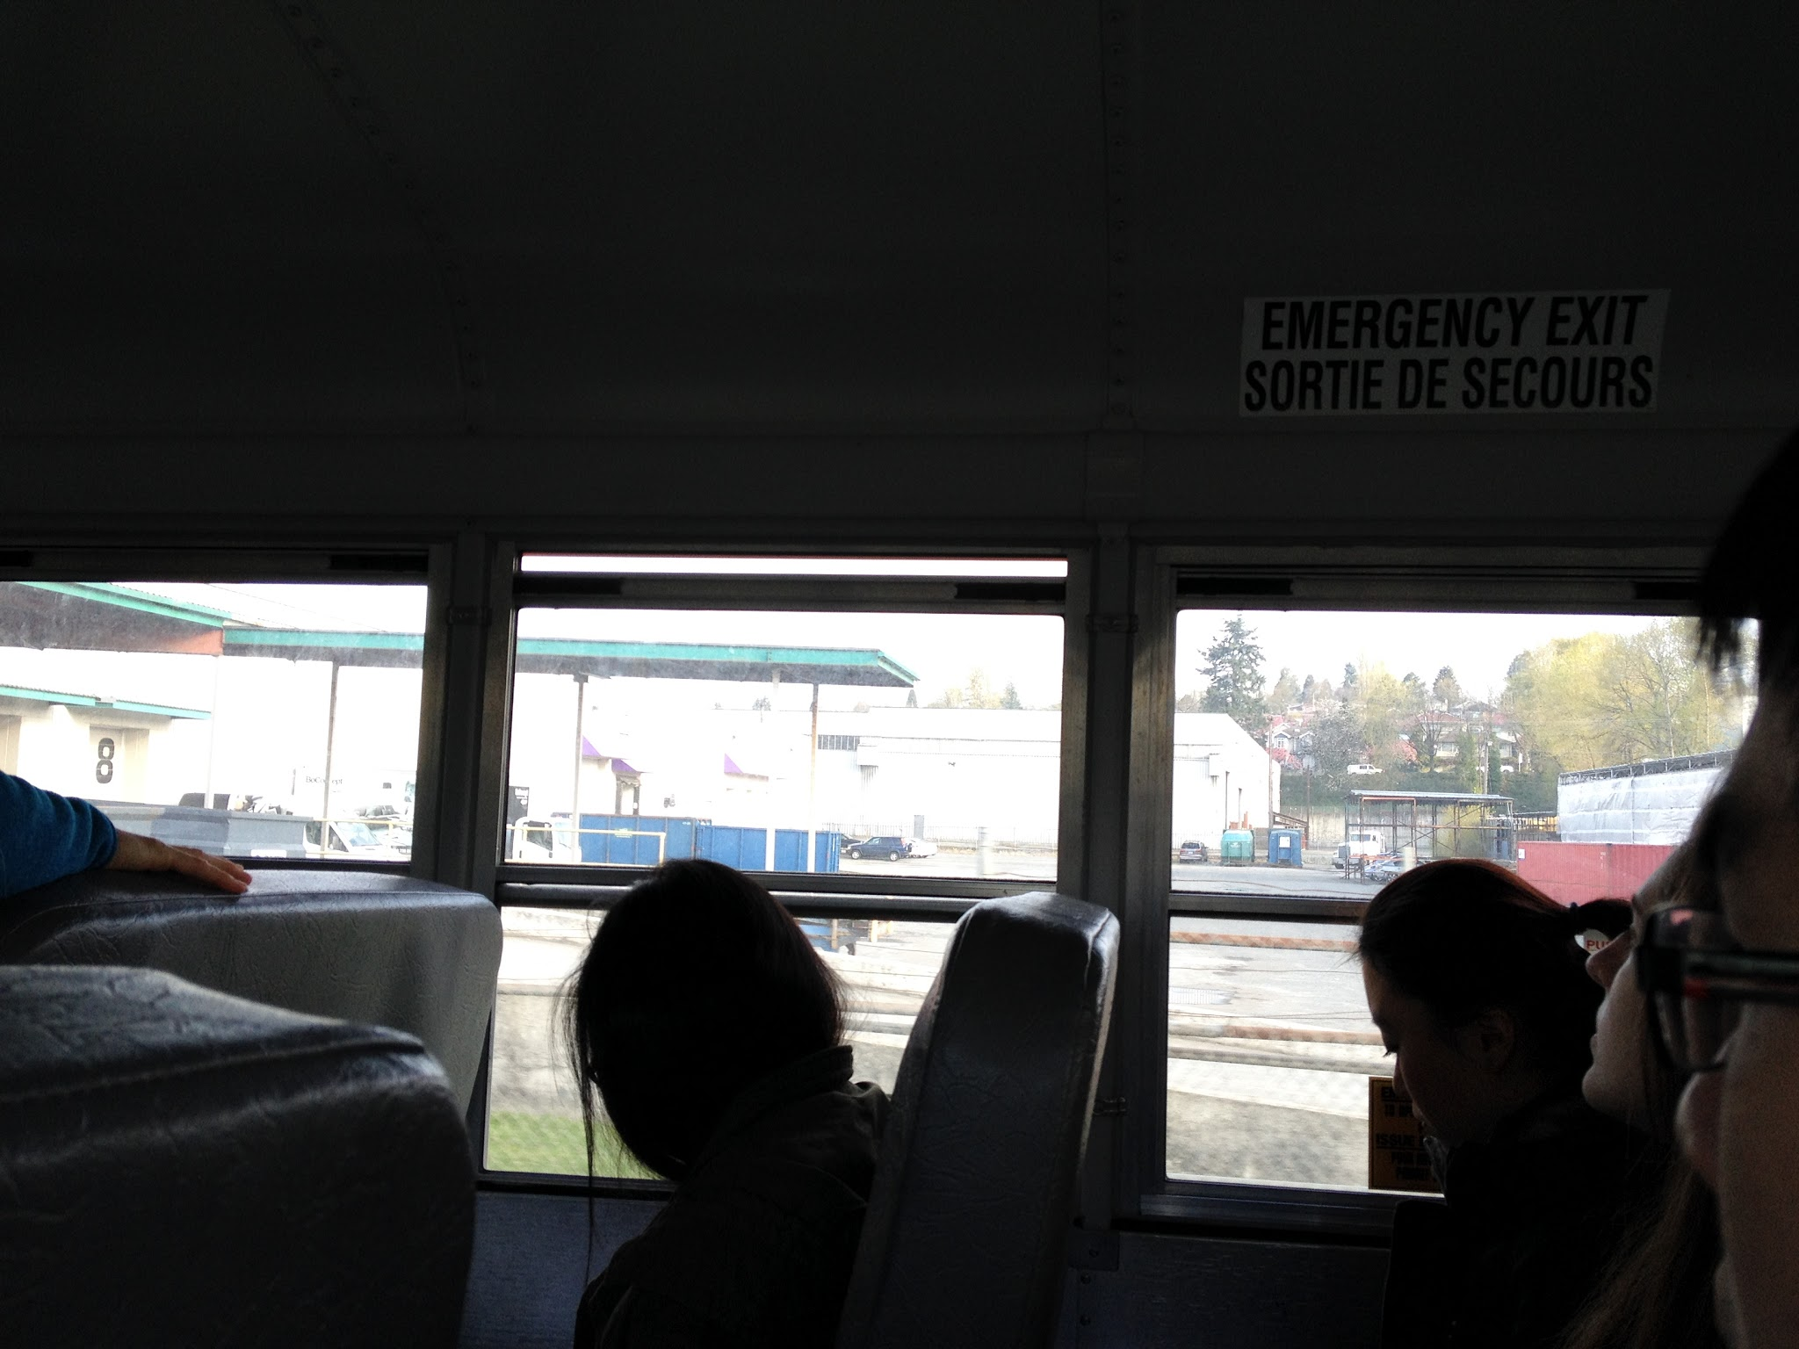
Light industrial land use
Light industrial land use is where the land is used for manufacturing in a manner that does not create outside nuisance factor.
The areas on the south of the S.E. Marine Drive are being used as light manufacturing for cars and others. The cheap lands encourage the industries to settle there, and since major commuter uses S.E. Marine Drive, lots of car industries also locate there.

Slide 16
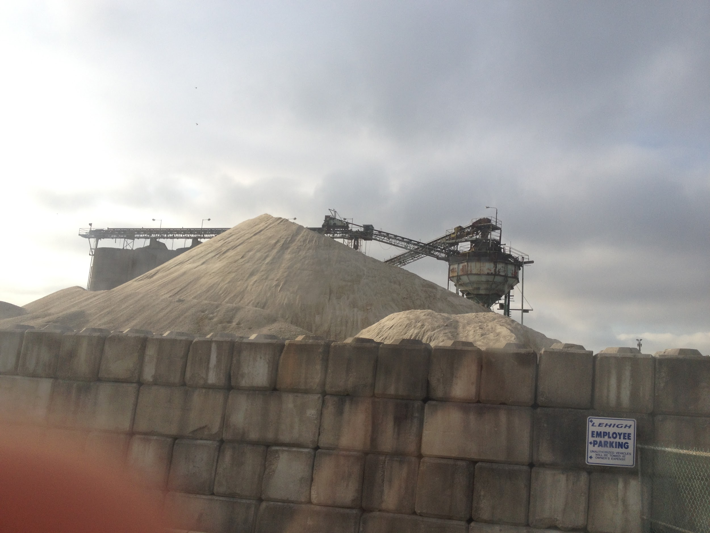
Heavy inductrial land use
Heavy industrial land use is where the land is used for intensive industrial purposes,in which usually have large and heavy equipments and facilities.
The pile of construction material and the factory in the back shows the presence of heavy industrial land use within the area.

Slide 17
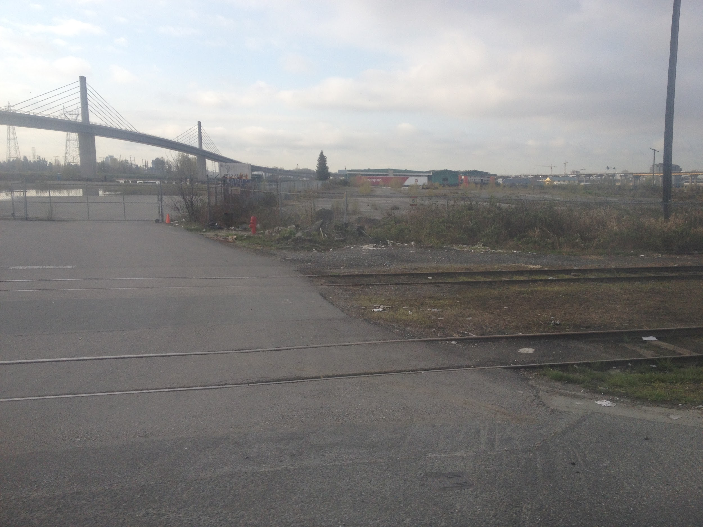
Brownfield site
A brown field site is an area that is abandoned but has potential for redevelopment. This area has potential for apartments because it has a good view of Fraser River and is near the City of Ricmond.

Slide 18
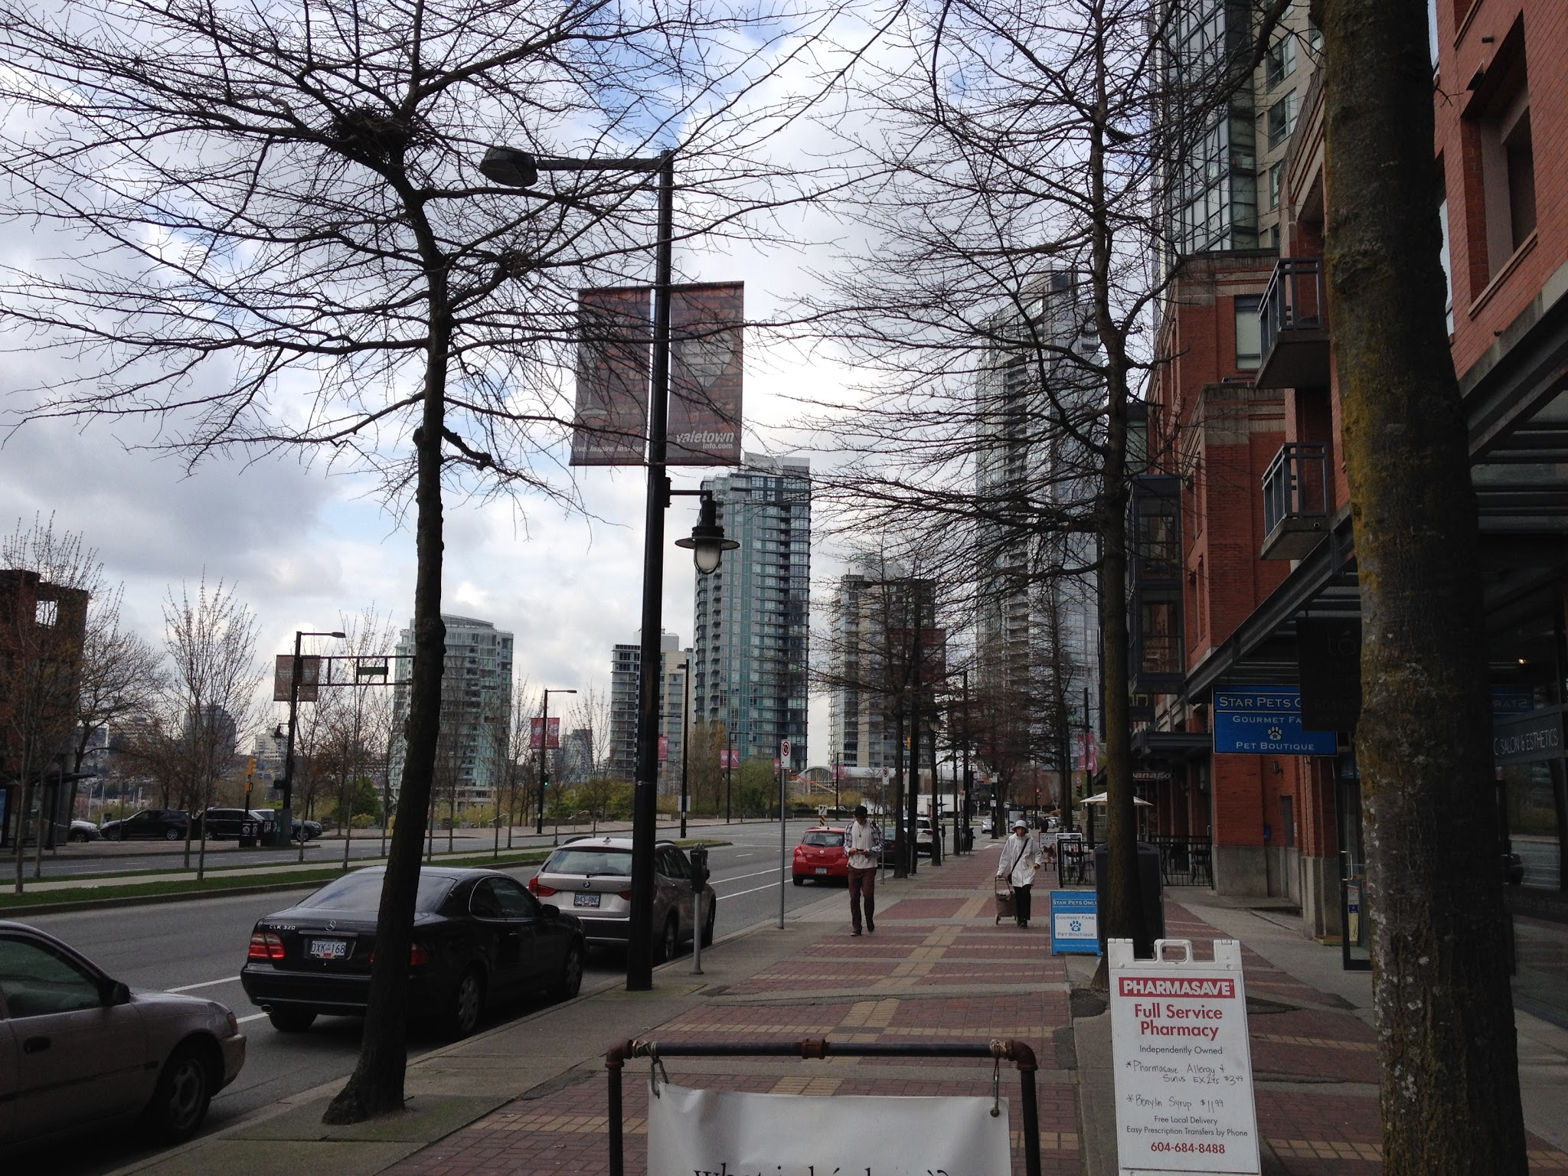
Adapted uses
Adapted use is when land previously used for certain purposes is redeveloped for different purposes, without entirely removing its past characteristics.
Yaletown used to be wardhouses and train stations, and now it turns into a high end district with residential and commercial lands.

Slide 19
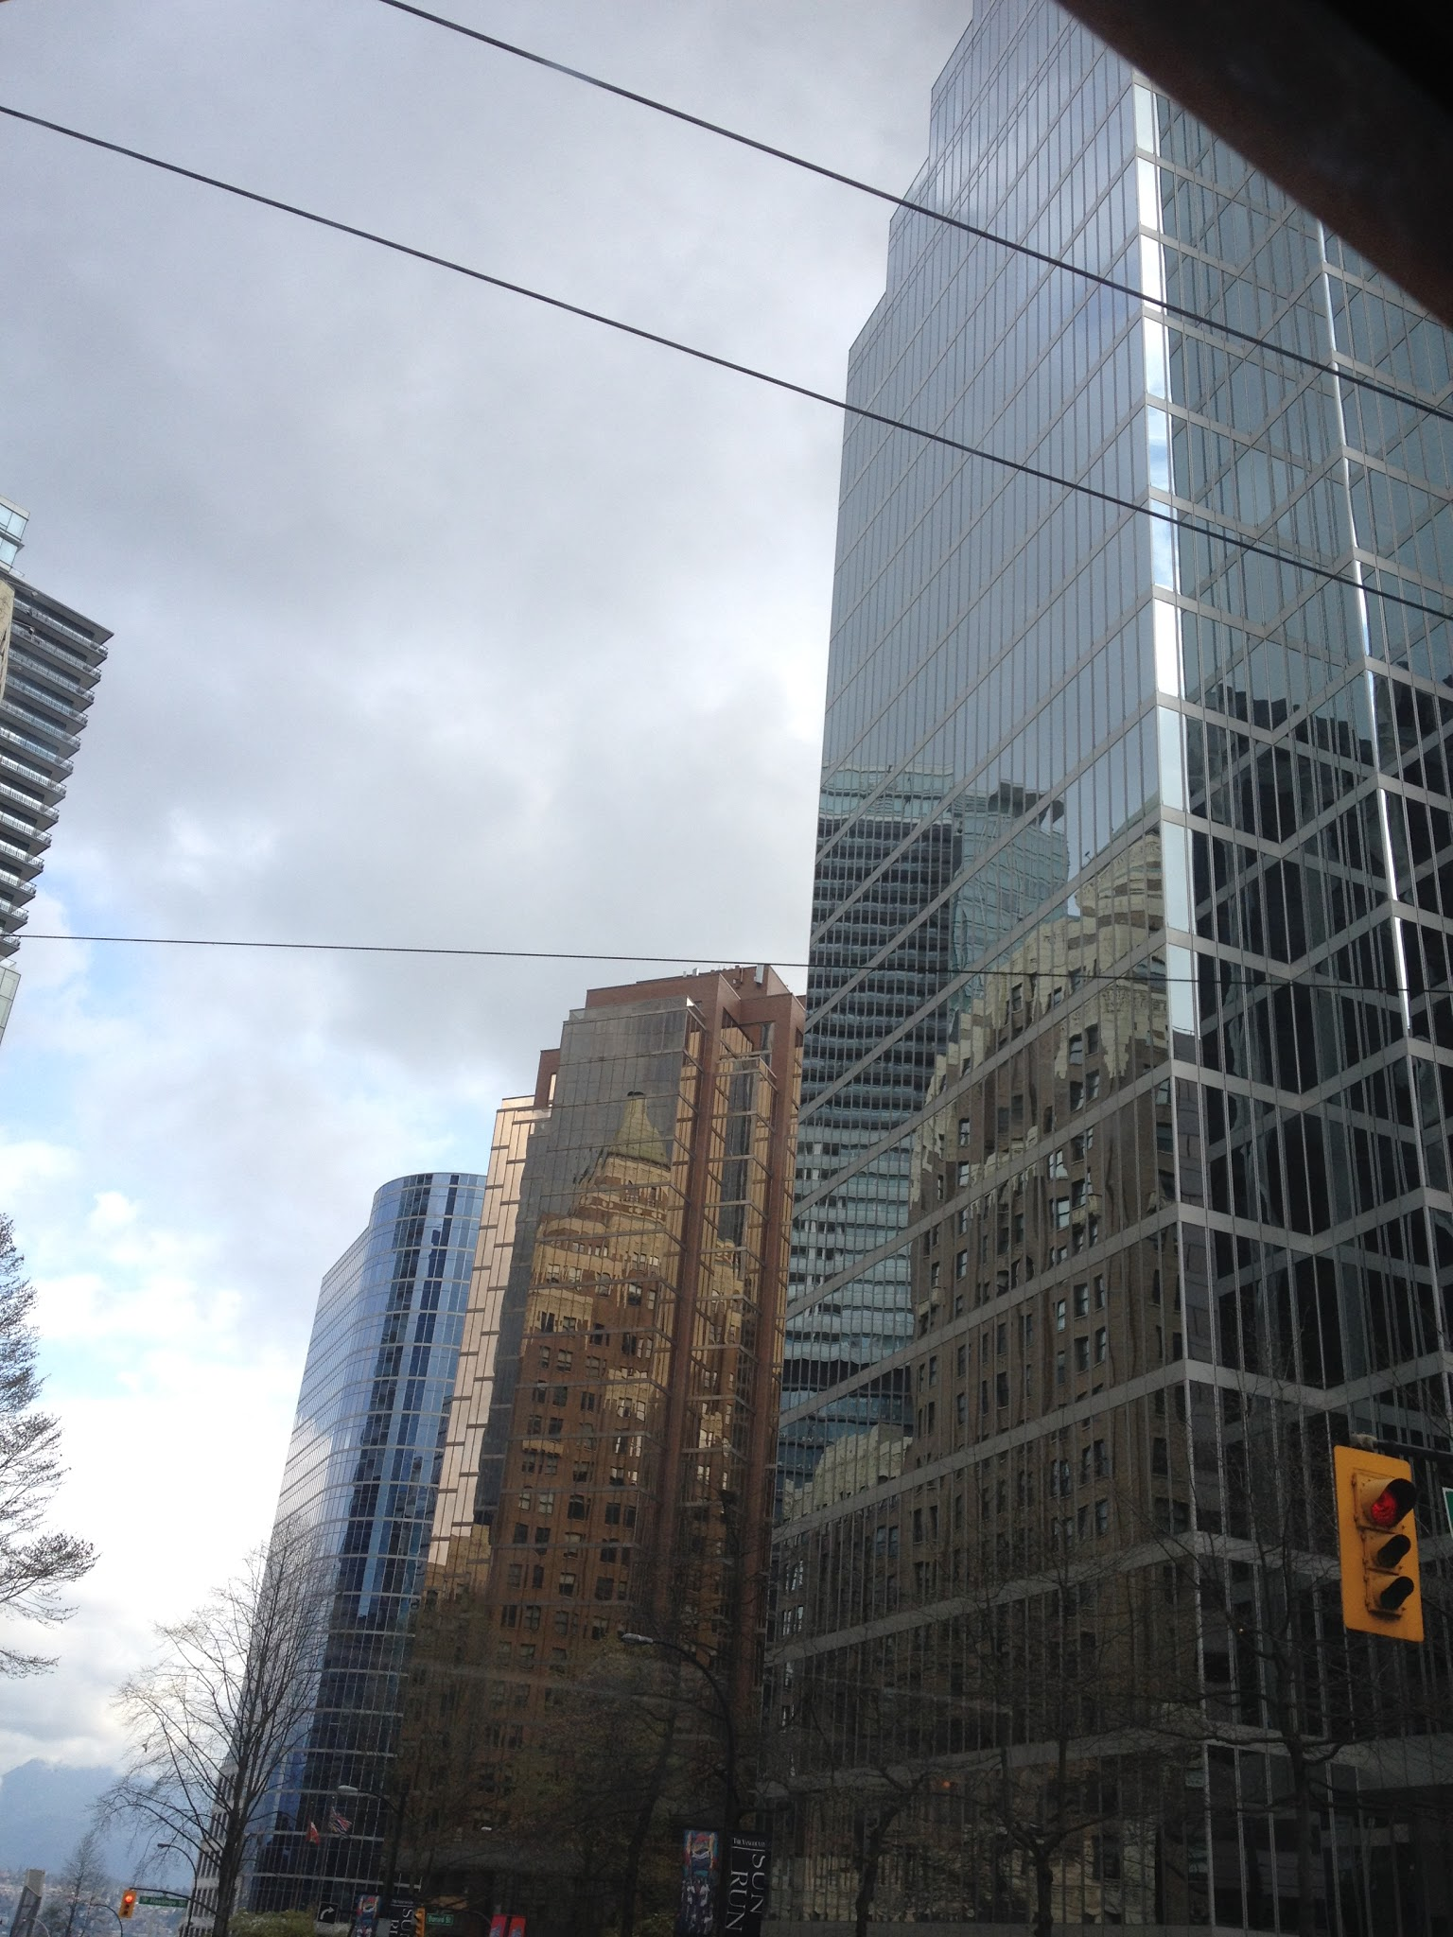
CBD (Central Business District)
The CBD is the centre of the city, where most of economic activity occur.
The West Hastings St. is the CBD of Vancouver because it has lots of high rises that are being used for businesses. This is also the terminal station for major Translink lines.

Slide 20
PLVI (Peak Land Value Intersection)
PLVI
The peak land value intersection where the land value is the greatest, which is located in the CBD as shown in the picture.

Slide 21
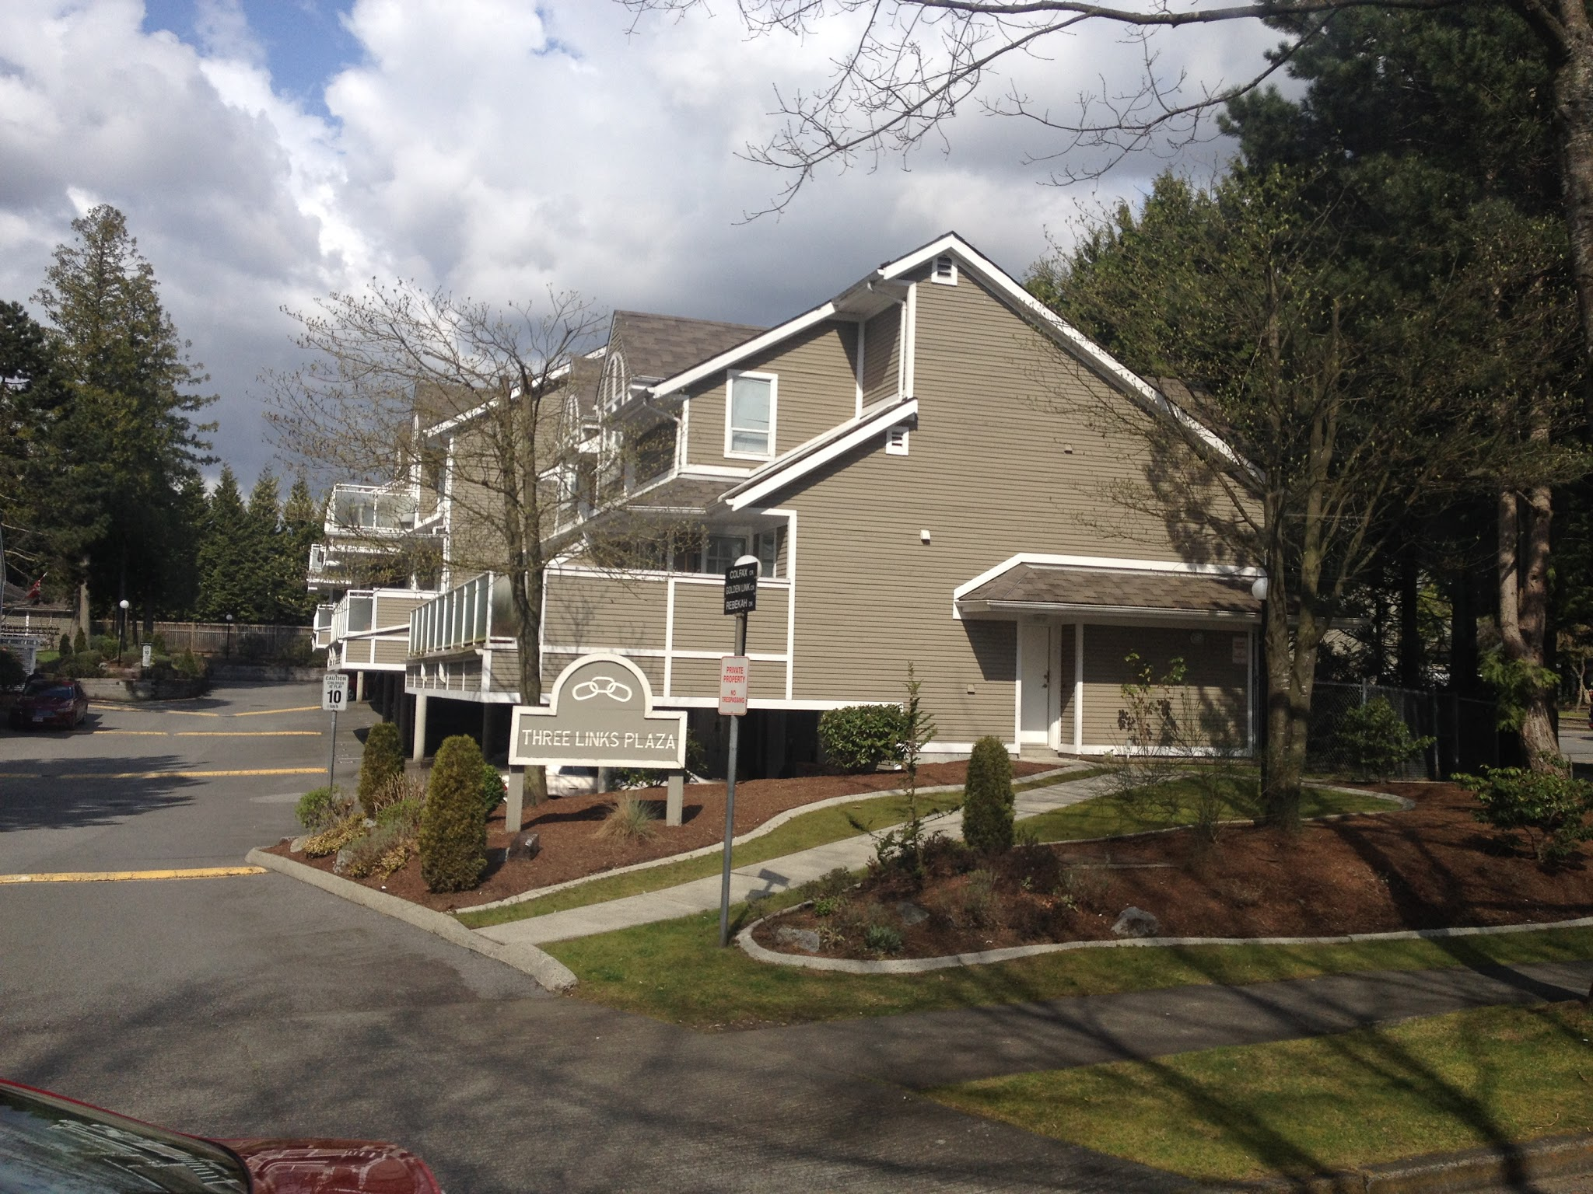
Social housing
Social housing are housing provided for residences of low income or with particular needs by government agencies or non-profit organizations.
This is an example of social housing becuase this is one of the affordable housings on the market. This area is being managed by the government and gives priority to those people who have low to middle income.

