Slide 1
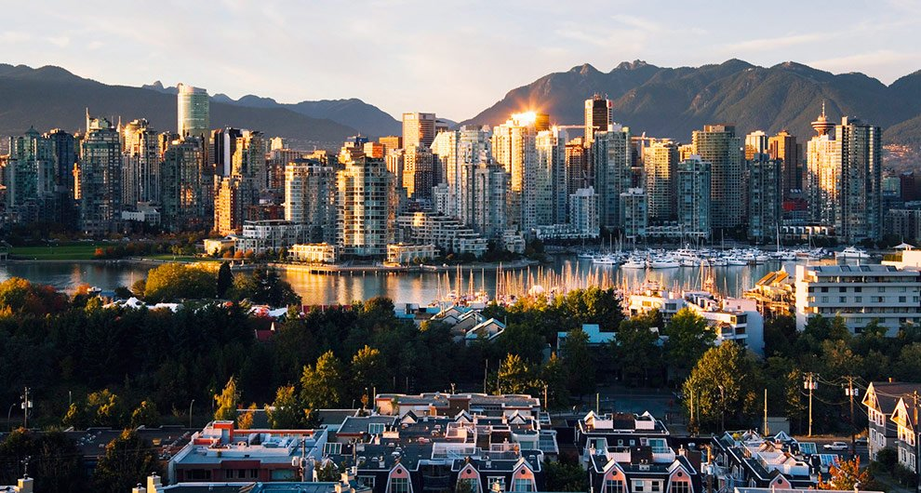
Vancouver Urban Tour
Michelle Chen Yolanda Jin

Slide 2
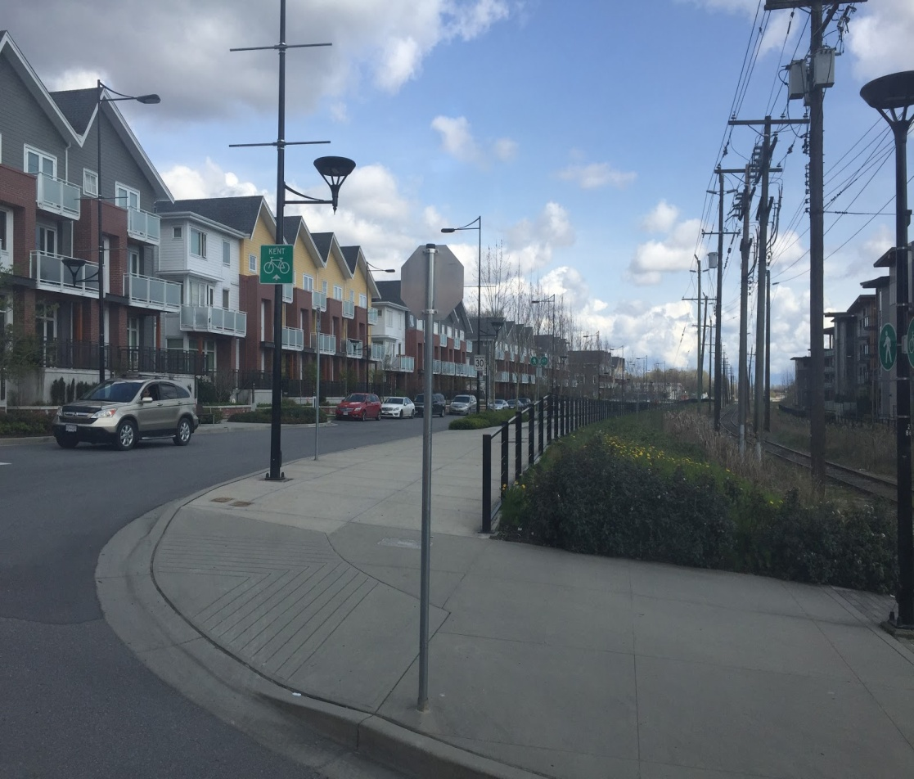
Reurbanization
Marine Drive/Fraser Foreshore
Reurbanization is the development of activities to increase residential population densities within a built-up area in a city.
This area used to be heavily industrialized, as hinted by the railroad on the right. It has now been redeveloped into a predominantly residential area as shown by the row of townhouses. This encourages movement of people into a previously uninhabited area.

Slide 3
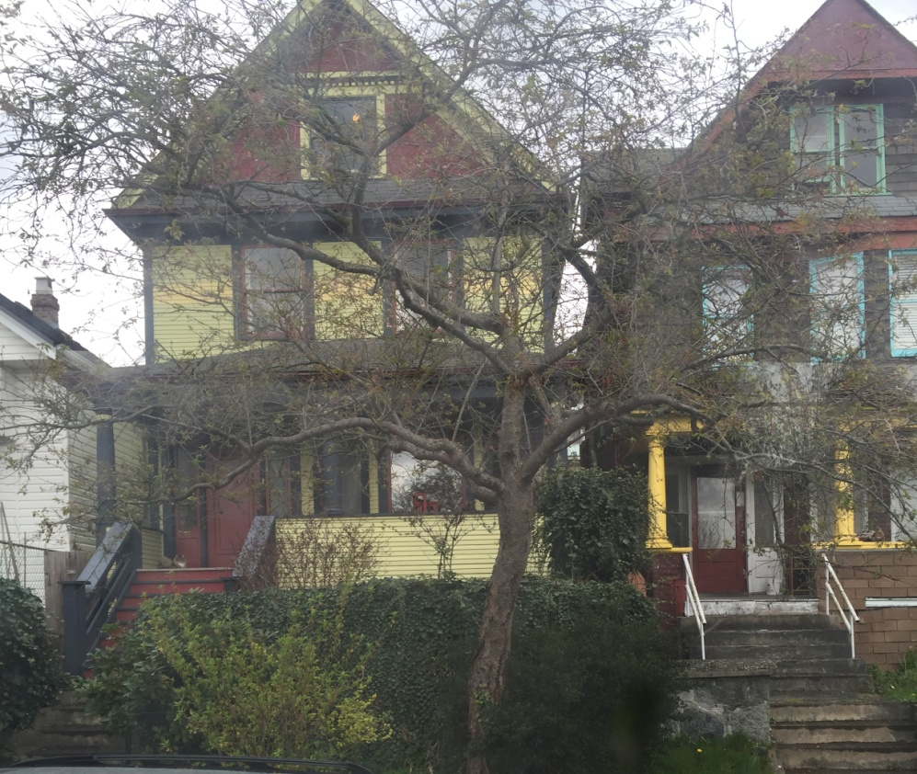
Gentrification
Strathcona
Gentrification is the renewal and redevelopment of a deteriorating area after affluent people move in, renovate the houses and neighborhood and bring in high-end retail. Gentrification results in the displacement of low-income residents.
In Strathcona, smaller, ill-maintained houses have been renovated into newer three story houses such as the ones demonstrated in the photograph.

Slide 4
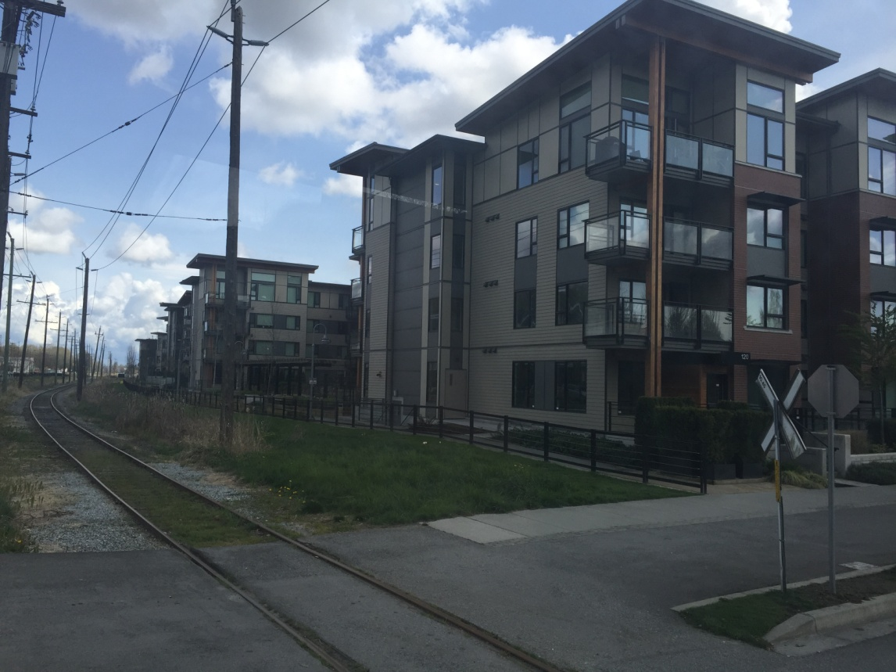
Infill
Marine Drive/Fraser Foreshore
Infill reuses obsolete or underutilized sites and allows for densification in the area.
The region shown in the photograph used to be an industrial site that was left abandoned, and then redeveloped for residential use.

Slide 5
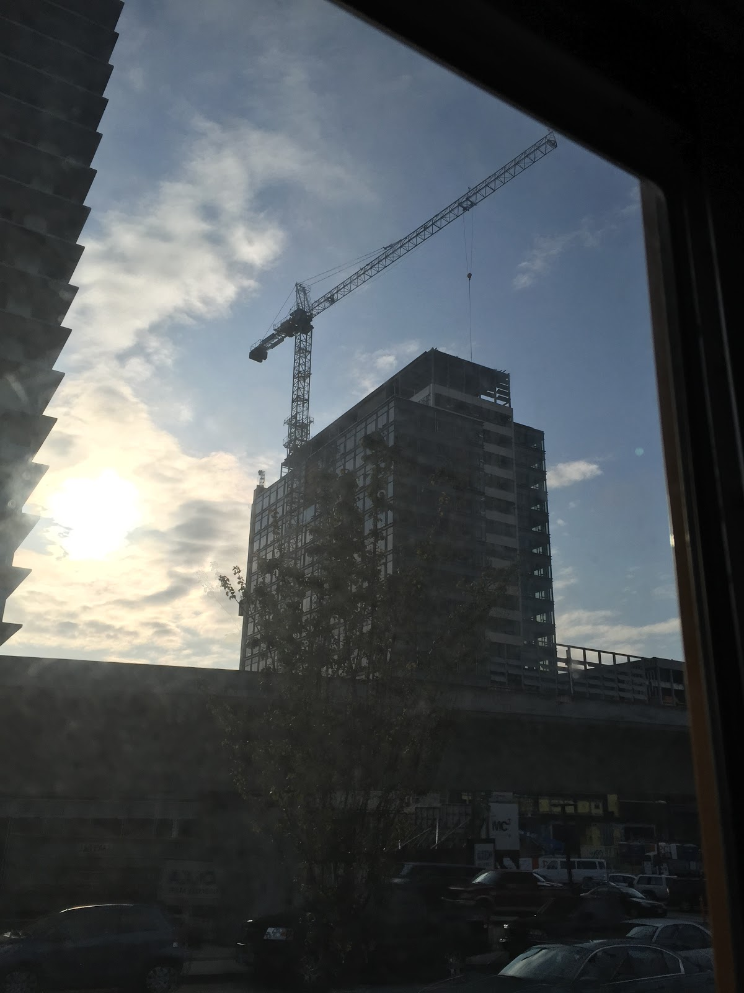
Densification/Intensification
Cambie Skytrain Station
Densification or intensification is the increase in the number of people over a certain area by replacing low density dwellings with high density dwellings.
New apartments are being built next to skytrain stations which support more people over a smaller area of land. These locations are preferred residential areas due to their proximity to public transportation and its easy access to the Downtown core.

Slide 6
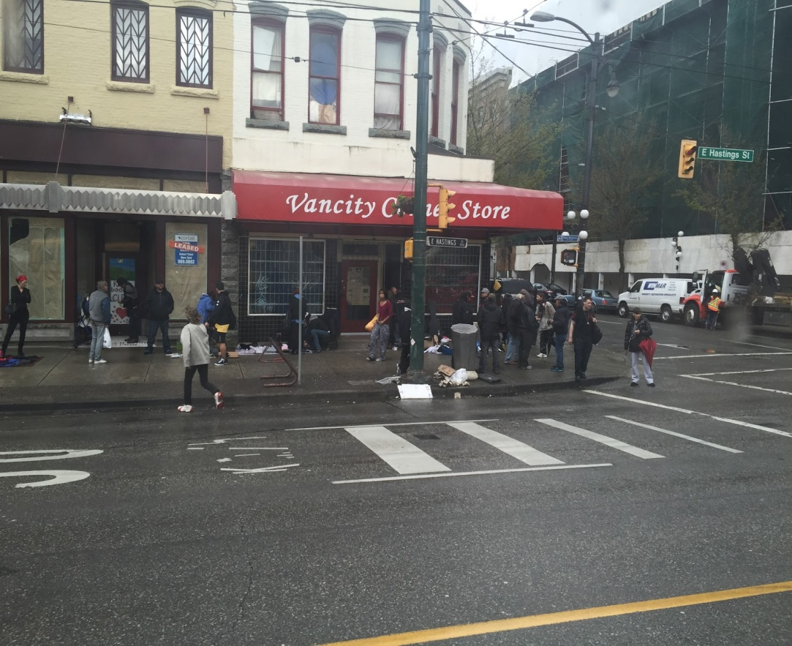
Deprivation
Downtown Eastside
Zones of deprivation are often located in the inner cities in MEDCs. They are characterized by poverty, crime, and poorly maintained streets and buildings.
Evidence of deprivation can be seen in the informal economy happening along the side of the street, the boarded up windows, and the overflowing trashcan.

Slide 7
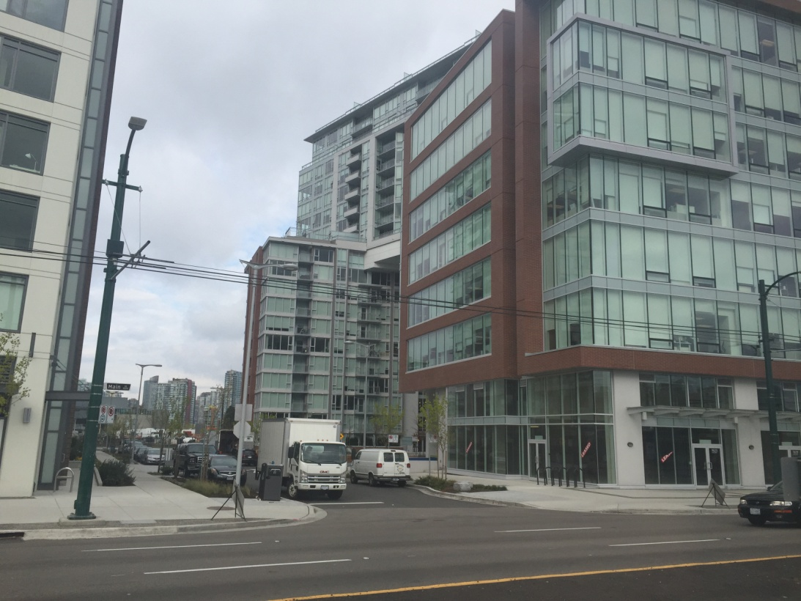
Zone of Assimilation
Thornton Park, at the head of False Creek
A zone of assimilation is an area that is being redeveloped and is soon to be part of the central business district.
Historically, this area housed many single room occupancies, but they were redeveloped during the 1986 World Exposition. Currently, the area is being redeveloped and high rises are being built to increase population density.

Slide 8
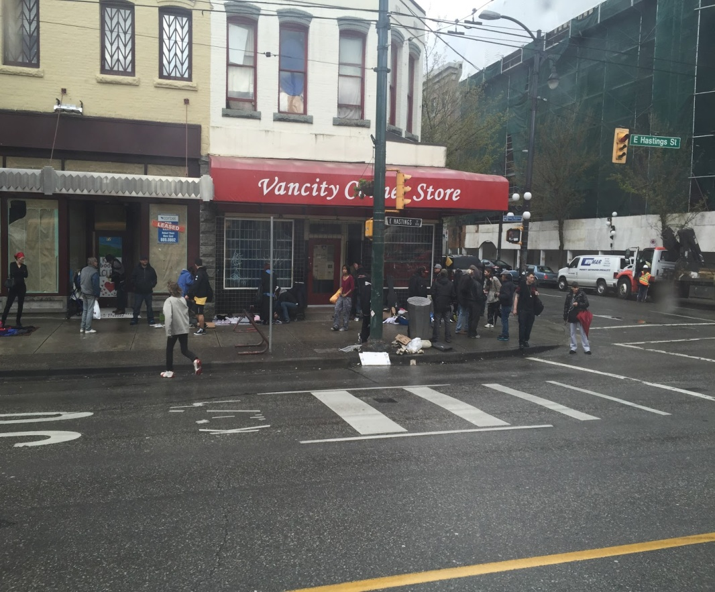
Zone of Discard
Boarded windows
Downtown East Side
A zone of discard is an area in the urban center that was once part of the CBD, and is characterized by vacant storefronts and low-income businesses. They are often frequented by low-income residents, and the streets and storefronts are poorly maintained.
The second stories of buildings in the Downtown East Side are derelict and boarded up, which indicates lack of use and suggests inefficient use of buildings and facilities. Informal retail on the sides of streets indicates a low-income area, and further degradation can be seen in the overflowing trash bins.
Overflowing trash bins

Slide 9
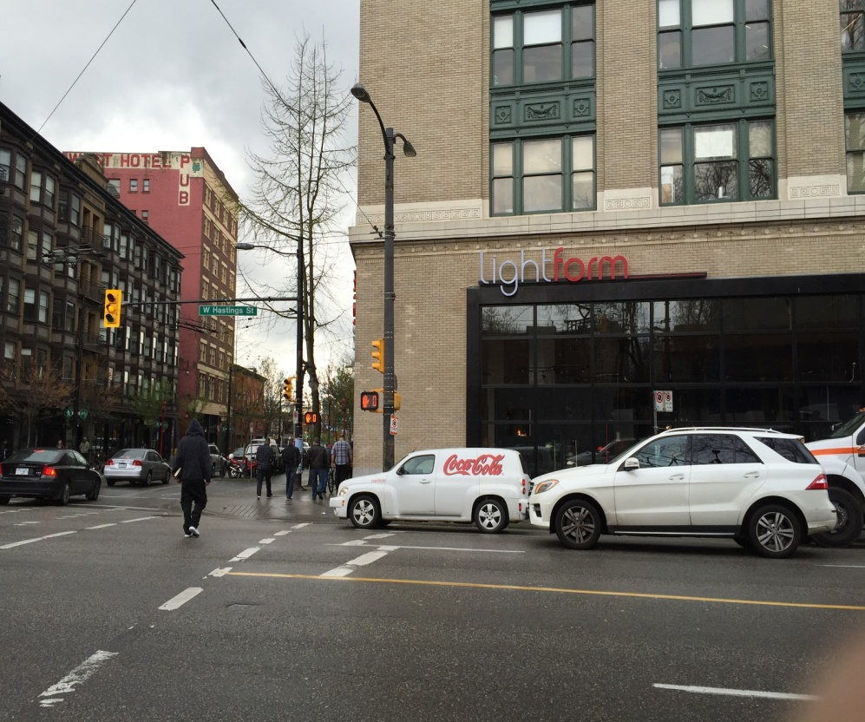
Retail: Variations in Scale
West Hastings: LightForm
Retail is the selling of consumer goods in small quantities for consumer use rather than for resale purposes.
A small scale retail store that sells lighting in small quantities for local consumers is located on West Hastings Street.

Slide 10
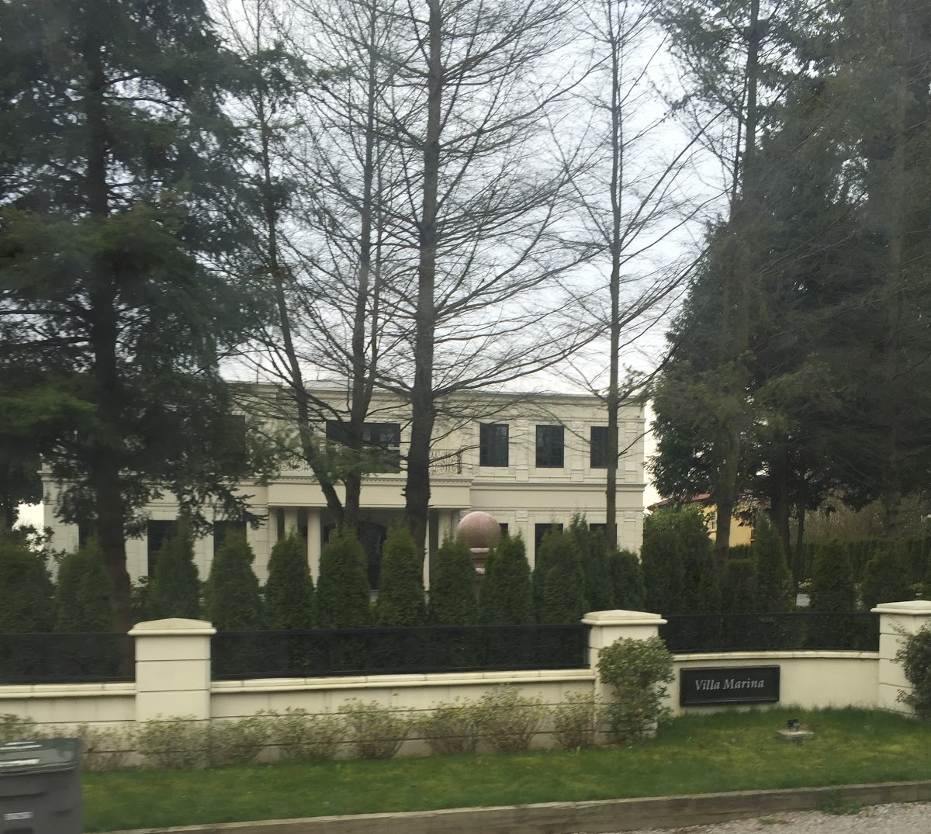
Residential: High
Residential along Southwest Marine Drive
Large lot sizes (60 ft. frontages), high amounts of green space, and expensive real estate prices all characterize high-end residential areas. They often consist of several individuals living together.

Slide 11
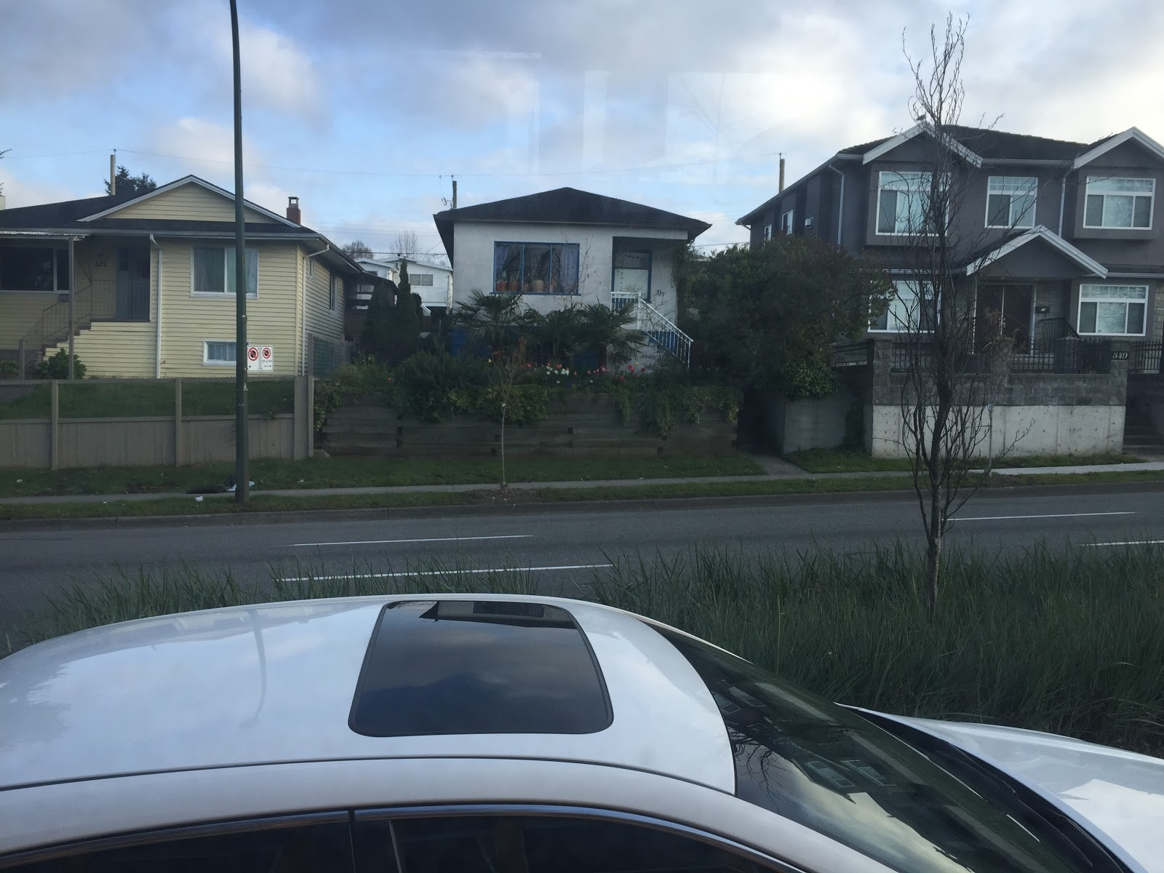
Residential: Middle
Residential along SE Marine Drive
Middle-income residential areas are characterized by average-sized single homes. The neighborhoods are often adequately maintained.
The residential areas along SE Marine Drive in Marpole are examples of middle-class neighborhoods. The land value is slightly lower in this area due to its proximity to a major thoroughfare, but the house sizes and conditions indicate middle-income residential.

Slide 12
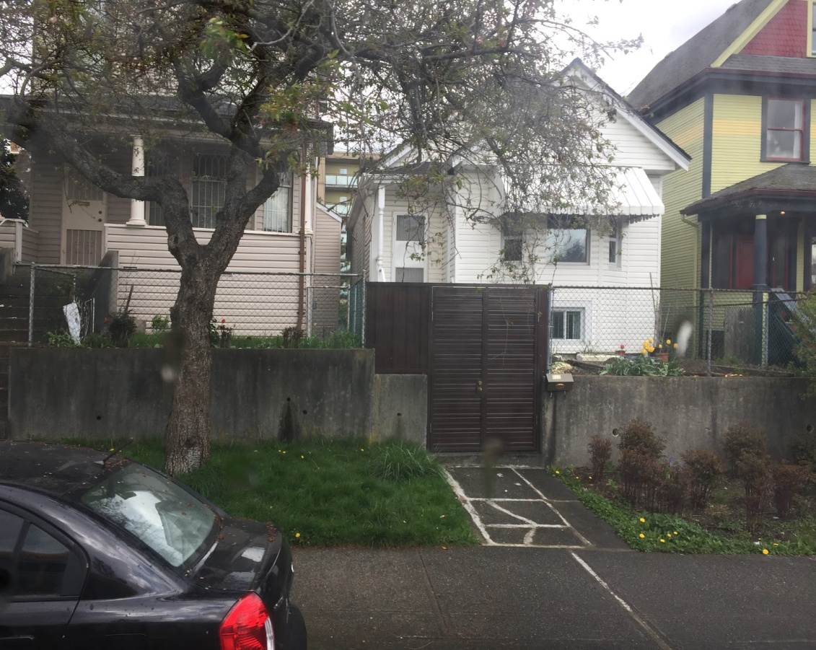
Residential: Low
Strathcona
Low-income residential neighborhoods are characterized by narrow, ill-maintained streets and small lot sizes.

Slide 13
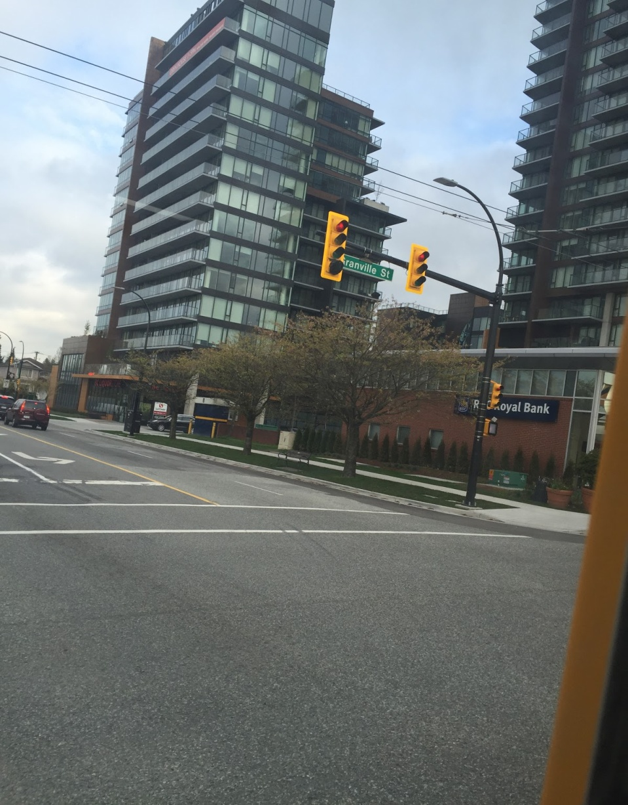
Commercial Ribbon
Granville Street
A commercial ribbon is a major thoroughfare that is heavily used by commuters. Ribbon development often happens alongside these roads.
Granville St is a commercial ribbon. There is heavy traffic along the road, especially during peak hours. Ribbon development is shown in the new apartments being built along Granville and 70th.

Slide 14
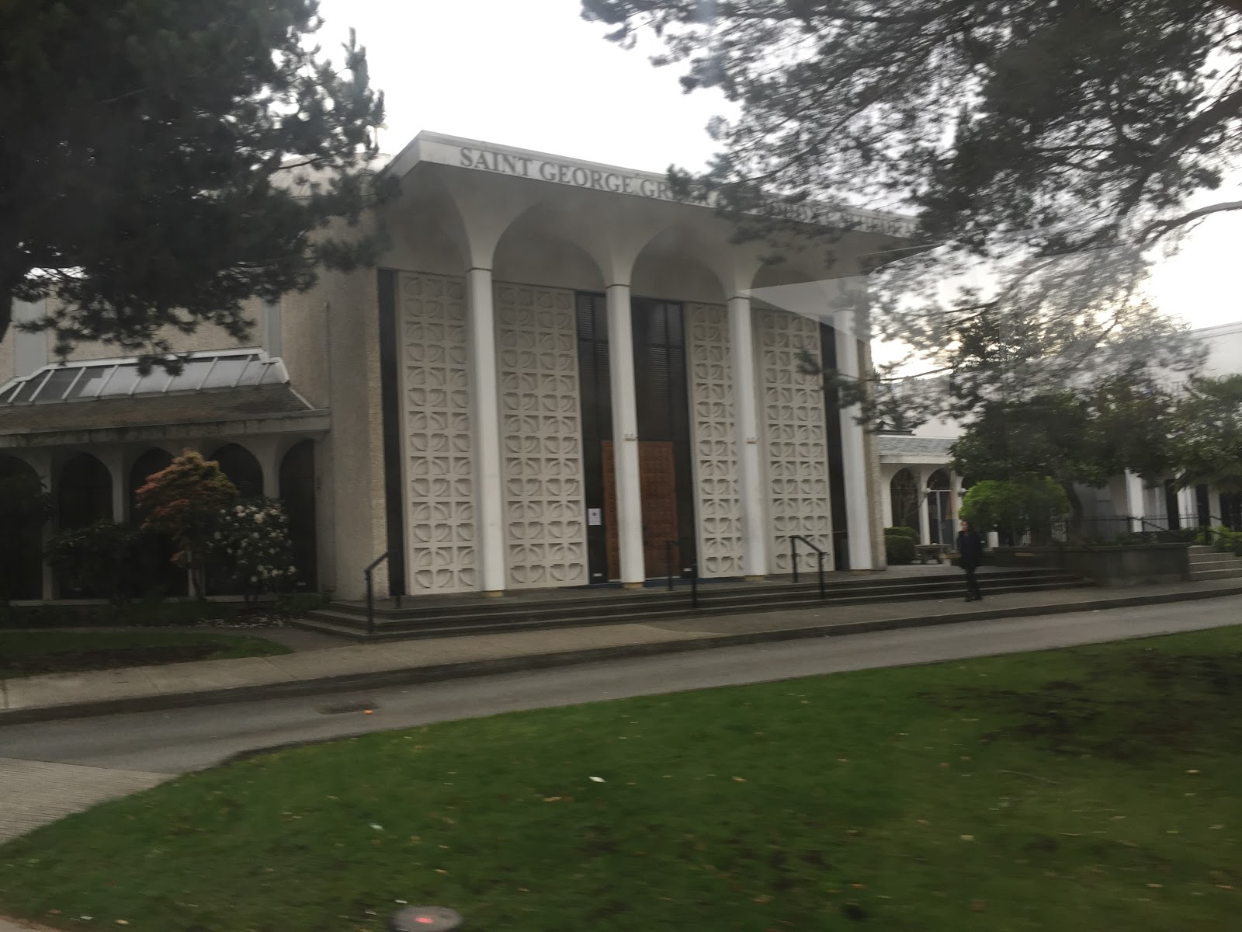
Ethnic Clustering
Arbutus Street
An ethnic cluster occurs in a community where the percentage of residents of a certain ethnicity is higher compared to the city average.
There is a prominent Greek community in the Arbutus area as shown by the Saint George’s Greek Orthodox Church.

Slide 15
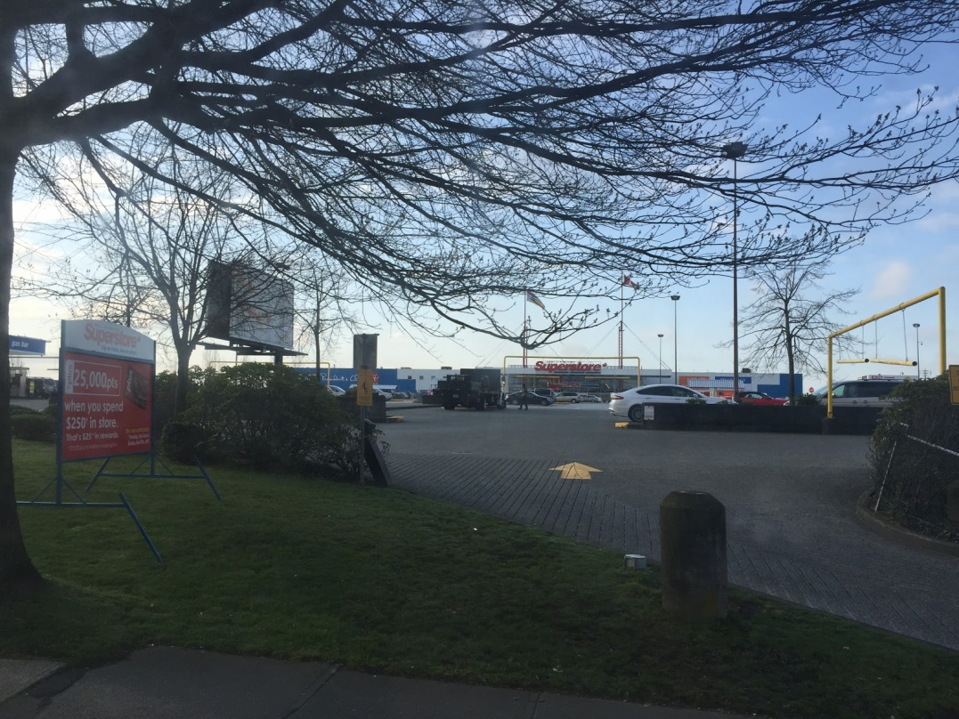
Industrial Land Use: Light
Southeast Marine Drive
Light industrial land use includes light manufacturing which does not produce as much pollution as heavy manufacturing.
There is a lot of big-box industry along this major thoroughfare, as shown by the Superstore in the photograph.
Not pictured: A lot of industry in the area are catered towards car traffic in the area.
Superstore

Slide 16
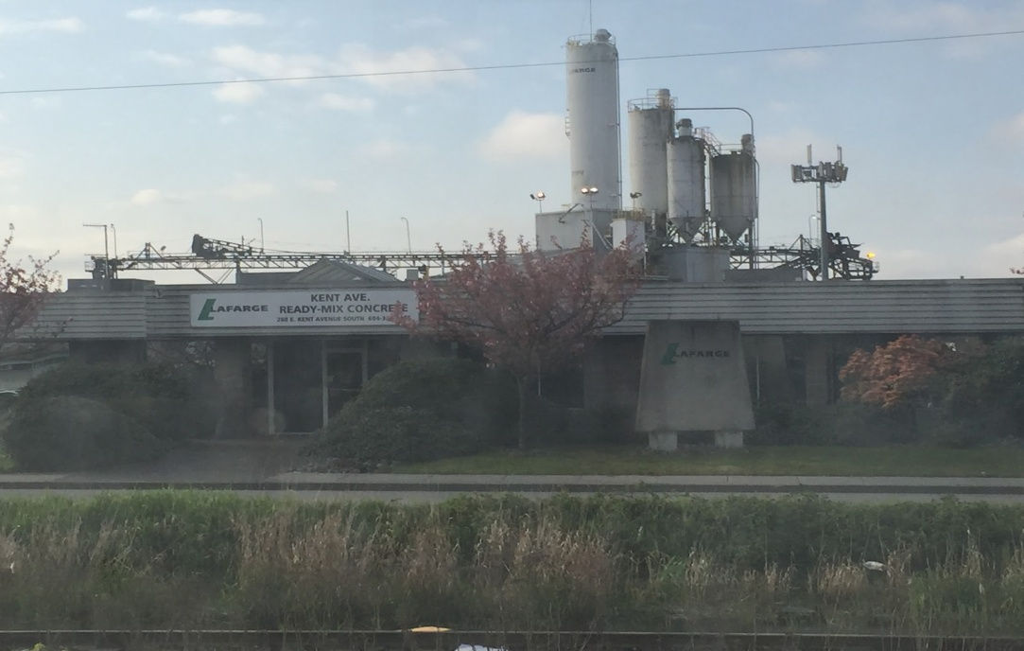
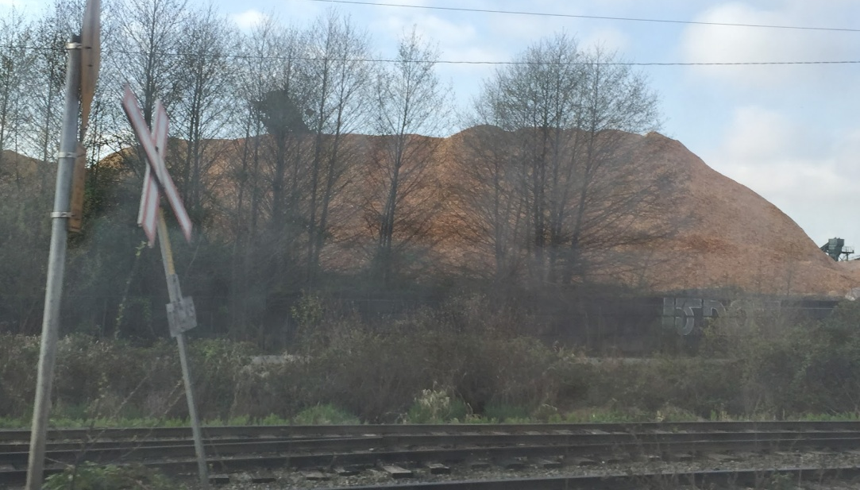
Industrial Land Use: Heavy
Industrial land use requires a large area of cheaper land that tends to be on the periphery of a city to accommodate its large-scale production of industrial materials such as cement and wood.
On the South (Fraser) side of Kent Street, land is occupied by heavy industry, such as the cement industry (top: Lafarge) and the logging industry (bottom: mountain of woodchips)
Land is by the Fraser river (not shown), and industries are able to make use of water transportation.

Slide 17
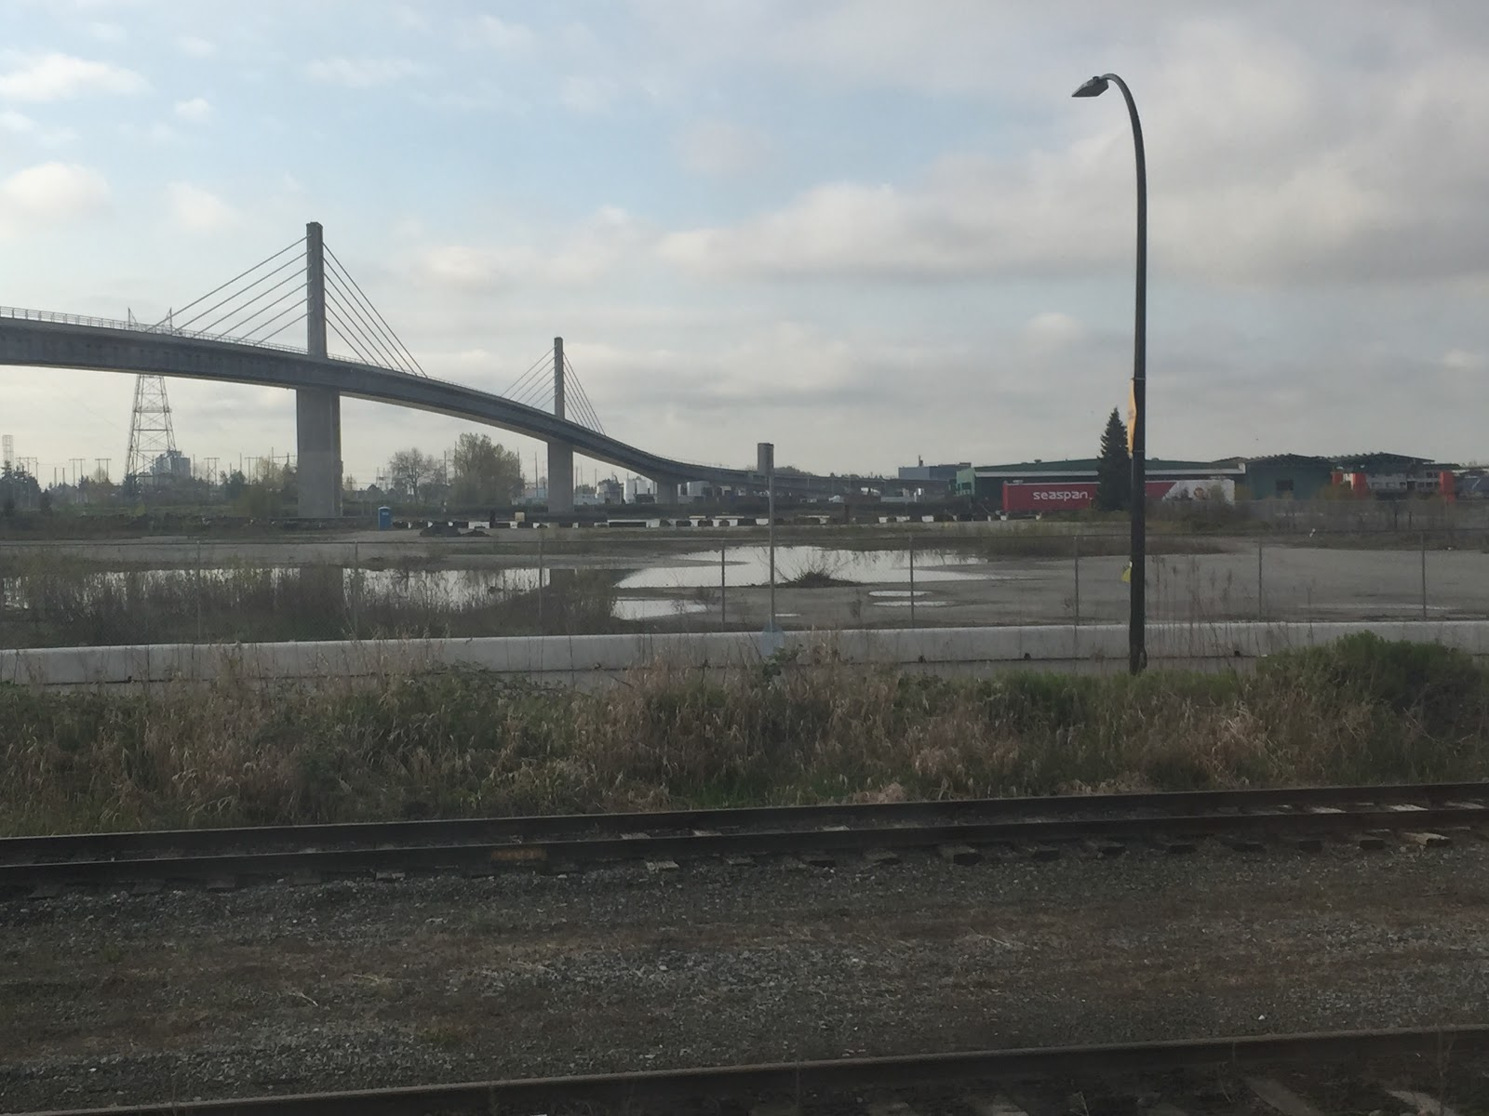
Brownfield Site
Kent Street
A brownfield site is an abandoned and derelict industrial building or land that has potential for redevelopment.
The land by the river on Kent Street is derelict and currently left unused. It will most likely be redeveloped into a low-income residential area in the future, due to its proximity to transportation services (skytrain) and the riverside view. The initial land value may be low due to its proximity to industrial areas.

Slide 18
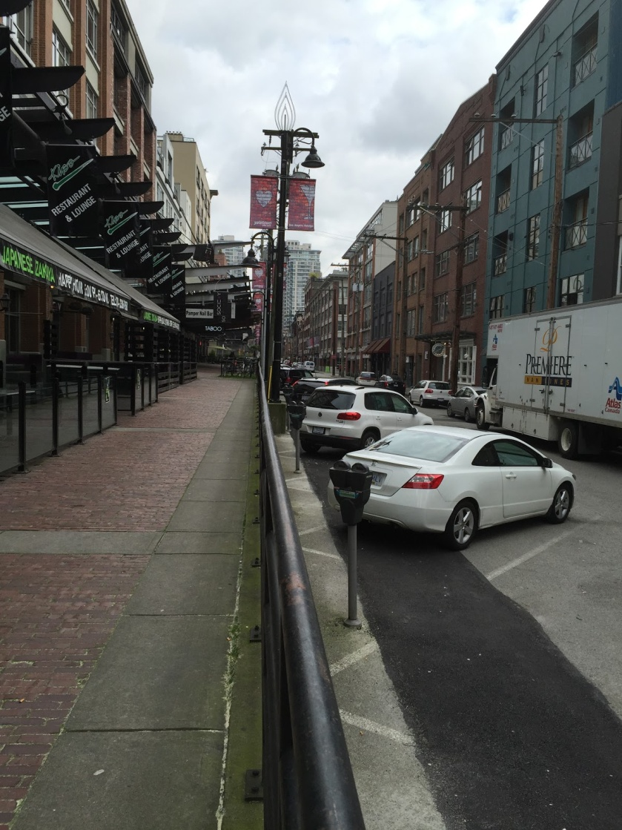
Adapted Use
Yaletown
Adapted use is the change of function of a structure or facility.
Historically, raised ledges in Yaletown were used for unloading cargo from trains. Today, they are used as sidewalks to separate pedestrians from car traffic, and restaurants often use them as balconies for their customers.

Slide 19
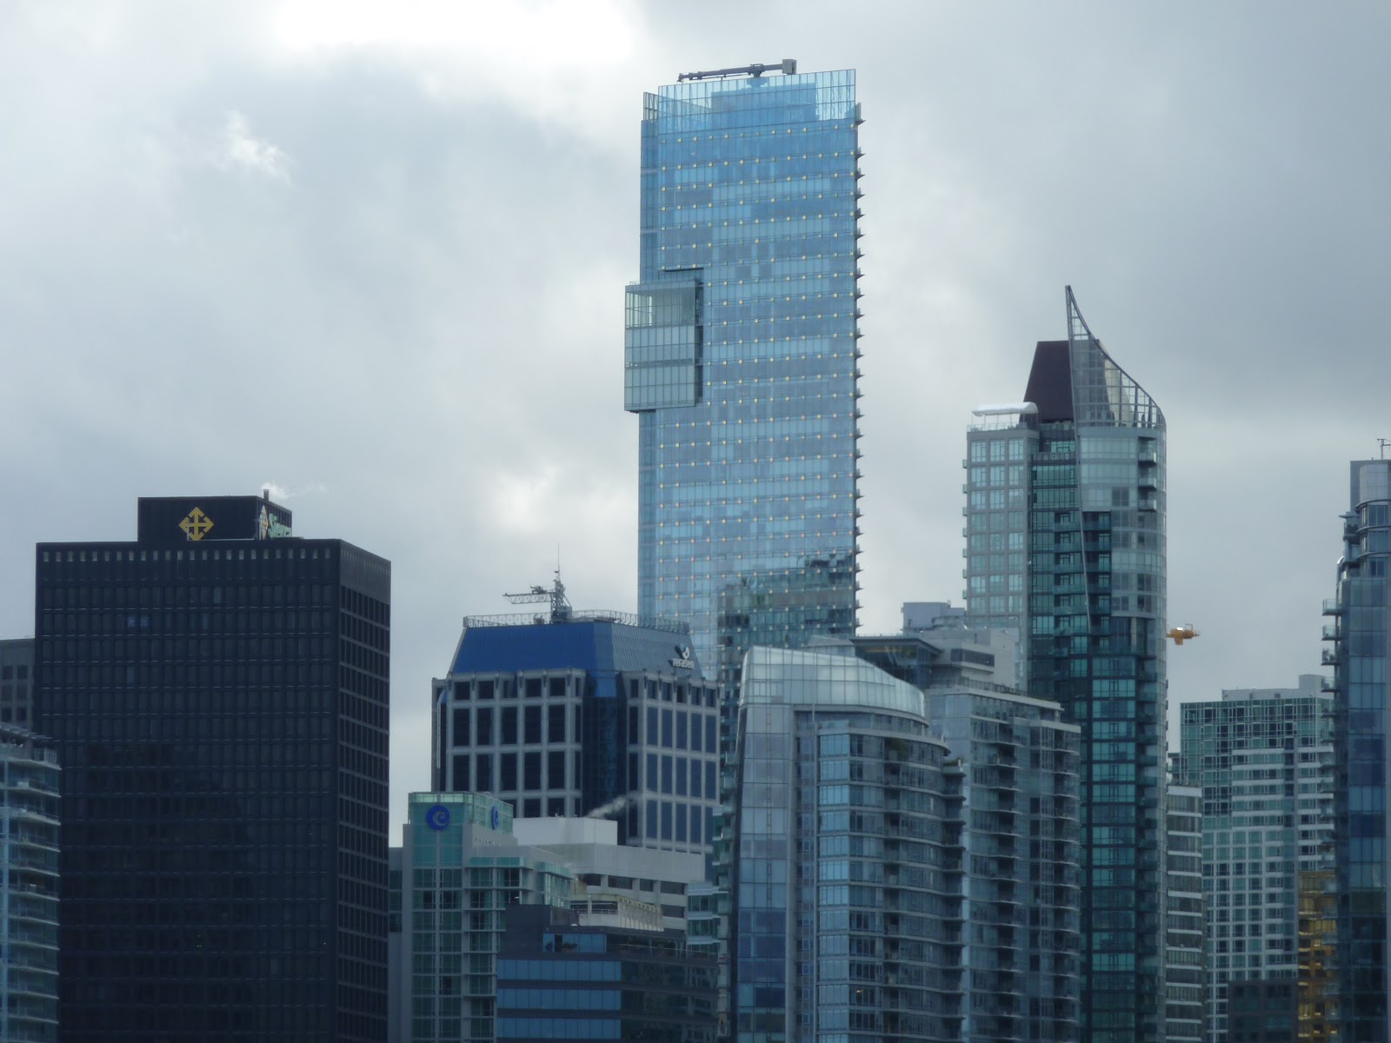
Central Business District (CBD)
The CBD is the center of business activities and often contains a hub of transportation networks that allow for easy access into the business core of the city.
In Vancouver, the CBD is the region around the intersection of Burrard and Georgia Street and is characterized by highly dense skyscrapers and high land value. Many commericial businesses (such as the Shangri-la Hotel) and services are located here, as they require access and transport as provided by the skytrain stations.
Shangri-la Hotel

Slide 20
Peak Land Value Intersection (PLVI)
The PLVI is a region with the highest land value and commerce. It is often located in the CBD.
The PLVI in Vancouver is located at the intersection of Granville and Georgia; the Vancouver City Center skytrain station is located in this area. Along the sides of the streets are several retail chains which benefit from being in the PLVI due to the access provided by transportation services.

Slide 21
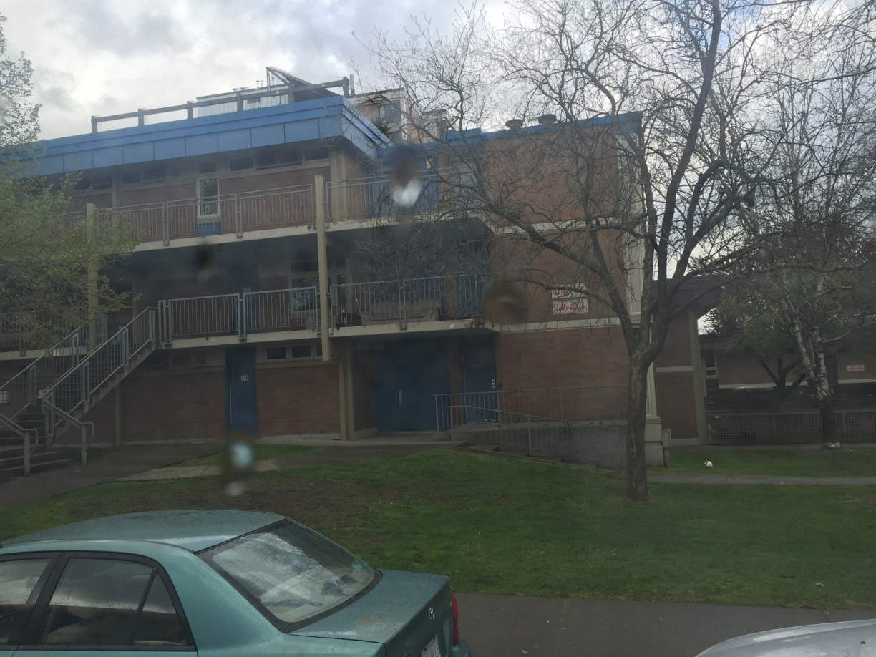
Social Housing
Raymur Housing Project in Strathcona
Social housing, or cooperative housing, are residential buildings
urban renewal scheme meant to replicate the social housing programs in the United States
Late 1950s: government planned for urban renewal in the area; undertook the Raymur Housing Project to group the low-income residents in one area
unsuccessful: created poverty

