Slide 1
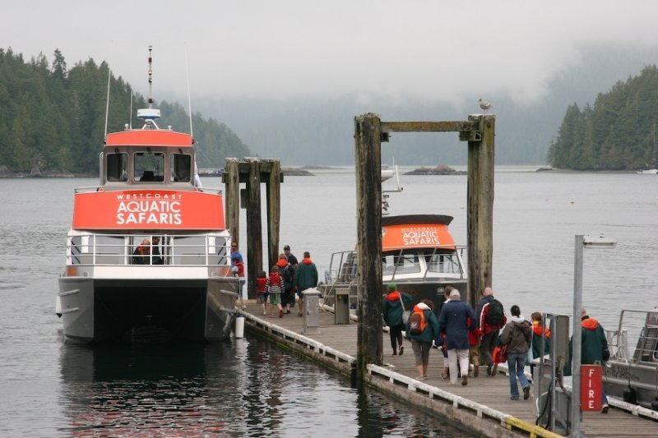
eMarketing – West Coast Aquatic Safaris
Denise Shu Yang
Dolly Yang
Fransiscus Denny
Sophie Wang
Oana Dan
Keith Phillips
December 4, 2014

Slide 2
O V E R V I E W O F S O C I A L M E D I A

Slide 3
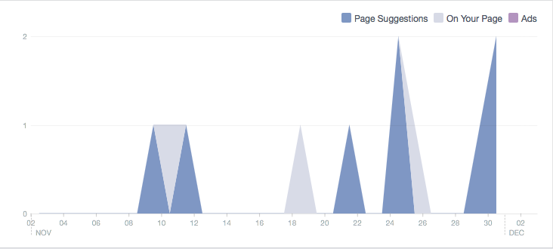
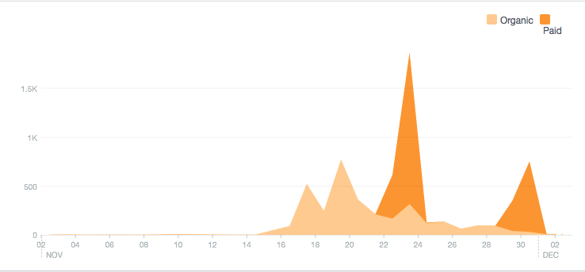
Acquiring & Reaching Fans via Facebook
Boosting on Faccebook is not so important!

Slide 4
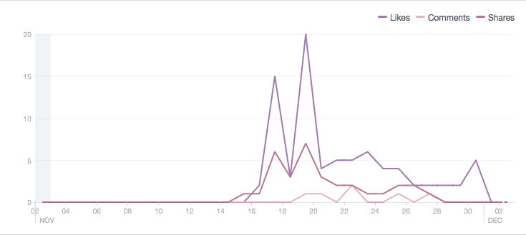
Engagement & Activity via Facebook
“Whale” like activity in a 24 hour period.
Post between 9am –midnight
It does not matter what day you post

Slide 5
Who Is & Isn’t Watching WACS Facebook
More women on Facebook
Need to post for older demographic

Slide 6
Ratio – Reach : Engagement on Facebook
 | Fans |  | Reach |  | Engagement |  | RtoE ratio
18-24 | 9% | 128 | 25% | 1,529 | 2% | 2.4 | 0.2%
25-34 | 29% | 413 | 32% | 1,957 | 23% | 27.6 | 1.4%
35-44 | 25% | 356 | 18% | 1,101 | 24% | 28.8 | 2.6%
45-54 | 19% | 271 | 10% | 612 | 22% | 26.4 | 4.3%
55-64 | 10% | 142 | 6% | 367 | 19% | 22.8 | 6.2%
65+ | 6% | 85 | 5% | 306 | 5% | 6 | 2.0%
 | total | 1424 | total | 6,117 | total | 120
 |  |  | organic | 3,075 | shares | 33
 |  |  | paid | 3,042 | comment | 6
 |  |  |  |  | like | 81
‘- instead of targeting the fans and the friends of fans, I would suggest to target the audience based on interest. That way, we can have the engagement with “the right people”.

Slide 7
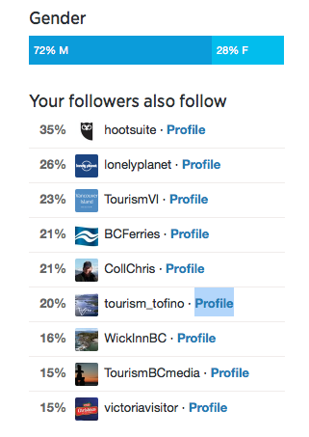
Overlap of Twitter Followers
Engagements: very low, and so far, our efforts cant significantly increase the engagement level.

Slide 8
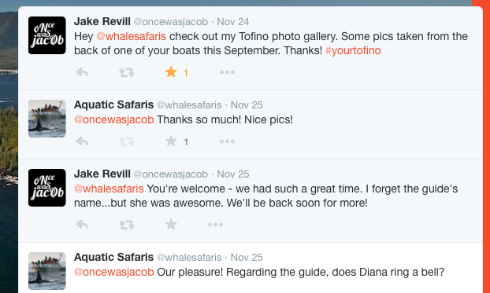
Ideal Twitter Interaction

Slide 9
How To Make It Happen? - Scheduling
Month | General holiday / event | Eco-tourism / Tofino / Whale watching / industry news | WCAS news | WCAS specials / promos
January
February | Valentine’s Day | Whale Fest | Introducing spring break packages | Valentine’s Day specials
March | Spring break | Whale Fest | Spring break packages | Easter / Spring break specials
April | Easter | Feast event | Introducing Mother’s Day packages | Mother’s Day specials
May | Mother’s Day | Grey Whales start making their way back towards BC Coast | Introducing Father’s Day packages and summer family packages | Father’s Day specials
June | Father’s Day | Summer in Tofino | Harbour / Fireworks Introducing “School’s out” packages | Father’s Day specials “School’s out” specials
July | Canada Day | Trace influencers and eco-tourism trends
August
September
October | Thanksgiving
November | Remembrance Day | Accessible Tourism Conference
December | Christmas / New Year |  |  | Holiday sale

Slide 10
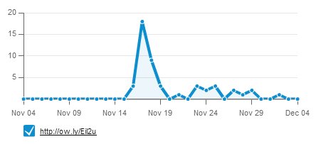
HootSuite Testing – Adventure vs Gift
F a c e b o o k
469
50
T w i t t e r

Slide 11
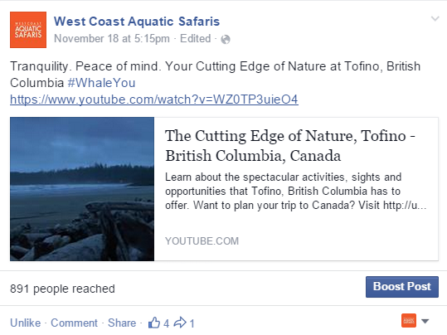
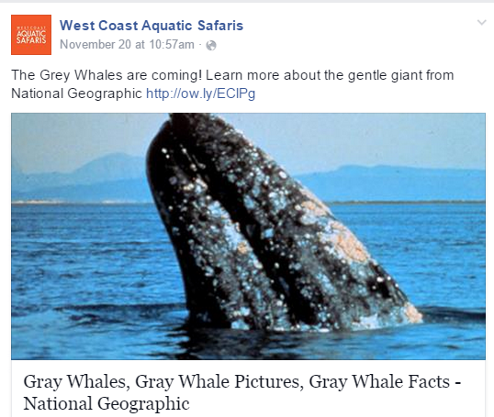
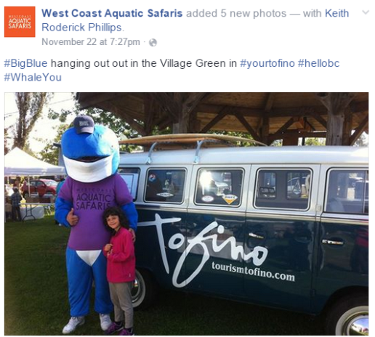
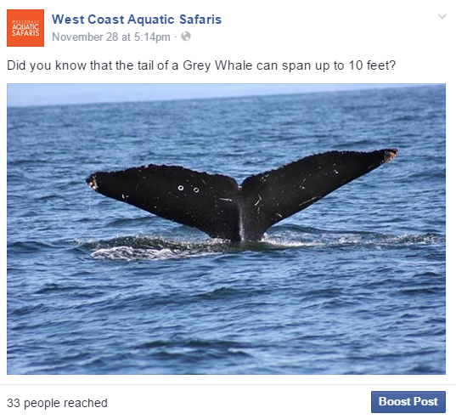
HootSuite Testing – Media Types
V i d e o v s P h o t o s
M e d i a Q u a l i t y
Video – YouTube
High Quality
891
Reached
131
Reached
Photo
Lesser Quality
389
Reached
33
Reached

Slide 12
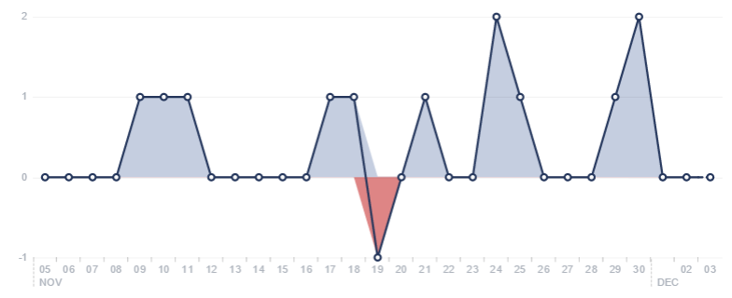
Promotion vs Followers
Facebook
Twitter
Notes:
Facebook – not very sensible to hard sell
Twitter – very sensitive, try to avoid hard sell

Slide 13
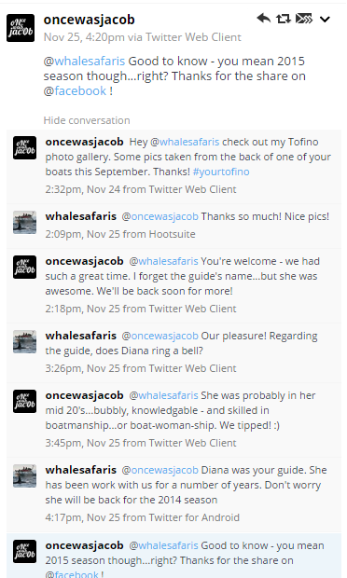
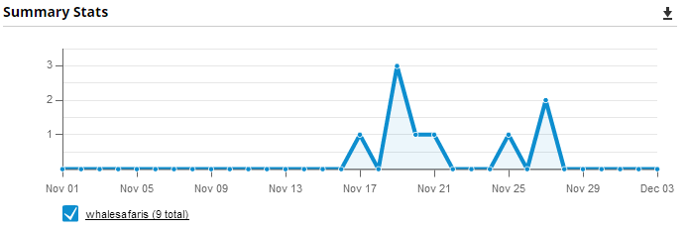
ReTweets vs Conversations

Slide 14
Recommendations
Social Media is to drive traffic, not to hard sell
Give Facebook more attention
Larger user base
Less sensitive to promotion
Avoid hard sell on Twitter
Utilize HootSuite Pro
Test Streams and engage conversation
Set a goal for interaction

Slide 15
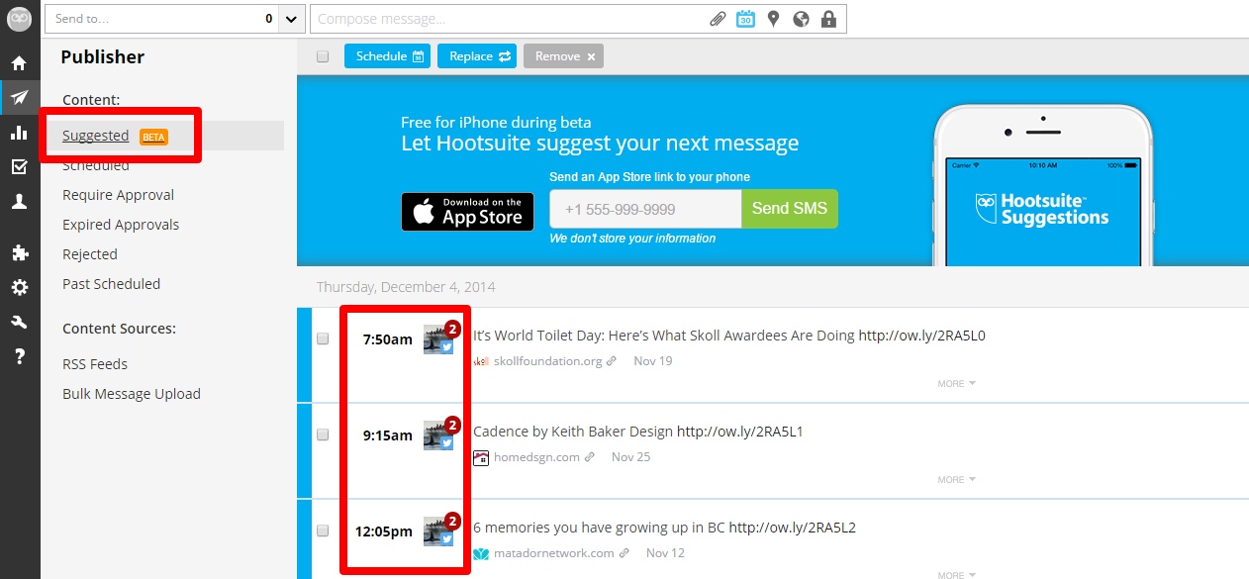
HootSuite Features

Slide 16
Rules of Thumb to Engage Your Audience
Facebook
Try to update at least 1 post per day
Comment / like / share at least 3 key influencers per day
Pre-schedule weekend conversation
Twitter
Try to update at least 1 post per day
Comment / like / retweet 3 key influencers per day
Thank everyone for retweet
Do NOT use HootSuite to send pictures on Twitter
Do NOT use Twitter app to auto forward Facebook post
Pre-schedule conversations, but remember over manage once per day
Timing – noon or afternoon

Slide 17
Gift vs Adventure
Google Adwords
Save 25% vs $175
CPC vs CPM
Adventure
$175
CPC -> CTR is Low
CPM -> CTR is High
*Note: CPC – Cost Per Click, CPM – Cost Per Impression, CTR – Click Through Rate

Slide 18
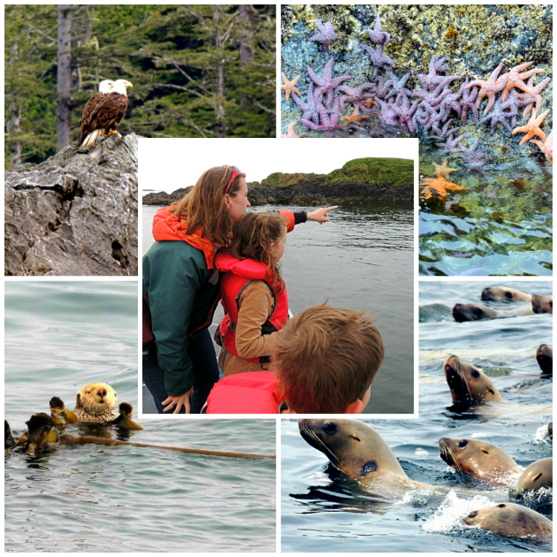
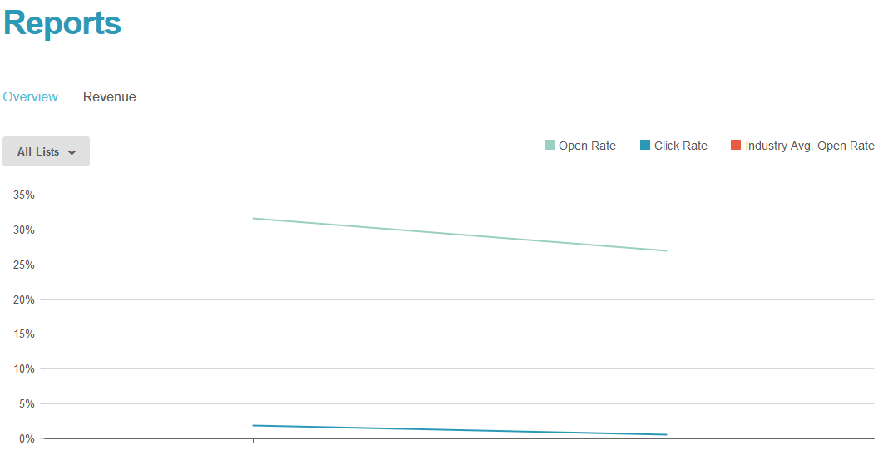
Mail Chimp - Testing
WhaleYou?
Test 2

Slide 19
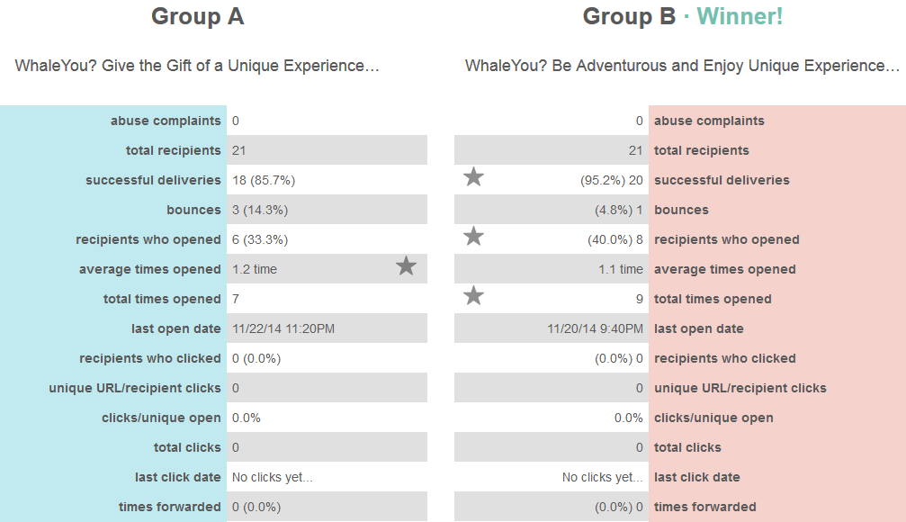
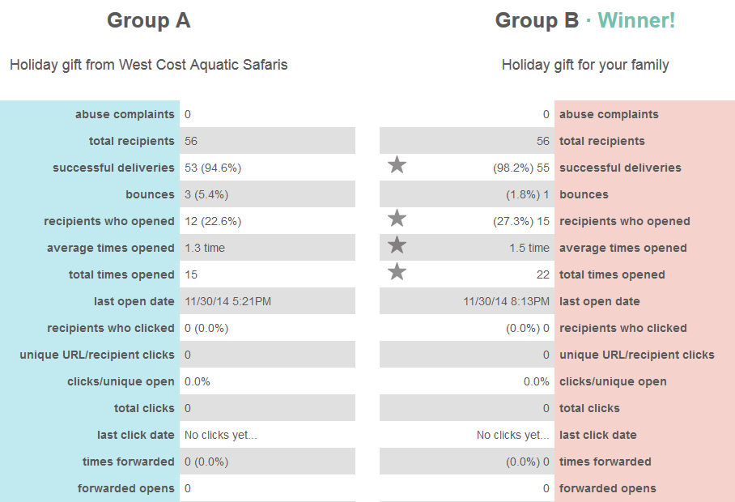
Results of the two Campaigns
WhaleYou?
Test 2
Winner!!

Slide 20
Google Analytics: Overview of the Campaign
Key results
The Good:
+17.47% sessions
+26.62% users
+2.10% page views
The Bad:
+8.80% bounce rate
-31.18% session duration
-13.04% pages per session
no sales

Slide 21
Your turn… Q & A Time
Thank you for the Opportunity and Cooperation

