Slide 1
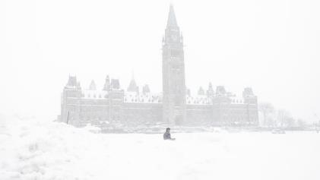
The ‘senior tsunami’ has arrived: what it means for Canada’s economy
Kevin Milligan Vancouver School of Economics
University of British Columbia
Ottawa Economic Association
Spring Policy Conference
Ottawa ON
April 13, 2023

Slide 2
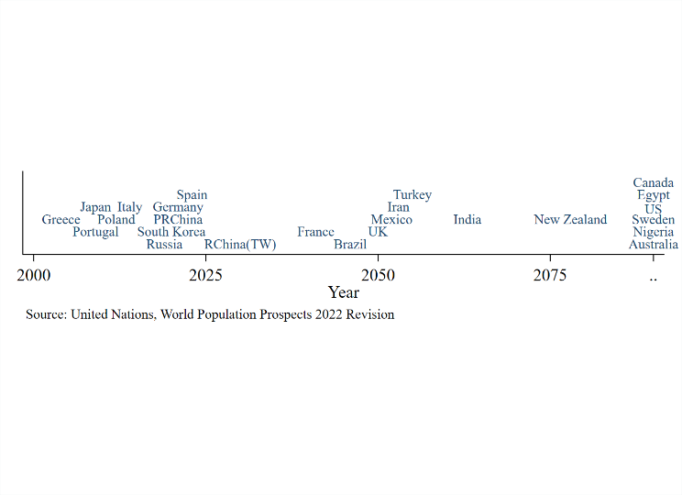
What does this timeline show?

Slide 3
Year of peak population

Slide 4
We all kind of know that the population is aging…

Slide 5
We all kind of know that the population is aging…
…but what does it really look like?

Slide 6
We all kind of know that the population is aging…
…but what does it really look like?
…and what does it mean for Canada?

Slide 7
What we’re going to do:
A new look at old data.
Implications for 8 big economic questions.

Slide 8
Let’s dig into the data…

Slide 9
Let’s dig into the data…
Two things going on:
The baby boom.
Longer lifespans.

Slide 10
Start with the babies.

Slide 11
The baby boom.

Slide 12
Living longer.

Slide 13
Living longer.

Slide 14
Lifespan inequality.

Slide 15
Let’s dig into the data…
Two things going on:
The baby boom.
Longer lifespans.
Consequence: a long-lasting population bulge…

Slide 16
New 65 year olds.

Slide 17
New 65 year olds.

Slide 18
New 65 year olds.

Slide 19
New 75 year olds.

Slide 20
New 85 year olds.

Slide 21
Total 65+ year olds.

Slide 22
Total 65+ year olds.

Slide 23
Total 75+ year olds.

Slide 24
Total 85+ year olds.

Slide 25
Summary of the data
The baby boom: it was big!
Lifespans: growing at about 1-2 months per year.
Consequence: large population bulge…and it’s sticking around.

Slide 26
Policy Implications
Pensions
Health
Long-term care
Labour markets
Growth
Real estate
Immigration
Fiscal outlook

Slide 27
1. Pensions

Slide 28
1. Pensions
Old Age Security:
Expenditures / GDP

Slide 29
1. Pensions
Old Age Security:
Expenditures / GDP
Mostly for ages 65+

Slide 30
1. Pensions
Old Age Security:
Expenditures / GDP
Mostly for ages 65+
Peaking soon; not all that high.

Slide 31
1. Pensions
OECD context: pension/GDP.
Pre-saving matters.

Slide 32
1. Pensions
OECD context: pension/GDP.
Pre-saving matters.
Italy spending x3 what Canada does.

Slide 33
2. Health

Slide 34
2. Health
Health expenditures by age group:

Slide 35
2. Health
Health expenditures by age group:
Starts to grow sharply by ages 75+

Slide 36
2. Health
Age 75+:
Gaining 3.6 million people in next 20 years

Slide 37
2. Health
Projected provincial health expenditures:
+1.5 points (PBO)
+3 points (C.D. Howe)

Slide 38
2. Health
Projected provincial health expenditures:
+1.5 points (PBO)
+3 points (C.D. Howe)
Starts picking up now.

Slide 39
3. Long-term care

Slide 40
3. Long-term care
LTC expenditures by age group:
Really grows post age 85.

Slide 41
3. Long-term care
As of 2021:
About 400K in nursing home or senior residence.

Slide 42
3. Long-term care
As of 2021:
About 400K in nursing home or senior residence.
Are we ready to build and staff 2x beds?

Slide 43
3. Long-term care
Age 85+:
Population total takes off after 2030.

Slide 44
3. Long-term care
Age 85+:
Population total takes off after 2030.
We’ve got some time….(?)

Slide 45
4. Labour markets

Slide 46
4. Labour markets
Quick thoughts:
Less labour; abundant capital.
Capital deepening; wages up.

Slide 47
4. Labour markets
Quick thoughts:
Less labour; abundant capital.
Capital deepening; wages up.
Baumol effects!
Innovation / productivity growth not likely in care sectors.
Who will be working there?

Slide 48
5. Economic growth

Slide 49
5. Economic growth
Quick thoughts:
Older age structure lowers productivity.
Abundant aggregate savings for retirement.

Slide 50
5. Economic growth
Quick thoughts:
Older age structure lowers productivity.
Abundant aggregate savings for retirement.
Growth likely to be low…but so will return to capital.
We will not see 1990s-style real interest rates.

Slide 51
6. Real estate

Slide 52
6. Real Estate
Quick thoughts:
People don’t move until they have to.
Don’t expect outflow of boomers in next 20 years.

Slide 53
6. Real Estate
Quick thoughts:
People don’t move until they have to.
Don’t expect outflow of boomers in next 20 years.
What’s going to happen in Asia?
 | Pop 2023 | Pop 2050 | Change
South Korea | 52 | 46 | -6
Japan | 123 | 104 | -20
PRChina | 1,426 | 1,313 | -113

Slide 54
7. Immigration

Slide 55
7. Immigration
Quick thoughts:
This is a choice variable; very different in Canada.
Integration and onboarding is costly.

Slide 56
7. Immigration
Quick thoughts:
This is a choice variable; very different in Canada.
Integration and onboarding is costly.
From point of view of 2050:
Would you rather have this extra human capital or not?
If not, how quickly should we aim to shrink?

Slide 57
8. Fiscal outlook

Slide 58
8. Fiscal outlook
Putting it all together:
Pensions: almost through it. (Federal)
Health: just starting the upswing. (Provincial)
LTC: need will grow in 2030s.

Slide 59
8. Fiscal outlook
Putting it all together:
Pensions: almost through it. (Federal)
Health: just starting the upswing. (Provincial)
LTC: need will grow in 2030s.
Contributing influences:
Wages for service-provision higher.
Growth likely low.
Real interest rates likely to stay low.

Slide 60
8. Fiscal outlook
Debt/GDP from PBO:
Fed-Prov differences driven by pension vs health responsibilities.
.
Too optimistic on low-cost government?

Slide 61
Summary
Let’s summarize using….

Slide 62
Summary
Let’s summarize using….

Slide 63
Can we handle the 65+ surge?
We are in the thick of it.
It is mostly pensions.
We’ve presaved a lot (CPP)

Slide 64
Can we handle the 65+ surge?
We are in the thick of it.
It is mostly pensions.
We’ve presaved a lot (CPP)
We’re like Tanooki Mario!

Slide 65
Can we handle the 75+ surge?
We are just starting into it.
Health spending—are provinces ready?

Slide 66
Can we handle the 75+ surge?
We are just starting into it.
Health spending—are provinces ready?
We’re like ‘Big’ Mario!

Slide 67
Can we handle the 85+ surge?
Starts in 2030s.
Caregiving—who is doing it? Who is paying?

Slide 68
Can we handle the 85+ surge?
Starts in 2030s.
Caregiving—who is doing it? Who is paying?
We’re like ‘little’ Mario—battered but perhaps still plucky.

Slide 69
Thank you!

Slide 70
The ‘senior tsunami’ has arrived: what it means for Canada’s economy
Kevin Milligan Vancouver School of Economics
University of British Columbia
Ottawa Economic Association
Spring Policy Conference
Ottawa ON
April 13, 2023

